Slide 1

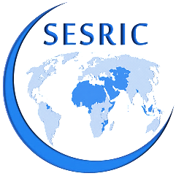
Financing SMEs and Entrepreneurship in OIC Countries
Risk sharing? A mere academic endeavour?
Statistical, Economic and Social Research and Training Centre for Islamic Countries
Prof. Savaş Alpay
Director-General
SESRIC
ADFIMI – SME BANK INTERNATIONAL DEVELOPMENT FORUM 2014 | OCT 20-21, KL, MALAYSIA

Slide 2
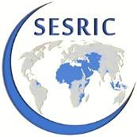
Outline
SMEs and Entrepreneurship
Current figures on MSMEs, their contribution to economic sectors and employment, as well as their obstacles and challenges.
SME Financing Mechanisms
An overview of available financing mechanisms for SMEs, and problems faced.
Islamic Finance Overview
Size and growth of Islamic finance assets, their decomposition by region and country, as well as inherent strengths of Islamic finance.
Islamic Finance and Entrepreneurship
How Islamic finance and its risk-sharing instruments can help promote SMEs and entrepreneurship in OIC countries and elsewhere.
Statistical, Economic and Social Research and Training Centre for Islamic Countries

Slide 3
SMEs & Entrepreneurship
Numbers & Density
In 132 countries in the world there are over 125 million formal Micro, Small and Medium Enterprises (MSMEs) …of which 72 per cent are operating in developing countries
In 34 OIC Countries ,with data, there are 48 million formal MSMEs ….accounting for 38 per cent of the world and 54 per cent of the developing countries total MSMEs
On average, there are 23 MSMEs per 1,000 people in OIC Countries compared to 27 in their Developing counterparts and 31 MSMEs per 1,000 people in the world
World=125.4
Data Source: World Bank International Finance Corporation (IFC), MSME Country Indicators 2010
Statistical, Economic and Social Research and Training Centre for Islamic Countries

Slide 4
SMEs & Entrepreneurship
Numbers & Density (2)
48 per cent of total MSMEs in OIC operate in three Countries from East Asia and Pacific region namely: Brunei, Indonesia and Malaysia
Six OIC Countries namely: Indonesia, Nigeria, Bangladesh, Pakistan, Turkey and Egypt are ranked among the top-20 countries with highest number of MSMEs operating in the world
Indonesia alone accounts for over 18 per cent of the world total MSMEs
Brunei and Indonesia are ranked First and Second in the world with highest density of MSMEs
Countries with Highest MSMEs , Millions
Data Source: World Bank International Finance Corporation (IFC), MSME Country Indicators 2010
Statistical, Economic and Social Research and Training Centre for Islamic Countries

Slide 5
SMEs & Entrepreneurship
Sector-level Contribution
71 per cent of SMEs in 20 OIC Countries, with data, are operating in Services (41%) and Trade (30%) sectors
Except East Asia & Pacific region, over 40 percent SMEs are operating in Services across the OIC regions
In South Asia and Sub-Saharan Africa Manufacturing accounts for the second highest share of SMEs compared to Trade in other regions
Services sector accounted for over 40 percent of total SMEs operating in 15 OIC Countries
Data Source: World Bank International Finance Corporation (IFC), MSME Country Indicators 2010
Statistical, Economic and Social Research and Training Centre for Islamic Countries

Slide 6
SMEs & Entrepreneurship
Share in Employment
On average, formal MSMEs employ 34 percent of the workforce in OIC Countries, compared to 39 percent in Non-OIC Developing and 41 percent in the world
Among the OIC regions, East Asia & Pacific region (58%) have the highest share of MSMEs employment in total employment followed by South Asia (45%)
MSMEs contribute 47 to 82 percent of total employment in 8 OIC Countries whereas this ratio is 20 to 40 percent for 9 OIC Countries
Data Source: World Bank International Finance Corporation (IFC), MSME Country Indicators 2010
Statistical, Economic and Social Research and Training Centre for Islamic Countries

Slide 7
SMEs & Entrepreneurship
Challenges & Obstacles
MSMEs and Entrepreneurs face a number of challenges during the evolution phases of businesses—inception, developing and maturity
Internal challenges (lack of managerial expertise among proprietors) and External challenges (inadequate access to finance, government inefficiencies, and infrastructural concerns)
Inception
Absence of Seed capital for establishing business
Bureaucratic hurdles in registering business
Developing
Inadequate funds for expansion of operation
Weak business environment
Mature
Insufficient demand
Political instability
Lack of a well trained labour force
Unstable political environment
Lack of business skills for managing operations
Poor infrastructure
Poor infrastructure
Threat from informal sector
Lack of intra-industry partnerships
Lack of a well trained labour force
Source: World Bank International Finance Corporation (IFC), Islamic Banking opportunities across SMEs in MENA
Statistical, Economic and Social Research and Training Centre for Islamic Countries

Slide 8
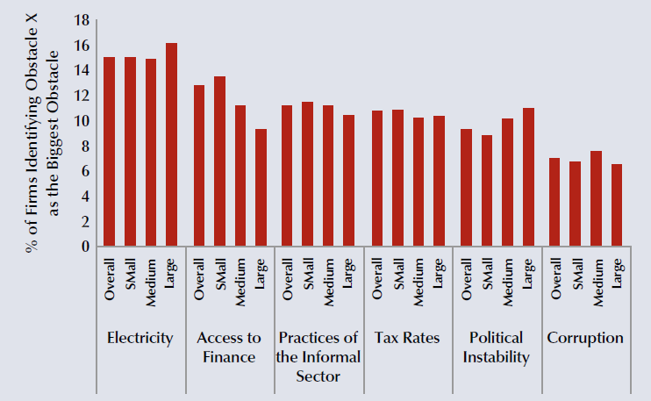
SMEs & Entrepreneurship
Challenges & Obstacles (2)
According to the findings of the World Bank Enterprise Surveys Dataset access to electricity and finance are the most cited obstacles for all businesses including SMEs in the developing countries
Six Most Commonly Cited Obstacles by Firms in Developing Countries
(out of 15 obstacles)
Data Source: World Bank International Finance Corporation (IFC), MSME Country Indicators 2010
Statistical, Economic and Social Research and Training Centre for Islamic Countries

Slide 9
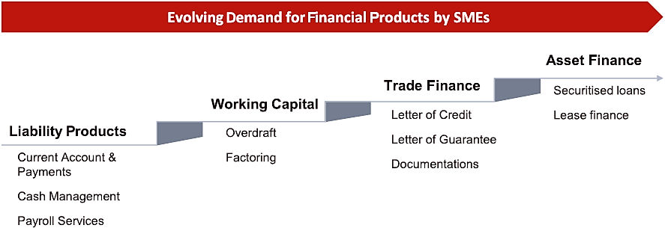
SME Financing
Changing needs
Source: IFC
As the SME sector develops across countries, their financial needs are likely to evolve. Expansion and development of SME operations would lead to the demand for more long-term and financially sophisticated products. Islamic FIs should recognize these issues and look to enhance and develop their Islamic product offerings to meet the needs of the SME sector – as SMEs are often ideal candidates for equity finance.
Statistical, Economic and Social Research and Training Centre for Islamic Countries

Slide 10
SME Financing
An overview of available mechanisms
According to Abdulsaleh and Worthington (2013) there are five different financing mechanisms for SMEs and entrepreneurship in practice:
Equity Financing
  Venture Capital
  Business Angels
Debt Financing
  Trade Deficit
  Nonbank Financial Institution Debt
Bank Finance for SMEs
Government Assistance and Initiatives
Islamic Finance for SMEs (Musarakah, Murabahah, Mudabarah)
Statistical, Economic and Social Research and Training Centre for Islamic Countries

Slide 11
SME Financing
An overview of available mechanisms (2)
Oliver Wynman (2014) makes a broader categorization than Abdulsaleh and Worthington (2013) on the capital market solutions (i.e. finance) for SMEs and provide the following exhibit:
Exhibit 1: Categorization of existing capital based mechanisms for SMEs
Source: Oliver Wyman (2014)
Statistical, Economic and Social Research and Training Centre for Islamic Countries

Slide 12
SME Financing
The Case of EU
Many countries and country groups have developed different indirect and direct mechanisms to finance SMEs and entrepreneurship that are engines for growth: SMEs contributed 49% of the global private sector output and 63% of global employment in 2013.
An example from the EU testifies how country/country groups play a special attention to SMEs that the EU developed specific support mechanisms.
The EU provides the SMEs with both indirect support, e.g.,
  High Growth and Innovative SME Facility – GIF,
  Bank credit and guarantee systems,
  Seed capital
And direct support, e.g.,
  Structural Funds,
  Joint European Resources for Micro-to-Medium Enterprises initiative (JEREMIE),
  Programme for Competitiveness of enterprises and SMEs (COSME) 2014-2020
Statistical, Economic and Social Research and Training Centre for Islamic Countries

Slide 13
SME Financing
The “credit gap” problem
Despite having different financial mechanisms, SMEs in many developing countries including the OIC member states experience “credit gap.” The IFC-AFME-Oliver Wyman (2014) report has found that restricted access to finance (conventional or sharia-complaint) was cited by SMEs as the greatest challenge for their growth.
70% of the SMEs do not use formal lending facilities in the world while 15% of underfinanced from these sources.
Total unmet demand for formal SME financing is estimated by IFC-AFME-Oliver Wyman (2014) to be 1.5 trillion USD where two-third of this unmet demand is in emerging markets and developing countries including the OIC member states.
Statistical, Economic and Social Research and Training Centre for Islamic Countries

Slide 14
SME Financing
The “credit gap” problem
Credit Gap of Unserved and Underserved SMEs in the World and OIC Countries
Statistical, Economic and Social Research and Training Centre for Islamic Countries
Notes:
-A higher credit gap (i.e. available sources to finance SMEs) denoted by a darker blue in the picture.
-Many OIC countries are coloured with a dark blue representing a credit gap higher than 50% whereas the Europe and North America have a gap below 40% that they are denoted in grey colour.

Slide 15
SME Financing
The “credit gap” problem
Financial Constraints of SMEs in Emerging Markets
Source: IFC & McKinsey (2010) Report.
Statistical, Economic and Social Research and Training Centre for Islamic Countries
Notes:
Another illustration prepared by IFC & McKinsey (2010) gives a similar message on the credit gap or financial constraints that SMEs experience:
-Approximately 45-55% of formal SMEs in emerging markets face financing constraints.
-This figure goes up to 70-78% when informal micro and SME counted in emerging markets

Slide 16
SME Financing
Lack of Sharia compliant Instruments
A recent study by International Finance Corporation (IFC) found that around 35 per cent of SMEs in the Middle East and North Africa (MENA) are excluded from the formal banking sector because they seek Sharia-compliant products that are not readily available in the market (i.e. underdeveloped Sharia-complaint instruments/models constitute a barrier.)
It is also hard to claim that SMEs in OIC member states fully utilize the available Sharia-Complaint Financial Instruments such as provided by the IDB Group.
A major reason behind this challenge observed in OIC member countries is underdeveloped technical capacity and less-skilled human capacity that SMEs have.
Statistical, Economic and Social Research and Training Centre for Islamic Countries
Notes:
-

Slide 17
SME Financing
Lack of Sharia compliant Instruments (2)
In summary, two challenges that lead to underutilization of Sharia-Complaint Financial Instruments to finance SMEs in OIC member countries are as follows:
  Underdeveloped Financial Instruments/Models
  Weak Technical and Human Capacity of SMEs to benefit from the available instruments
Saaid Ali (2013) from IRTI mentioned two additional obstacles that complete the picture for OIC member countries:
  Poor infrastructure: Underdeveloped transportation, energy network and warehouses. Many Islamic instruments (Murabaha, Mudabarah, Salam) depend on financing the product in kind that warehouses play an important role.
  Weak institutions: problems associated with rules, regulations and mechanisms especially related with international trade such as complex customs clearance procedures and high tariff rates in some OIC member states.
Statistical, Economic and Social Research and Training Centre for Islamic Countries
Notes:
1.Underdeveloped Financial Instruments/Models: To address this challenge financial actors need to improve Sharia-complaint instruments and develop new ones. Promotion of these instruments for SMEs should be included into such a program.
2. Weak Technical and Human Capacity of SMEs to benefit from the available instruments: Capacity development programs Islamic financial training programmes designed for professionals who work for SMEs can play a vital role to address this challenge.

Slide 18
Islamic Finance
IF is lagging behind
Statistical, Economic and Social Research and Training Centre for Islamic Countries

Slide 19
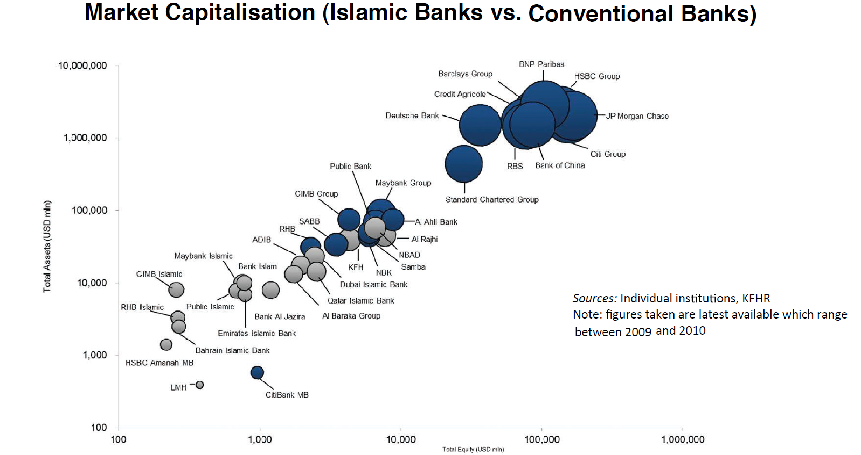
Islamic Finance
IF is lagging behind (2)
The top ten Islamic banks’ market capitalisation was only 4.1% of the top ten conventional banks’ market capitalisation at end-2010.
Statistical, Economic and Social Research and Training Centre for Islamic Countries

Slide 20
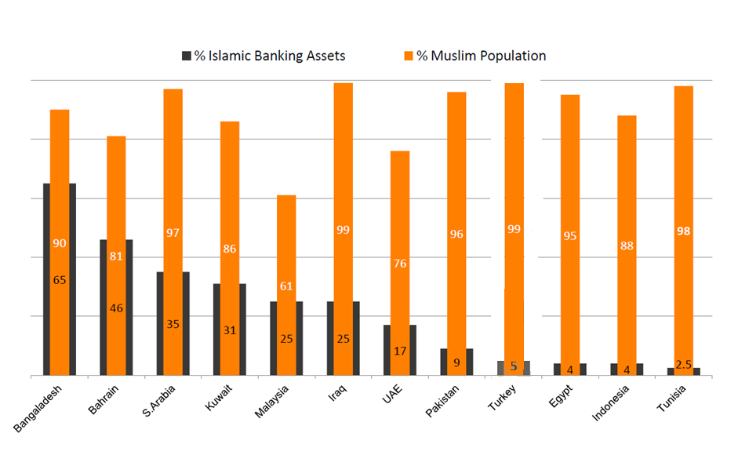
Islamic Finance
Inadequate penetration
Islamic Finance Penetration in Selected OIC Countries 2012
Source: Maris Strategies, The Banker, Pew Research
Statistical, Economic and Social Research and Training Centre for Islamic Countries

Slide 21
Islamic Finance
Demand largely unmet
COUNTRY | SURVEY (YEAR) | RESULT
MENA | IFC (2014) | 35% of SMEs in the Middle East and North Africa (MENA) are excluded from the formal banking sector because they seek Sharia-compliant products that are not readily available in the market
MENA | IFC (2014) | of the 36% of banks in the MENA region that offer SME products, only 17 per cent offer Islamic options
Muslim-majority Countries | Karim, Tarazi and Reille (2008) | 72% of individuals living in Muslim-majority countries do not use any form of Islamic financial services . This statistic is likely due to the limited reach of Islamic banking institutions to SMEs in the Muslim world
Global Survey | CGAP (2007) | Islamic microfinance has an estimated global outreach of only 380,000 customers and accounts for only around 0.005% of total microfinance outreach. Although 2010 estimates now put this figure at 0.05%, the potential still remains mainly untouched.
MENA | IFC (2014) | If proper products are developed and introduced there exists an estimated potential “new to bank” gap of $8.63 billion to $13.20 billion for Islamic SME financing, with a corresponding depository potential of $9.71 billion to $15.05 billion across MENA countries. However, to tap the underlying potential, Islamic banks need to build capacity and develop Shariah-compliant products to cater to this emerging sector.
Statistical, Economic and Social Research and Training Centre for Islamic Countries

Slide 22
Islamic Finance
IF is catching up
CAGR (2008 - 2013) : 18,4%
Islamic financial assets forecast to reach USD 4 trillion by 2020
Since 2008, Islamic finance has been growing at a CAGR of 18.4%, and in 2012, its global assets reached $1.6 trillion
  OIC member countries are home to over 95% of the global shariah-compliant assets
Statistical, Economic and Social Research and Training Centre for Islamic Countries

Slide 23
Islamic Finance
Regional distribution
Regional distribution of sharia compliant assets, 2013
Source: The Banker
MENA accounts for almost four-fifths (77.8%) of global shariah-compliant assets whereas Asia has a one-fifth (20.8%) share
Statistical, Economic and Social Research and Training Centre for Islamic Countries

Slide 24
Islamic Finance
Regional growth dynamics
Regional growth in global assets of Islamic finance (2007-2013)
Source: The Banker
The growth in Islamic finance is mainly driven by the growth in the MENA region
Statistical, Economic and Social Research and Training Centre for Islamic Countries

Slide 25
Islamic Finance
By country
Country Level Decomposition of Islamic Finance 2013
Source: The Banker
Iran, Saudi Arabia, Malaysia, UAE and Kuwait hold around 84% of total sharia-compliant assets worldwide
Statistical, Economic and Social Research and Training Centre for Islamic Countries

Slide 26
Islamic Finance
Inherent strengths
■ Efficiency gains
■ Alignment with real assets and real economy
■ Market discipline
■ Community banking: serving communities not markets
ZONE OF SUSTAINABILITY
■ Equitable & efficient
distribution of credit
ISLAMIC
FINANCE
■ Transparency and fairness
in business
■ Strong prudential advantages
■ Socio-economic justice: wide ownership base of society
■ Sharing of risk & reward
■ Moral constraints (values)
■ Stability
Avoidance of:
Riba (Interest)
Gharar (Uncertainty)
Maysir (Gambling)
Socio-economic Development Imperative
Business/Profit Imperative
Statistical, Economic and Social Research and Training Centre for Islamic Countries
Notes:
An Islamic financial system is the combined influence of three forces which can help prevent the recurrence of crises:
Moral constraints on the greed to maximize profit, wealth and consumption;
Market discipline which is expected to exercise a restraint on leverage, excessive lending and derivatives;
Reform of the system’s structure along with prudential regulation and supervision appropriately designed to prevent crises, achieve sustainable development and safeguard social interest.
One of the most important objectives of Islamic perspective of development is to realize greater justice in human society. This would not be possible unless all human institutions, including the financial system, contribute positively towards this end. All aspects of human life, social, economic, political and international, should adhere to moral values. This will help curb greed (avarice) which have made maximization of wealth and want satisfaction as the highest measure of human achievement.
Strong prudential advantages through prohibition of interest (riba), uncertainty (gharar ) and gambling (maysir)
Emphasis on linkage with the real economy, transparency and fairness in business relations, and risk-sharing among the parties (not risk-shifting!) through equity-based transactions
Aspires to be more human friendly financial system, where the priorities are given to overall socio-economic development, as opposed to individual improvements
Driven by moral values, and gives primary importance to the realization of socio-economic justice and well-being of all humans, contrary to neo-classical development paradigm, which emphasizes development of material factors and places undue reliance on market forces
Efficiency gains by the choice of interest-free operations
Allows for a more equitable and efficient distribution of credit.
In conventional banking, utmost attention is given to the ability to repay loans which relies on the provisions of collaterals and guarantees. Hence, the rich has the most access to finance.
In contrast, a participatory financial systems is more concerned about profitability and value-added, and less about collateral as funds are provided on equity or profit-sharing basis. Those who have worthy investment projects even they are not wealthy, have a chance of obtaining finance. (Positive implications for the SMEs)

Slide 27
IF and Entrepreneurship
Overview
The world is accustomed to a lending system in which the distribution of risk among the haves and have-nots is disproportional (those with less money, the more vulnerable, have greater risk).
There are millions of ambitious, intelligent, and energetic Muslims who can’t get ahead for lack of capital.
Islamic finance stipulates the “sharing” rather than “transferring” of the risk – so that financier and entrepreneur have aligned interests, and the risk is spread across the strata of society (no justification for interest left!).
Greater outreach to SMEs and microenterprises can be achieved through the wider application of equity-based structures in financing for SMEs and Islamic microfinance – given their strong emphasis on promoting entrepreneurship and value-added activities.
  The primary forms of Islamic finance – Mudarabah and Musharakah– have many of the characteristics of venture capital
The basis for selecting the projects/businesses and funding shifts from creditworthiness to profitability, which further leads to an emphasis on stability and growth.
When financiers/investors are more concerned with interest rates and guaranteed returns than they are with operations and the use of funds, the opportunity to add value and provide much-needed guidance to the entrepreneur is lost out!
Statistical, Economic and Social Research and Training Centre for Islamic Countries

Slide 28
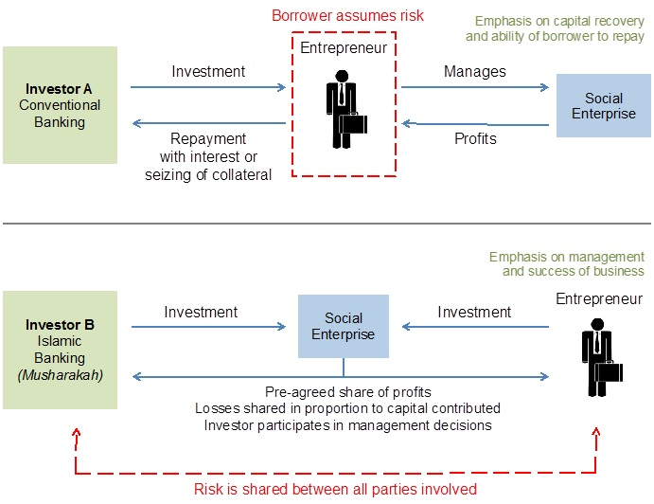
IF and Entrepreneurship
An illustration: conventional vs. Islamic
Statistical, Economic and Social Research and Training Centre for Islamic Countries

Slide 29
IF and Entrepreneurship
Risk-sharing instruments are not picking up
Share in total Islamic financing (%)
Source: IRTI-IDB
The problems associated with the use of Mudarabah and Musharakah provide some justification for the current predominance of debt-based instruments within Islamic finance assets.
Statistical, Economic and Social Research and Training Centre for Islamic Countries

Slide 30
Mudarabah
Suitable for business ventures?
Profit sharing loss absorbing contract (rather than profit and loss sharing)
Perceived as particularly risky by Islamic FIs due to “acute” principal/agent problem (the contract relies on trust between financier and entrepreneur)
  Information asymmetry
  Moral hazard
  Adverse selection
Resolution of possible disputes on management of the project as well as the outcome (in case things do not go as planned) is hard to achieve. There exists the challenge of foreseeing and agreeing ex-ante on all possible outcomes and their consequences
Called a “sleeping partnership” (from financier viewpoint as the latter cannot intervene in the business activities)
If problems are overcome, Mudarabah is more suitable for businesses with a longer profit cycle
Statistical, Economic and Social Research and Training Centre for Islamic Countries

Slide 31
Mudarabah
Suitable for business ventures? (2)
Equity-based two-tier Mudarabah model (TTMM) closely resembles venture capital fund structure
  On the liability side, the Islamic FI is assumed to play the role of Mudarib for the suppliers of capital (Rabb al-mals)
  On the asset side, it acts as the equity financier (Rabb al-mal) for entrepreneurs (Mudaribs)
  If a business venture fails, the capital provider (Islamic FI) loses its capital, and labour provider (entrepreneur) loses his/her time and efforts.
TTMM–Wakalah hybrid, whereby clients authorize a bank or fund manager to invest funds on their behalf in return for a predetermined fee (widely used by Islamic mutual funds) offers a suitable model both for an Islamic financier and entrepreneur by overcoming some of the aforesaid problems with sole Mudarabah
Mudarabah–Shirkah al-‘Inan hybrid structure, whereby capital provider can place any number of restrictive covenants on the functioning of SMEs and entrepreneurs (even after the disbursement of funds) provides an acceptable risk mitigation mechanism over sole Mudarabah
Statistical, Economic and Social Research and Training Centre for Islamic Countries

Slide 32
Musharakah
A better option?
Two or more partners with a given amount of capital come together in a business venture (they pre-agree to share the profit in a pre-determined ratio)
Can be either permanent, temporary or diminishing (in latter, financier receives profits on a regular basis, his/her equity diminishes, entrepreneur gradually becomes the only owner of the project)
Partners may incur financial losses, strictly in proportion to their capital contribution
Therefore, its absence from Islamic FI balance sheets cannot be justified on the same ground as that of Mudarabah (the financier has the option to engage, directly or indirectly, in the management, and monitor the activities, of the SME or any other type of enterprise)
  In practice, however, the banks’ right to participate in the management of firms funded by Musharakah deals is almost invariably waived (this degree of involvement would be prohibitively costly)
Although to a lesser extent, same agency problems also apply to Musharakah
Statistical, Economic and Social Research and Training Centre for Islamic Countries

Slide 33
Musharakah
A better option? (2)
Compared to the rate of return of conventional finance (interest rate), Musharakah is argued to offer higher rates of return to the capital provider
Compared to his/her share in the total capital (due to management effort), Musharakah is argued to offer slightly higher rates of return to the entrepreneur
No strict collateral guarantees and, therefore, entrepreneur is relieved from heavy burden of debts or any other obligations
Suitable for both fixed and working capital financing for SMEs
Diminishing Musharakah model (Musharakah Mutanaqisah Partnership – MMP) in fact makes it feasible for an Islamic FI to become an effective partner in a high number of and diverse set of partnerships at the same time (which would seem infeasible otherwise) and presents the entrepreneur with the opportunity of taking the total ownership the business/project
Tax exemptions to Musharakah operations with SMEs and entrepreneurs could significantly increase the use of these contracts
Statistical, Economic and Social Research and Training Centre for Islamic Countries

Slide 34
Final Remarks
Summary and takeaways
SMEs are important. Evolving Increasing importance of economic contributions made by SMEs (e.g., employment, output, competition) necessitates better understanding of their financial needs.
  This is so even it’s not possible to gauge the real contribution of SMEs due to the large number of informal/unregistered SMEs, and even the data on SMEs are not collected in a standardized manner.
SMEs are unique. So do their financial needs. Financing methods for SMEs should, therefore, be “tailored” to SMEs rather than simply mimicking those for large-scale firms
Access to finance is limited. SMEs in OIC countries and elsewhere continue to experience severe difficulties in accessing finance which generally stem from (1) limited availability of capital as well as conventional instruments, (2) high borrowing costs, and (3) limited number of alternative financing mechanisms, including Islamic ones.
Islamic finance is coming of age. There is huge demand from SMEs and entrepreneurs for rapidly growing Islamic finance services and products, which remains, however, largely unmet.
  There is little, or no, evidence that IF has played any significant role in providing venture capital or financing SMEs and entrepreneurs
Statistical, Economic and Social Research and Training Centre for Islamic Countries

Slide 35
Final Remarks
Summary and takeaways
Opportunity to create lasting synergies. Both Islamic finance and SMEs are natural fits for each other (with incentives aligned to real economic activity and promotion of socio-economic justice and fairness).
Risk-sharing capacity and talent is inadequate. As Islamic finance centres on the notion of risk-sharing, both Islamic FIs and SMEs must also build the necessary technical capacity and expertise to assess and manage the risks involved in risk-sharing contracts effectively
  The evidence suggests that the problem rests with the potential parties to the risk-sharing contract (i.e., Islamic FIs and entrepreneurs) rather than the construct and spirit of the contract itself
Vicious spirals remain at work. Islamic FIs should divert their focus from quasi “fixed income/profit” contracts and competing with conventional FIs (both end up with dominance of Murabahah and other debt-like instruments!)
Statistical, Economic and Social Research and Training Centre for Islamic Countries

Slide 36


Thank you for your attention
www.sesric.org
https://twitter.com/sesric

