Slide 1

Small & Medium Enterprises Development Authority – (SMEDA) Pakistan
Innovation – A value Creation Tool for SMEs in Changing Business Ecosystem
ADFIMI – SME Bank Malaysia Joint International Development Forum, KL, Malaysia, 20-21 October 2014

Slide 2






Scheme of Presentation
1
Introduction to SMEDA
2
SME Sector of Pakistan
3
SMEs, Innovation and Value Creation
4
Innovation Requirements and Financing Options
5
BDS for Innovation – Role of the Development Institutions
6
SMEDA Initiatives for Supporting Innovation

Slide 3


SMEDA – An Introduction

Slide 4
SMEDA - Mandate & Mission
Initiate, Take, Continue, Implement & Perform Any & All Activities for Encouraging and Facilitating Growth & Development of SMEs
To assist in Employment Generation and
Value Addition to the National Income,
through
Development of the SME Sector,
by helping Increase the Number, Scale and Competitiveness of SMEs

Slide 5
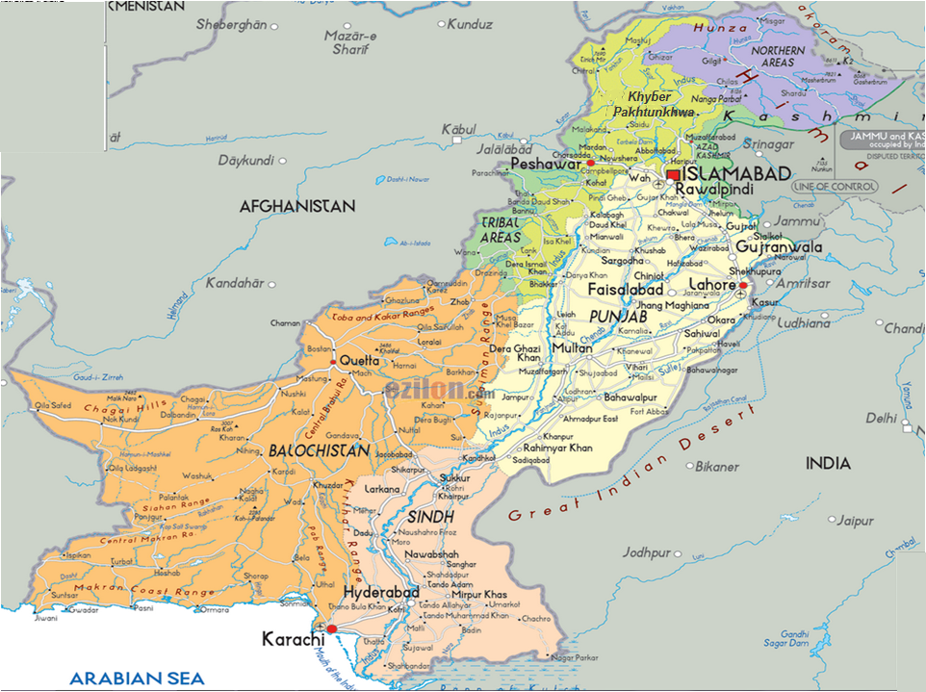
SME Density & SMEDA Outreach
14.21%
Mingora
2.18%
Issues
65.26%
Ghotki
17.83%
Provincial Offices (4)
Hub
RBCs Operational (25)
Source: Census of Economic Establishments 2005

Slide 6
SMEDA Key Achievements (1998 – 2012)
Over 66,000 walk-in SMEs facilitated
193 Pre-feasibilities & 285 Business Plans prepared
Over 1,800 training programs organized with over 88,000 participants
Investment facilitation of over Rs. 23 billion
Industry Support to over 470 firms
Over 10 Sector Strategies developed
Projects with International Development Partners:
  Economic Revitalization of Khyber Pakhtunkhwa and FATA - Multi Donors Trust Fund (MDTF)
  Early Recovery & Restoration of Flood Affected Communities
27 Demonstration Projects undertaken through Public Sector Development Program (PSDP) Funding

Slide 7
SMEs in Pakistan

Slide 8
SME Sector of Pakistan
Approximately 3.2 million business enterprises in Pakistan.
Enterprises employing up to 99 persons constitute over 90% of all private enterprises in the industrial sector and employ nearly 78% of the non-agriculture labor force.
Contribute over 30% to the GDP
25% of exports of manufactured goods besides sharing 35% in manufacturing value added.
Major Sectors include; Textile Garments and made-up, Leather & Leather made-up, Horticulture, Fisheries, Dairy, Livestock and Poultry, Light Engineering, Mine and Minerals, Gems & Jewelry, Marble & Granite etc.

Slide 9
SMEs, Innovation & Value Creation

Slide 10





Business Ecosystem
Investors
Banks, Equity Markets, Private Equity
Competitors
Similar Businesses
Government Agencies
Regulators and Development Support Organizations
Direct Consumers
Individual or Corporate Customers, Consumer Protection Orgs., Trade Bodies Etc.
Core Business
Suppliers, Service Providers, distributers etc.

Slide 11

SME Strengths for Innovation
Low Market entry barriers for SMEs
Generally more aware of the customer requirements due to presence at the grassroots
Better suited for offering customized service to the clients
Strong entrepreneurial skills leading to identification of niche markets
More aggressive in developing add-ons for products / services offered by larger firms
Passionate personal involvement of the entrepreneur helps peruse individuals and institutions in investing in the new idea

Slide 12
Innovation Value Creation for SMEs
Increase profits / margins
Product diversification / differentiation
Building customer loyalty
Maintenance or increase of market share
Customization of service
Value preposition for suppliers, distributers and service providers
Value creation for Society in terms of addressing their requirements through social enterprises

Slide 13


Types of Innovation
PRODUCT
Features / Usability
PROCESS
Manufacturing / Logistics / Distribution
01
02
04
03
MARKETING
Design / Package / Pricing
ORGANIZATION
Business Practices / External Relations

Slide 14























Innovation Process
Market Assessment
Technical Assessment
Financial Assessment
Value Preposition
Product Definition
Prototype Development
In-house Prototype Testing
Production Arrangements
Full Scale launch
Result Monitoring

Slide 15
Innovation and Financing Options

Slide 16
Innovation and Financing Options
S# | Funding Type | Description | Remarks
1 | Grant / Subsidy | Generally provided by the Government. Used as SEED FUNDING for innovative start-ups and SMEs at the seed and early stage | Complements market failures, financing at seed and initial stage
2 | Business Angel | Financing source at EARLY RISKIER STAGE and provides financing, advice and mentoring on business management. Tends to invest in the form of groups and networks | Financing at start-up and early stage

Slide 17

Innovation and Financing Options
S# | Funding Type | Description | Remarks
3 | Venture Capital | Tends increasingly to invest at later, less risky GROWTH STAGE. Referred to as patient capital owing to the lengthy time span (10-12 years) for investing, maturing and finally exiting | Financing at later expansion stage
4 | Corporate Venturing | Used by large firms to invest in innovative start-ups with a view to improving corporate competitiveness with either strategic or financial objectives. | Strategic motive

Slide 18
Innovation and Financing Options
S# | Funding Type | Description | Remarks
5 | Tax Incentive | A broad range of tax incentives for R&D and entrepreneurial investments in most countries | Indirect, non-discriminatory
6 | Bank Loan | Used as one of the most common tools for access to finance, It needs collateral or guarantees in exchange for loans | Obligation to repay as debt

Slide 19
BDS for Innovation – Role of the Development Institutions

Slide 20

Facilitation Counterparts
SMEDA
National Productivity Organization
Technology Upgradation & Skill Development Co.
Pakistan Industrial & Technical Assistance Center
Engineering Development Board
Pakistan Institute of Management
Pakistan Industrial Development Corporation

Slide 21










Oversight
Feedback
Coordination
BDS Data
Products & Services
Support Org.
Counterparts
Field Visits / Info Services
Networking
Services
BDSPs / FIs

Slide 22

SME Facilitation Components
Database & Linkage
BDSP Networks
Capacity Building
A content placeholder. Use for text, graphics, tables and graphs. You can change this text or delete it.
  Here is a placeholder for more text. You may delete this text
  Here is a placeholder for more text. You may delete this text
Investment Potential
Supporting CCI / Trade Bodies
Lending Programs
Investment Facilitation
Regulatory Compliance

Slide 23

SME Database & Linkage Facilitation
1
2
SME Profiling For BDS Need Assessment
Development of Database of SMEs: Site Verification & Geo Tagging.
Enrolment of interested businesses in SME Club of Pakistan
Networking of Vendors with OEMs
A content placeholder. Use for text, graphics, tables and graphs. You can change this text or delete it.
  Here is a placeholder for more text. You may delete this text
  Here is a placeholder for more text. You may delete this text
3
4
5
6
7
8
To panel board main

Slide 24
Service Providers’ Networks
1
2
Identification, Capacity Building and Networking Support to Private Sector Service Providers
Facilitation For Quality Assured and Sustainable Service Delivery to SMEs at the Target Locations.
A content placeholder. Use for text, graphics, tables and graphs. You can change this text or delete it.
  Here is a placeholder for more text. You may delete this text
  Here is a placeholder for more text. You may delete this text
3
4
5
6
7
8
To panel board main

Slide 25
Capacity Building Support to SMEs
1
2
Delivery of Capacity Building Support to SMEs on Identified BDS requirements.
Special Training Programs with 50% Subsidy on Fee.
A content placeholder. Use for text, graphics, tables and graphs. You can change this text or delete it.
  Here is a placeholder for more text. You may delete this text
  Here is a placeholder for more text. You may delete this text
3
4
5
6
7
8
To panel board main

Slide 26
Identification of Regional Potential for Investment
1
2
Identification of Region Specific Investment Opportunities and Development of Over the Counter (OTC) Products
A content placeholder. Use for text, graphics, tables and graphs. You can change this text or delete it.
  Here is a placeholder for more text. You may delete this text
  Here is a placeholder for more text. You may delete this text
3
4
5
6
7
8
To panel board main

Slide 27
Support to Trade Bodies & Chambers
1
2
Programmed Networking with CCIs, and Trade Bodies for Improved Working Relationships
Assessment of Grassroots Requirement, for Effective Design and Delivery of Advocacy & Development Initiatives
A content placeholder. Use for text, graphics, tables and graphs. You can change this text or delete it.
  Here is a placeholder for more text. You may delete this text
  Here is a placeholder for more text. You may delete this text
3
4
5
6
7
8
To panel board main

Slide 28
Lending Programs
1
2
Networking with Financial Institutions for Capacity Building of Credit Officers for SME Financing.
Awareness of Banking Products and Services Offered to SMEs
A content placeholder. Use for text, graphics, tables and graphs. You can change this text or delete it.
  Here is a placeholder for more text. You may delete this text
  Here is a placeholder for more text. You may delete this text
3
4
5
6
7
8
To panel board main

Slide 29
Investment Facilitation
1
2
Develop Programs and Products for Handholding of SMEs in Developing Investment Proposals
Supervised Interaction with Bank Officials for Improved Deal Flow.
A content placeholder. Use for text, graphics, tables and graphs. You can change this text or delete it.
  Here is a placeholder for more text. You may delete this text
  Here is a placeholder for more text. You may delete this text
3
4
5
6
7
8
To panel board main

Slide 30
Regulatory Compliance
1
2
Information Dissemination Regarding Corporatization, IPR, Taxation, and Other Regulatory Procedures and Compliance Requirements.
A content placeholder. Use for text, graphics, tables and graphs. You can change this text or delete it.
  Here is a placeholder for more text. You may delete this text
  Here is a placeholder for more text. You may delete this text
3
4
5
6
7
8
To panel board main

Slide 31
SMEDA Initiatives for Supporting Innovation

Slide 32
SMEDA’s Industry Support Program
  Foreign Experts Engaged: 39
  Companies Facilitated: 472
    Productivity 328
    Energy Efficiency 134
    Environment / Green Productivity 10
  Major Sectors:
    Textile Light Engineering
    Auto Parts Foundry
    Footwear Sports Goods
    Fan Food Processing
    Marble Chemical
    Forging Steel Re-rolling
  Training Workshops / Seminars: 142
  Best Practices Reports / Training Manuals: 6

Slide 33
Industry Support Program
Improvement Example - Productivity
Improvement Areas | Before | After | Improvement
Daily Production | 240 pcs | 420 pcs | 75 %
Line Balance Efficiency | 61.5 % | 85.7 % | 40 %
Work in Process Inventory | 7 pcs | 3 pcs | 60 %
Lead time | 30 days | 12 days | 60 %
Setup Time | 35 min | 15 min | 57 %
Productivity Improvement |  |  | 75 %

Slide 34
SMEDA – Cluster Based Support for Value Creation
Establishment of Food Processing Common Facility Center for Mango / Guava Pulp making
Establishment of Common facility production unit in Sialkot to support Sports Goods Industry for making mechanized balls
Establishment and operations of Foundry Service Center for providing simulation facility for product designing
Establishment of Women Business Incubation Centers (WBICs) for promoting value creation and innovation among female entrepreneurs of Pakistan

Slide 35
SMEDA – SME Support for IP Protection
Establishment of IP Desk at SMEDA Offices
Capacity Building / training and awareness creation among SMEs for Intellectual Property concept and benefits
Development / customization of reference publications / guides, in collaboration with WIPO
IP registration support to individual SME businesses through Networks of Legal Service Providers

Slide 36

Questions?
More Information?
Thank You!
Raja Hassanien Javed
Provincial Chief- Punjab
SMEDA, Pakistan
janjua@smeda.org.pk

