Slide 1
Plugging the Financial and Business Knowledge Gap in an Innovative Way…
Turgut BOZ Senior Assistant General Manager, SME Banking Group and Deputy General Manager

Slide 2
SMEs in TURKEY
Share of SMEs in total exports
%62
%99
Share of SMEs in all companies
2,5 Million SME units
Share of SMEs in total imports
%38.5
%50
%76
Share of SMEs in employment
Share of SMEs in total investments
%26
Share of SMEs loans in total loans

Slide 3
SMEs’ role in Turkey

Slide 4
What do SMEs need?
Technology
R&D
Knowledge

Slide 5
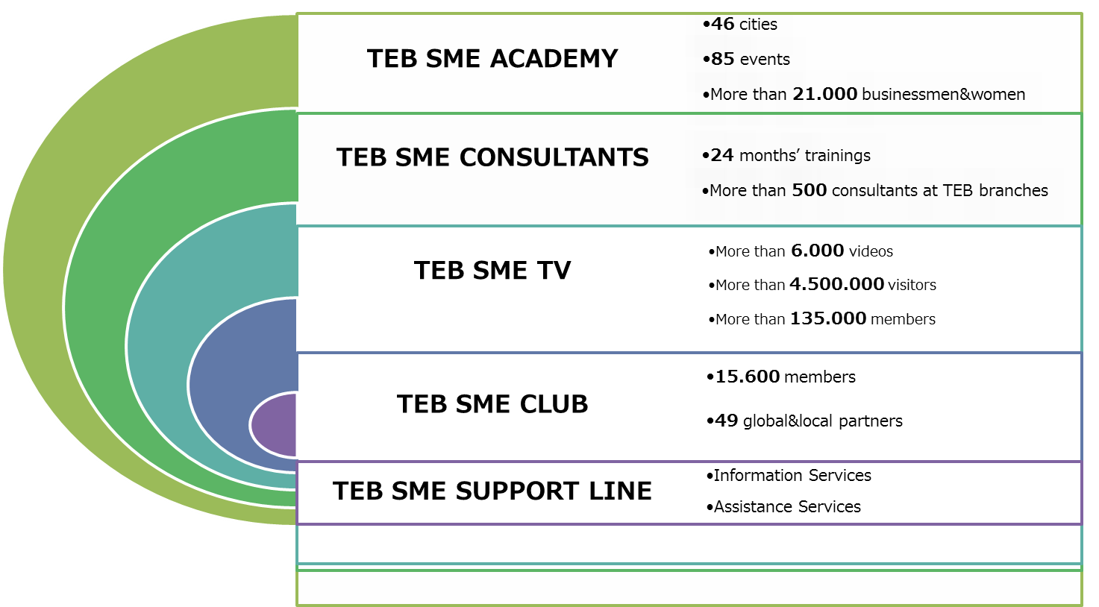
Differentiation: Being the «Consultant Bank» for SMEs!

Slide 6
New Ideas? Start-up Business Banking
Notes:
6

Slide 7
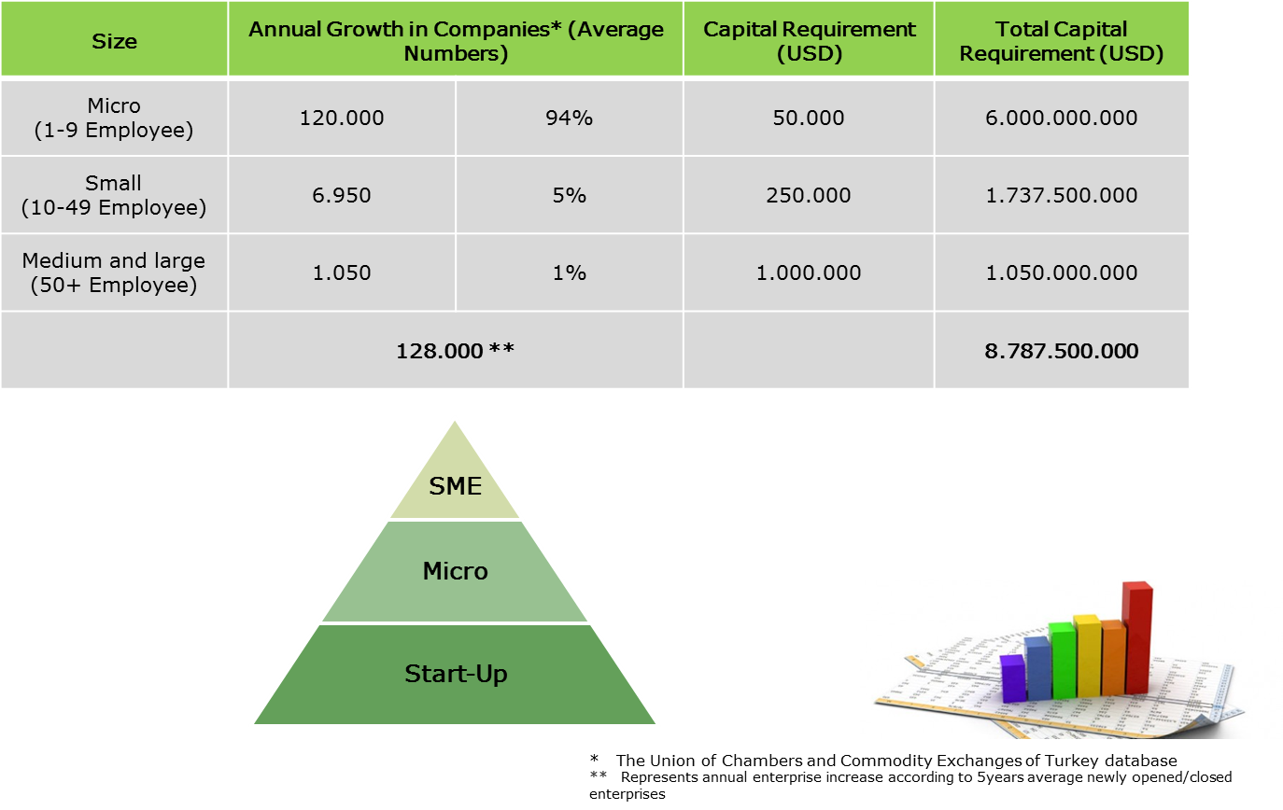
Startup Business in Turkey

Slide 8
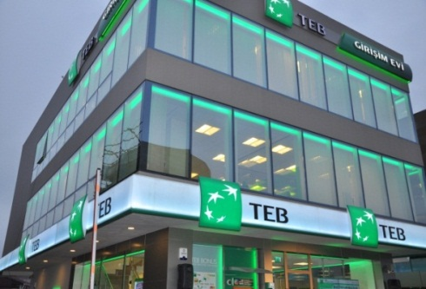
Innovation: TEB Start-up Business Banking
TEB Start-Up Business Banking
Financial Services Package
TEB Start-up House
Business Management Consultancy
Incubation Center
Start-up Business Trainings
Universities
Technopolises
Business Angels &
Venture Capitalists
TEB Branches –trained RMs
Regional Start-up Business Trainings
Non-financial Services

Slide 9
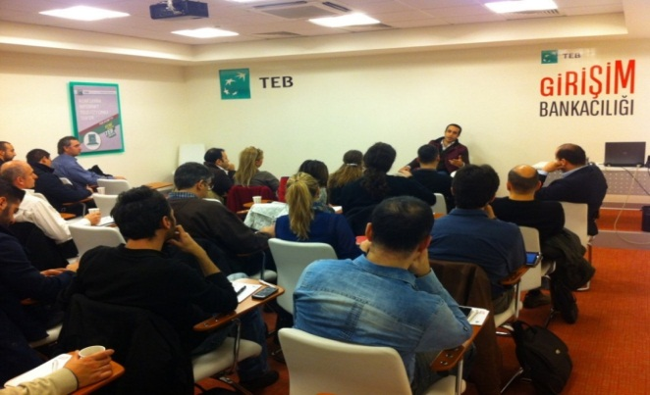
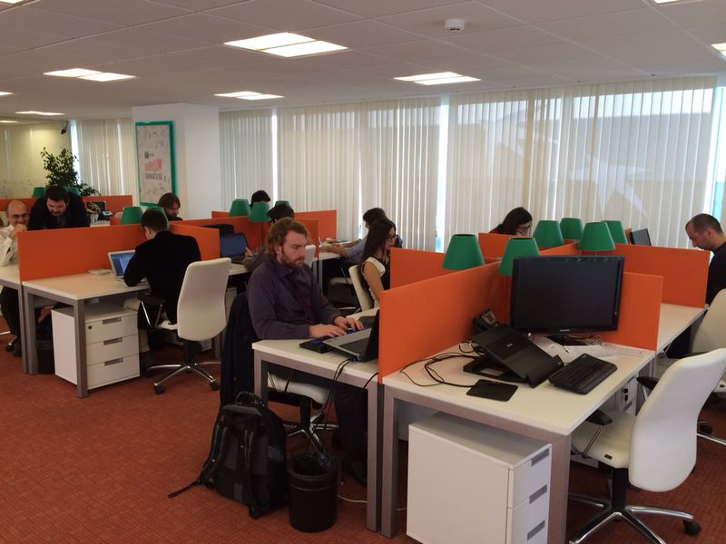
Target Group
FIRST TARGET GROUP
University Graduate
Innovative and value-Added ideas in the fields as IT/Software Development
Entrepreneurs which benefit from government assistance like Ministry of Science, Industry and Technology, KOSGEB, TUBİTAK
POSITIVE DISCRIMINATION
Technopreneur
Start-up Business projects supported by TUBITAK, KOSGEB, Ministry of Economy, Ministry of Science, Industry and Technology
Entrepreneurs which have project in the fields as Environment/Energy
Women Entrepreneurs
SECOND TARGET GROUP
The entrepreneurs who want to establish (grocery, green grocer or restaurants etc.)
Traditional entrepreneurs

Slide 10
TEB Start-up House
Consultancy
1.755 hrs total
501 hrs via phone
Trainings
More than 5.300 entrepreneurs
124 trainings
@18 different cities
1.254 hrs face-to-face
1.146 entrepreneurs
1105 hrs total
We provide Business Management Consultancy support for every start-up which complete the establishment phase;
and also for ones before the beginning of their enterprises.
The aim is to expand the consultancy model of our incubation center by reaching every technopark in Turkey
TEB Startup Business Banking provide free trainings to all entrepreneurships.
Trainings include different kinds of contents to be able to cover all training needs of techno-entrepreneurs and startups in other sectors. These trainings help our spread model.
*As of August’14

Slide 11
RESULTS?
Notes:
11

Slide 12
TEB SME Banking Group
TEB Segmentation
TEB Market share: 6,42%
SME+ USD9mio<USD23mio
SME USD1.2mio<USD9mio
Micro <USD1mio
Sector SME Loans USD 140.000mio
TEB SME Loans USD9.000mio
Total Loans* USD8.811mio
Deposits* USD2.953mio
Total Customer* 946.208
Net Banking Income** USD581mio
NPL* 2,54%
Net Profit** USD191mio
1USD=2.21TL
* As of August’14 **2014 forecast

Slide 13
TEB Start-up Business Banking
Total Loans
USD77mio
Unsecured Loan Ratio %58
Deposits USD54mio
Total Customer 31.725
Net Banking Income USD12mio
NPL 2,23%
*As of August’14

Slide 14
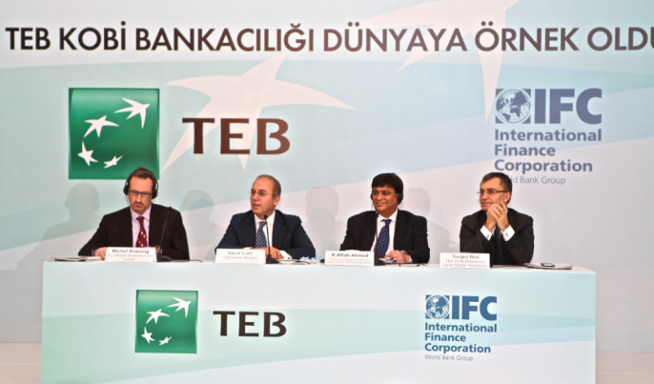
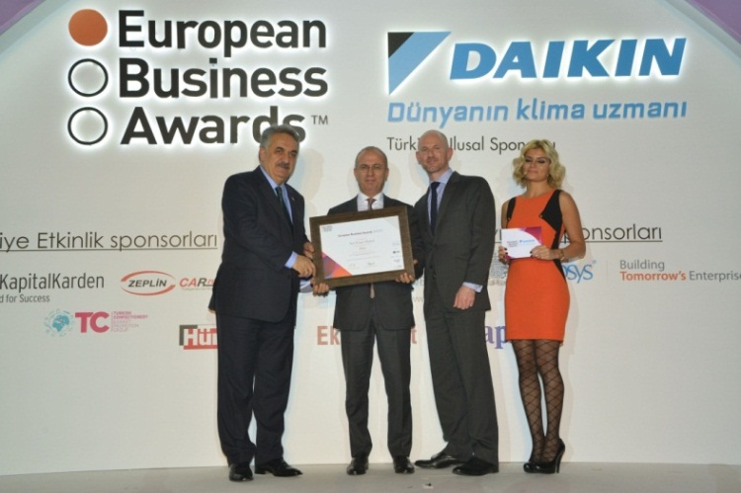
...Success
More than 40 prestigious international & national awards...
IFC has announced
as a success story for both bank and clients while studying over the non-financial services provided to SME clients.
has been announced as the best company in Europe for Customer Focus category
June 2013

Slide 15
Thank You
Turgut BOZ Senior Assistant General Manager, SME Banking Group and Deputy General Manager
: +902166352232
: turgut.boz@teb.com.tr

