Slide 1
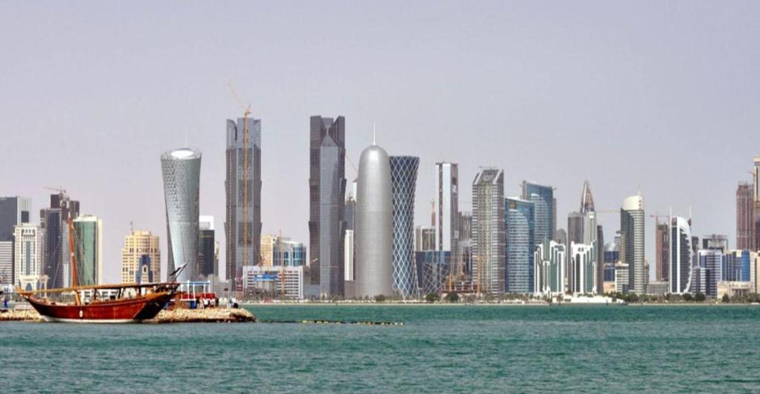
QDB PRESENTATION ALIDE HQ LIMA, PERU
Khalid Al Mana
October 8th, 2015

Slide 2
Qatar’s economy is highly dependent on oil compared to other countries
GDP breakdown by economic sector 2010 (Nominal), Percent
Non-oil
Oil
52
41
1
8
G7
Other resource-based economies¹
GCC
Qatar
1 Other resource-based economies include: Mexico, Canada, Netherlands, Norway and Indonesia
SOURCE: Qatar Statistics Authority, WMM Global Insight

Slide 3
Access to funding is one of the main obstacles to doing business in Qatar
Ranking of ease of
doing business
Improvement required
Qatar
Measured factors
Ranking by category of doing business
140
105
70
35
1
1
Singapore
1
Starting a business
2
New Zealand
2
Dealing with cons-truction permits
3
Hong Kong
SAR, China
3
Getting Electricity
13
Germany
4
Registering Property
25
UAE
5
Getting credit
44
Saudi
Arabia
6
Protecting investors
45
Qatar
7
Paying Taxes
53
Bahrain
8
Trading across
Borders
9
Enforcing contracts
10
Resolving insolvency
SOURCE: Doing Business report 2014; World Bank; Team analysis

Slide 4
SME promotion around 6 pillars, focused on consistent customer journey
Al Dhameen
Business Finance
Export promotion and financing
Advisory
Customer
Equity
Strategic procurement
SOURCE: Source

