Slide 1
The Sustainable Development Agenda and the role of SMEs
13 February 2017
Muscat
The Union of Chambers and Commodity Exchanges of Turkey

Slide 2
Agenda
Our world is in the midst of unprecedented challenges
  Are we going to survive? Lessons from the history
From the Millennium Development Goals to the Sustainable Development Goals
  A more pretentious set of targets to be reached by 2030
Where does SMEs stand when it comes to the SDGs?
  The link between good management practices and sustainability

Slide 3
What happened to Mayan Civilization and Easter Island?
Mayans: A vibrant and highly cultured society that occupied parts of Central America
  Rapid population growth (A.D. 400)
  The carrying capacity of fertile land exceeded
  Major droughts occurred (500-800)
  Uptick in infant mortality and collapse of the royal dynasty (822)
Easter Island: Lies 2000 miles off the coast of Chile
  Rapid population Growth (16th century)
  Over-extraction of forests
  Over-extraction contributed to soil erosion, diminished food supply
  Social response was warfare and self-destruction (18th century)
The world as a whole is heading to new challenges

Slide 4
The globe’s challenges are many fold
Increase in greenhouse gas emissions

Slide 5
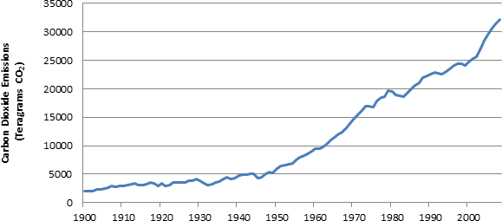
Global Carbon Dioxide (CO₂) emissions from fossil-fuels 1900-2008
Source: United States Environmental Protection Agency

Slide 6
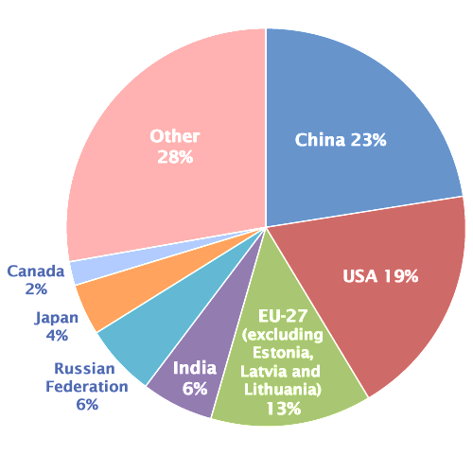
2008 Global CO₂ Emissions from Fossil Fuel Combustion and some Industrial Processes (million metric tons of CO₂)
Source: United States Environmental Protection Agency

Slide 7
The globe’s challenges are many fold
Increase in greenhouse gas emissions
Climate change

Slide 8
Global land and ocean temperature anomalies (wrt 20th century average)
0,9
0,8
0,7
0,6
0,5
0,4
0,3
0,2
0,1
0,0
-0,1
-0,2
-0,3
-0,4
-0,5
-0,6
Source: United States Environmental Protection Agency

Slide 9
The globe’s challenges are many fold
Increase in greenhouse gas emissions
Climate change
Water scarcity

Slide 10
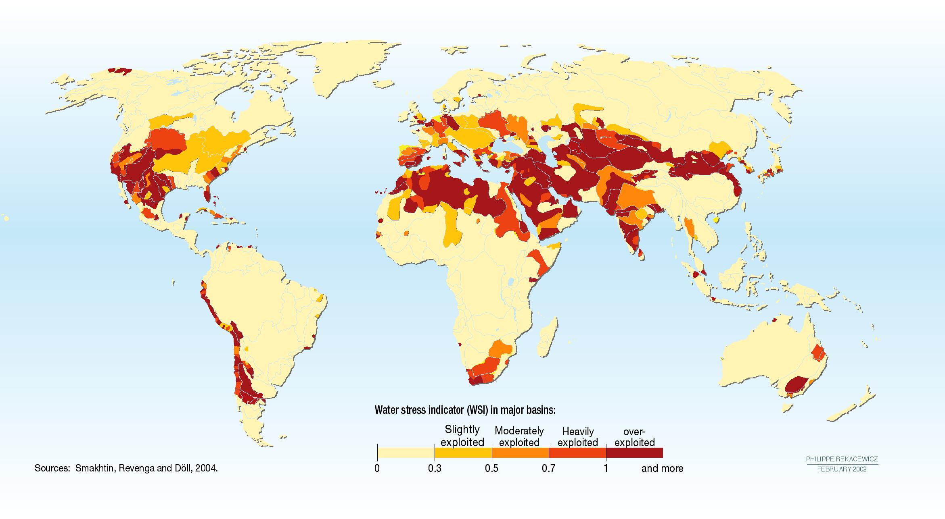

Slide 11
The globe’s challenges are many fold
Increase in greenhouse gas emissions
Climate change
Water scarcity
Persistent poverty

Slide 12
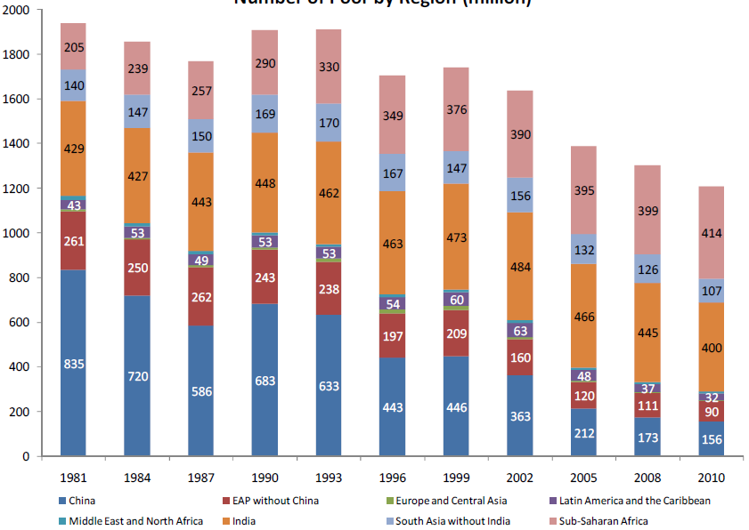
Number of poor by region (million)
Source: World Bank

Slide 13
Poorest and richest countries in the world (GDP pc, current USD, 2015)
Top 10 wealthiest |  |  | Top 10 poorest
Luxembourg | 101,450 |  | Guinea | 531
Switzerland | 80,945 |  | Mozambique | 529
Macao SAR, China | 78,586 |  | Gambia, The | 472
Norway | 74,400 |  | Congo, Dem. Rep. | 456
Qatar | 73,653 |  | Liberia | 456
Ireland | 61,134 |  | Madagascar | 402
Australia | 56,311 |  | Malawi | 372
United States | 56,116 |  | Niger | 359
North America | 54,831 |  | Central African Republic | 323
Singapore | 52,889 |  | Burundi | 277
Source: World Bank

Slide 14
The Millenium Development Goals were supposed to be reached by 2015

Slide 15
From the Millenium Development Goals to the Sustainable Development Goals. What is the difference btw the two?
SGDs are broader in scope: 17 SDGs with 169 targets, addresses the root causes of poverty, three dimensions
  Economic Growth, social inclusion and environmental protection
  8 MDGs and 21 targets
Universal and growth oriented: Apply to all countries both developed and developing and strong economic growth is one of the goals
  Eg. environment protection and gender equality are horizontal issues
Strong focus on implementation: The mobilization of financial resources—capacity-building and technology
  Special vehicle for technology and innovation

Slide 16
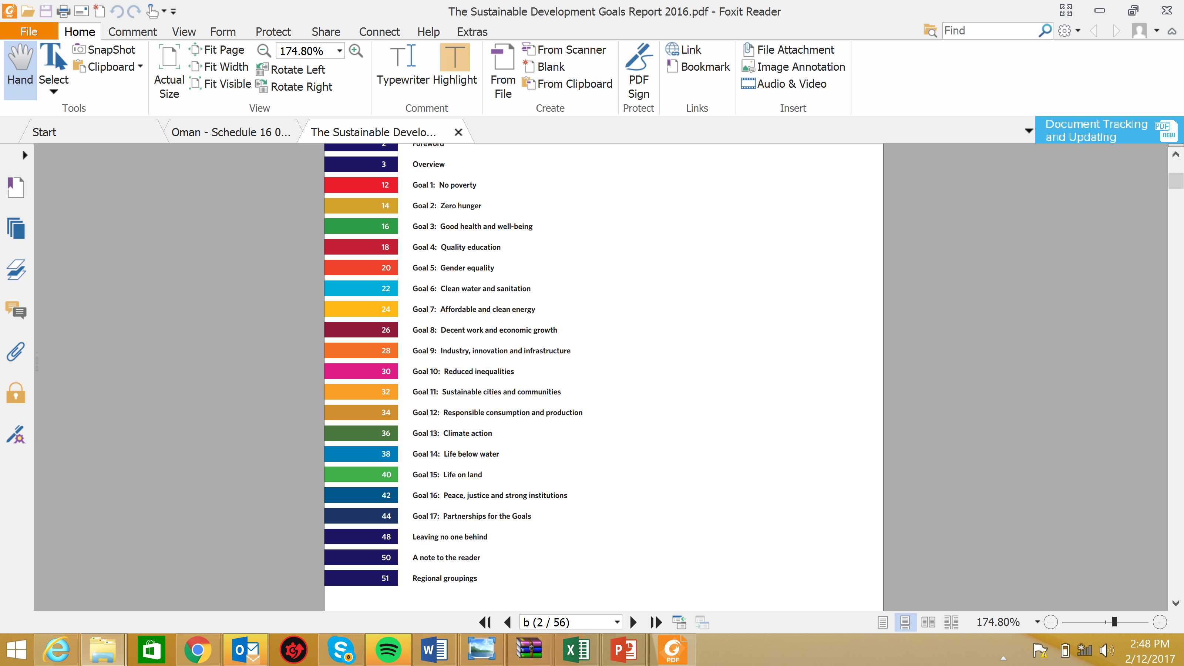
Goal 8 establishes a direct link between SMEs and sustainable development…

Slide 17
… there are other goals that could be supported by a vibrant and productive SME sector

Slide 18
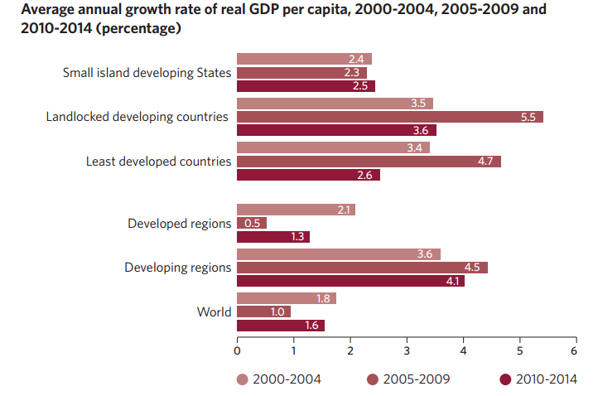
Growth performance of the least developing countries accelerated for a time but has slowed down in the last couple of years

Slide 19
2016 is the fifth consecutive year with global growth below long-term average
EU
USA
TR
GCC

Slide 20
Rich countries are rich because of a vibrant SME sector
SMEs employment share and per capital GDP
50.000
45.000
40.000
35.000
Norway
Denmark
Sweden
Austria
30.000
France
Germany
GDP pc
US
Belgium
25.000
Hong Kong, China
20.000
Ireland
Italy
15.000
Argentina
Spain
10.000
Turkey
Croatia
5.000
Cote d’Ivoire
Cameroon
Guatemala
Brazil
C. Republic
Zimbabwe
Honduras
Romania
0
SME employment share

Slide 21
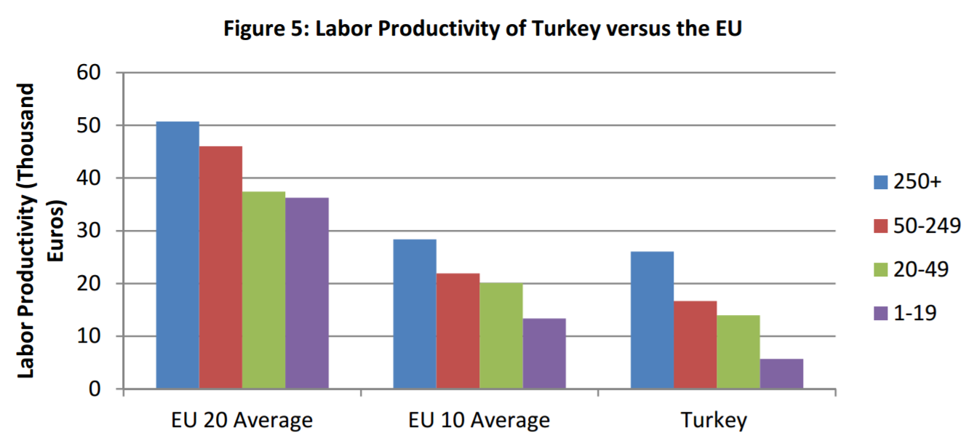
Developing country SMEs have lower levels of productivity relative to their developed country counterparts
The typical case of Turkey
Labor productivity of Turkey vs. the EU (by firm employment size)
Source: Sabancı Economic Research Forum

Slide 22
Within country productivity differentials are also substantial
Ratio of labour productivity of largest to smallest enterprise size class, 2010
4,3
3,2
3,3
2,6
2,8
2,4
2,5
2,0
1,7
1,7
1,8
1,8
1,8
1,8
1,5
1,6
1,4
0,9
1,0
1,1
Denmark
Luxembourg
UK
Finland
Sweden
Austria
Germany
Australia
Belgium
Czech Rep.
Slovenia
Slovakia
Spain
Portugal
Italy
Greece
Hungary
Poland
Mexico
Turkey

Slide 23
SMEs have significant disadvantages vis-a-vis large enterprises
External factors that affect the productivity level of the SMEs
SMEs in developinng countries have significant disadvantages vis-a-vis SMEs rich countries
Access to capital
Access to talent
Access to technology
Internationalization
…
Access to capital
Access to talent
Access to technology
Better regulations
…
Internal factors that affect the productivity of the SMEs
Good management practices

Slide 24
A new strand of the economics literature: Understanding the basics of good firm management and its macroeconomic consequences
An almost twenty year LSE, Harvard, Stanford and McKinsey project to measure management across firms and countries
  Led by Stanford Professor Nicholas Bloom (one of the most influential economists under 40 years old)
LSE graduate students evaluate the management practices of firms from different sizes and countries
  Almost 12K companies from 34 countries were evaluated
  Target setting, HR management, use of data, documentation etc…
The results suggest that about a quarter of cross-country and within-country TFP gaps can be accounted for by management practices across firms
  Has something to do with the achieving the SDGs

Slide 25
Companies in developed countries are on average managed better than companies in developing countries
US
Japan
Germany
Sweden
Canada
UK
France
Australia
Singapore
Italy
Mexico
Poland
New Zealand
N. Ireland
Portugal
Ireland
Spain
Africa
Asia
Australia
Europe
LAC
North America
Chile
Turkey
Greece
China
Argentina
Brazil
Colombia
Kenya
India
Nigeria
Nicaragua
Myanmar
Zambia
Tanzania
Gana
Ethiopia
Mozambique
2,0
2,1
2,2
2,3
2,4
2,5
2,6
2,7
2,8
2,9
3,0
3,1
3,2
3,3
Average Management Score
Source: The World Bank, WMS

Slide 26
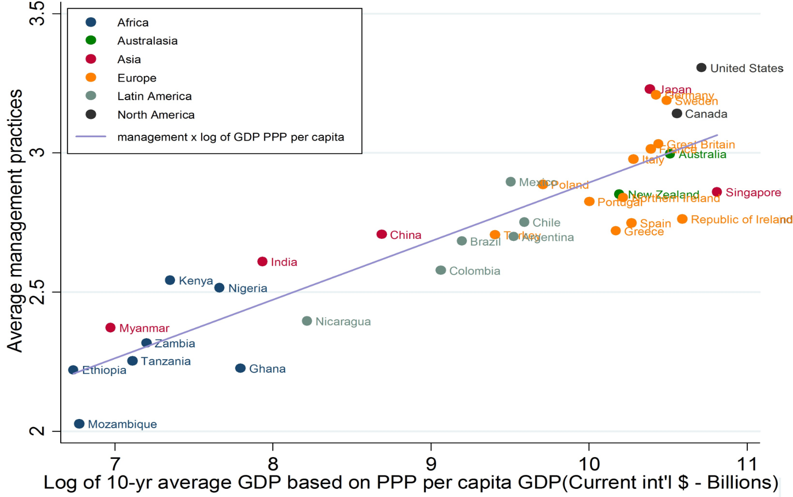
Countries with a higher average firm management score tend to grow faster
Average firm management score and GDP growth averages of selected countries

Slide 27
Firm managers are got to selfscore their companies’ management performance at the end of the interviews
They generally over-score their firm’s management. But more in some countries
The difference between the selfscore and the score given by the evaluater
Turkey
Mexico
Brazil
Argentina
Chile
Greece
India
Portugal
Ireland
China
N. Zealand
Canada
Australia
Poland
Italy
UK
Germany
US
Sweden
France
Japan
Singapore

Slide 28
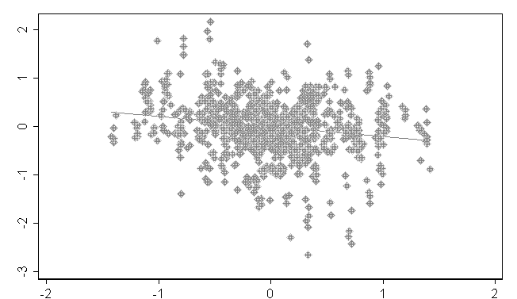
A case in point: Well managed firms are more energy efficient
One of the main pillars of SDGs: environmental sustainability
1 point higher management score associated with about 20% less energy use
Energy use, log( KWH/$ sales)
Management
Source: Bloom, Genakos, martin and Sadun, NBER WP14394. Analysis uses Census of production data for UK firms

Slide 29
Some policy takeaways for improving management performace and achieving SDGs
More competition leads to better management
  Trade-openess, market concentration, product market regulations
Multinationals appear able to transport good management around the world
  Liberalize FDI policy, avoid any discriminative practices
Flexible labor market policies tend to facilitate good management practices among firms
  Ease of hiring and firing is a key attribute to form the best team
Time to rethink about the SME support schemes especially in the developing countries
  A paradigm shift from increasing the longevity of SMEs to incentivizing the improvement of good management

