Slide 1
Entrepreneurship and Innovation as a Tool to Promote SMEs ADFIMI – Oman Development Bank Joint Regional Seminar on “SME DEVELOPMENT” Crown Plaza Hotel, Muscat, Oman, 13-15 February 2017 Dr. Shahid Qureshi, Director, AMAN Centre for Entrepreneurship Development, IBA, Karachi

Slide 2
Utilitarianism is a modern form of the Hedonistic ethical theory which states that the end of human conduct is happiness and what distinguishes conduct into right and wrong is pleasure and pain. John Stuart Mill describes this as follows:
“Utility or the greatest happiness principle, holds that actions are right in proportion as they tend to promote happiness, wrong as they tend to produce the reverse of happiness. By happiness is intended pleasure and the absence of pain; by unhappiness, pain and the privation of pleasure” (Utilitarianism, ii, 1863).
Utilitarianism
Justifies human actions in terms of pursuit of happiness and avoidance of pain. Selfishness
Assumptions:
Human Beings are selfish.
Welfare depends on consumption
Societies benefit by increasing wealth.

Slide 3
Corporate Model
Competition
Barriers to Entry
Cut Throat Competition
Assumptions:
Darwin’s theory
Theory of evolution
Survival of the fittest
Resources
Scarce
Ownership
Utilitarianism
Justifies human actions in terms of pursuit of happiness and avoidance of pain. Selfishness
Assumptions:
Human Beings are selfish. Welfare depends on consumption
Societies benefit by increasing wealth.
Tool Kit: Strategic Thinking, Networks, Understanding of corporate culture, politics, adroit talk, connections, and self-promotion

Slide 4
Comparison between Small Entrepreurial firms and Corporations
Entrepreneurship
Corporations
Resources Parsimony
Creativity, Bootstrapping, Sharing, Control without owning
Resources
Scarce
Ownership
Spend a lot
Cooperation
Treat others as you like to be treated.
Share wealth
Return back to community
Competition
Barriers to Entry
Cut Throat Competition
Idea is important Utilitarianism + Service
Utilitarianism
Justifies human actions in terms of pursuit of happiness and avoidance of pain. Selfishness
Tool Kit: Creative use of resources, Resource parsimony, proactiveness, ability, talent and hard work,
Tool Kit: Strategic Thinking, Networks, Understanding of corporate culture, politics, adroit talk, connections, and self-promotion

Slide 5
E+ Plus versus Entrepreneurship and Corporations
Entrepreneurship
PLUS
Entrepreneurship
Corporations
Resource
Barakat
Unlimited resources
More from Less
Multiplier Effect
Limitation: Yaqeen
Resource
Parsimony & creativity
Bootstrapping & sharing
Limitation: creativity and thoughts (Brain)
Resources
Scarce
Ownership
Limitation: the scarce resources of the world
Cooperation & Service
Treat others as you like to be treated.
Share the wealth
Return Back to society
Cooperation
Treat as you like to be treated.
Competition
Barriers to Entry
Cut Throat Competition
Pursuit of Happiness by Pleasing God (SQ)
Idea is important Utilatiarianism + Service
Utilitarianism
Selfishness
Pursuit of Happiness
Tool Kit: Faith, Charity, Fear of God, Humbleness, Prayers, Kindness to others
Tool Kit: Strategic Thinking, Networks, Understanding of corporate culture

Slide 6
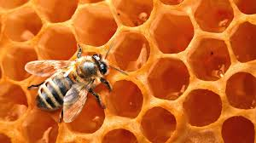
Grave yard exercise
Galaxies Scale of the Universe
Small things exercise
Bath room cleaning
Plantation exercise
Fasting
Praying
Henry Mintzberg: Confidence – competence = Arrogance
Self awareness, self esteem, perseverance, Humility, gratitude, respect of humanity, parsimony
Faith in the unseen, Life after
Intrinsic strength
Sense of Direction
Imortance and place of human beings in the universe
Values
Spiritual
Orientation
Meaningful
Life
Peaceful life
Hayat Tayyiba
Stories from Quran Prophet Ibrahim, Musa, Eesa, Sulaiman, Dawood and Muhammad PBU them all
Universal truths from Quran
The creation of humans (embryology)
Entrepreneurs feel closer to God
Rope as a time line
A life of purpose
Clean life (free from unneccassory thinkging and actions)
Nobility
Service
Effectual
Life Skills
How will you measure your life: Clayton
Vison exercise
Who you are, what you know, whom you know
Affordable loss (how much willing to loose)
Action (Pilot in the plane)
Leveraging surprises
Collaborative mindset
Creativity
Courage
Roxanne Quimby
Ice Hotel
Stallion Deliveries
Beaver Story
Honey Bee story

Slide 7
Effectuation
Evolving Means
New and Different Goals
Effectuation evokes creative and transformative tactics
heuristics (rule of thumb, intuitive, common sense) used by expert entrepreneurs in new venture creation.

Slide 8
Bird in Hand Principle – Start with your means. Don’t wait for the perfect opportunity. Start taking action, based on what you have readily available: who you are, what you know, and who you know.
Affordable Loss Principle – Set affordable loss Evaluate opportunities based on whether the downside is acceptable, rather than on the attractiveness of the predicted upside.
Lemonade Principle – Leverage contingencies Embrace surprises that arise from uncertain situations, remaining flexible rather than tethered to existing goals.
Crazy-Quilt Principle – Form partnerships Form partnerships with people and organizations willing to make a real commitment to jointly creating the future—product, firm, market—with you. Don’t worry so much about competitive analyses and strategic planning.

Slide 9
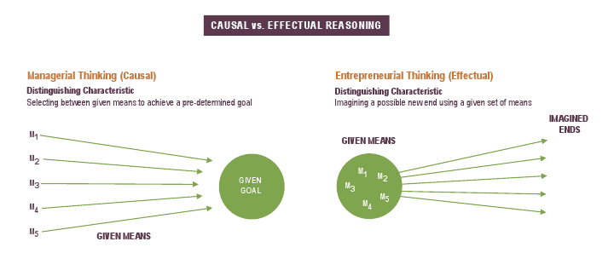

Slide 10
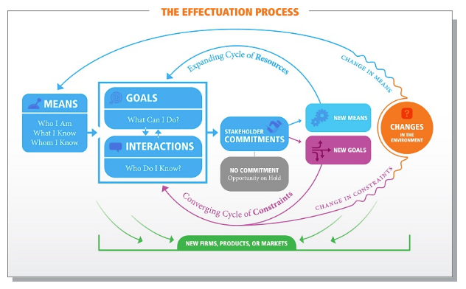
Source www.effectuation.org
It is a logic and process used in early startup phase. Expert entrepreneurs follow the process to gain early customers and committed partners who then create new means and new goals, as resources and viewpoints are added to the mix. Thus, instead of having a stated goal and finding means to reach it, expert entrepreneurs use the new means and new goals to drive the creation of the venture in ways they hadn’t expected, leveraging surprises as they present themselves. Effectuators use the process to lower the risk of the venture (by getting customers and income early, setting affordable loss, and spreading risk to others) and finding truly new and useful market opportunities by leveraging constraints and new information.

Slide 11
Framework for promoting Entrepreneurship leading to SME development
Environment
University Resources
Implementation
Outcome
University Software
Faculty Motivation ,Experiential background, Business Knowledge / Market understanding, Involvement / Cooperation
Administration: Friendly and supportive, Efficient, Involvement of faculty in administrative matters
Students and Alumni
Knowledge, Experience, Networks and financial resources are part of the feed back loop
University Policy, Vision and Systems (Internal Environment)
VC, Org structure, Core steering Committee, Governance Mechanism, Culture, Financial Mgt
Teaching the Entrepreneurial Mindset
New Venture Creation & Spin Off Companies
Teaching Programs Relevant to Problems and Opportunities of the surroundings
Faculty, Staff, Students and Alumni Entrepreneurs
Applied Research
University Hardware
Technology: Expertise of the University
Infrastructure: Labs, ORIC, TTO, Incubation, Tech Parks, Equipment
Financial Resources: Endowment, revenue from commercialization and other sources University, Industry, Public, Banks/Venture capitalists, Private, tenants and others.
Education and training of SMEs
External Conditions (Environment)
Changing Social needs
Government Priorities and support
State level economic growth
Market opportunity
Industry attractiveness / R&D funding
Embedding Entrepreneurship teaching in other programs
Learning opportunity of the University
Outreach Programs for the community

Slide 12
Values
Self Esteem
Consultation
Parsimony
Respect
Case Studies
Role plays
Field Visits
Seminars and Exhibitions
Trust
Patience
Anger Control
Entrepreneurship
Know your self (Who I am, What I Know, and Whom I Know)
Opportunity Recognition
Effectuation theory of Entrepreneurship
Entrepreneurial Process, Entrepreneurial Method, Entrepreneurial Mindset
E-Marketing
E-Accounting & E-Finance
E-Human Resources
E-Operations, E-Law
Social Entrepreneurship
Humility
Field Work
Vision
Time Management
Sleep Management
Purpose
Gratitude
Affordable
Loss Principle
Bird in Hand Principle
Khidmat
Lemonade Principle
Pilot in the Plane Principle
Haya
Self Esteem
Perseverance
Self awareness
Identifying a problem in the society and solving it
Communication &
Presentation Skills
Respect of others
Return to society
Cleaning
Tree Plantation
Hygiene, Teeth cleaning
Interview an Entrepreneur
Return to society
IT Skills
Excel, SPSS
Web Design
Physical Fitness : Aerobics
Hakeem Saeed, Chinoti Entrepreneurs, Manzil, Kashif Thala

Slide 13
“It is better for anyone of you to take a rope and cut the wood (from the forest) and carry it over his back and sell it [as a means of earning a living] rather than to ask a person for something and that person may give him or not.” (Sahih Bukhari Volume 2, Book 24, Number 549)

Slide 14
Science
Management
Engineering & Tech
Social & Humanities
Entrepreneurial University
VC. Administration
Ent. Characteristics
Effectuation
Roxanne Quimby
Nils Birgovist
Golden star Pvt
Zaki Mustafa at Corning
ID Fresh
Pakistani case studies
Entrepreneurial Center
Business Incubation
Entrepreneurial -Mindset
Lectures
Experiential learning
Student teacher interaction
Participant Centered Learning and the case method
Tools for Teaching
Meaningful life
Nation Builder
Insaniat
Pakistaniat
Islamiat
Social Internship
Corporate Internship
Final Year Projects
Nafs Mutmainnah
Hayat Tayyiba
Interview an Entrepreneur
Guest Speakers & Field Visits
Case Studies Exercises &
Presentations
Experiential Activities
Building your Vision
Time Management
Sleep Management
Where do you want to go?
Affordable
Loss Principle
Bird in Hand Principle
Skills Training
Lemonade Principle
Pilot in the Plane Principle
Values
Self Esteem
Consultation
Parsimony
Respect
Perseverance
Hygiene: Teeth
Food:
Haya
Patience
Anger Control
Trust
Humility
Return to society
Cleaning
Tree Plantation
Gratitude
Hakeem Saeed, Chinoti Entrepreneurs, Dr. Abdul Wahab IBA, Manzil, Kaleem Siddiqui, Henry Mintzberg, Clayton Christensen

