Slide 1
SME Development in Pakistan SMEDA’s Experience (ADFIMI-ODB Joint Regional Seminar on SME Development)
Presented by
Sheharyar Tahir
Head- External Relations SMEDA
February 14, 2016

Slide 2
Scheme of Presentation
Economic Profile of Pakistan
SME Sector in Pakistan
Business Support Organizations in Pakistan
Introduction to SMEDA
SME Development Initiatives
Future Programs

Slide 3
Economic Profile of Pakistan
GDP (US$ Billion) 283.678
Population (Million) 195.40
Per Capita Income (US$) 1,560.70
Exports (US $ Billion) 20.803
Imports (US $ Billion) 44.233
FDI (US $ Billion) 2.06
Contribution by Sector;
Industry (21.02%), Agriculture (19.82%) & Service (59.16%)
Source: Pakistan Economic Survey 2015-16, Ministry of Commerce
(MoC), Board of Investment (BoI) & SBP

Slide 4
SME Definition (Current)
SME Policy 2007
Enterprise Category | Employment Size | Paid Up Capital | Annual Sales
SME | Up to 250 | Up to Rs. 25 Million | Up to Rs. 250 Million
Other Organizations have also developed their own SME definitions, as per requirement
4

Slide 5
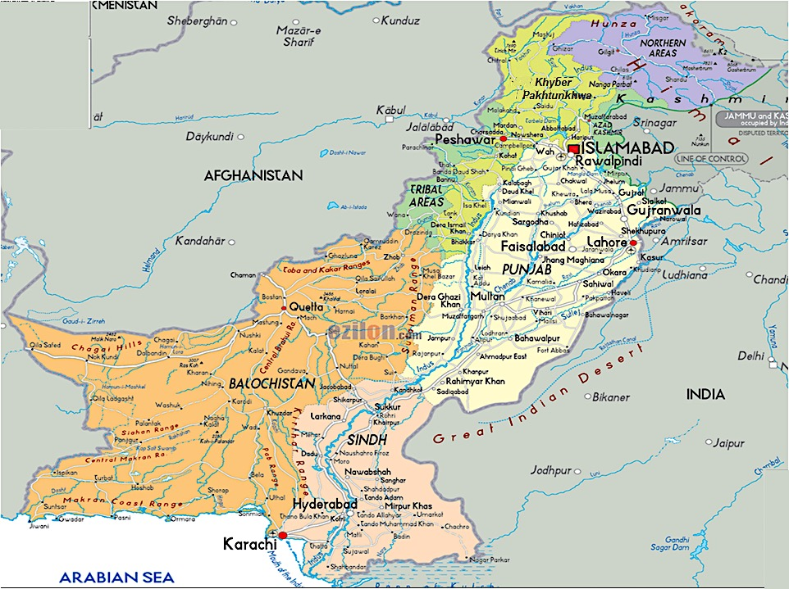
SME Sector in Pakistan
3.2 Million SMEs
Khyber Pakhtunkhwa
14.21%
Contribution to GDP 40 %
Share in Exports over 40 %
Punjab
65.26%
Balochistan
2.18%
Sindh
17.83%
Source: Census of Economic Establishments 2005

Slide 6
Establishments vis-à-vis Employment Size
Source: Census of Economic Establishment 2005

Slide 7
Pakistan – Major Exports
Source: Pakistan Economic Survey 2015-16

Slide 8
Growth Rate of Manufacturing Sector
Growth Rate %
Source: Pakistan Economic Survey 2013-14

Slide 9
Credit Extended to SME Sector (2003-2015)
6.5 % of total Private sector credit off take
260.8
Source: State Bank of Pakistan

Slide 10
Business Support Organizations
Federal
Provincial
Financial
Tech., Training,
Test., & Cert.
Export
Promotion
Ministries / Organizations
Federal Board of Revenue (FBR)
Securities & Exchange Commission of Pakistan (SECP)
Board of Investment
Export Processing Zones Authority (EPZA)
Engineering Development Board (EDB)
Sector Development Companies
Provincial Departments / Organizations
Small Industries Corporation (PSIC)
Punjab Board of Investment & Trade (PBIT)
Sindh Small Industries Corporation (SSIC)
Sindh Board of Investment (SBI)
Small Industries Development Board (SIDB)
Khyber Pakhtunkhwa Board of Investment and Trade (KP-BOIT)
Balochistan Board of Investment
State Bank of Pakistan
Public Sector Banks
Private Sector Banks
Specialized Banks
Development Financial Institutions (DFIs)
NGOs
NTB
NAVTTC
NPO
PITAC
PNAC
PSQCA
PCSIR
TUSDEC
Provincial TEVTAs
PVTC
PIM
Trade Development Authority of Pakistan (TDAP)
Pakistan Software Export Board (PSEB)
Pakistan Horticulture Development Export Company (PHDEC)
Business Membership Organizations (Private Sector)
Small & Medium Enterprises Development Authority (SMEDA)

Slide 11
Vision - Ministry of Industries & Production
‘To play a leadership role in formulating and implementing a comprehensive strategy for industrialization of Pakistan which aims at maximizing job creation and enhancing Pakistan’s international competitiveness’

Slide 12
National Fertilizer Corporation
Pakistan Steel Mills (PSM)
Furniture Pakistan
Utility Stores Corporation (USC)
Heavy Mechanical Complex
ENAR Petro-Tech
Small & Medium Enterprises Development Authority (SMEDA)
Pakistan Industrial Development Corporation (PIDC)
Pakistan Hunting & Sporting Arms Development Company
Department of Explosives
Aik Hunar Aik Nagar (AHAN)
Heavy Electrical Complex
Pakistan Institute of Management (PIM),
Lahore
National Industrial Parks Development & Management Company (NIP)
Ceramic Development & Training Complex, Gujranwala
Ministry of Industries & Production, Government of Pakistan
Pakistan Industrial Technical Assistance Centre (PITAC)
Technology Upgradation & Skill Development Company
Karachi Tools, Dies & Moulds Company
Engineering Development Board (EDB)
Southern Punjab Embroidery Industries (SPEI)
State Engineering Corporations
National Productivity Organization (NPO)
Leather Craft Development Company (LCDC)
Gujranwala Tools Dies & Moulds Company (GTDMC)
Export Processing Zones Authority (EPZA)
Pakistan Gems & Jewellery Development Company (PGJDC)
Pakistan Machine Tool Factory (PMTF)
Pakistan Chemical & Energy Sector Skills Development Co.
Pakistan Stone Development Company (PASDEC)
Pakistan Engineering Company (PECO)

Slide 13
SMEDA Mission & Mandate
To assist in Employment Generation and
Value Addition to the National Income,
through
Development of the SME Sector,
by helping Increase the Number, Scale and Competitiveness of SMEs
Initiate, Take, Continue, Implement & Perform Any & All Activities for Encouraging and Facilitating Growth & Development of SMEs

Slide 14
SME Development Strategy
Building a Conducive Environment
Developing Sectors and Clusters
Provision and Facilitation of Services to SMES
Notes:
Building a Conducive Environment
Proposing and facilitating changes in Policy and Regulatory Environment
SME Policy
Budgetary & Trade Policies recommendations
Participating in Industrial Policy Exercise
Reducing the Cost of Doing Business
Formal Lending Cost: Development of Program Lending models for Power Loom, Fisheries, Cutlery, Auto parts Vendors, Schools etc.
Taxation policy & Procedure e.g. Income tax & Sales tax
Major policy shake up on import tariffs for Raw Materials
Utilities next target: Power Tariff, Telephone etc.
Facilitating Government-SME Interface
Public Private Dialogue; Policy Consultative Processes in Fiscal, Trade & Monetary
Developing Clusters and Sectors
Sector Studies, Strategies and Implementation
Marble & Granite, Dairy strategy, Poultry Sector Strategy, Leather, Garments, Horticulture, Fisheries, Textiles, Transport
Cluster Development
Ceramic Pottery, Fans, Surgical, Garments, Cutlery, Leather, Furniture, Gems & Jewelry, Ginning, Handloom etc.
Common Facility Centers

Slide 15
Strategy for Implementation
Federal Govt.
Provincial Govt.
SMEDA
Partnerships
Int’l Dev. Partners
Chambers & Trade
Associations
Academia & Pvt. Sector

Slide 16
Building a Conducive Environment

Slide 17
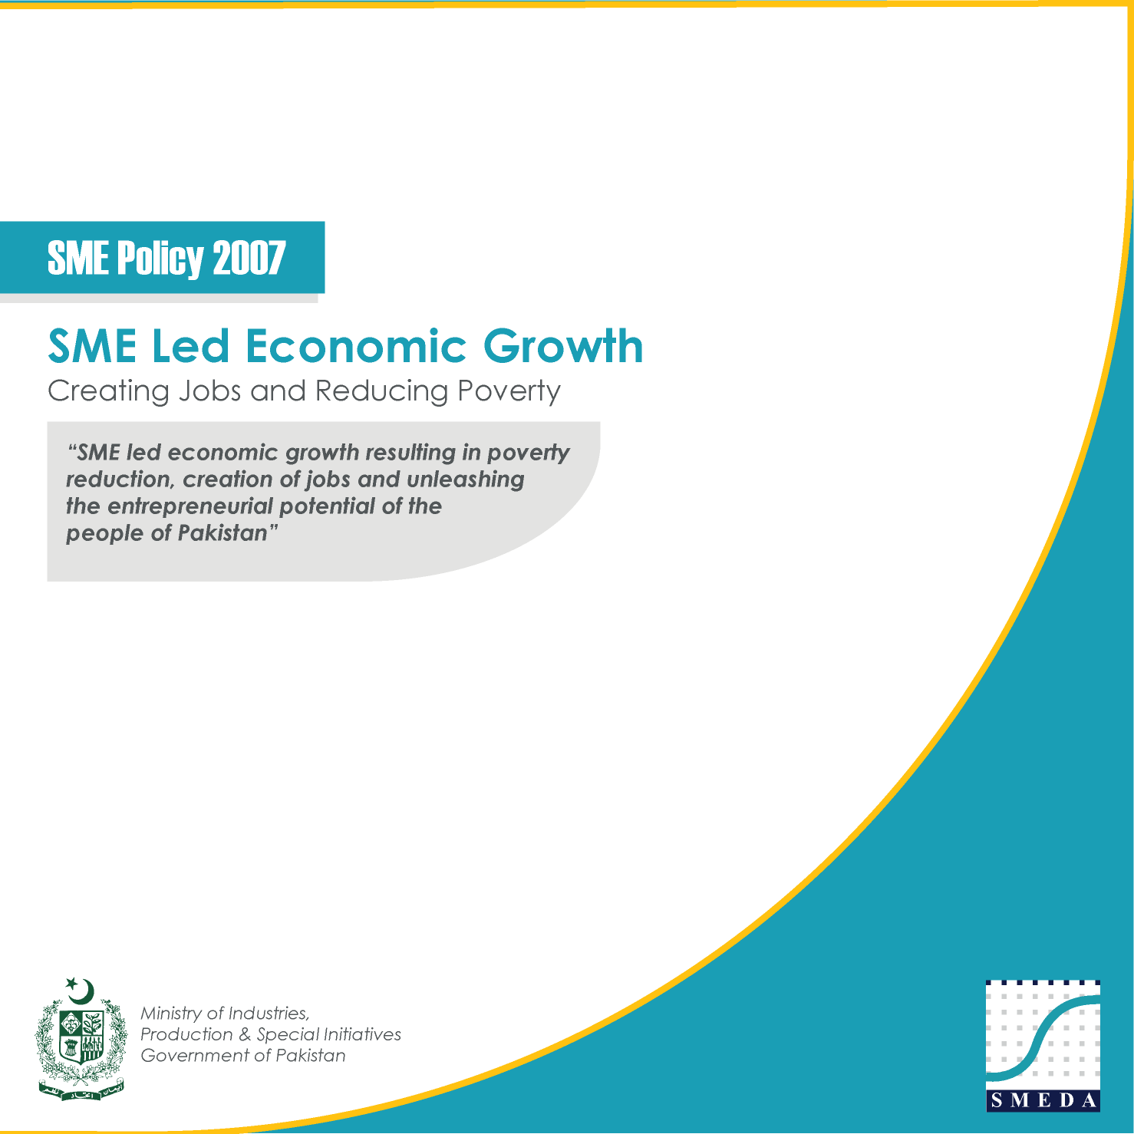
I- SME Policy Framework
Approved by Cabinet in 2007

Slide 18
Roadmap for SME development
Business Environment
Access to Finance & Related Services
Access to Resources & Services
SME Definition, Feedback, Evaluation & Monitoring Mechanism
Notes:
18

Slide 19
II. Facilitation and Support
Federal Government
Provincial Government
Prime Minister’s Secretariat
Ministry of Foreign Affairs
Commercial Offices of the Government of Pakistan
Ministry of Commerce
Ministry of National Food Security & Research
Federal Board of Revenue
Planning Commission of Pakistan
Ministry of Science & Technology
Semi-Government / Autonomous Departments across various Ministries
Punjab
Development Projects
OTCs & Business Development Services
Sindh
Development Projects
Program design & Implementation Support
Balochistan
Facilitation & Support to Balochistan Board of Investment
Khyber Pakhtuinkhwa
Policy Development Support
Collaboration with Economic Zones Development and Management Company, for SME facilitation

Slide 20
III. Research, Policy & Publications
Research & Policy
SME Policy 2007
SME Development Report 2008-10
SME Baseline Survey 2009
SME Genesis, Challenges & Prospects
SME Development Report 2007-08 in Urdu
SMEDA: Journey Through The Decade-An Organizational Biography
SMEDA Research Journal
SMEDA Research Report Series
New Framework for Cluster Development
SMEDA Annual Reports

Slide 21
SMEDA’s Priority Sectors
&
Cluster Development Approach

Slide 22
Regional Strategic Thrust Plans
Region/Sector | Logis. | ICT | Gems & Jewelry | Hort. | Energy | Dairy & livestock | Const | Fisheries (Marine) | Light Engg. | Leather | Textile | Mineral | Tour
Punjab | ✓ | ✓ | ✓ | ✓ | ✓ | ✓ | ✓ | ✗ | ✓ | ✓ | ✓ | ✓ | ✗
Sindh | ✓ | ✓ | ✓ | ✓ | ✓ | ✓ | ✓ | ✓ | ✓ | ✓ | ✓ | ✓ | ✗
KPK | ✓ | ✓ | ✓ | ✓ | ✓ | ✗ | ✓ | ✗ | ✓ | ✗ | ✗ | ✓ | ✓
Bal. | ✓ | ✗ | ✓ | ✓ | ✗ | ✓ | ✗ | ✓ | ✗ | ✓ | ✗ | ✓ | ✗
GB | ✓ | ✗ | ✓ | ✓ | ✓ | ✗ | ✗ | ✗ | ✗ | ✗ | ✗ | ✓ | ✓
AJK | ✗ | ✗ | ✓ | ✓ | ✓ | ✗ | ✓ | ✗ | ✗ | ✗ | ✗ | ✓ | ✓
FATA | ✓ | ✗ | ✗ | ✓ | ✗ | ✗ | ✗ | ✗ | ✗ | ✗ | ✗ | ✓ | ✗
Total | 6 | 3 | 6 | 7 | 5 | 3 | 4 | 2 | 3 | 3 | 2 | 7 | 3
Complete Value Chain Analysis & Implementation of Interventions across Sectors

Slide 23
SMEDA Cluster Development Approach
Identification of SME Cluster
Meetings with CCIs, TAs, Cluster Key Players and Support Institutions
Need Assessment for Cluster
Meetings, Workshops/seminars and Surveys
Proposal Development
Data collection, Specifications, Inputs from experts & consultants, Financial estimations, Draft proposal preparation, Proposal validation and Final proposal
Project Implementation
Proposal submission with funding agency for implementation
Establishment of Board of Management
Project Monitoring
Marketing and promotion of center

Slide 24
Development Programme (PSDP)
Catalyzing SME Development through;
Demonstration of new technologies
Common Facility Centers for:
Proto-type Product Development
Design facilities
Training Services
Market Linkages
Business Incubation
Projects planned in close consultation with private sector (Chambers / Associations)
Implementation through Private Sector Board Members
Notes:
24

Slide 25
PSDP Funded Project Sports Industries Development Center, Sialkot
Successfully Manufactured approx. 580,000 different sports items including:
500,000 bladders
55,000 thermo balls
25,000 basketballs
Approx. 100,000 + Yarn Winding with Latex
Soccer Ball manufactured by SIDC was approved by FIFA
ISO 9001, 2008 certifications obtained
Providing services of Laboratory and Workshop
Manpower skills training in collaboration with TEVTA and PVTC / NAVTTC
Cont…

Slide 26
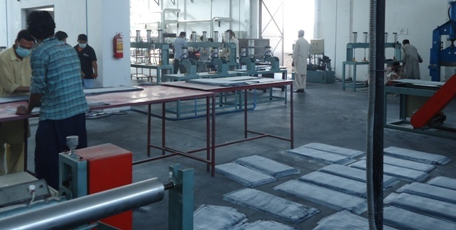
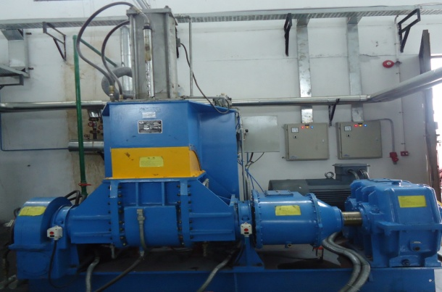
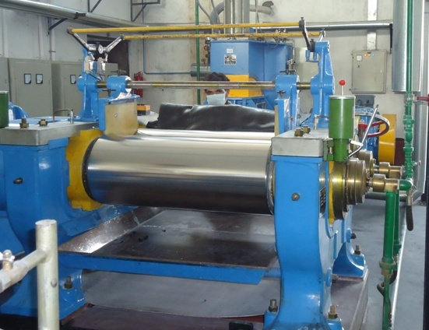
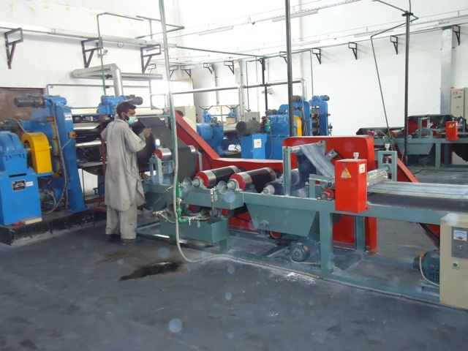
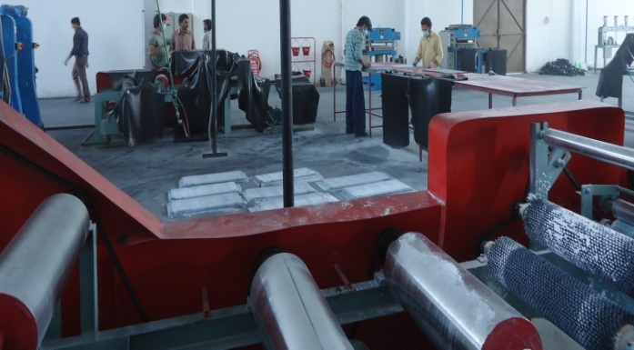
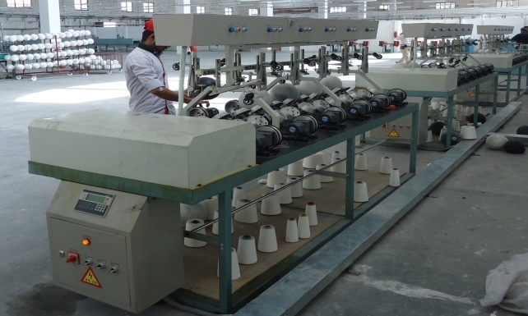
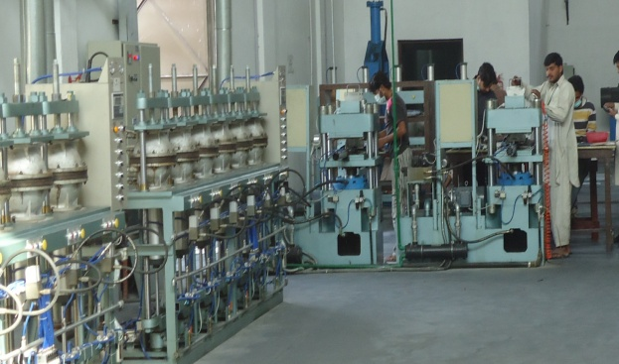
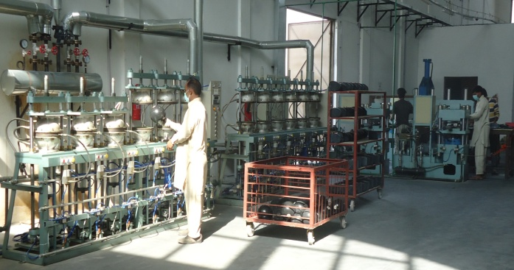
SIDC - Picture Gallery
Cont…

Slide 27
Provision and Facilitation of Services

Slide 28
SME Facilitation
Walk-ins Facilitation
Investment Facilitation
Business Development Services
Business Plans
Pre-Feasibilities
Cluster / Sector Profiles
Training Programs
Provision of Legal Services
Awareness Workshops on SME Financing
Establishment of Service Providers Networks
Cont…

Slide 29
Industry Support Program
Foreign Experts Engaged: 52
Companies Facilitated: 505
Production Efficiency Improvement 331
Energy Efficiency 158
Environment / Green Productivity 16
Training Workshops / Seminars: 165
Best Practices Reports / Training Manuals: 6
Major Sectors:
Textile Light Engineering
Auto Parts Foundry
Footwear Sports Goods
Fan Food Processing
Marble Chemical
Forging Steel Re-rolling

Slide 30
SME Support Publications
SME Guides
SMEDA Newsletter – Quarterly
SME Observer – Quarterly (Over 75 Research articles published)
Intellectual Property Rights Series (5 WIPO’s Booklets)
Investment Guides – Balochistan, Punjab and KPK
Secrets of E-Commerce - A Guide for Small & Medium Entrepreneurs
Trade Secrets – The Export Answer Book for SME Exporters
Trade in Services – An Answer Book for SME Exporters
How to Approach Banks
Accounting Handbook for SMEs

Slide 31
Development Partners
Multilateral Donors
International Agencies
Asian Development Bank
SME Sector Development Program
Rural Modernization Project (AHAN)
The World Bank
ICA I & II
ERKF
USAID
Pakistan Initiative for Strategic Development and Competitiveness (PISDAC)
EP- Firms
ASP-RSP
UNDP
Pro-Gole
Early Recovery
UNIDO
Cluster Development Program (Diagnostic Studies)
Investment Promotion Unit
ILO
Research Studies (women entrepreneurship and WIN website)
European Union
TRTA Cluster Studies
OIC /ICCI
Hosted Meeting and TOT Programs
WIPO
IPR publications & awareness
JICA
Industry Support Program through Senior Volunteers, JICA Experts (for reducing Energy and Production inefficiencies)
ITC, Geneva
Adaptation of Publications (Trade Secrets etc)
Seminars
SES, GIZ, Bfz, Germany
Energy Efficiency & Renewable Energy
KOSGEB, Turkey
Investment & Trade Promotion
SEHDA, Mauritius
Trade Delegations
CBI, Netherlands
Export Couching Programs , Productivity Enhancement Programs , CSR for Industry
Regional Networking
SAARC Trade Promotion Network, ECO, D-8 and Heart of Asia, SCO

Slide 32
Value Chains in Focus
1
2
3
BDS
Policy
Lbr.
Fin.
Tax
1
2
3
Gap
R&D
Domestic Value Chain
Global Value Chain
Cert.
Enhanced
Value
Greater Integration in Global Supply Chains

Slide 33
Future Programs

Slide 34
SMEDA’s SME Development Plan – Key Pillar of Vision 2025

Slide 35
SME Development
Vision
Growth of globally competitive SME sector,
through a conducive environment and
support services, serving as an engine of sustainable growth
for national economy
Goal
New Jobs
Value Addition in
GDP
New Enterprises &
Increasing Scale
Exports
Strategy
Policy Advocacy
Sector Development
Entrepreneurial
Ecosystem Dev.
Access to Finance
E-Enablement
Business Dev.
Services
Institutional
Support
Partnerships
Effective
Coordination
Reliable
Database
Monitoring &
Evaluation

Slide 36
Thank You

Slide 37
SMEDA’s PSDP Portfolio (Since 2006)
PKR Million
Completed Projects (16) | 1,895.13
Operational/ Under Execution Projects (07) | 706.13
Non funded / closed Projects (4) | 171.71
Total (27 projects) | 2,772.97
Contribution by Private Sector & Provincial Govt. | 1,047.15
Total Portfolio | 3,820.12
Cont…
Notes:
37

Slide 38
 | Interventions | Government Priorities | Cost (Rs. Mil)
1 | Sports Industries Development Center (SIDC) Sialkot | Sports Goods Sector Dev. Technology Up-gradation Common Facility Center | 435.64
2 | Sialkot Business and Commerce Centre (SBCC), Sialkot | Infrastructure Dev. SME Sector Dev. Common Facility Center | 341.67
3 | Foundry Service Center (FSC), Lahore | Engineering Sector Dev. Technology Up-gradation Common Facility Center | 206.31
4 | Agro Food Processing Facilities (AFP), Multan | Horticulture Sector Dev. Technology Up-gradation Common Facility Center | 207.73
cont…

Slide 39
 | Interventions | Government Priorities | Cost (Rs. Mil)
5 | Women Business Incubation Center - Quetta | Women Entrepreneurship Dev. Common Facility Center | 58.08
6 | Women Business Incubation Center - Karachi | Women Entrepreneurship Dev. Common Facility Center | 58.84
7 | Red Chilies Processing Centre, Kunri | Agriculture Sector Dev. Technology Up-gradation Common Facility Center | 244.70
8 | Women Business Development Center (WBDC) Peshawar, Khyber Pakhtunkhwa | Women Entrepreneurship Dev. Common Facility Center | 28.41
9 | Revival of Cutlery Institute of Pakistan | Cutlery Sector Technology Up-gradation Common Facility Center | 39.84
cont…

Slide 40
 | Interventions | Government Priorities | Cost (Rs. Mil)
10 | Women Business Development Center (WBDC) Mingora Swat, Khyber Pakhtunkhwa | Women Entrepreneurship Dev. Common Facility Center Regional Dev. | 35.01
11 | CFTC for Light Engineering Cluster, Mardan | Engineering Sector Dev. Technology Up-gradation Common Facility Center | 39.98
12 | Establishment of Spinning CFC at Islampur, Swat Khyber Paktunkhwa | Regional / Rural Dev. Technology Up-gradation Common Facility Center | 29.69
13 | Establishment of CFC for Honey Processing & Packaging at Swat | Regional Dev. Value addition Common Facility Center | 38.17
cont…

Slide 41
 | Interventions | Government Priorities | Cost (Rs. Mil)
14 | CFC for Silk Cluster, Swat Khyber Paktunkhwa | Regional Dev. Value addition Common Facility Center | 57.53
15 | SMEDA SME Facilitation Complex at PITAC, Lahore | Better Service Delivery for SMEs | 57.20
16 | Revival of Hyderabad Leather Footware Centre, Hyderabad | Value addition Common Facility Center | 58.89
17 | Glass product Design and Manufacturing Centre, Hyderabad | Value addition Common Facility Center | 59.27
18 | SME Subcontracting Exchange at Gujranwala | SME Sector Dev. Value Chain Integration | 26.09
Cont…

Slide 42
 | Interventions | Government Priorities | Cost (Rs. Mil)
19 | Spun Yarn Research & Development Company, Multan | Regional Dev. Value addition Common Facility Center Technology Upgradation | 59.75
20 | Juice Producing & Packaging Line for Fresh Fruits & Vegetables, Multan | Value addition Common Facility Center | 59.00
21 | Leather Crafts Development Company | Value addition Technology Upgradation | 214.00
22 | Gujranwala Business Center | Common Facility Center Business Development Market Linkages | 98.78
23 | Khadi Crafts Development Company, Multan | Cluster Development | 230.00
Cont…

Slide 43
 | Interventions | Government Priorities | Cost (Rs. Mil)
24 | Policy & Project Implementation, Monitoring & Evaluation Unit | SME Sector Development | 25.82
25 | Chromite Beneficiation Plan, Khanozai | Common Facility Center Technology Upgradation Regional Development | 24.66
26 | Washing & Pressing Unit, Matta Mughal Khel | Value addition Common Facility Center | 5.38
27 | Women Business Incubation Center, Lahore | Women Entrepreneurship Development Common Facility Center Business Development Services | 59.59

Slide 44
SMEDA’s BDS Services
Sr. No. | Initiative | Achievements
1 | SME Facilitation | 102,402
2 | Business Plan | 381
3 | Training Programs | 2,558
4 | Investment Facilitation | PKR 29.26 Billion
5 | Industry Support | 525 firms
6 | Sector Strategies | 33
7 | Demonstration Projects | 27

Slide 45
SMEDA’s BDS Services
Development & Downloads of Products & Services:
Sr. No. | Product | Number | Download
1. | Pre-Feasibility Studies | 192 | 2.335 Mn
2. | Regulatory Procedures | 37 | 0.41 Mn
3. | Commercial Contracts | 319 | 0.168 Mn
4. | Cluster Profiles / Diagnostic Studies | 42 | 183,280
5. | District Economic Profiles | 31 | 31,384
6. | SMEDA Accounting Package | 1 | 31,816
SMEDA Web Portal
Total No. of Visitors: 10,408,893
Avg. Visitors per day: 2,193

Slide 46
Development Projects
Projects with International Development Partners:
Economic Revitalization of Khyber Pakhtunkhwa and FATA - Multi Donors Trust Fund (MDTF)
Investment Promotion Unit (IPU) – UNIDO/Italian Govt.
Early Recovery & Restoration of Flood Affected Communities – UNDP

Slide 47
Collaboration with International Development Partners
On-Going Initiative
Economic Revitalization of Khyber Pakhtunkhwa & FATA – Multi Donor Trust Fund managed by the World Bank
1,568 Business Rehabilitated/Upgraded
1,353 SMEs already revitalized, 23000+ jobs created
Approval granted to 1,670 SMEs against target of 850
Component | Amount Approved (Rs) | No of Grants Approved (No) | Amount Disbursed (Rs.) | No of Grants Disbursed
FATA | 458,302,495 | 408 | 442,852,495 | 401
Rehabilitation | 442,623,349 | 385 | 428,173,349 | 379
Upgradation | 15,236,771 | 20 | 1,4236,771 | 19
CB & BDS | 442,375 | 3 | 442,375 | 3
Khyber Pakhtunkhwa | 902,737,227 | 1262 | 838,640,413 | 1,167
Rehabilitation | 744,066,334 | 1014 | 708,317,234 | 974
Upgradation | 148,144,493 | 182 | 123,050,729 | 151
CB & BDS | 10,526,400 | 66 | 7,272,450 | 42
Grand Total | 1,361,039,722 | 1,670 | 1,281,492,908 | 1,568

Slide 48
Investment Promotion Unit – UNIDO
Feasibility Study on Establishing Credit Guarantee Fund for SMEs
Consultative workshops with key stakeholders organized in April & May 2015
SPX Program - Joint Project of UNIDO and SMX SMEDA
28 Investment Profiles developed & Uploaded on UNIDO ITPO Network
4 Training Programs conducted by international Trainers, where 130 staff from Partner Organizations participated
Facilitated B2B for Pakistani trade delegation in “EIMA 2014”- The largest Italian show of Agri & Food Processing Machinery
Facilitated B2B Pakistani trade delegation in “ECOMONDO 2014”, the waste management & Technologies Fair
Facilitated B2B Pakistani trade delegation in “MACFRUT 2014”, the Fruit & Vegetable Processing & Technologies Fair

Slide 49
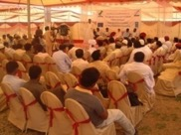
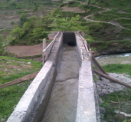
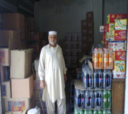
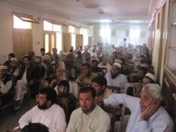
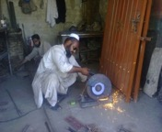
Early Recovery & Restoration of Flood Affected Communities
Provision of Cash Grants
Enterprise Rehabilitation Grants (Rs.30,000 Each)
Distributed | Rs. 82.50 Million to Livestock trading, furniture making, Mini Flour Mills etc.
2,750
 | Abdul Manan, Shangla Repair of water channel of Micro Hydro Power Unit swept away in floods. Grant ID: k-SHG-68
Livelihood Restoration Grants (Rs.12,200 Each)
Distributed | Rs. 32. 15 Million to Females engaged in micro farming, needle crafts micro and livestock.
2,881
 | Name: Haji M. Zada District: Dir Upper Restoration and expansion of retail store damaged by the floods. Grant ID: K-DUP-53
Cooperative Grants (Rs.7,120 Each)
Distributed | Rs. 49.29 Million to Destitute selected on the basis of poverty score.
5,940
 | Name: Noor ul Islam District: Nowshehra Purchase of electric cutter and grinder for his welding shop. Grant ID: K-NSW-87

