Slide 1
SUPPORTS and SERVICES
Recep BİÇER
President
ADFIMI – Oman Development Bank Joint Regional Seminar
on «SME Development», 14 February 2017, OMAN

Slide 2
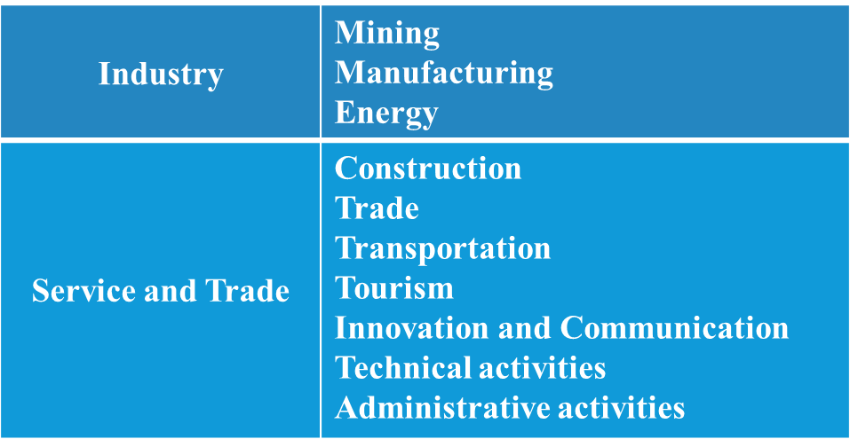
General Information About KOSGEB
KOSGEB was established in 1990.
The aims of KOSGEB are;
To increase the share and effectiveness of SMEs
To strengthen competitive power of SMEs
To realize the integration in industry in accordance with economic developments to meet social and economic needs of Turkey.
KOSGEB is an affiliated body of the Ministry of Science, Industry and Technology.
KOSGEB target groups are SMEs operating in the sectors of;

Slide 3
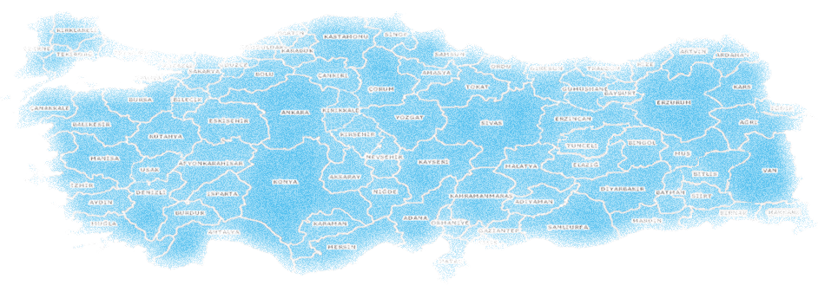
KOSGEB Service Networks
In 81 Cities
88 Branches
32 Technology Development Centers (TEKMER)
87 R&D and Innovation Cooperation with Universities
The number of SMEs registered in KOSGEB database : 1 Million TL
Number of SMEs which submit annual SME Decleration: 278 Thousand TL
Number of Supported SMEs (2016) : 40 Thousand TL
Support Budget (2016) : 991 Million TL
* 1 USD is approx. 3.5 TL

Slide 4
SME Definition in Turkey
Less than 250 employees
Less than 11 million USD annual net sales or balance
Type | Employees | Revenue (million USD) | Net Sales (million USD)
Micro | <10 | ≤ 0.285 | ≤ 0.285
Small | <50 | ≤ 2.3 | ≤ 2.3
Medium | <250 | ≤ 11 | ≤ 11

Slide 5
The Importance of SMEs
The share of SMEs in economy;
Total enterprises %99,83
Total employment %73,5
Total value added %53,5
Total sales %62,5
Total investments %55
Total exports %55,1
%99,83 (3.578.807)
%0,17 (6.025)
Scale Distribution
0,9
Medium(50-249)
1-249 Total SMEs
5,4
Small (10-49)
250+ Large Entreprises
93,6
Micro (1-9)
Source: BDDK ; TUİK , 2014

Slide 6
KOSGEB Supports and Services
Support Programmes
Financial Supports
Laboratory Services
Information, Cooperation and Projects
10 Support Programmes
Loan Interest Supports
12 Laboratories
68 MOUs with 61 counterpart organizations from 51 countries, 2 international non-governmental organizations and 3 international organizations,
47 inhouse Projects, 38 Occasional Organisation Projects

Slide 7
KOSGEB SUPPORT PROGRAMMES
R&D, INNOVATION AND INDUSTRIAL IMPLEMENTATION SUPPORT PROGRAMME
Aim of the Program:
Supporting innovative activities
Commercializing the results of R&D and innovation projects
Support Upper Limit: 768 Thousand TL (grant)
800 Thousand TL (reimbursable)
Support Ratio: 75%
COOPERATION - COLLABORATION SUPPORT PROGRAMME
Aim of the Program:
Producing common solutions to common problem in SMEs
Developing cooperation culture in SMEs.
At least 5 enterprises come together and form a partnership
In medium high and high technology areas, at least 3 enterprises come form a partnership
Support Upper Limit: 300 Thousand TL (grant)
1.2 Million TL (grant)
Support Ratio: Varies between 50%, 60% or 70% according to the economic development level of the region

Slide 8
KOSGEB SUPPORT PROGRAMMES
KOBİGEL- SME DEVELOPMENT SUPPORT PROGRAMME
Call based project support programme.
KOSGEB determines the title, context and target sector of the call
Support Upper Limit: 300 Thousand TL (grant)
700 Thousand TL (reimbursable)
Support Ratio: Varies between 60% or 80% according to the economic development level of the region
GENERAL SUPPORT PROGRAMME
Not Project based program. SMEs benefit from supports directly by application
15 sub-supports
Support Upper Limit: 470 Thousand TL (grant)
Support Ratio: Varies between 50%, 60% or 70% according to the economic development level of the region

Slide 9
KOSGEB SUPPORT PROGRAMMES
ENTREPRENEURSHIP SUPPORT PROGRAMME
New Entrepreneur Support, Applied Entrepreneurship Training
İŞGEM (Business Incubator) Support, Business Plan Award
Support Upper Limit: 50 Thousand TL (grant)
100 Thousand TL (reimbursable)
Support Ratio: Varies between 60% or 90% according to the economic development level of the region
Support rates increase 10% if the case of women or disabled entrepreneurs
THEMATIC PROJECT SUPPORT PROGRAMME
Supporting projects prepared by Professional Organizations for the needs of their members
Support Upper Limit: 150 Thousand TL (grant)
Support Ratio: Varies between 50% or 60% according to the economic development level of the region

Slide 10
KOSGEB SUPPORT PROGRAMMES
EMERGING ENTERPRISES MARKET SME SUPPORT PROGRAMME
Providing opportunity for SMEs to procure funds from capital markets
Support Upper Limit: 100 Thousand TL (grant)
Support Ratio: Between 75-100%
INTERNATIONAL INCUBATION CENTER AND ACCELERATION SUPPORT PROGRAMME
International Incubation Center Support
Support Upper Limit: 3.85 Million USD (grant)
Support Ratio: Between 75-100%
Accelerator Support
Support Upper Limit: 60 Thousand USD (grant)
Support Ratio: 80%
TECHNOLOGIC PRODUCT PROMOTION AND MARKETING SUPPORT PROGRAMME
Ensuring the promotion and marketing of technologic products & prototypes
Support Upper Limit: 150 Thousand TL
Support Ratio: 100%

Slide 11
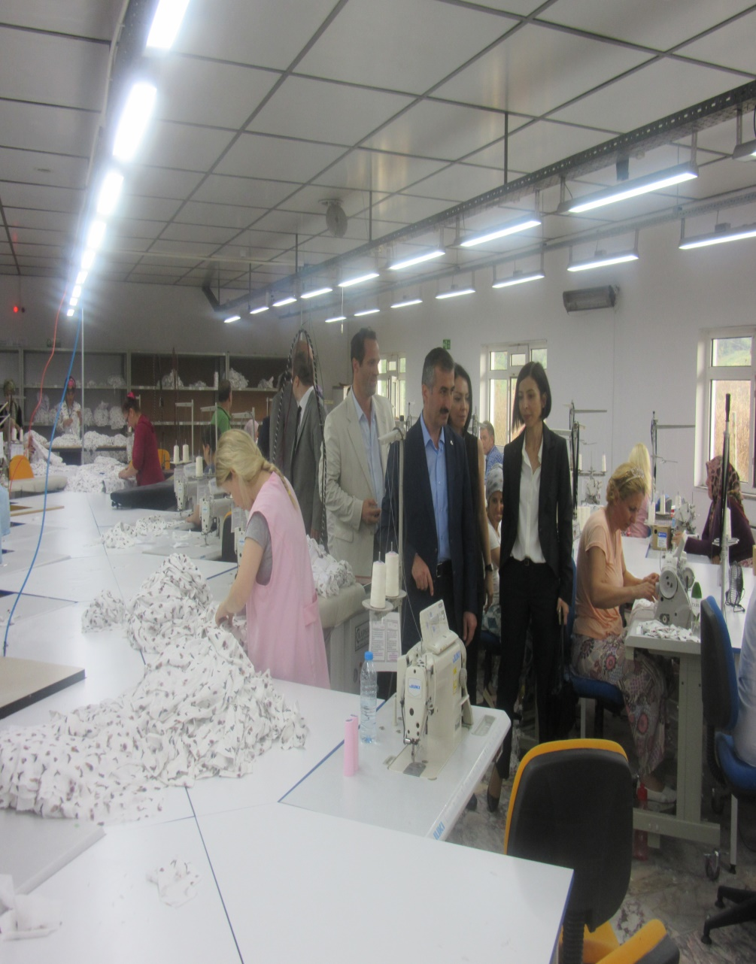
Started Spectecularly with KOSGEB Support

Slide 12
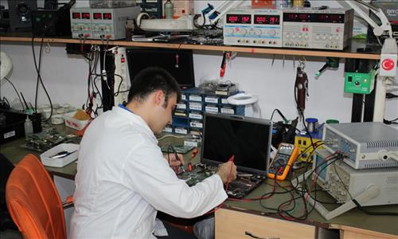
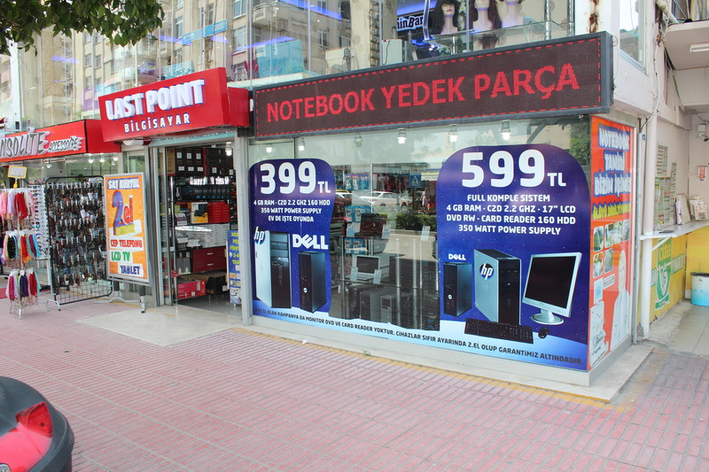
Created Spare Parts Pool from Waste Computers with KOSGEB Support

Slide 13
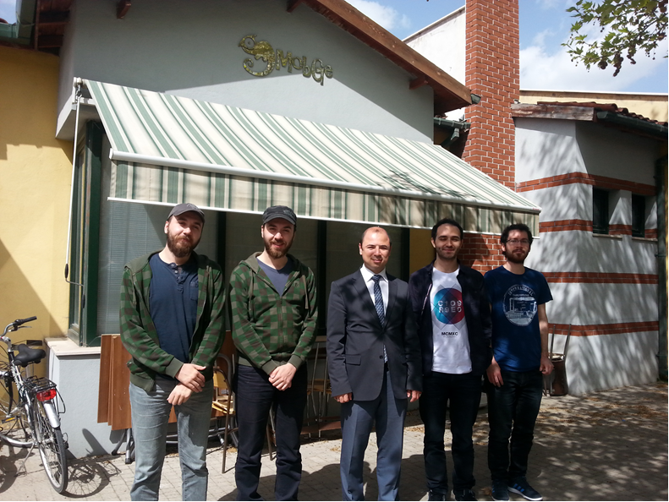
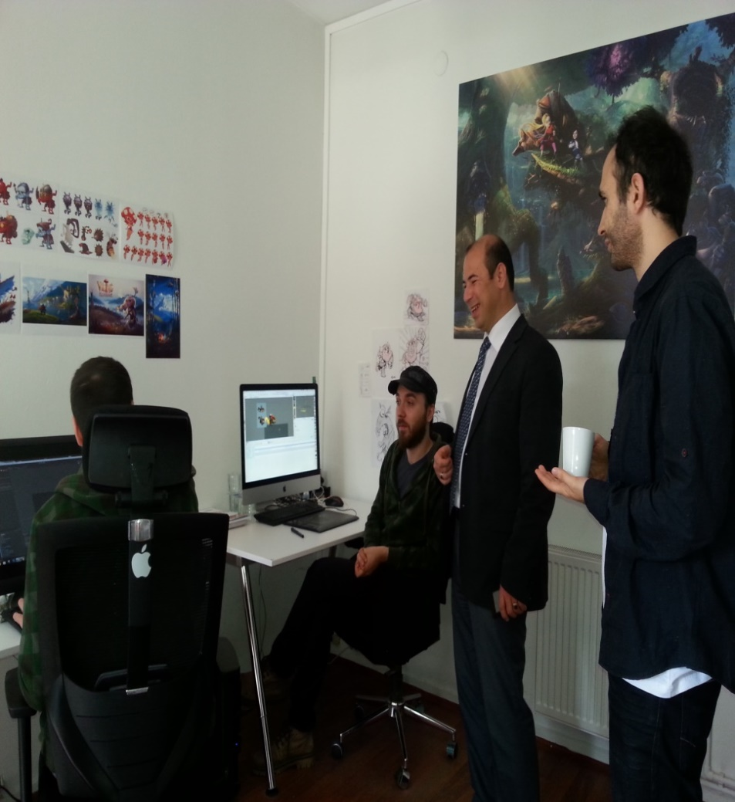
R&D, INNOVATION AND INDUSTRIAL IMPLEMENTATION SUPPORT SUCCESS STORIES
Students from Bilkent University Designing Games with R & D Support…

Slide 14
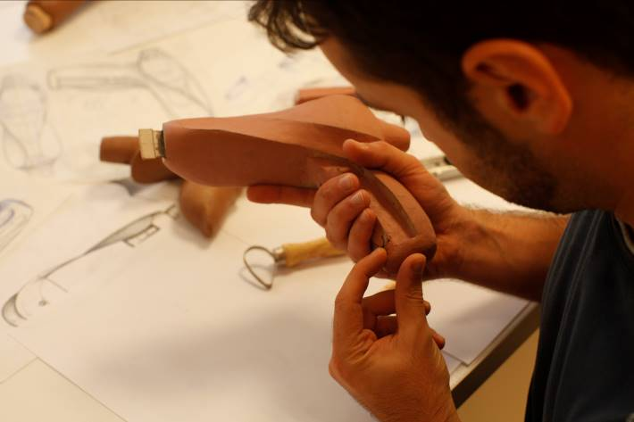
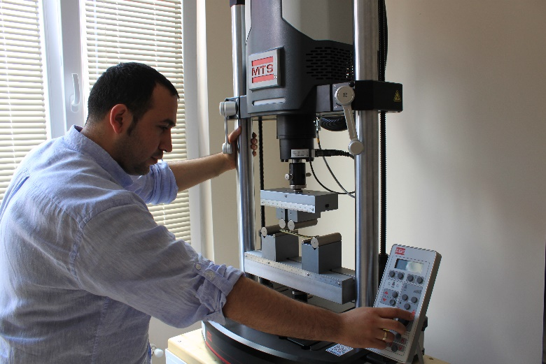
"Computer Assisted Bone Deviation Correction System" Supported by KOSGEB…

Slide 15
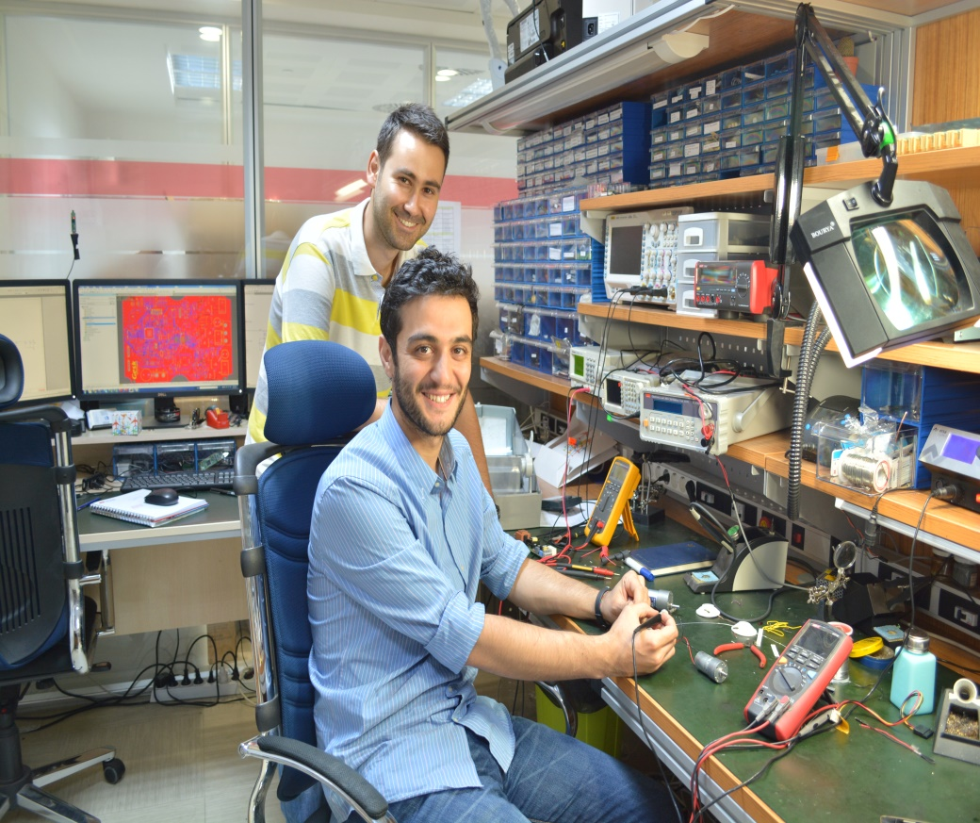
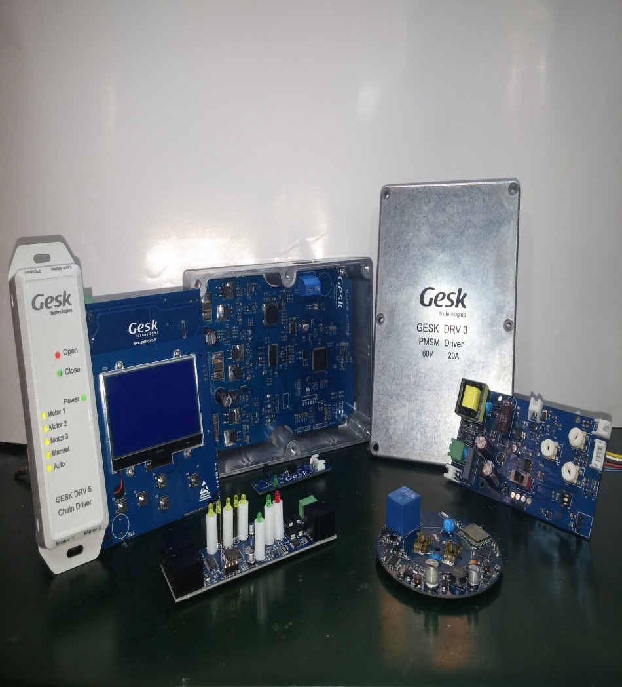
They Realized Their Dreams with KOSGEB, they Continue with KOSGEB

Slide 16
THANK YOU
شكرا

