Slide 1



ADFIMI – Oman Development Bank Joint Regional Seminar on
“SME DEVELOPMENT”
Overview of Incubation, Entrepreneurship
and SMEs Development in Bahrain
Dr. Abdulhasan Al-Dairi
Chairman, Bahrain SMEs Society
Founding Board Member, Union of GCC Entrepreneurs
Email: bahrainsmes@gmail.com – Web: www.bsmes.net
13-15 February 2017, Muscat, Oman

Slide 2
جمعـيــة المؤسـسـات الصغـيرة والمتوسـطـة البحــريـنـية
Bahrain Small & Medium Enterprises (SMEs) Society
Member of Arab Union for Small Enterprises عضو الاتحاد العربي للمنشآت الصغيرة
AGENDA:
Overview of Incubation, Entrepreneurship and SMEs Development in Bahrain
Challenges faced and Successes
Cross-Border Cooperation with other GCC countries
Overview of the Incubation in Bahrain
The Role of Bahrain SMEs Society – Video

Slide 3
جمعـيــة المؤسـسـات الصغـيرة والمتوسـطـة البحــريـنـية
Bahrain Small & Medium Enterprises (SMEs) Society
Member of Arab Union for Small Enterprises عضو الاتحاد العربي للمنشآت الصغيرة
Overview of Incubation, Entrepreneurship and SMEs Development in Bahrain- I
Definition:
“Entrepreneurship is the combination of initiative, innovation and calculated risk-taking, associated with identifying market opportunities, mobilizing resources, and managing them efficiently in the operation of productive, viable, and socially responsible enterprises” -ILO
“Entrepreneur is a person who starts his own business.. An Inventor, Contractor or a Broker”.

Slide 4

جمعـيــة المؤسـسـات الصغـيرة والمتوسـطـة البحــريـنـية
Bahrain Small & Medium Enterprises (SMEs) Society
Member of Arab Union for Small Enterprises عضو الاتحاد العربي للمنشآت الصغيرة
Overview of Incubation, Entrepreneurship and SMEs Development in Bahrain- II

Slide 5
جمعـيــة المؤسـسـات الصغـيرة والمتوسـطـة البحــريـنـية
Bahrain Small & Medium Enterprises (SMEs) Society
Member of Arab Union for Small Enterprises عضو الاتحاد العربي للمنشآت الصغيرة
Overview of Incubation, Entrepreneurship and SMEs Development in Bahrain- III
SMEs Support Agencies in Bahrain *
Ministry of Industry & Commerce*
Ministry of Labor & Social Development
Economic Development Board (EDB)
Bahrain Development Bank (BDB)
Ebda’a Bank
Family Bank
Standard Chartered Bank
HSBC Bank
Tamkeen
Labor Market Regulatory Authority (LMRA)
Supreme Council for Women
Bahrain Chamber of Commerce & Industry (BCCI)
United Nation Development Program (UNDP)
United Nation Industrial Development Organization (UNIDO)
Bahrain Training Institute (BTI)
University of Bahrain
Bahrain Polytechnic
Bahrain SMEs Society
Bahrain Entrepreneurs Society
Bahrain Family Business Society
Bahrain Businessmen Society
Bahrain Businesswomen Society
BDO Jawad Habib
Ernst & Young
KPMG Fakhro
Talal Abu Ghazalah University
Bahrain Business Incubator Centre (BBIC)
Bahrain Investment Centre (One-Stop Shop)
MENA Investment Centre
Business & Professional Women Club
Ebtikar Bahrain Association
CH9 Business Accelerator Centre (New)
C5 Technology Accelerator (New)
*Source: Bahrain SMEs Society, 2016

Slide 6
جمعـيــة المؤسـسـات الصغـيرة والمتوسـطـة البحــريـنـية
Bahrain Small & Medium Enterprises (SMEs) Society
Member of Arab Union for Small Enterprises عضو الاتحاد العربي للمنشآت الصغيرة
Overview of Incubation, Entrepreneurship and SMEs Development in Bahrain- IV
Definition of SMEs in Bahrain*
Category | Number of Employees | Capital Investment / Annual Turnover (BD)
Micro | Up to 10 | Up to 20,000/ 100,000
Small | 11 - 50 (for construction sector up to 100) | 20,001 – 500,000 / 100,001 - 500,000
Medium | 51 - 150 (for construction sector up to 250) | 500,001 – 2m / 500,001 - 5m
* Source: Ministry of Industry & Commerce, Kingdom of Bahrain

Slide 7
جمعـيــة المؤسـسـات الصغـيرة والمتوسـطـة البحــريـنـية
Bahrain Small & Medium Enterprises (SMEs) Society
Member of Arab Union for Small Enterprises عضو الاتحاد العربي للمنشآت الصغيرة
2. Challenges faced and Successes- I
Percentage in terms of Number of Enterprises
Sector | Bahrain* | EU Countries
Micro | 92.07% | 92.2%
Small | 6.66% | 6.5%
Medium | 1.07% | 1.1%
Large | 0.2% | 0.2%
* Source: Labour Market Regulatory Authority, Kingdom of Bahrain

Slide 8
جمعـيــة المؤسـسـات الصغـيرة والمتوسـطـة البحــريـنـية
Bahrain Small & Medium Enterprises (SMEs) Society
Member of Arab Union for Small Enterprises عضو الاتحاد العربي للمنشآت الصغيرة
2. Challenges faced and Successes- II
Contribution of the SMEs Sector to GDP
Country | % Contribution to GDP
Luxembourg | 76.30
Portugal | 67.25
Spain | 64.70
France | 61.80
Panama | 60.12
UAE | 60.00
Italy | 58.50
Canada | 57.20
Country | % Contribution to GDP
Hungry | 56.80
Indonesia | 56.70
Denmark | 56.70
Japan | 56.42
Peru | 55.50
Argentina | 53.65
UK | 51.45
Netherlands | 50.00
Country | % Contribution to GDP
USA | 48.00
Poland | 48.00
Korea Rep | 45.90
El Salvador | 44.05
Romania | 42.73
Germany | 42.50
Bahrain | 23.00

Slide 9
جمعـيــة المؤسـسـات الصغـيرة والمتوسـطـة البحــريـنـية
Bahrain Small & Medium Enterprises (SMEs) Society
Member of Arab Union for Small Enterprises عضو الاتحاد العربي للمنشآت الصغيرة
2. Challenges faced and Successes- III
Contribution of the SMEs Sector to Employment
The SME Sector makes up 77% of the total jobs in the private sector (67.4% in EU Countries)
  86% Non-Bahraini
  14% Bahraini

Slide 10
جمعـيــة المؤسـسـات الصغـيرة والمتوسـطـة البحــريـنـية
Bahrain Small & Medium Enterprises (SMEs) Society
Member of Arab Union for Small Enterprises عضو الاتحاد العربي للمنشآت الصغيرة
2. Challenges faced and Successes- IV
Foreign Workers in SMEs Sector
2005 100,000 employees
2015 375,417 employees
(only 53,390 Bahraini)

Slide 11

2. Challenges faced and Successes- V
Resistance to
Change
Lack of skills, R&D
and Training
Business case
Is not clear
Challenges
Lack of policies
&
Encouraging Ecosystem
Poor Leadership

Slide 12
جمعـيــة المؤسـسـات الصغـيرة والمتوسـطـة البحــريـنـية
Bahrain Small & Medium Enterprises (SMEs) Society
Member of Arab Union for Small Enterprises عضو الاتحاد العربي للمنشآت الصغيرة
2. Challenges faced and Successes- VI
Successful Measures
Economic & Market Reforms
Establishment of Tamkeen
Establishment of Micro Finance Banks besides BDB
Establishment of Bahrain Business Incubator Centers
Tamkeen’s Scheme with 7 Private Banks (subsidized interest rate)
Establishment of Tenmou for Business Angels funding
CH 9 Accelerator’s cooperation with Seedstars Intl. for Crowd funding

Slide 13

جمعـيــة المؤسـسـات الصغـيرة والمتوسـطـة البحــريـنـية
Bahrain Small & Medium Enterprises (SMEs) Society
Member of Arab Union for Small Enterprises عضو الاتحاد العربي للمنشآت الصغيرة
3. Cross-Border Cooperation with other GCC countries

Slide 14
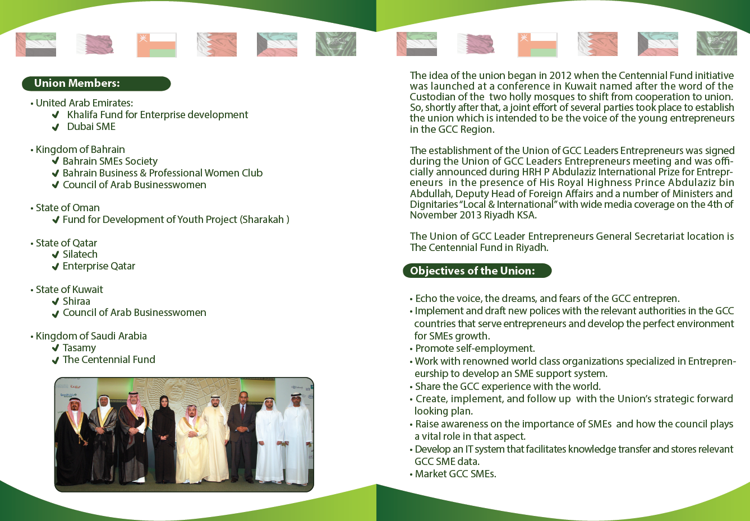
جمعـيــة المؤسـسـات الصغـيرة والمتوسـطـة البحــريـنـية
Bahrain Small & Medium Enterprises (SMEs) Society
Member of Arab Union for Small Enterprises عضو الاتحاد العربي للمنشآت الصغيرة
3. Cross-Border Cooperation with other GCC countries

Slide 15
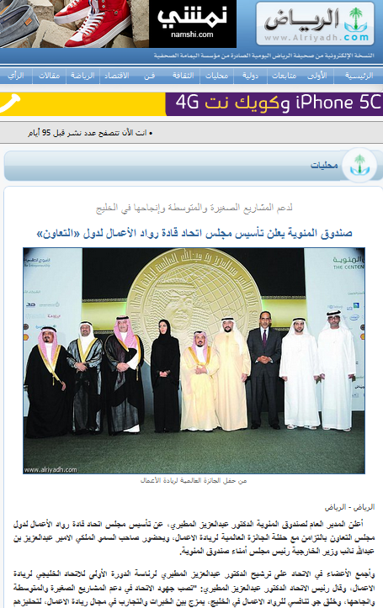

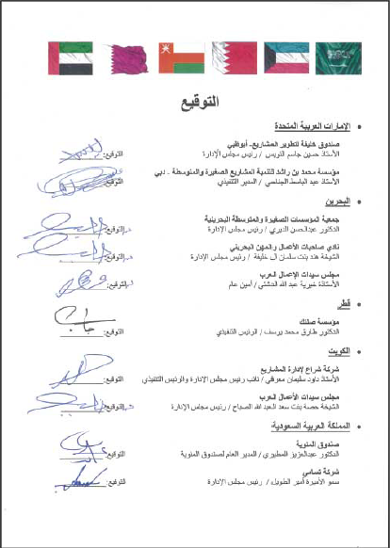





جمعـيــة المؤسـسـات الصغـيرة والمتوسـطـة البحــريـنـية
Bahrain Small & Medium Enterprises (SMEs) Society
Member of Arab Union for Small Enterprises عضو الاتحاد العربي للمنشآت الصغيرة
3. Cross-Border Cooperation with other GCC countries

Slide 16
جمعـيــة المؤسـسـات الصغـيرة والمتوسـطـة البحــريـنـية
Bahrain Small & Medium Enterprises (SMEs) Society
Member of Arab Union for Small Enterprises عضو الاتحاد العربي للمنشآت الصغيرة
4. Overview of the Incubation in Bahrain- I
*Source: Bahrain SMEs Society, 2017
Incubator | Supported by
Bahrain Business Incubator Centre (BBIC) | BDB
Reyadat Center | BDB
Capital Mall for Bahraini Products | MoLSD
Sitra Food Processing Center | MoLSD
Manama Handicraft Center | MoICT
Al Jasra Handicraft Center | MoICT
Hoorat A’ali Agro Incubator | MoWMUP
University Business Incubator | University of Bahrain*

Slide 17
جمعـيــة المؤسـسـات الصغـيرة والمتوسـطـة البحــريـنـية
Bahrain Small & Medium Enterprises (SMEs) Society
Member of Arab Union for Small Enterprises عضو الاتحاد العربي للمنشآت الصغيرة
4. Overview of the Incubation in Bahrain- II
*Source: Bahrain SMEs Society, 2017
Incubator | Supported by
Bahrain Chamber of Commerce Accelerator (In process)* | BCCI
Al Jasra Incubator Center | BPW & BASME- NGO
Farouk Business Center | Private- NGO
Wahat Baytek | Private Sector- KFH
Majal Incubator Center | Private Sector- Majal Company
CH9 Business Accelerator Centre (New) | Private Sector- CH9 Company
C5 Technology Accelerator (New) | Private Sector- C5 Company
Young Trader Mini Accelerator (New) | Private Sector & BASME- NGO

Slide 18
جمعـيــة المؤسـسـات الصغـيرة والمتوسـطـة البحــريـنـية
Bahrain Small & Medium Enterprises (SMEs) Society
Member of Arab Union for Small Enterprises عضو الاتحاد العربي للمنشآت الصغيرة
5. The Role of Bahrain SMEs Society
Video

Slide 19
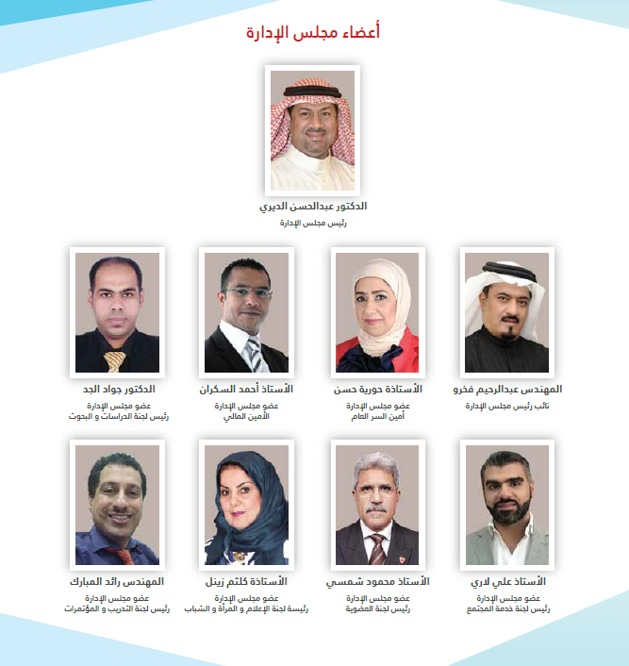
جمعـيــة المؤسـسـات الصغـيرة والمتوسـطـة البحــريـنـية
Bahrain Small & Medium Enterprises (SMEs) Society
Member of Arab Union for Small Enterprises عضو الاتحاد العربي للمنشآت الصغيرة
Our Contact Details
Bahrain SMEs Society
P O Box 18521,
Manama, Kingdom of Bahrain
Tel +973 3995 2000
Fax +973 1782 7678
E-mail bahrainsmes@gmail.com
Web www.bsmes.net

Slide 20
شكراً لكم
Thank You!
جمعـيــة المؤسـسـات الصغـيرة والمتوسـطـة البحــريـنـية
Bahrain Small & Medium Enterprises (SMEs) Society
Member of Arab Union for Small Enterprises عضو الاتحاد العربي للمنشآت الصغيرة

