Slide 1
Supporting SMEs in Kuwait
Nizamuddin Arshad

Slide 2
Disclaimer: Views expressed here are strictly personal

Slide 3
Outline
Why SMEs matter
SMEs in Kuwait
Constraints to SME Growth
Addressing the Funding Constraint
Central bank regulations and the bank lending
National Fund for SME Development
a holistic approach to facilitate the growth of SMEs
Way forward

Slide 4
Why SMEs Matter
Helping diversify the economy
Covering the otherwise 'missing middle’
Promoting economic dynamism
Creating job opportunities in the private sector

Slide 5
Why SMEs matter
SMEs in OECD
95% of enterprises
SMEs in Developing Countries
99% of enterprises
37% of the GDP
SMEs in MENAP
Between 80%-95% of formal sector enterprises
70% of employment
20-50% of private sector employment
30% of the GDP
78% of employment

Slide 6
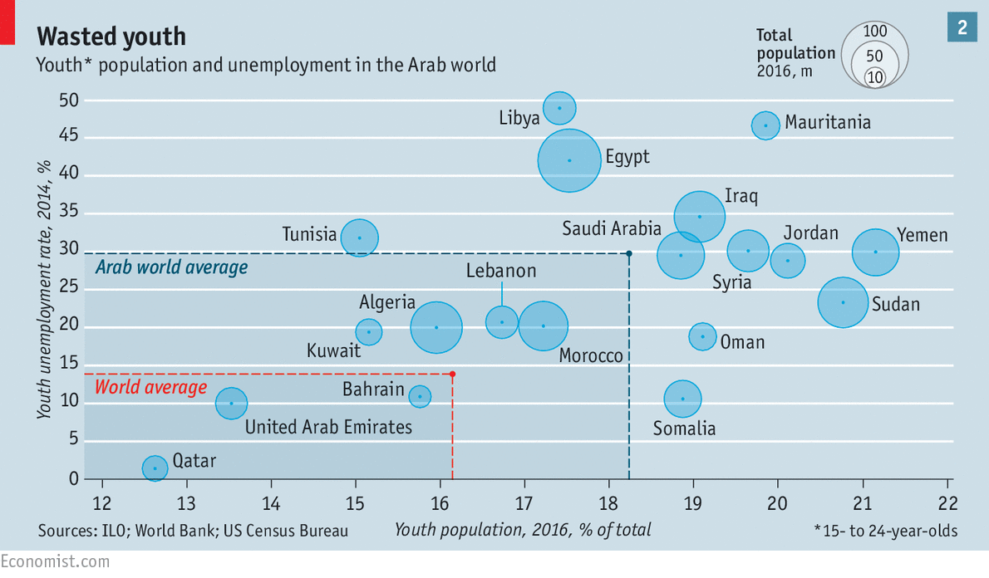
SMEs can help address youth unemployment

Slide 7
SMEs in Kuwait
94% of enterprises
23% of total work force
3% of GDP

Slide 8
SMEs in Kuwait
Share of employment by enterprise
(2002-2010)
Share of self-employed

Slide 9
Kuwait: Constraints to SMEs
Excessive Regulation
Challenges in recruiting and retaining skilled Kuwaitis
Perception and Culture
Small domestic market
Lack of access to finance
Lack of access to latest and relevant info

Slide 10
Ease of doing business: not that easy

Slide 11
Ease of doing business: not that easy
Ranking on Doing Business
Distance to frontier score

Slide 12
CBK and sME finance
Lower Risk Weight
Less Stringent Treatment
SME risk weight: 75%
Non-rated corporates’ risk weight: 100%
Less stringent regulatory treatment than personal and installment loans
Interest Rate Ceiling
Loans under 12 months; 2.5% above discount rate
Loans for more than one-year; 4% above discount rate

Slide 13
Lending to smes

Slide 14
National fund for SME development
Established in 2013
Executive regulations issued in Dec 2014
Capital of KD 2 billion
Creating jobs for Kuwaitis in the pvt sector
Increasing SME participation in economy
Creating business friendly environment for SEMs
Will finance upto 80% of capital for feasible SMPs by Kuwaiti nationals
With financing requirement that do not exceed KD 0.5 million
Eligible SMEs: employing upto 50 Kuwaiti

Slide 15
National Fund: Services
Financial & Business Support to Startups
SME Financing to Existing SMEs
Professional Management and Technical Training
Business development services
Allocation of land and office spaces for SMEs
Facilitation of market linkages
Improving business environment for SMEs

Slide 16
National Fund: achievements so far
Supporting Business
Market access
Unified Application form
9 MOUs with Govt. entities to facilitate business registration
3 year leave plan for clients who are public sector employees
Market entry mechanism for SMEs with Central Tenders Committees and MOF for government projects
SME fund and MOCI: One-Stop-Shop to reform the business registration process

Slide 17
National Fund: achievements so far
Institutional development
Kauufam Fast track
Exploring entrepreneurship
Staffing
Launch of Arabic/English website
Launch of media accounts
Q&A list
Call center
Allocation of sites of Hubs
Entrepreneurship Capacity building and support program
2 Groups
60 Graduates
Exploring entrepreneurship
5 Groups
137 Graduates

Slide 18
National Fund: achievements so far
Toolkit
Dev. Entrepreneurial culture
Financial Services
SME Toolkit: collaboration with IFC
Start a new business
Create a business plan
Managing financials
Story telling platform
Mix N’ Mentor: Kuwait Edition
59 projects approved

Slide 19
A final thought How to make the horse Drink?
What is next?
Holistically facilitating SMEs through NF
Encouraging banks to lend

Slide 20
Thank you

