Slide 1

Non-Financial Advisory Services
Imran Ahmad
Infrastructure, Housing & SME Finance Department
State Bank of Pakistan

Slide 2
Developmental Role of SMEs
  Employment Opportunities (esp. new jobs)
  SMEs are Labs of Innovation
  SMEs are promoters of Entrepreneurship
  Mobilizing Domestic Savings
  Social Development (Income Distribution and better quality of life)
  Regional Development (heterogeneous nature of SMEs in each major region/hub/cluster)
  Creating an environment in which large firms flourish (forward & backward linkages)
  Contributing to export earnings

Slide 3
Strategic Direction of State Bank of Pakistan
  SBP Vision 2020:
  The vision recognizes activities around the following Six Strategic Imperatives:
  Enhance the effectiveness of Monetary Policy
  Strengthen the Financial System Stability regime
  Improve the Efficiency, Effectiveness and Fairness of the Banking System
  Increase Financial Inclusion (MSME, Agriculture, Housing, Islamic, Digital Payments, Pension)
  Develop modern and Robust Payments System
  Strengthen SBP's organizational efficiency and effectiveness

Slide 4
National Strategic Direction
  National Financial Inclusion Strategy (NFIS):
  SME Lending to total bank credit to the private sector from 7% to 15% by 2020
  Investment in new credit products tailored to SMEs
  Formation of Technical committee on SME Finance
  NFIS identifies four high priority measures for the MSMEs and Agricultural finance:
    Assess the effectiveness of current govt. interventions
    Build the capacity and develop the expertise
    Strengthen value chain linkages and access to clusters and industry associations
    Secure the commitment of senior management

Slide 5
SME Financing Trends
Borrowers is ‘000’, Amount in Billion PKR
 | Dec-04 | Dec-05 | Dec-06 | Dec-07 | Dec-08 | Dec-09 | Dec-10 | Dec-11 | Dec-12 | Dec-13 | Dec-14 | Dec-15 | Dec-16
SME Outstanding | 284 | 361 | 408 | 437 | 375 | 348 | 334 | 294 | 266 | 273 | 288 | 305 | 400
% Share in Total O/S | 17% | 18% | 17% | 16% | 12% | 10% | 10% | 8% | 7% | 7% | 6% | 6% | 9%
SME Borrowers | 106 | 161 | 168 | 185 | 215 | 212 | 211 | 168 | 132 | 137 | 135 | 158 | 175
% NPLs | 11% | 12% | 9% | 9% | 16% | 23% | 29% | 32% | 36% | 32% | 30% | 25% | 21%

Slide 6
SME Financing Trends

Slide 7
Key Initiatives by SBP
Key Initiatives by SBP
Revision in PRs for SME Financing
Establishing a Secured Lending Framework
Formation of SME Finance Technical Committee under NFIS
Allocation of SME Financing Targets
Capacity Building/Awareness Programs for FIs
Market Analysis & Research (NPLs, SME Lending Market Survey etc.)
SBP Schemes for SMEs (CGS, Rice Husking, BMR, PMYBL, EFS)
SBP & SMEDA Collaboration

Slide 8
SBP Approach
Creation of Enabling Regulatory Framework
Market Development Initiatives
  Schemes (CGS, PMYBL, Rice Husking)
  Surveys/Studies
  Information Dissemination
Building Market Infrastructure
  Secured Transactions Framework
  Credit Guarantee Company
Capacity Building and Awareness Creation
Stake-holders Interaction

Slide 9
Steps Taken by SBP
Revision in SME Prudential Regulations
Secured Transaction Framework
Introduction of SME Financing Targets
Implementing Supportive Financing Schemes for SMEs
  Credit Guarantee for Small & Rural Enterprises.
  Refinancing Schemes for SMEs – BMR (SMEDA Role)
  Mark up Subsidy and Guarantee Facility for the Rice Husking Mills in Sindh
PM Youth Business Loans (PMYBL) Programme
Capacity Development (Seminars, IBP, NIBAF, Univ…)
Cluster studies of important SME clusters
Multi-stake-holders’ Forums
Islamic SME Financing

Slide 10
Steps Taken by SBP
SBP-SMEDA Joint Sessions
Financial Awareness of SMEs (Expos)
Updation of websites of Banks/DFIs
Booklet on SBP, SMEDA, SECP Initiatives
SME Web Portal
Advertisements (Print, Radio etc)
Use of Digital Media (Social Media)
Non-Financial Advisory Services
Brochures availability
Information Dissemination through periodic reviews
Analyses of Non-Performing Loans

Slide 11
SME Financing Targets Mechanism
Individual Targets assigned to each bank/DFI
Separate SME Set-up (from commercial)
Specialist in Risk Management Departments
Islamic SME Financing Targets
Strategic Meetings held with Senior management of banks & DFIs
Data rationalization
Competition among banks
30% Rise in Outstanding SME Finance in a year

Slide 12
Banks Efforts to Attract Customers
Advertisements
Internet Banking
Mobile Banking
Branchless Banking
Brochures
ATM – Screen used for Advertisement
Sponsoring events
Non-Financial Advisory Services

Slide 13
Non Financial Advisory Services
Non-Financial Advisory Services are business support services, enterprise development or value added services which compliment the financial offerings of a bank
NFAS services started being offered in past few years, which correlate to the rise of SME banking in emerging markets
Both current and prospective clients are served – Most of banks target existing clients for seminars and workshops
NFAS can facilitate financial inclusion and help reach new target segments such as MSMEs, farmers, women and start-ups

Slide 14
Non Financial Advisory Services
If financial institutions focus customers i.e.; SMEs, they can make them bankable by facilitating them in following areas:
Business Planning
Accounting & Finance
Human Resource Development
Operations
Marketing & Sales
Insurance & Taxation
Technology
Audit

Slide 15
Non Financial Advisory Services
Financial Institutions should connect SMEs with the following:
Cost and Management Accountants
Legal Experts
Chartered Accountants
HR Development Consultants
Business Development Partners
Tax Consultants
IT Consultants

Slide 16
Benefits of Non Financial Advisory Services to SMEs
Bank offering NFAS can become SME Bank of choice
Strengthened knowledge of SME clients
Positive branding and differentiation
Attracting more SME customers - market share
Increasing loyalty of existing customers
Better marketing/cross selling
Improving quality of SME Portfolio

Slide 17
NFAS - Impact
SMEs Gaps
NFAS Provides
Impacts
Irregular Cash Flows
Focused Trainings
Increased
Financial Inclusion
Incomplete Financial
Documentation
Management
Education
Coherent
Business Strategy
Limited Management
Expertise
Tools and Techniques
Enhanced Loan
Repayment Ability
Operational
Inefficiencies
Advisory Services
Improved
Business Practices
Notes:
Our Non-Financial Advisory Services Program focuses on providing SMEs with relevant trainings, advisory services, management education, tools and techniques to build structure around their business and addresses obstacles to gain a rather easy access to finance.
As shown in the slide , some impediments to SME financing are irregular cash flows, operational inefficiencies, incomplete financial documentation and limited management expertise.
NFA is designed to address the above issues through an outreach solution, providing SMEs with much needed fundamental knowledge required for managing businesses efficiently.
The impact of NFA on SMEs include improved business practices, coherent business strategy, enhance ability to repay their loans leading to increased financial growth and stability across the segment.
Benefits of the NFAS to the Bank include New Customer acquisition, Customer Loyalty, Cross sell opportunities, Lower loan Delinquencies and Resource expertise .

Slide 18
NFAS – SME Advisor
  Assessment of internal capacity to provide NFAS
  Needs assessment for the bank’s SME clients
  Advice on strategy for NFAS products
  Sharing best practices in NFAS
  Building capacity of the Bank’s internal network of co-trainers and training assessors
  Defining roles and responsibilities and KPIs for trainers
  Training program “Business Academy” to SMEs
Notes:
Altogether, RBA has conducted 82 seminars, helping about 1000 participants, including
380 women, from 700 companies to improve financial management skills.
Client Need
Position in the market as SME partner bank
Increase market share in fast expanding SME segment
Increase client’s loyalty
Expand and improve quality of SME loan book
IFC Advisory
Assessment of internal capacity to provide NFS
Needs assessment for the bank’s SME clients
Advice on strategy for NFS products to SMEs to include SME conferences, training on business management topics, quarterly magazine, and SME Club
Sharing best practices in NFS, study visit to TEB Bank
Building capacity of the Bank’s internal network of co-trainers and training assessors
Defining roles and responsibilities and KPIs for co-trainer position
Piloting and rolling out of the training program “My Business” to SMEs: 4 training modules on financial management developed for on-delivery to SMEs through its internal network of trainers
In 2014 the Bank conducted 30 trainings to SMEs in 17 cities for more than 350 participants from about 300 SMEs

Slide 19




Types of NFAS Offerings
Information Dissemination
Training/Capacity Development
Consultancy / Mentoring
Networking
Web-based / online platforms and toolkits
Call centers
Publications related to various industries, economic condition of target export markets etc.
TV /radio/ print media
Organization of training workshops/ seminars on:
  Business planning
  Financial management
  Accounting
  Taxation
  Trade & Export
  Policies & regulations
  Government schemes
  Sales & Marketing
Advice by in-house and/outsourced consultants/ mentors on:
  Business (i. e. marketing, business plan; HR)
  Operational
  Financial (i. e. account manage-ment, tax)
Trade fairs / SME expos
Road shows
Discounted buying
Business Clubs/SME Clubs
Excellence awards

Slide 20

NFAS – SME Web Portal
Best-of-breed small business content
Computer-based Training Workshops
Marketing support (global awareness raising activities, networking events, manuals, tips)
Technical support (host the site, training of the team, CMS and analytics tools, upgrades, etc.)
Content development (Content in local language, Quality control of translation and additional global content etc.)
Preparation of a media and promotion plan (online/offline)
Calendar of all SME events including workshops and education across country

Slide 21





NFAS Offering: SME Web-Platform Features
Main platform features include:
  Free, Downloadable Business Forms, Templates & Tools
  Interactive Learning Videos
  Business Software
  How-to Articles
  Small Business Blog
  Global Business Directory

Slide 22
Business Advice Managers
Business Advice Managers (BAMs) are trained business professionals who provide recommendations to SMEs after a systematic analysis of the SMEs’ business to improve business management practices and increase access to finance.
All BAMs will work closely with their existing SME Customers to assess the need of Business Advisory and provide necessary guidance and will evaluate the performance.
Notes:
The last but the most powerful tool for business advisory is dedicated and tailored advisory solutions for SMEs. This service is provided to all the SMEs through our Business Advice Managers. They are specifically trained to facilitate our clients in identifying problems and improving business performance through specific use of the SME Toolkit.
22

Slide 23
“Change the rules of the game and become ‘the Consultant Bank’ of our clients”
Information Dissemination
Training / Capacity Development
Consulting / Mentoring
Networking
SME Hotline
SME TV
Ask the Expert
Data screen to monitor financial markets
Translation platform
SME Academy Workshops
Business planning
Marketing & sales
Foreign Trade
SME Consultants Program
Start-Up House
SME Club
https://www.youtube.com/watch?v=w3EsX4Hhpqo
TEB BANK - Turkey

Slide 24
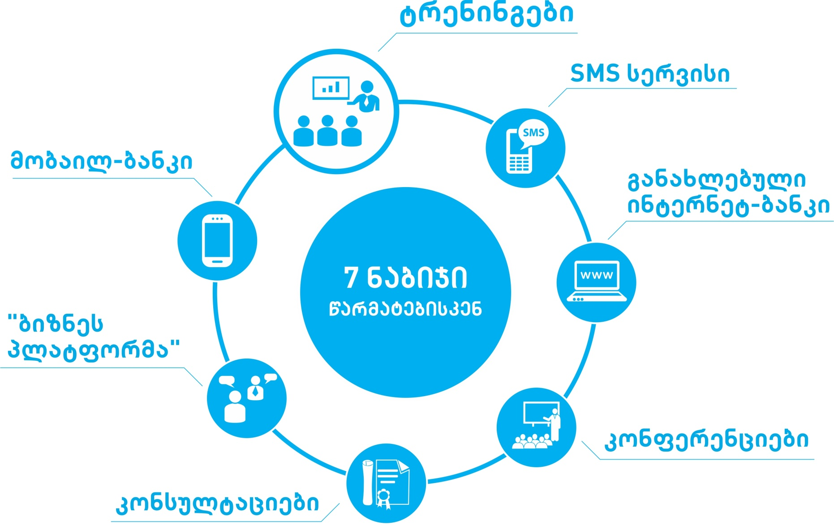
“The Best Partner Bank for Your Business” Program
Free Trainings
trained clients – 4,300
SMS Service
8,100 registered users
Mobile Banking
New Internet-Banking
Registered Users: 6,867
21,760 users, 23% increase
7 Steps to Success
SME Web Platform www.tbcbusiness.ge
Uniques visitors: 607,967
Conferences
10 Events, 1,230 participants: “MOTIVATION”, “LEADERSHIP”, “MARKETING”, “RECRUITING AND STAFFING”
Consulting Services
PUM Consultations
11 in-depth
TBC BANK - Georgia

Slide 25
Benefits of NFAS
Improved cross-sell penetration
More information about clients (NPL mitigation)
‘Stickier’ clients (harder to move elsewhere)
Happier clients (needs are being met)
Improved profitability (better to sell 5 products to 1 customer than 1 product to 5 different customers)
$
i
©
☺
%

Slide 26
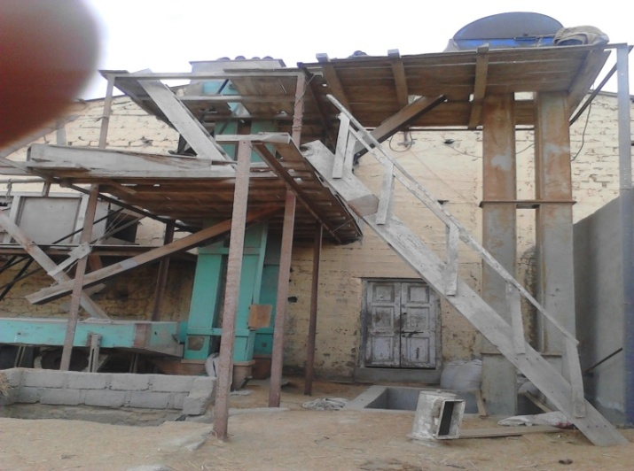



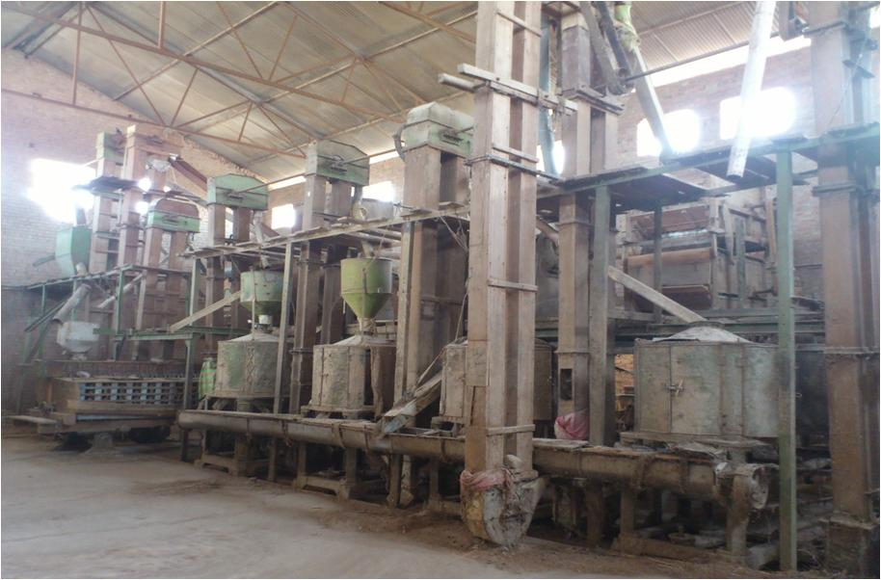
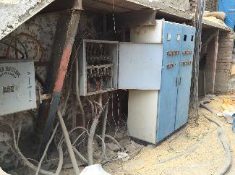

Before Up-gradation

Slide 27
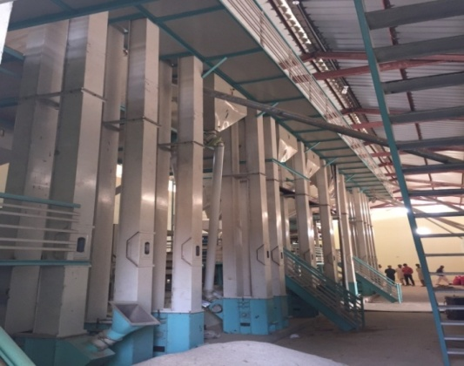
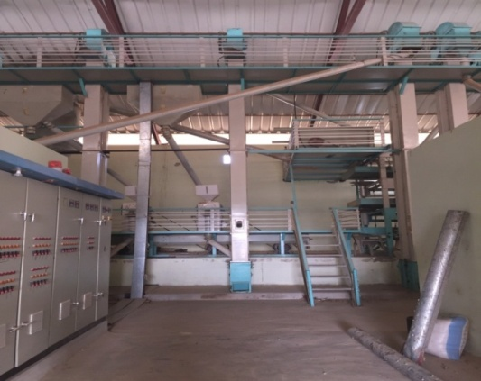
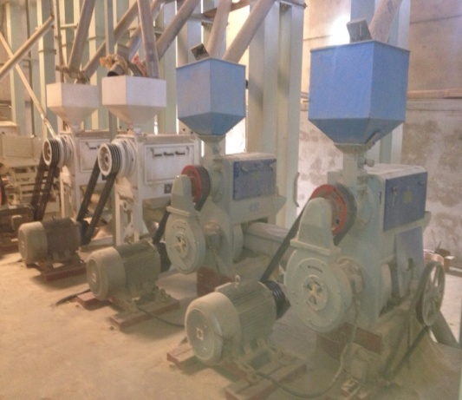
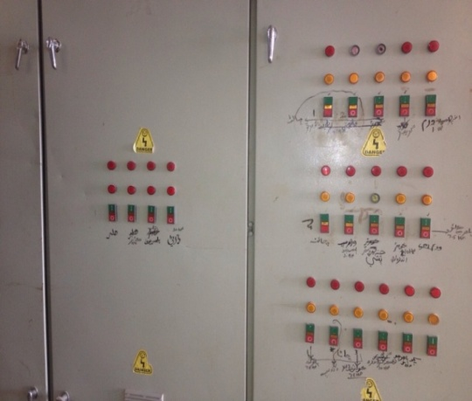
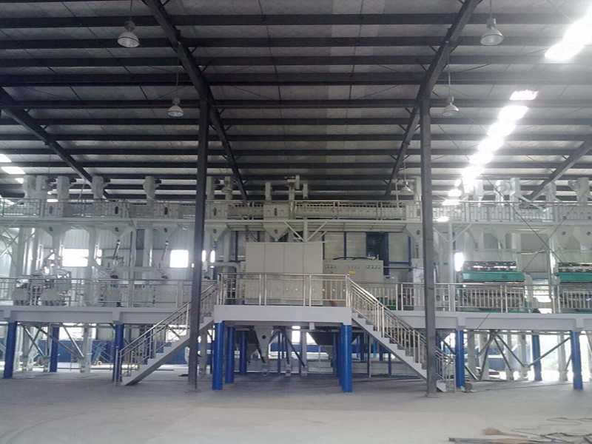
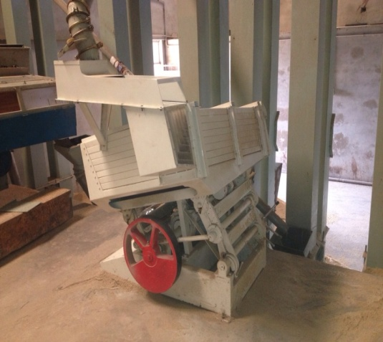

After Up-gradation

Slide 28



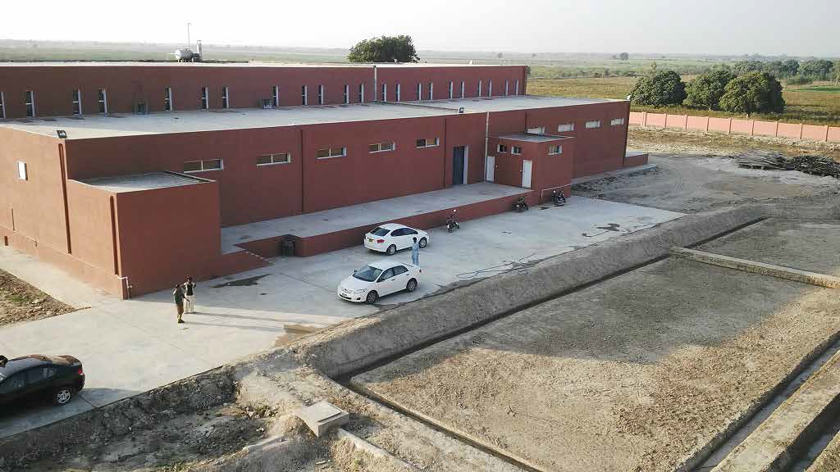


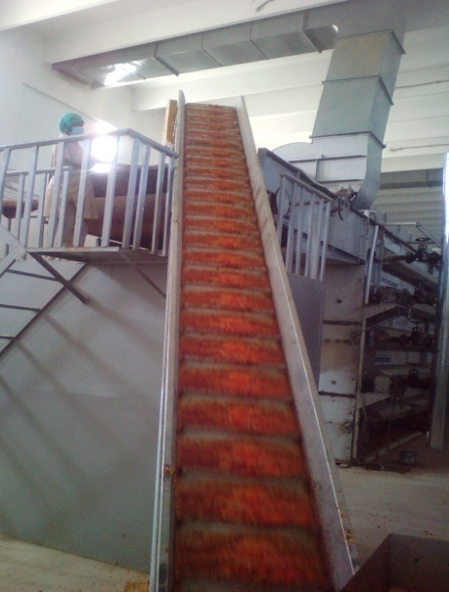
Before Intervention
After Intervention
Subsidy Cheque for
Red Chilli Growers (PMEX)
SMEDA De-hydration Unit

Slide 29
Thanks
imran.ahmad@sbp.org.pk

Slide 30
SME Advisor Role
  Competitive advantage
  Client retention
  SME business expansion
  Staff motivation
Goal
Dynamic SME sector presenting big opportunities for banks
Why
Audience
Existing (priority) customers with deep relationship with bank + growth potential
Non-customers who are an attractive acquisition object
Experienced RMs
Pre-screening & training gap analysis
Who
SME Advisor
Challenge
How
Results
for clients
The RM/SME role balance
Client data beyond regular disclosure
External factors vs – SME-Advisor efforts
Learning SMEs operations
SME Advisor training program
Passing certification
Results for banks
Practical business advice: oral and written
Improved business skills of clients
Clients’ business growth
New jobs created
Differentiation in the market via unique SME Advisor offering
Better client retention and cross-sales
New SME clients

