Slide 1
New Approaches to SME and Entrepreneurship Financing
14 February 2017

Slide 2
TSKB at a Glance

Slide 3
Mission of TSKB
Promote investments of private initiative in the Turkish Industry
Assist the participation of domestic and foreign capital to companies
Contribute to the development of the Turkish capital markets
1
2
3
SMEs
TSKB is focused on “M” of the SMEs in direct lending and is providing APEX banking services for smaller-sized companies

Slide 4
TSKB @ a Glance
Ownership Structure
First and only Private Development Bank in Turkey
TRY 24.0 bn asset size
357 employees, 2 branches
19th bank in terms of Asset size
3.3% market share in LTFC corporate loans
TRY 3.0 bn MCAP*
59.6% of free float belongs to foreign funds
*As of Feb, 02
OK
Main Subsidiaries
Ratings
Yatırım Finansman Securities
TSKB REIT
Iş Leasing
TSKB Real Estate Appraisal
Escarus
EIF
 | TSKB | Turkey
Fitch LTFC | BB+ | BB+
Moody’s LTIR | Ba1 | Ba1
Corporate Governance Rating
SAHA | 9.53/10

Slide 5
TSKB @ a Glance II
Summary Financials - TL Mn | YE 16 | YE 15 | YE 14 | YE 13
Total Assets | 24,002 | 20,735 | 15,701 | 12,911
Loans | 17,322 | 13,675 | 10,981 | 9,177
Funds Borrowed | 15,840 | 13,445 | 9,996 | 9,109
Shareholders’ Equity | 2,928 | 2,489 | 2,288 | 1,885
Non – Performing Loans (2012 – 2016)

Slide 6
Main Activities
Corporate Banking
Corporate Lending
Project Finance
Investment Banking
IPO
Derivatives
Advisory
Strategic Advisory
Apex Banking (11 commercial banks, 12 leasing companies, 3 factoring companies, 4 participation banks)
Leasing
Foreign Trade Financing
Bond Issuance
M&A
Asset Purchase – Sale
Money and Capital Markets Brokerage
Portfolio Management
Real Estate Appraisal
Environment and Sustainability
Working Capital
ECA Credits
2016 YE | % of Income | % of Assets
Corporate Banking | 43% | 69%
Investment Banking | 47% | 24%
Other Income, mainly from Subsidiaries as dividends | 10% | 7%

Slide 7
Funding Structure

Slide 8
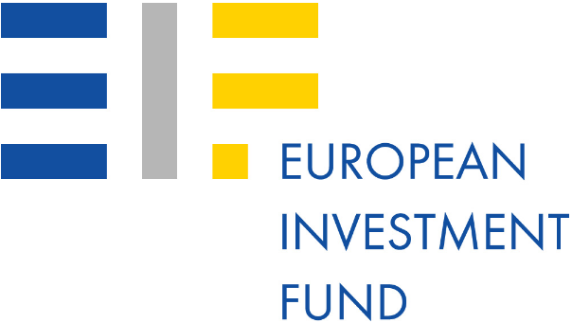
Long Term DFI Funding
Outstanding Funding Base
87% of DFI Funding guaranteed by Turkish Treasury
DFI Funding - 2016 | Amount | Theme
EIB | 100 mio EUR | SME and Midcap
EIB | 100 mio EUR | Energy and Environment
AFD | 100 mio EUR | Women Employment and Occupational Health&Safety
IBRD | 150 mio USD | Geothermal Energy
CEB | 100 mio EUR | APEX
KfW | 150 mio EUR | Renewable Energy and Environment
TOTAL 2016 | 733 mio USD
Yearly Multilateral Funding Agreements
USD mn
InnovFin SME Guarantee Facility agreement which has a maximum portfolio volume of EUR 20 million with European Investment Fund (EIF) to ease financial access of innovative SMEs and small Mid-caps
*DFI: Development Finance Institutions
Notes:
8
ok

Slide 9
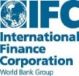
Current Long Term DFI Funding Themes
Energy Efficiency
Renewable Energy
Resource Efficiency
SME & MidCap
Sustainable Tourism
Agribusiness
Women’s Employment
&
Occupational Health and Safety

Slide 10
EIF InnovFin SME Guarantee Facility

Slide 11
EIF Innovfin Facility

Slide 12
InnovFin Product Overview

Slide 13
InnovFin SME Guarantee Innovation Logic

Slide 14
Innovfin SME Guarantee

Slide 15
Key Guarantee Terms

Slide 16
Guarantee Fee

Slide 17
Transfer of Benefit (indicative example)

Slide 18
Development Finance Institutions Department
Email: developmentfinanceinstitutions@tskb.com.tr
Thank You

