Slide 1

TSKB Presentation on SMEs
13 February 2017

Slide 2
TSKB at a Glance

Slide 3
Privately Owned Development Bank with Public/Private Mission
Private Sector
Public Authority
IFI’s
Both as Client & Shareholder
Guarantor of the system & priorities of the country
As LT Fund Providers

Slide 4
Mission of TSKB
Promote investments of private initiative in the Turkish Industry
Assist the participation of domestic and foreign capital to companies
Contribute to the development of the Turkish capital markets
1
2
3
SMEs
TSKB is focused on “M” of the SMEs in direct lending and is providing APEX banking services for smaller-sized companies

Slide 5
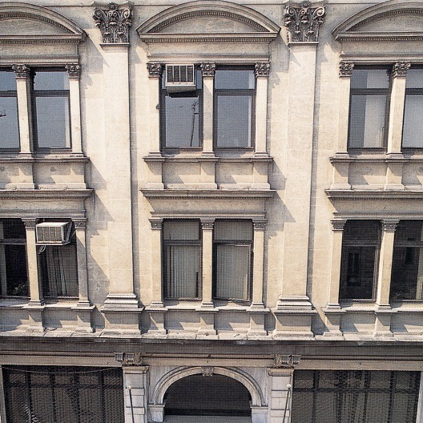
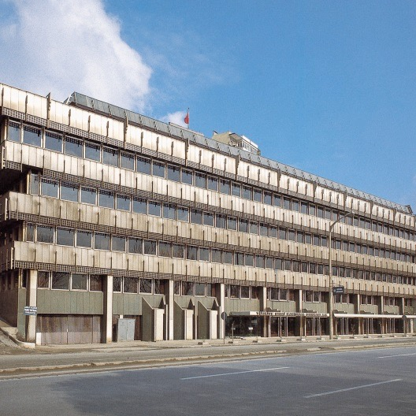
TSKB’s First Shareholders
İş Bankası 24%
Osmanlı Bankası 16%
Yapı ve Kredi Bankası 12%
Selanik Bankası 4%
T. Ticaret Bankası 4%
Garanti Bankası 3.86%
Akbank 2%
Banka Komerçiyale İtalyana
(Banca Commerciale Italiana) 2%
Banka di Roma 2%
Hollantse Bank Uni. 2%
Tutum Bankası 2%
T. İmar Bankası 2%
T. Kredi Bankası 2%
İstanbul Ticaret Odası 8%
İstanbul Ticaret Borsası 8%
Çukurova Sanayi İşletmeleri 2%
Mensucat Santral 2%
İzmir Pamuk Mensucat 2%
Others (7 persons) 0.14%
TOTAL 100%
Banks 77.86%
Chambers 16%

Slide 6

TSKB’s Shareholders
1963, 1986, 2002 & 2015
1963
Banks* | 51.4%
Insurance Companies | 16.3%
Chambers | 8%
Companies | 2.2%
Others (273 participants) | 22.1%
TOTAL | 100%
1986
Banks | 83%
Chambers | 5%
Companies | 1%
Others | 11%
TOTAL | 100%
* IFC as a Development Finance Institution became the second largest shareholder of TSKB in 1963 with a share of 15%.
2002**
Banks | 87%
Chambers | 1%
Others | 12%
TOTAL | 100%
2015
İş Bank Group | 50.6%
Free Float and Others | 41.0%
Vakıfbank | 8.4%
TOTAL | 100%
** Merger of TSKB and Sınai Yatırım Bankası was completed in 2002.

Slide 7
TSKB @ a Glance
Ownership Structure
First and only Private Development Bank in Turkey
TRY 24.0 bn asset size
357 employees, 2 branches
19th bank in terms of Asset size
3.3% market share in LTFC corporate loans
TRY 3.0 bn MCAP*
59.6% of free float belongs to foreign funds
*As of Feb, 02
OK
Main Subsidiaries
Ratings
Yatırım Finansman Securities
TSKB REIT
Iş Leasing
TSKB Real Estate Appraisal
Escarus
EIF
 | TSKB | Turkey
Fitch LTFC | BB+ | BB+
Moody’s LTIR | Ba1 | Ba1
Corporate Governance Rating
SAHA | 9.53/10

Slide 8
TSKB @ a Glance II
Summary Financials - TL Mn | YE 16 | YE 15 | YE 14 | YE 13
Total Assets | 24,002 | 20,735 | 15,701 | 12,911
Loans | 17,322 | 13,675 | 10,981 | 9,177
Funds Borrowed | 15,840 | 13,445 | 9,996 | 9,109
Shareholders’ Equity | 2,928 | 2,489 | 2,288 | 1,885
Non – Performing Loans (2012 – 2016)

Slide 9
Main Activities
Corporate Banking
Corporate Lending
Project Finance
Investment Banking
IPO
Derivatives
Advisory
Strategic Advisory
Apex Banking (11 commercial banks, 12 leasing companies, 3 factoring companies, 4 participation banks)
Leasing
Foreign Trade Financing
Bond Issuance
M&A
Asset Purchase – Sale
Money and Capital Markets Brokerage
Portfolio Management
Real Estate Appraisal
Environment and Sustainability
Working Capital
ECA Credits
2016 YE | % of Income | % of Assets
Corporate Banking | 43% | 69%
Investment Banking | 47% | 24%
Other Income, mainly from Subsidiaries as dividends | 10% | 7%

Slide 10

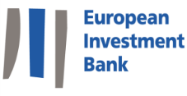



TSKB’s APEX Banking Operations
Under its APEX Banking operations TSKB acts as an intermediary bank through lending to leading Turkish commercial & pariticipation banks and leasing & factoring companies, namely Participating Financial Institutions (PFIs), which in turn on-lending to SMEs and EoEs*.
The development finance institutions in which TSKB secures funds for its APEX Banking activities
TSKB has a well-established network of 30 Participating Financial Institutions (PFIs) under APEX Banking
*EoEs: Export oriented Enterprises

Slide 11
















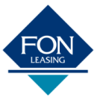
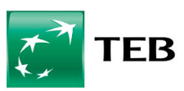









PFIs under APEX Banking Operations
Commercial Banks
Leasing Companies
Participation Banks
Factoring Companies

Slide 12
Funding Structure

Slide 13
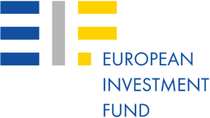
Long Term DFI Funding
Outstanding Funding Base
87% of DFI Funding guaranteed by Turkish Treasury
DFI Funding - 2016 | Amount | Theme
EIB | 100 mio EUR | SME and Midcap
EIB | 100 mio EUR | Energy and Environment
AFD | 100 mio EUR | Women Employment and Occupational Health&Safety
IBRD | 150 mio USD | Geothermal Energy
CEB | 100 mio EUR | APEX
KfW | 150 mio EUR | Renewable Energy and Environment
TOTAL 2016 | 733 mio USD
Yearly Multilateral Funding Agreements
USD mn
InnovFin SME Guarantee Facility agreement which has a maximum portfolio volume of EUR 20 million with European Investment Fund (EIF) to ease financial access of innovative SMEs and small Mid-caps
*DFI: Development Finance Institutions
Notes:
13
ok

Slide 14

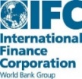





Current Long Term DFI Funding Themes
Energy Efficiency
Renewable Energy
Resource Efficiency
SME & MidCap
Sustainable Tourism
Agribusiness
Women’s Employment
&
Occupational Health and Safety

Slide 15
DFI Fundings with SME Theme
Loans Provided From DFIs with SME Theme
Since 1997
3 Billion USD
In Total

Slide 16
Loan Portfolio
Loans by Sector
Loans by Type
67% Investment Loans
25% Working Capital Loans
8% APEX
SMEs in Portfolio
93% foreign currency denominated
38% in Euros, 55% in USD
5.9 years of average maturity
Notes:
ok
SME funding 3 billion TL / total funding 17,3 billion TL

Slide 17
Financials

Slide 18
Banking Sector vs TSKB
ok
* Sector data as of Dec. 16
Banking Sector
TSKB
Deposits
(Average maturity less than 3 months)
Long Term DFI Funding
(11 years of average maturity)
Notes:
ok

Slide 19
Asset Composition
ok
Growth (FX adjusted)
 | YoY | QoQ
Loans | 8.2% | -0.1%
Securities, Cash&MM | -13.4% | -18.3%
Total Assets | 1.8% | -5.0%
FX Assets | 1.3% | 0.3%
TRY Assets | 0.7% | -19.3%
24,002
73.4%
69.9 %
76.8%
29.4%
26.6%
30.1%
23.2%
2015
2016
Leverage Ratio | 8.2X
Loan to Asset Ratio | 72.2%
Notes:
ok

Slide 20
Liabilities Composition
ok
Growth (FX Adjusted)
 | YoY | QoQ
Funding | 5.1% | -2.0%
Equity | 17.7% | 2.0%
FX Liabilities | 6.2% | -0.6%
TRY Liabilities | -14.6% | -21.0%
24,002
74.4%
74.9%%
29.2%
25.6%
25.1%
2016
2015
Duration:
Loans | 2.8Y
Funding | 5.4Y
Notes:
ok

Slide 21
Development Finance Institutions Department
Email: developmentfinanceinstitutions@tskb.com.tr
Thank You

Slide 22
Annex

Slide 23
Firsts by TSKB
1950’s
Financing private sector with mid-long term loans on a project basis
Technical consulting services for project sponsors
Realizing a preliminary survey and pioneering in the foundation of capital markets
The only organization able to provide export loans in foreign currency in a period when the lack of foreign currency in the country was at its highest
The only organization mediating in the cash sale of the foreign currency released from Marshall relief fund
1960’s
Acting as the undertaker and the guarantor for private sector bonds issued
Initial public offerings of the share capital
First independent auditing by an international independent auditing firm
TSKB became the first participation of IFC in Turkey,
Loan support to the manufacturing of first Turkish bus, first Turkish automobile, automobile tire, LPG cylinder, and high voltage cables
First Turkish music record, first movie sector loan, first encyclopedia
First Turkish battery, first cola drink, toilet paper, pencil, carton, plastic, and acrylic fiber

Slide 24
Firsts by TSKB
1970’s
Investment incentive for private sector investments in developing regions
First long term bond issue
Providing funds by mid term syndication loans from European markets
Providing large scale research services for manufacturing and services sectors
1980’s
Developing the first short term econometric model for Turkish economy
Developing the fund-flow model for the financial sector in Turkey
Extending hedged foreign currency investment loans (FERIS)
Its own bond issue in international capital markets (Tokyo)
Organizing manufacturer surveys for various sectors
Providing buyer loans from European and Japanese financial institutions (1970’s and 1980’s)
Consulting services for textile and other sectors in cooperation with international consulting organizations
Privatization consulting services for the state-owned cement factories
Preparing the Privatization Master Plan for Turkey
First public offerings with the firm commitment offering method
Establishing capital markets relationship with Islamic Development Bank
Bank bonds and bank guaranteed bonds operations

Slide 25
Firsts by TSKB
1980’s
Econometric model survey for Turkish Economy (TEM)
First dental prosthesis in Turkey, first modern packaging, first double-blade shaver, first sneakers manufactured with modern methods, first advanced technology journalism, and first Turkish encyclopedia
Loan support for the first application of modern greenhouse floriculture
1990’s
Signing long term foreign currency and interest swap deals with international banks
Providing mid term TL loans with floating interest rates for the industry sector
Consulting services for the World Bank in Uzbekistan
Management of Risk Capital Fund founded by European Investment Bank (EIB)
Voluntary participation in “Risk Management Analysis’’ program supported by the World Bank
2000’s
Extending a loan for a healthier environment – first credit appraisal studies considering “environment criteria”,
The first bank that established a real estate appraisal company approved by the Capital Markets Board (SPK),
Coordination secretariat services within the framework of Istanbul Approach,
Developing the “risk-based loan pricing model”,
Obtaining ISO 14001 Environment Management System Certificate,
Being selected as the “Sustainable Bank of the Year'' in Eastern Europe Region.
TSKB has joined EIF's registry of shareholders and currently holds 0.18% share in the Fund.

Slide 26
Firsts by TSKB
2010’s
Provision of a credit line specifically for a healthier environment – the first loan operations that takes “energy efficiency” into consideration
The first Turkish bank to release the GRI approved sustainability report
EMEA Finance: “Best Equity House in Turkey" award, Euromoney: "European Hydro Power Deal of the Year", "European Utilities Deal of the Year"
Corporate Governance Awards: “Highest Corporate Governance Ratings”, Financial Times and IFC: “Nominated as the best bank in Europe”, TIREC Summit: “Best Business Partner”, Clean Technology and Energy Awards: “Best Inventor” award
Launched www.tskbenerjiverimliligi.com a web site that focuses on energy efficiency
Corporate Governance Association of Turkey (TKYD) – 5th Corporate Governance Summit, 2nd Corporate Governance Awards/Highest Corporate Governance Rating
The first Turkish bank to receive ISO 14064 Greenhouse Gases Emissions Certificate
Corporate Governance Association of Turkey (TKYD)- 6th Corporate Governance Summit, 3rd Highest Corporate Governance Rating
Membership of UNEP FI, LTIC, IDFC
The first and only Turkish bank to have been granted membership of the Long-Term Investors’ Club (LTIC)
Issuance of 14 thematic funds
Securing the first EBRD credit which aims to finance SME’s industrial projects based on agriculture.
TSKB ranked among the companies with highest scores in “Transparency” and “Performance” categories under “CDP Turkey 2013 Climate Change Leaders” awards and received awards in both categories.

Slide 27
Firsts by TSKB
2010’s - Continued
Secured its first OPIC covered loan amounting USD 40 mn in 2014 under the theme of SME, renewable energy and energy efficiency
Tapped the international debt capital markets first time in 2014 with a 5 year tenor USD 350mn senior unsecured bond issuance
Established its MTN Programme in 2015 with the size of USD 750 mn; the first drawdown under the programme which is 5 year tenor USD 350 mn due 2020
As of August 2015, upon the invitation of the EIF, TSKB participated in the funds of fund titled «Turkish Growth and Innovation Fund (TGIF)» through a commitment amounting to EUR 20 mn.
On May 2016, TSKB realised the first Green / Sustainable Bond ever from Turkey and also the broader CEEMEA region. 5 years tenor USD 300 million bond issuance reached over US$ 4bn with the largest oversubscription for a Turkish FI in years.

Slide 28
Development Finance Institutions Department
Email: developmentfinanceinstitutions@tskb.com.tr
Thank You

