Slide 1
The Challenges of SMEs Intervention in a Competitive Market Place :
The Malaysian Experience
PRESENTATION TO THE CHAIRMAN AND MANAGING DIRECTOR OF SME DEVELOPMENT AUTHORITY OF MAURITIUS
BY:
Dr. Sheikh Ghazali Abod
COO, CEDAR
13 January 2016
Sheikh Ghazali Abod, PhD
Director of Entrepreneur Development,
SME Bank, Malaysia

Slide 2
IMPORTANCE OF SMEs IN AN ECONOMY

Slide 3
The Importance of SMEs to the Global Economy

Slide 4
SMEs and the Global Economy

Slide 5
Common SMEs Issues in Emerging Markets
TOWARDS A
DEVELOPED NATION
INCREASE IN
GDP SHARES
ENHANCE EMPLOYMENT RATE
ECONOMICS SUSTAINABILITY
SOME KEY ISSUES CONFRONTING THE SMES
INNOVATION AND TECHNOLOGY ADOPTION
ACCESS
TO FINANCING
LEGAL AND REGULATORY ENVIRONMENT
HUMAN CAPITAL DEVELOPMENT
MARKET ACCESS
INFRASTRUCTURE

Slide 6
Some Key Drivers in Ensuring the Success of SMEs
Access to Financing
Intervention - Beyond Financing
Product Differentiations
Branding and Market Access
Networking & Partnerships
Capacity & Capability
R&D & Innovation
Exports & Regionalisation

Slide 7
THE MALAYSIAN SMEs LANDSCAPE

Slide 8
Who Are the SMEs in Malaysia?
 | SIZE | MANUFACTURING (INCLUDING AGRO-BASED) & MANUFACTURING RELATED SERVICES | SERVICES SECTOR (INCLUDING ICT)
FULL TIME EMPLOYEE | Micro | Less than 5 employees | Less than 5 employees
 | Small | Between 5 - 75 employees | Between 5 - 30 employees
 | Medium | Between 75 - 200 employees | Between 30 - 75 employees
CRITERIA
ANNUAL SALES | Micro | Less than USD 68,000 | Less than USD 68,000
 | Small | Between USD 68,000 & less than USD 3.4million | Between USD 68,000 & less than USD 0.7million
 | Medium | Between USD 3.4million & USD 11.4million | Between USD 0.7million & USD 4.5million

Slide 9
SMEs in Malaysia
77%
496,458
WOMEN
MUSLIMS
90%
217,152
Services
(90%)
19.7% 127,092
MICRO
SMEs
645,136
Manufacturing (5.9%)
20%
128,787
MUSLIMS
8%
19,302
MUSLIMS
37.4%
241,280
SMALL
Construction
(3%)
3%
19,891
Agriculture
(1%)
MUSLIMS
2%
4,826
MEDIUM
Mining & Quarrying
(0.1%)
Source: SMEs 2011 Census Report by the Statistics Department of Malaysia & Eleventh Malaysia Plan

Slide 10
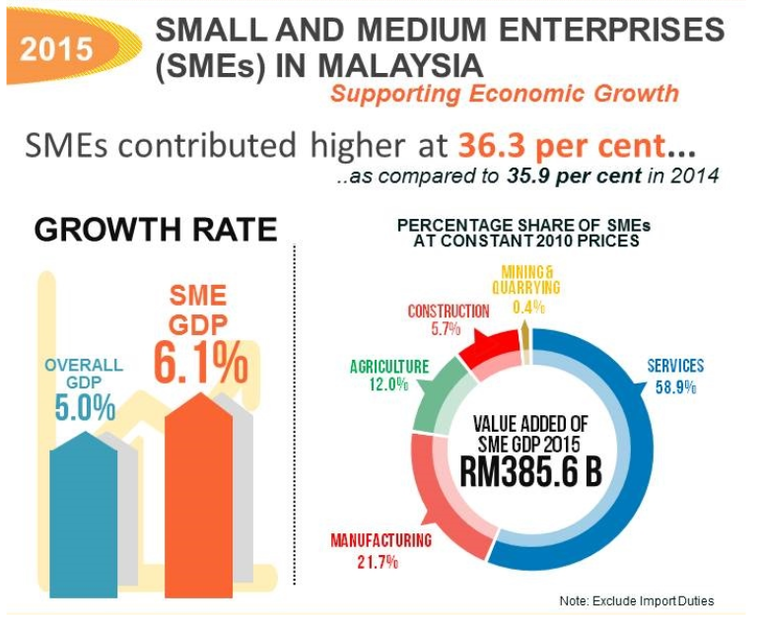
Malaysia: SMEs Contribution to Overall GDP in 2015
SMEs contributed about 36.3% to the Overall GDP in 2015
Value added of SMEs GDP USD87.6b
Source: Dept. of Statistics, Malaysia

Slide 11
Government Targets
SME GDP Growth & Overall GDP
SMEs Contribution (2015) |  | Target 2020
GDP | 36.3% | 41%
Employment | 65.5% | 65%
Exports | 17.6% | 23%
Partly due to the redefinition of SMEs
Source: Department of Statistics Malaysia and SME Corp, Malaysia

Slide 12
Total No. of SMEs vs Contribution to GDP
Total No. of SMEs
Contribution to GDP*
Large Companies
(63.7%)**
Large Companies
(2.7%)*
Target by 2020
SMEs
(36.3%)**
SMEs Contribution
to GDP: 41%
SMEs
(97.3%)*
Muslims Contribution
13%***
Muslims SMEs
Contribution: 20.5%
Source:
* SME Annual Report 2011/12,
**18th National SME Development Council, 25th of June 2015,
***ETP Annual Report 2011 / CEDAR Estimates <9%

Slide 13
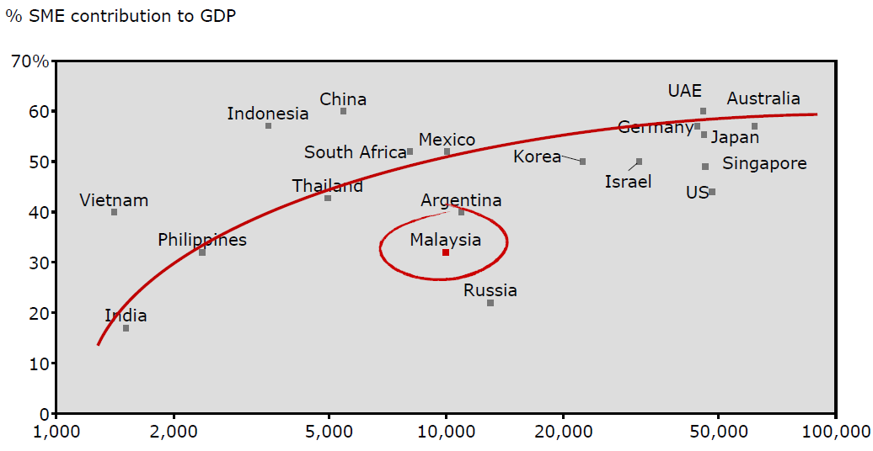
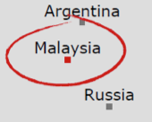
Malaysia’s SMEs GDP Contribution to Comparable Markets
USD GDP per capita

Slide 14
THE GOVERNMENT POLICIES ON SMEs

Slide 15
Government Economic Agenda
11th Malaysia Plan (2016-2020)
SME Masterplan 2012-2020
The Eleventh Malaysia Plan is formulated with the Rakyat as the centrepiece.
The people economy will be given priority, reinforcing the Government’s commitment to bring further development to the people.
All segments of society must benefit from the country’s economic prosperity in order to create an advanced economy and inclusive nation by 2020.
The SME Masterplan has proposed a new framework to align SME development to the broader national aspirations.
The Masterplan will be for all SMEs in Malaysia, irrespective of sector, gender, geographical region and ethnic background.
Successful implementation of the Masterplan will result in raising contribution of SMEs to the economy by 2020.
SMEs’ Target contribution to the economy by 2020
41%
GDP
65%
Employment
23%
Exports

Slide 16
National SMEs Development Council (NSDC) and Key Roles

Slide 17
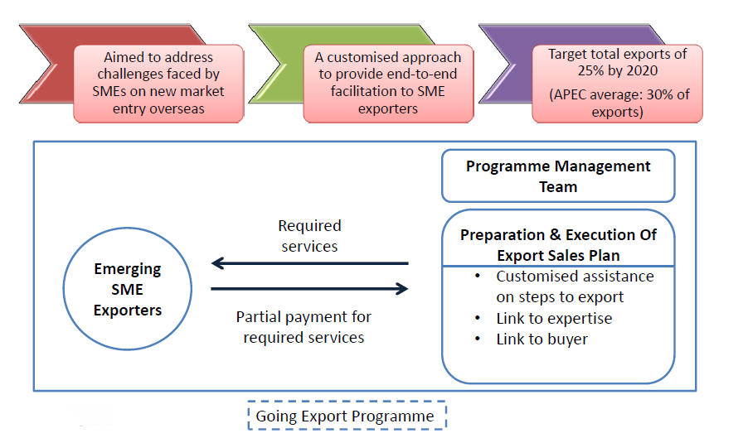
Going Export (GoEx) offers customized assistance to
new exporters and SMEs venturing into new markets

Slide 18
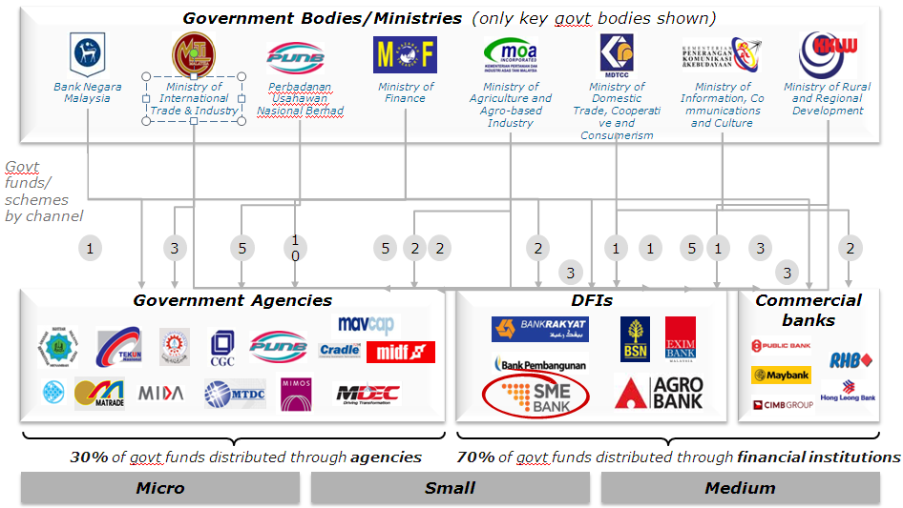
Various Channels of Agencies for SMEs Funding and Financing

Slide 19
FINANCING ISSUES OF SMEs
IN MALAYSIA

Slide 20
Sources Of Financing: % Accessed by SMEs Sizes
Others
Borrowings from Friends or Relatives
Personal Savings or Internally Generated Funds
Financing from Banks, DFIs, Micro Credits Insts. and Others

Slide 21
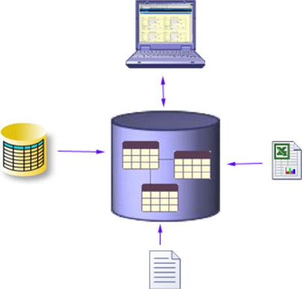
Access to Financing: Common Constraints from
the Banking Perspective
Transaction
Costs
Risk Issues
Environment

Slide 22
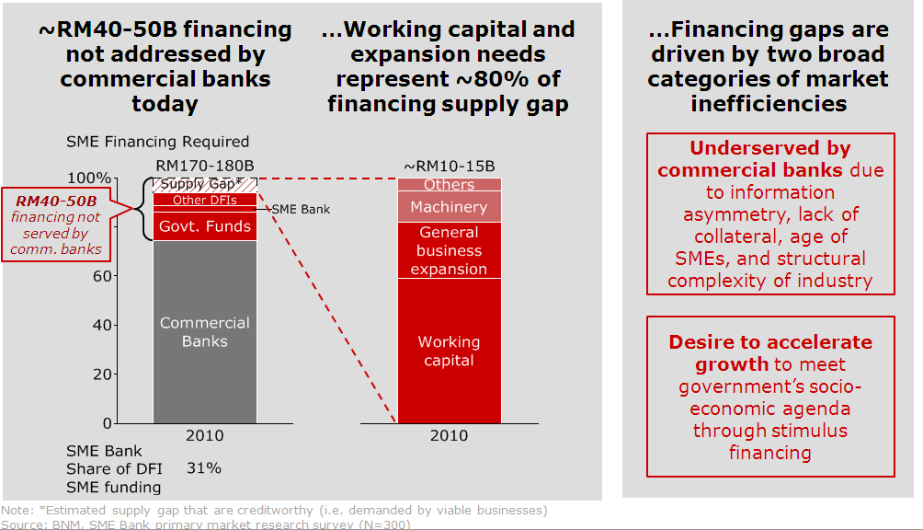
Various Channels of Agencies for SMEs Funding And Financing
Source: Bain & Co

Slide 23
ADDRESSING THE SMEs
FINANCING ISSUES

Slide 24
Malaysia’s Broadbased Financial Landscape
Financial
Institutions
Development Financial Institutions
Licensed Insurance Co
& Takaful Operators
Licensed Banking Institutions
Prescribed under DFIA 2002
Not prescribed under DFIA 2002
Commercial Banks
Investment
Banks
Islamic Banks

Slide 25
Perspective of DFIs in Malaysia
Roles and functions in providing focused financial and development support to bolster economic growth, socio-economic agenda and human capital development
DFIs are specialised FIs established by the Government with specific mandate to develop and promote key sectors that are considered of strategic importance to the overall socio-economic development objectives of the country

Slide 26
Introducing the SME Development Bank, Malaysia
Supervising
Ministry
Shareholder
100% owned
Regulator
Under DFIA 2002
MITI
MOF Inc.
Central Bank of Malaysia
Broad Sector Focus:
Manufacturing sector
Services sector
Construction sector

Slide 27
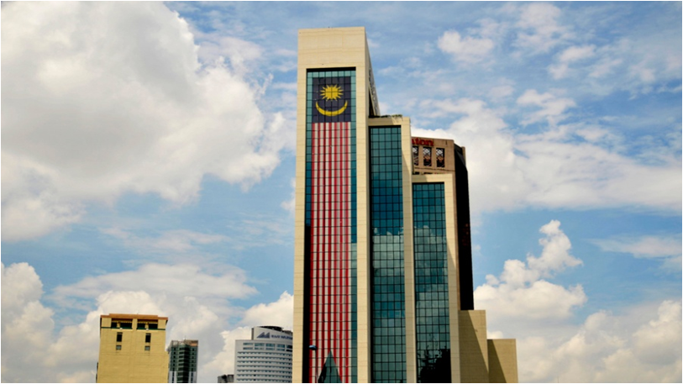
The SME Development Bank, Malaysia
VISION
A full-fledged specialised financial institution, an international benchmark for nurturing SME excellence
MISSION
To develop SMEs to be the nation’s engine of growth, in line with the Government’s economic agenda

Slide 28
SMEs Loan in Malaysia
Total financing in banking system
USD 386.4 Bil
Large Loan / Household Loan
USD 322.7 bil.
SMEs Loan
USD 63.6 Bil
Commercial Banks
USD 60.1 Bil
Development Financial Institutions (DFis)
USD 3.5 Bil
SME Bank
USD 1.4 Bil (40% of DFIs Loan)
Other ‘5’ DFis
USD 2.1 Bil

Slide 29
The SME Bank’s Mandate
Providing financing and advisory services activities to SMEs involved in manufacturing, services and construction sectors
SME
GDPs
Impact
Muslims
Participation
SME
Growth in
NKEAs
Financial Sustainability (ROE to be independently scalable)
High
Growth
SMEs
Access to Financing
Capacity Building
“Do Good”
Socio-Economic Impact
“Do Well”
Financial Sustainability
Notes:
To recap, the mandate given by the Government ie providing financing and advisory services activities to SMEs involved in manufacturing, services and construction sectors
The Bank needs to play the balancing act between socio-economic agenda vs. financial sustainability
To ensure the Bank is financially sustainable, we have to Do Well in order to DO Good which means even though we have a specific mandate to nurture and develop the SMEs, we also have to ensure that our financial position is equally strong.

Slide 30
Balancing Sustainability & Developmental Roles
Financial
Social

Slide 31
Introducing CEDAR
Supervising
Ministry
Shareholder
100% owned
Regulator
Under DFIA 2002
Ministry of International Trade and Industry Malaysia
Ministry of Finance Malaysia
Central Bank of Malaysia
SMEs Financing
Manufacturing sector
Services sector
Construction sector
SMEs Developmental Role
Business Coaching
Development & Intervention
Market Updates & Info Sharing
Wholly-owned subsidiary of the Bank

Slide 32
CEDAR’s Mission
To continuously develop the capability of entrepreneurs towards sustaining their business growth in support of the national economic agenda.

Slide 33
SME Bank’s Group Complementing Roles
Banking
Developmental
FINANCING
INTERVENTION
Financial assistance
serves as enabler
for SMEs, as
engine of growth, to
move up the value
chain and create
viral effect to
the economy
Hand-holding
approach from
the entry point
to inculcate business
acumen and propel
SME business
to the next level
High Impact Developmental
Program Through
Synergized Approach of
Financial Assistance
and Intervention
Small Medium Enterprises (SMEs)
MICRO
SMALL
MEDIUM

Slide 34
THE STRATEGIES IN SMEs INTERVENTION

Slide 35
Cultural Bounds
Mindset
Attitude
Religious Bounds
Competencies
Value Chains
Independency
Issues confronting SMEs Entrepreneurs

Slide 36
Maximising Potentials of Business Objectives
Business $$
Marketplace &
Business
Ecosystem
Cultural
Bounds
Maximum Business Potentials
Values & Attitudes
Quantity / Time

Slide 37
Appreciating Types of SMEs Entrepreneurship
Out of Necessity
Synchronise Mindset
Subsistence Driven
Government Support
Small Business
Risk Averse
Inheritance
Out of Opportunity
Dissynchronise Mindset
Risk Taker
Social Disrupter
Wealth Aggregator
Innovative
Highly Educated

Slide 38
CEDAR’S Entrepreneur Development Roadmap
Large SMEs
Medium
Small
Micros
Startups
Harvesting
Diversifying
Wealth Creation
Stage 7
MATURITY
GROWTH
INFANCY
Expansion
Turning Auto-Pilot On
Stage 6
Sustainability
Building a Balanced Business
Stage 5
Growth
Capture Market Share & Getting Out of Chaos
Stage 4
Survivability
Hand-to-Mouth Strategy
Stage 3
Foundation
Mastery of Essential Knowledge/Skills
Stage 2
Ideation
Identifying & Refining Idea Potential
Stage 1

Slide 39
CEDAR’S Entrepreneur Development Roadmap
Phase | Target | Stage | Focus | Developmental Areas | Frequency
MATURITY | LARGE SMEs | 7 | HARVESTING (Diversifying Wealth Creation) | Consulting on harvesting strategies | Based on SLA
 | MEDIUM | 6 | EXPANSION (Turning Auto-Pilot On) | Coaching, Consulting, Counseling, Training or Turnaround | Based on selected cases and business assessment report Quarterly engagement
GROWTH | SMALL | 5 | SUSTAINABILITY (Building a Balanced Business) | Coaching, Consulting, Counseling, Training or Turnaround | Based on selected cases and business assessment report Every alternate month engagement
 | MICROS | 4 | GROWTH (Capture Market Share and Getting Out of Chaos) | Coaching, Consulting, Counseling, Training or Turnaround | Based on selected cases and business assessment report Once a month engagement
INFANCY |  | 3 | SURVIVABILITY (Hand-to-Mouth Strategy) | Coaching on: Business Health Assessment 3 Steps to Profit Strategic Planning Financial Management 25:10, etc | Based on demand or where the need arise based on assessment report Once a month engagement
 | START-UPS | 2 | FOUNDATION (Mastery of Essential Knowledge/Skills) | Training on: Entrepreneurship Sales & Marketing Financials Management, etc. | Based on demand or at least once a quarter
 |  | 1 | IDEATION (Identifying and Refining Idea Potential) | IQ-DAGANG PROGRAMME | Based on demand or at least once per quarter

Slide 40
The Broad-based Approach
Directive
Enabling
Instructor
Teacher / Lecturer
Consultant
Trainer
Mentor
Facilitator
Coach

Slide 41
Skill & Will Matrix …
HIGH
Guide/ Mentor
Coach & Empower
WILL
Train & Direct
Excite & Inspire
LOW
S K I L L
HIGH

Slide 42
Developmental Process
PRELIMINARY ASSESSMENT
DEVELOPMENT
ACHIEVEMENT
1
PARTICIPANT SELECTION
FOCUS AREAS
MONITORING
2
Business Performance
Strategic Planning
Business Models
Sales
Marketing
Branding
Management
Financials
Certification
Risk & Liabilities
Technical Improvement
Processes
Innovation
Talent Development
Actual Vs Target
DIAGNOSTIC & GAP ANALYSIS
Reporting
KPI SETTING & REQUIREMENT IDENTIFICATION
3

Slide 43
Leaders Entrepreneurship Acceleration Program Framework (LEAP)
Turning Ideas Into Bankable and Sustainable Business
Financing
Stage
PRE-COMMERCIALISATION
COMMERCIALISATION
1 month – 3 months
From 3 – 12 months
IDEATION
FOUNDATION
EVALUATION
INITIATION
INTERVENTION
AREAS | Idea Generation Idea Refinement Idea Innovation | Business Modeling Financial Modeling Operation Modeling Technology Modeling | Business Viability Business Bankability Financing Options | Running Your Business Managing Your Business Nurturing Your Business | Profitability Productivity Sustainability Growth and Development

Slide 44
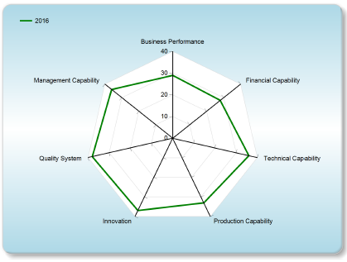
SME Competitiveness Rating for Enhancement (SCORE)
1
Business Performance
7
2
Innovation
Business Modeling
Branding Development
Strategic Marketing & Selling
Global Business Strategy
Financial Capability
Innovative & Creative Thinking
Intellectual Property & Trademark
Financial Management
Strategic Costing
Cash Flow Management
6
3
Quality System
Management Capability
Certification e.g. ISO, Halal, MeSTI, etc.
Quality Improvement
Strategic Planning
Leadership Management
Business Transformation
Project Management
5
4
Technical Capability
Production Capacity
Process Improvement
Kaizen
Inventory Management
Total Productivity Management

Slide 45
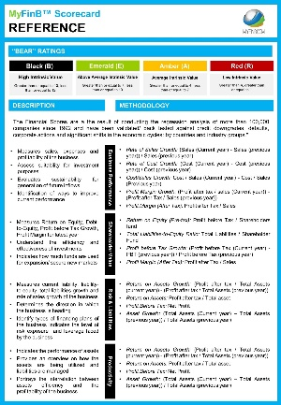
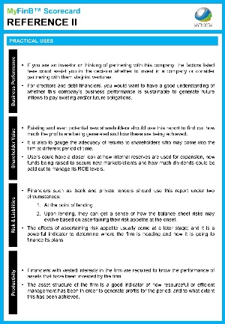
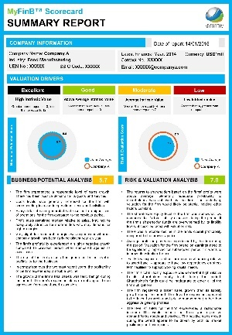
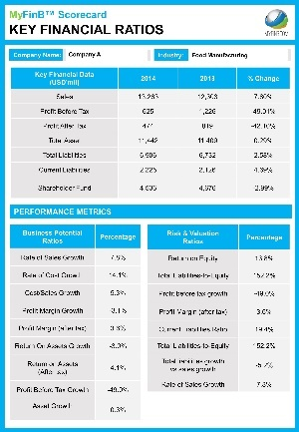
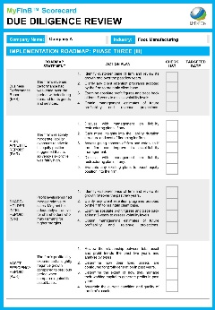
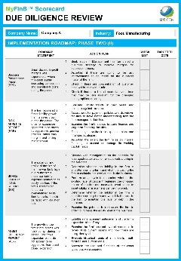
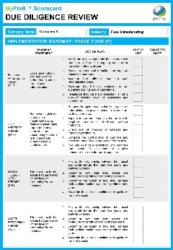
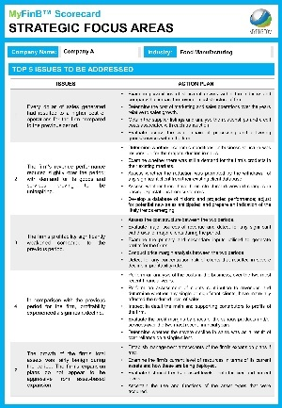
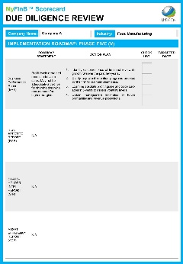
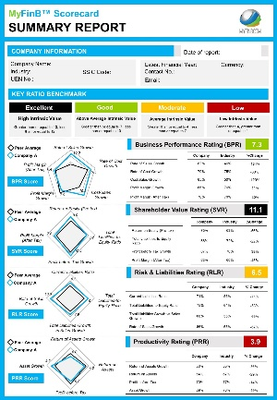
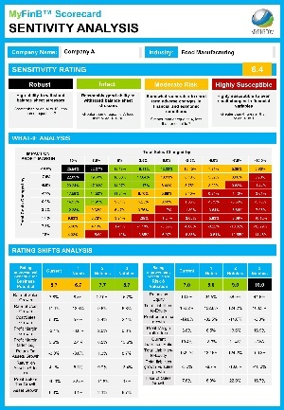
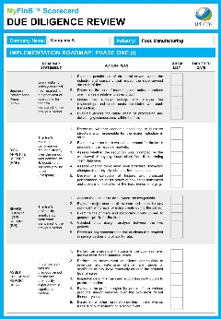
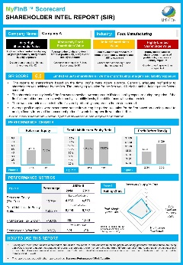
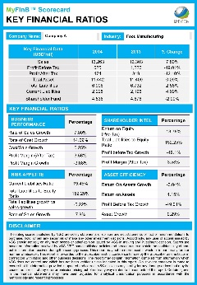
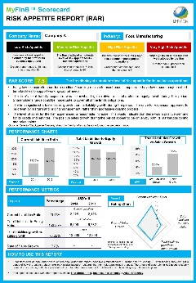
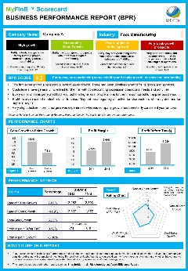
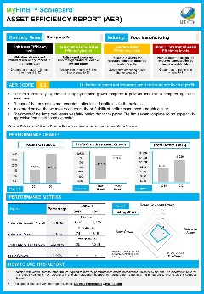
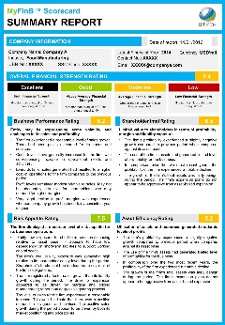
Tech-based Developmental Tools…
ALL ENCOMPASSING REPORTS
BASIC PROFILING
VALUATION DRIVERS
MANAGEMENT REVIEW
A basic analysis of a company in terms of its financial position versus industry average based on key indicators. Comes with an explanation of how to interpret and apply the reports to make preliminary assessment.
A review of the factors that drive the company’s business and risk position, sensitivity analysis on its profit margins and top 5 key issues/highlights; and what needs to be done.
A comprehensive analysis of past and current issues and what needs to be assessed in the future. Includes sectional analysis and a 4-part financial checklist / roadmap to help improve financial strength across key dimensions.

Slide 46
OUTCOME BASED STRATEGY
 | DETECTS | ACTIONS | OUTCOME
RISK MANAGEMENT | Anticipate risks or "red" flags | Pre-emptive measures | Optimal capital-risk allocation
TRANSFORMATIONAL | Evaluate gaps and opportunities | Strengthen financial position | Improve ROI
PRODUCTIVITY | Highlight areas of inefficiency | Rationalise costs and resource allocation | Increase value-added output

Slide 47
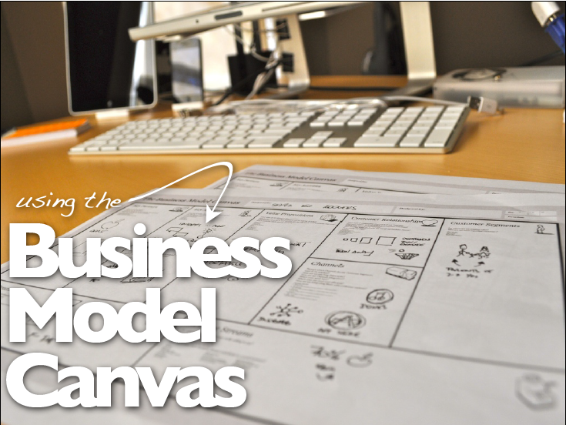

Slide 48
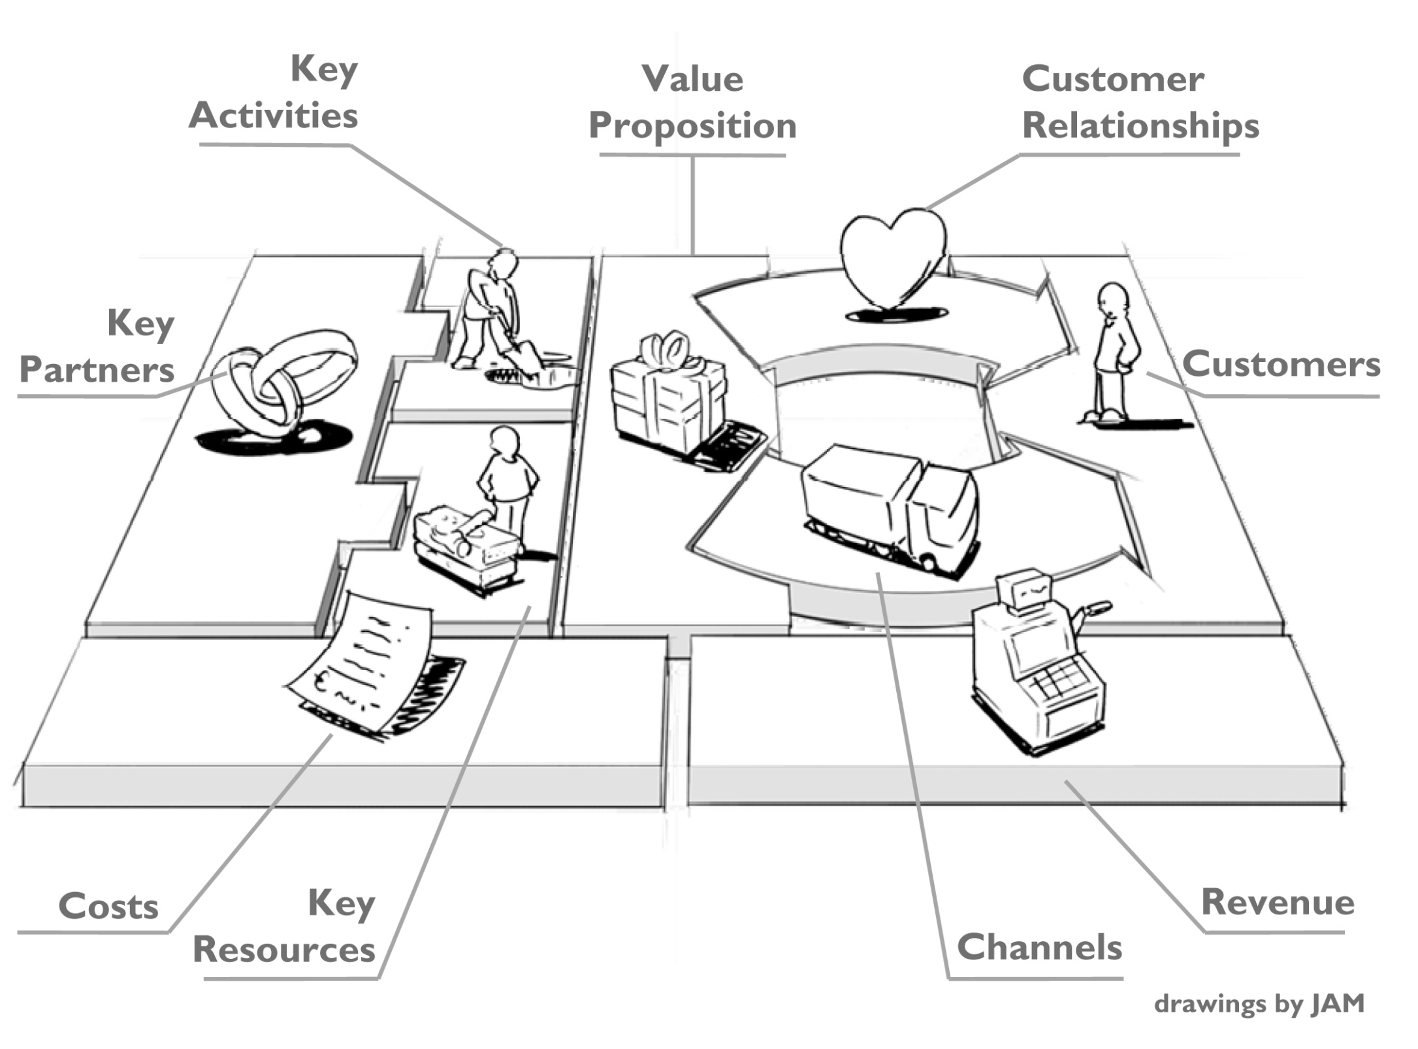

Slide 49
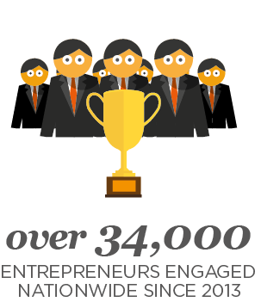
Beyond Financing: Entrepreneur
Development & Intervention
A Pool of
Certified Business Coaches
& Industry-Expert Counselors

Slide 50
SOME SUCCESS STORIES

Slide 51
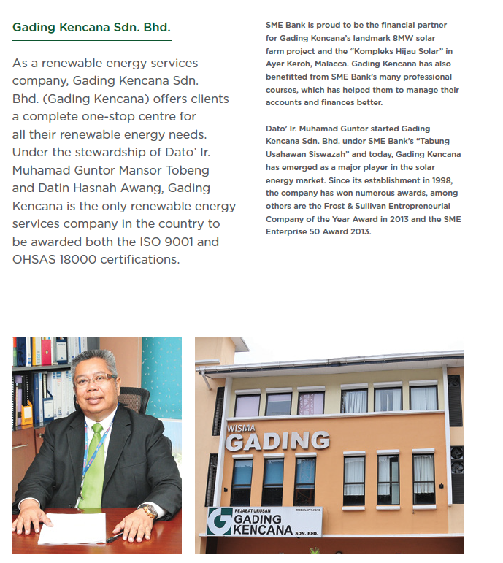
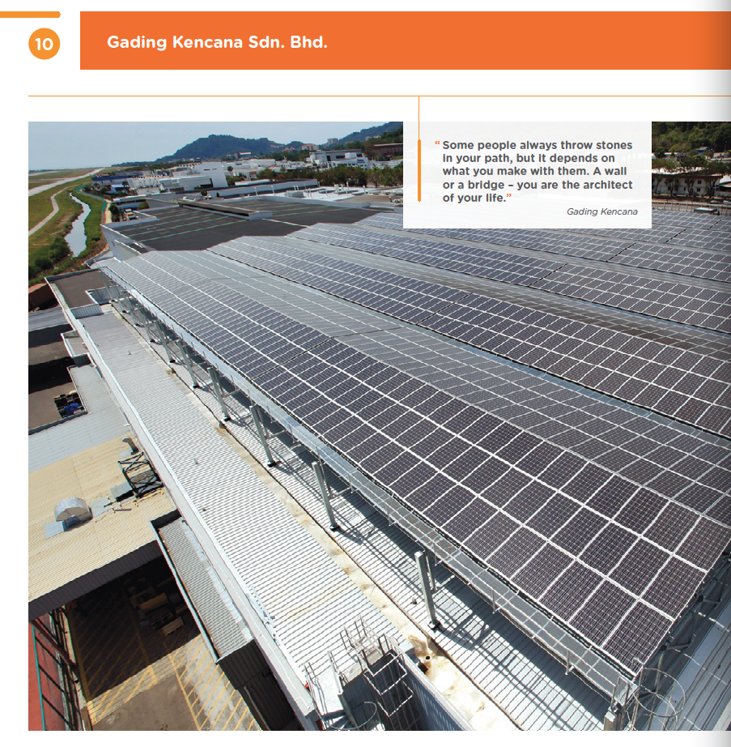
GADING KENCANA
The company is the only renewable energy services company in Malaysia to be awarded both the ISO 9001 and OHSAS 18000 certifications and has won prestigious award: Frost & Sullivans Entrepreneurial Company of the Year Award in 2013.

Slide 52
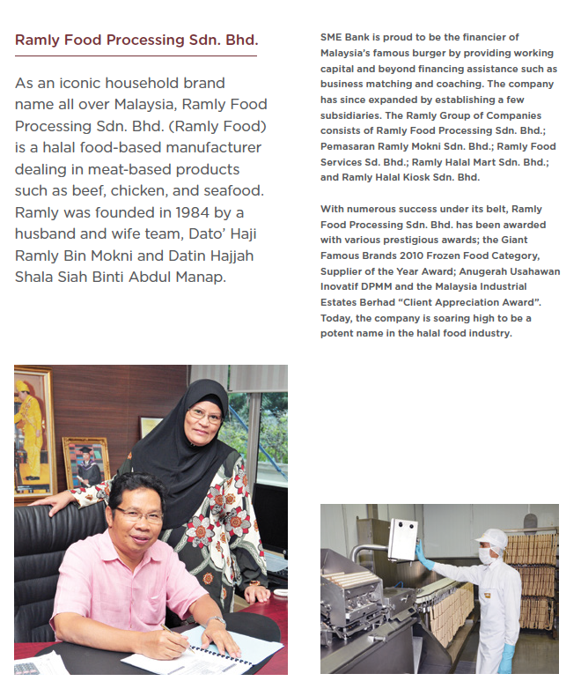
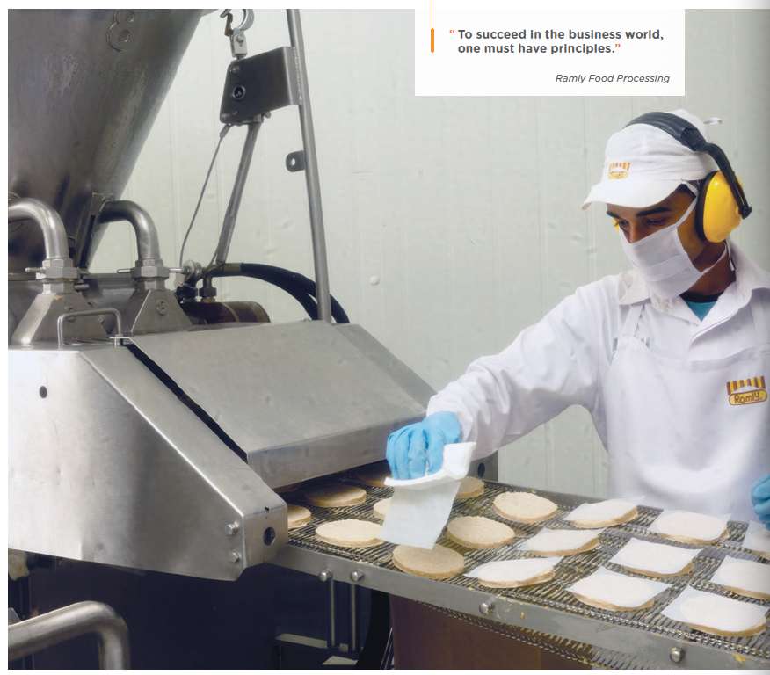
RAMLY FOOD PROCESSING
An iconic household brand name for halal frozen food such beef, chicken and seafood, the company has been awarded various prestigious awards such as the Giant Famous Brands and Supplier of the Year Award.

Slide 53
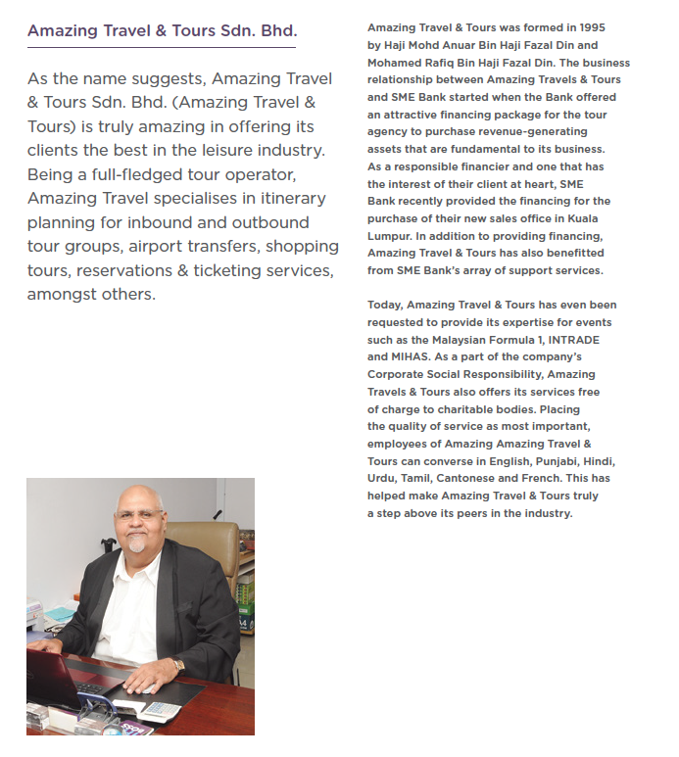
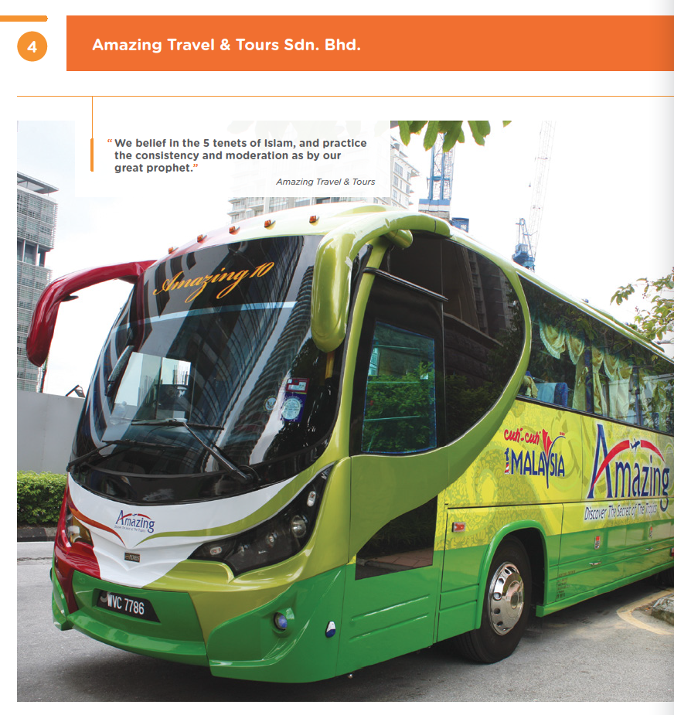
AMAZING TRAVEL & TOURS
Starting as a provider in itinerary planning for inbound and outbound tour groups, airport transfers and travel agency, the company is now able to offer expertise for events such as the Malaysian Formula 1 and global trade expos.
JMV FERRY SERVICES
The company is one of the most established passenger ferry operators in Langkawi Island, Malaysia. It is now also operating a 231-room-hotel as part of its expanded business investments.

Slide 54
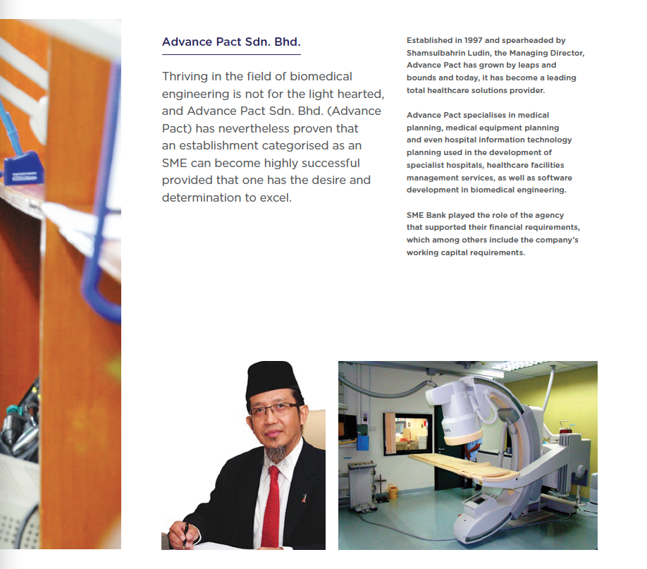
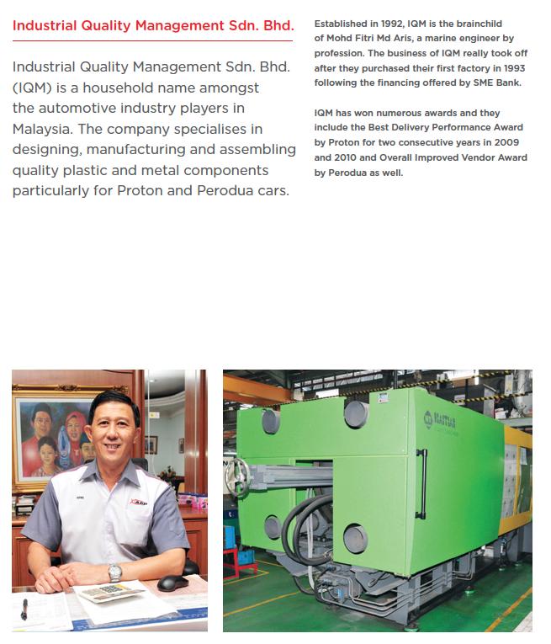
ADVANCE PACT
Thriving in the field of biomedical engineering, the company has become a leading total healthcare solutions provider in Malaysia specializing in medical and hospital IT planning, medical equipments and software development in biomedical engineering.
INDUSTRIAL QUALITY MANAGEMENT
Specializing in automotive parts and components, the company has won numerous awards such as Best Delivery Performance Award (Automotive) and Overall Improved Vendor Award.

Slide 55
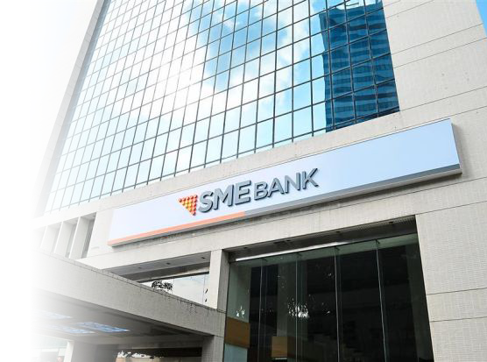
As a Group, we bring
some practical
experiences with more
than 30 years of critical track records in SMEs
development & interventions in leading industries & business sectors…...

Slide 56
sheikh.ghazali@smebank.com.my

