Slide 1



Slide 2
The Role of Leasing
in Supporting SME Growth
Muscat, 13.02.2017
Hasan K. BOLAT, CEO of İş Leasing, Turkey

Slide 3
The Role of Leasing
in Supporting SME Growth
Muscat, 13.02.2017
Hasan K. BOLAT, CEO of İş Leasing, Turkey

Slide 4
About İş Leasing
Pioneer in the Turkish leasing industry
Established in 1988 by İş Bank, IFC and Societe Generale
IFC and SocGen provided leasing know-how
İş Bank provided customer knowledge and access to the market through its branches
İşbank Group took over in 1995
Went public in 2000, traded in BIST100
One of the largest leasing company

Slide 5
About İş Leasing
Key Financials, 30.09.2016 | Million USD
Lease Receivables | 1.157
Factoring Receivables | 807
Total Assets | 2.133
Equity | 245
ROE | %13,3
ROA | %1,7
Key Metrics,30.09.2016
Regional Offices | 15
Bank Branches | >1.350
Active Customers | >5.700
Active Contracts | >7.500
Employees | 149

Slide 6
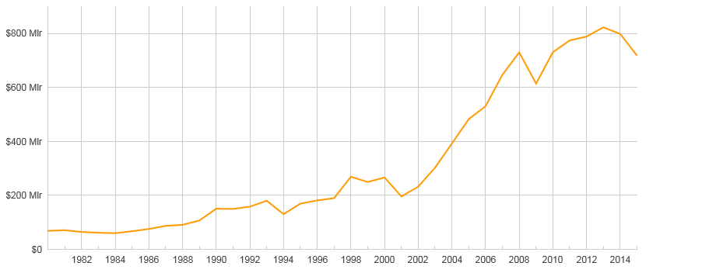

Turkey’s Macro Economic Outlook
GDP Growth Rates,
(annualized averages, %)
1982-1986 : 5,3
1987-1991 : 4,3
1992-1996 : 4,4
1997-2001 : 1,5
2002-2006 : 7,2
2007-2015 : 3,5
GDP Growth Rate Projections (%)
2016 - % 3
2017 - % 4
2018 - % 5
Demographic Profile: (as of 2013)
0-14 Age : % 25,7
14-60 Age : % 63,5
60+ Age : % 10,8
Population Prospects : (in millions)
2015- 77,7
2016- 78,6
2017- 79,4
2018- 80,2
2

Slide 7
Av. Annual Growth in Turkey
3

Slide 8

What is Leasing ?
Leasing is a contractual agreement where a leasing company(lessor) makes an asset it owns available for use by another party (lessee) for certain period of time in exchange of payment
Operating Lease : Only the right to use an asset for an agreed period of time is granted to the lessee in return for a series of rental payments. Asset is returned at the end of the lease term.
Finance Lease :Not only the right to use, but all risks and rewards incidental to title of an asset is transferred to the lessee in return for a series of rental payments. Transfer of title is optional, but highly probable.
4

Slide 9

Finance Lease Test
A contract meeting one of the conditions below is a finance lease:
  Transfer of title of the asset to the lessee is foreseen,
  A purchase option below fair market value is present,
  Leasing term extends > 80% of economic life (useful life),
  NPV of leasing payments > 90% of PV of leased asset
4

Slide 10

Turkish Leasing Framework
First leasing law enacted in 1985 (allowing only finance leases)
Leasing sector was placed under the supervision of the Banking Regulation and Supervision Agency (BRSA) in 2006
New leasing law enacted by the end of 2012, introducing new products:
  sale and lease back
  operating lease
  software leasing
  leasing of integrated parts
5

Slide 11

Leasing Products
Finance Lease
Sale and Lease Back
Software Leasing
Cross Border Leasing
Vendor Leasing
Sub Lease
Operating Lease

Slide 12

Distribution & Customers
Bank Branches
Suppliers’ dealer network
Direct Marketing
>60.000 active customers
>95.000 active contracts
1500 personnel

Slide 13

Which Assets Can Be Leased?
Real Estate (land, buildings, factories, warehouses etc.)
Machinery and equipment, including
  Transportation vehicles (aircrafts, vessels and motor vehicles)
  Heavy duty and construction machinery
  Medical devices
  Textile machinery
  Electronic and optical equipment
  Press-publishing hardware
  Office equipment
  Computer software licenses

Slide 14
Type of Leasing Companies
Bank-Owned
Part of a financial group, utilize bank’s branch network and intelligence services, broad funding base
Captive
Part of a manufacturing group, utilize manufacturer’s sales network, vast product knowledge, targeted to increase ultimate product sales volumes
Independent
Operate independently, focus on niche areas neglected by captives and bank-owned companies.

Slide 15
Leasing Penetration by Country
Country | 2014 Penetration Ratio %
Canada | 31,00
US | 22,00
Germany | 16,40
France | 13,10
Italy | 11,70
Turkey | 11,00
Japan | 8,90
China | 3,40
13

Slide 16
Leasing Penetration, Equipment
Leasing Penetration Rates in Turkey
12

Slide 17
Leasing Companies in Turkey
COMPANY TYPE | No. of COMPANIES | (On the Basis of Leasing Receivables) MARKET SHARE
Market Share >%5 | 9 Companies 9 Bank Affiliates | 80,2%
Market Share <%4.99->%1 | 6 Companies 4 Bank Affiliates 2 Vendors | 15,8%
Market Share <%1 | 12 Companies 3 Bank Affiliates 6 Independents 3 Vendors | 4%
7

Slide 18
Transaction Volumes of Leasing in Turkey
million USD
Sharp decline due to tax changes coupled with global financial turmoil
Strong growth due to new products and tax incentives
Decline due to slowing GDP growth
Strong growth rates
1st Phase
2nd Phase
3rd Phase
4th Phase
June 1985 – Dec 2006
Jan 2007 – Dec 2009
Jan 2010-Dec 2014
current
10

Slide 19
Sectoral Allocation
8

Slide 20
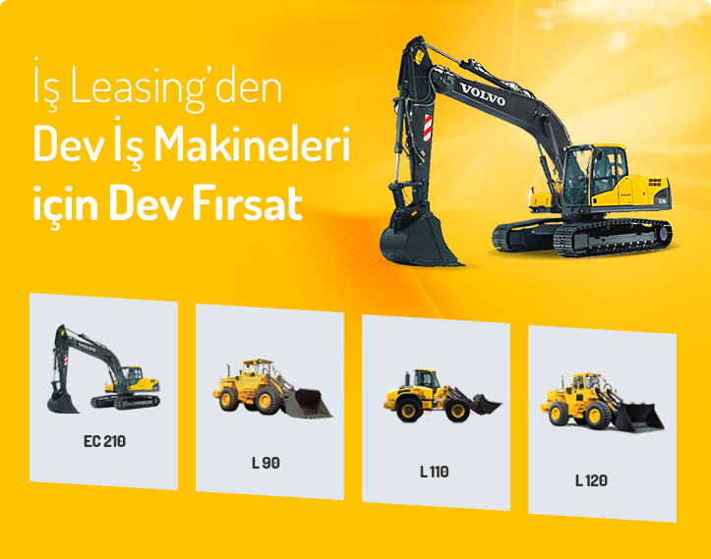
Asset Class Allocation
9

Slide 21
New Contracts
11

Slide 22
Future Projections
14

Slide 23
Client Segments
15

Slide 24

SMEs in Turkey
Medium Sized Enterprises
Number of employees < 250
Net sales < 11.5 million USD
Small Enterprises
Employees < 50,
Net sales < 2,3 million USD
Micro Enterprises
Employees < 10,
Net sales <300 thousand USD

Slide 25
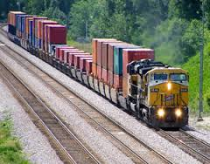
SME Share in Turkish Economy
%99 of all enterprises in Turkey are SMEs
  employ %78 of the total workforce
  pay %52 of total wages
SMEs account for %60 of total exports and %40 of total imports
SMEs are the biggest potential
for leasing demand

Slide 26

Why SMEs Should Use Leasing
Easy access to financing (without providing colleteral or guarantee to lender)
No need for credit history for start-up SMEs
Existance of the asset facilitates credit decision, especially for riskier sectors
Suited for small firms (micro entities) for operational easyness
Accounting and VAT advantage
Access to mid-long term financing without allocating capital

Slide 27
Why SMEs Should Use Leasing
Price of financing an asset via leasing relatively cheap to other type of finance
Enables better cash flow management
Predictability and transparency of rental payments.
Ability to adapt the lenght of the contract according to your company business needs
Ability to upgrade assets and evade second hand risks
Ability to bundle finance with options of services like maintanence , insurance and replacements

Slide 28
Why SMEs Should Use Leasing
For the SME’ s the key reason preferring other type of finance e.g. bank loans or cash and equity is to own assets outright
Yet, it should be known that Leasing enable SME’s to fund their activities without drawing scarce resources out of the business itself

Slide 29
FUNDEMENTAL SOURCE OF GROWTH KEY NOTES
SME’s are a key determinant of economic prosperity, as well as an important source of innovation, research and development.
Since SME’s play a vital role in current economic growth, affordable and flexible acces to finance for SME’ s is crucial
Surveys show that increasing importance of leasing as source of SME finance particularly for micro, growth and exporting SME’s

Slide 30
As 99% of firms in Turkey and %70 of existing clients are SMEs, Turkish Leasing Industry will continue to support SMEs by providing broad-based, high-quality, differentiated service and consistent support. And we will try to improve awareness and understanding of the benefits of leasing among SME’s

