Slide 1
The Importance of Financial Inclusion vis-a-vis Poverty Alleviation and their Correlation with Reference To SDGs
Syed Othman Alhabshi
and
Mohamad Ashraful Mobin
Jakarta International Convention Centre
17th May 2015 | 1.30 pm

Slide 2
Contents
Background and Motivation
Financial inclusion and poverty
Financial inclusion and MDG
A journey from MDG to SDG
Triangle of SDG, Financial inclusion and poverty
Methodology & Variables
Results
Financial Inclusion and SDGs
Proposed Indicators
Conclusion and Recommendation

Slide 3
BACKGROUND & MOTIVATION
What is the Issue ?
Determining relationship between poverty and financial inclusion
Role of financial inclusion to achieve SDGs to eliminate poverty

Slide 4
WHY It is an Issue ?

Slide 5
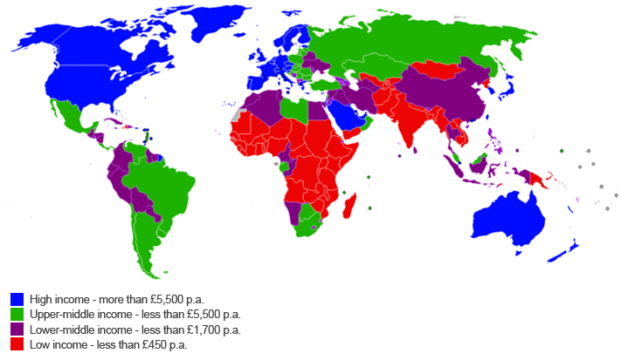
World Poverty Map

Slide 6
BACKGROUND & MOTIVATION
WHY it is an Issue ?
16.1% of worldwide population lives with less than one US dollar a day and 57.6% with less than 2.5 USD.
44% of this extreme poor people is concentrated in the Muslim countries.
About 65 million people around the world received small loans without collateral through microfinance.

Slide 7
BACKGROUND & MOTIVATION
WHY it is an Issue ?
72% of the people in Muslim countries do not use formal financial services.
20%-40% people do not use conventional microfinance to avoid interest.
Currently more than 300 Islamic Microfinance Institutions are working to alleviate the poverty.

Slide 8
Sustainable Development Goals ( SDGs)

Slide 9
SUSTAINABLE DEVELOPMENT GOALS
On 25 September 2015, the United Nations General Assembly adopted the 2030 Agenda for Sustainable Development, along with a new set of development goals that are collectively called the Sustainable Development Goals (SDGs)

Slide 10
SUSTAINABLE DEVELOPMENT GOALS
The Agenda is a culmination of many years of negotiation and was endorsed by all 193 member-nations of the General Assembly, both developed and developing—and applies to all countries.

Slide 11
SUSTAINABLE DEVELOPMENT GOALS
UN Secretary General Ban Ki-Moon noted that “the new agenda is a promise by leaders to all people everywhere. It is an agenda for people, to end poverty in all of its forms—an agenda for the planet, our common home.”

Slide 12
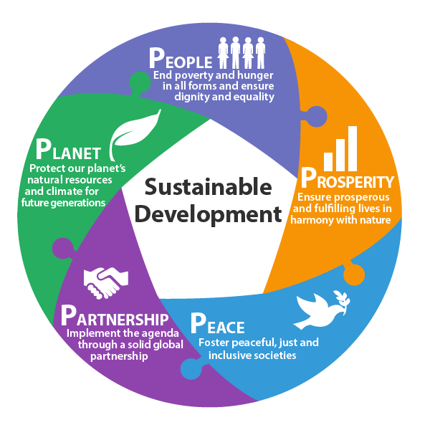
THE ELEMENTS UNDERPINING THE SDGs?
The Goals will stimulate action over the next 15 years in 5 areas of critical importance: People, Planet, Prosperity, Peace & Partnership.

Slide 13
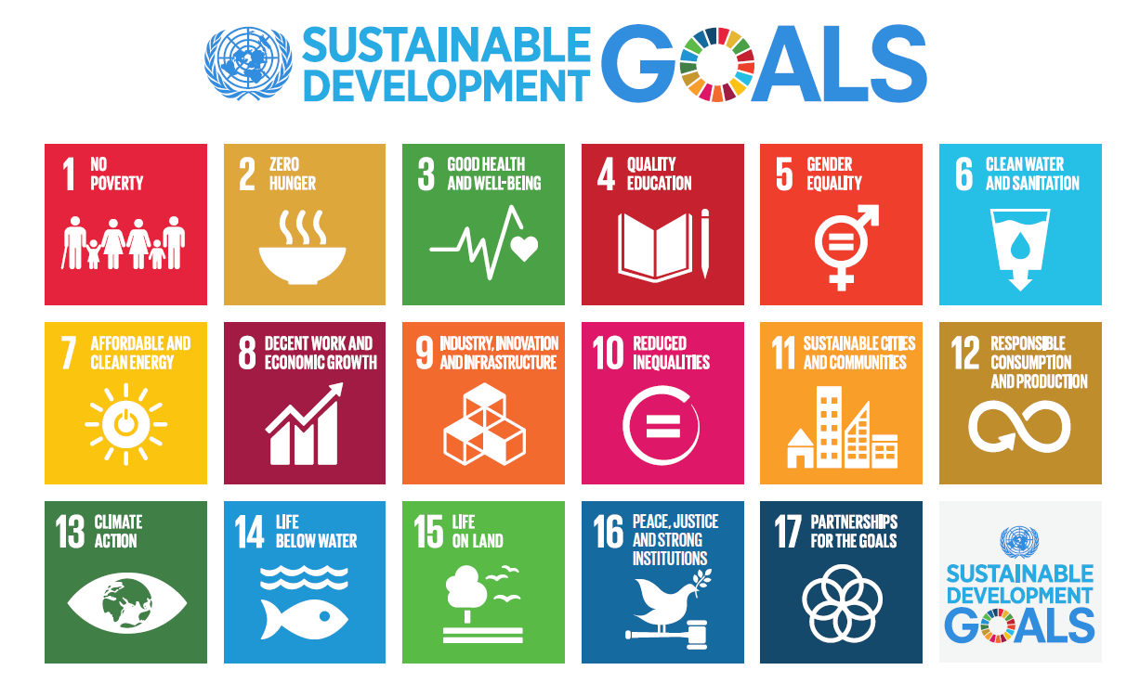
The 17 Sustainable Development Goals

Slide 14
17 SUSTAINABLE DEVELOPMENT GOALS
Poverty
Hunger
Health
Education
Gender equality
Safe water and sanitation for all
Energy for all
Growth and jobs
Infrastructure
10 Inequality
11 Safe cities
Sustainable consumption
Climate change
14 Marine conservation
15 Biodiversity
Peace, justice and governance
Means of implementation

Slide 15
MILLENIUM DEVELOPMENT GOALS

Slide 16
A JOURNEY FROM MDGs TO SDGs
The MDGs have 10 goals
The SDGs comprise an ambitious 17 goals
While the SDGs do not explicitly target financial inclusion, greater access to financial services is a key enabler for many of them.

Slide 17
From Millennium Development Goals to Sustainable Development Goals
8 goals
21 targets 60 indicators
17 goals 169 targets 304 indicators

Slide 18
SDGs 17, 169, 24
MDGs vs. SDGs: Goals
1
End poverty in all its forms and everywhere
Econ/Social
2
End hunger, achieve food security and improved nutrition and
promote sustainable agriculture
Social
3
Ensure healthy lives and promote well-being for all at all ages
Soc/ health
4
Ensure inclusive and equitable quality education and promote lifelong learning opportunities for all
Social
5
Achieve gender equality and empower all women and girls
Social
6
Ensure availability and sustainable management of water and sanitation for all
Environ
MDGs 8, 21, 60
1 | Eradicate extreme poverty and hunger
2 | Achieve universal primary education
3 | Promote gender equality and empower
4 | Reduce child mortality
5 | Improve maternal health
6 | Combat HIV/AIDS, malaria and other diseases
7 | Ensure environmental sustainability
8 | Develop a global partnership for development
7
Ensure access to affordable, reliable, sustainable and modern
Environ
energy for all
New!
8
Promote sustained, inclusive and sustainable economic growth, full and productive employment and decent work for all
Econ
9
Build resilient infrastructure, promote inclusive and sustainable industrialization and foster innovation
Econ
New!
10 Reduce inequality within and between countries
Social/Econ
11 Make cities and human settlements inclusive, safe, resilient
and sustainable
Social
expanded
12 Ensure sustainable consumption and production patterns
Econ
Ne¹³w!
Take urgent action to combat climate change and its impacts
Environ
14 Conserve and sustainably use the oceans, seas and marine resources for sustainable development
Environ
Limitations of MDGs:
15 Protect, restore and promote sustainable use of terrestrial ecosystems, sustainably manage forests, combat desertification, and halt and reverse land degradation and halt biodiversity loss
Environ
Prepared over relatively short time period among selected pool of experts from UN and OECD
Focused on social development and on developing countries
Insufficiently addressed environmental issues
16 Promote peaceful and inclusive societies for sustainable
Institutiona l
_{New!} development, provide access to justice for all and build
effective, accountable and inclusive institutions at all levels
17 Strengthen the means of implementation and revitalize the global partnership for sustainable development
13
Instrument

Slide 19
Resource crisis/ climate change
Millennium
Declaration
> MDG
Rio+20:
green
economy
SDG
Common challenges
the 2030 Agenda for Sustainable Development

Slide 20
EMPIRICAL STUDY
Hypothesis that will test whether or not the microfinance as a proxy of financial inclusion lead economic growth that eradicate poverty.
Available data from 1985 up to 2013 has been collected from Micro finance regulatory authority website and the DataStream; Data has been taken on yearly basis.
Bangladesh has been taken as case for this empirical study.
The model is specified as follows:
LOG (RGDP) =g0 +g MFLA+g2RINTR+g3INF +Ut
Where;
RGDP = Real Gross Domestic Product (a proxy for economic growth)
MFLA = Microfinance Loan and Advances
RINTR = Real Interest Rate
INF =Inflation

Slide 21
METHODOLOGY & VARIABLES
Methodology
Johansen Co-integration Test
Vector Error Correction Model (VECM)
Variables
RGDP = Real Gross Domestic Product (a proxy for economic growth)
MFLA = Microfinance Loan and Advances
RINTR = Real Interest Rate
INF =Inflation

Slide 22
WHY BANGLADESH ?
Known as Birth Place of Microfinance.
Bangladesh is well-known for its "minimalist" Grameen program focusing mainly on livelihood enterprises.
MFIs in Bangladesh serve a total number of over 20 million members, with Grameen Bank leading the flock with 7.2 million, ASA with 6.4 million and BRAC with 5.3 million members.
The average size of the loan stands at BDT8,000, making the Bangladesh microfinance segment a vibrant US$2.3 billion industry.
All the MFIs claim to have reported excellent repayment rates at 98 percent and above.
Data is available

Slide 23
RESULTS
Variable | ADF Test Statistics | Critical Value | Implication
LRGDP | 2.3142 | -3.6921 | Non -Stationary
LMFLA | -1.9343 | -3.6921 | Non -Stationary
RINTR | -3.3459 | -3.6921 | Non -Stationary
INF | -2.4947 | -3.6921 | Non -Stationary

Slide 24
RESULTS
Johansen Co-integration
The maximal Eigen value suggests one co integration
Null Critical Value | Alternative | Statistic | 95%
r = 0 | r = 1 | 80.3794 | 31.7900
r<= 1 | r = 2 | 25.0497 | 25.4200

Slide 25
RESULTS ANALYSIS
The results show that the independent variables (MFLA, RINTR and INF) jointly explained variations or changes in economic growth.
More specifically, the result reveals that a microfinance bank operation (MFLA) has a positive impact on economic growth.
Furthermore, the result indicates that microfinance bank is statistically significant in explaining economy of Bangladesh. That is, MFLA plays a vital role in the achievement of economic growth.

Slide 26
RESULTS
Variable | ECM(-1) t-ratio p-value | Implication
dLRGDP | 0 | Variable is endogenous
dINF | 0.057 | Variable is endogenous
dLMFLA | 0.553 | Variable is exogenous
dRINTR | .075 | Variable is endogenous

Slide 27
RESULTS ANALYSIS
The analysis result reveals that microfinance operations (captured by the loans and advances microfinance banks offer to the members of the society) have statistically significant positive impact or effect on the Bangladesh economy.
That is, the more the activities of microfinance banks in Bangladesh, the higher would be the growth of the economy.
Furthermore, the vector error correction model test result shows a unidirectional causality running from economic growth to microfinance banks operations.

Slide 28
RESULTS ANALYSIS
The analysis results reveal that microfinance operations have statistically significant positive impact on the economic growth.
The more the activities of MFIs, the higher would be the growth of the economy of the country.
The Vector Error Correction Model Test results show a unidirectional causality running from MFIs’ operations to economic growth

Slide 29
MICROFINANCE AS A PROXY FOR FINANCIAL INCLUSION AND SDGs
Kate McElligott, Director of strategic development at the Aspen Network of Development Entrepreneurs (ANDE) in an interview with inclusion hub that …
“Microfinance support entrepreneurs whose businesses address quality education, clean water and sanitation, and many other of the issues the SDGs target. Microfinance institutions themselves are core to addressing many of the SDGs: they tack on health insurance products, savings products and credit products for the poor”.

Slide 30
MICROFINANCE AS A PROXY FOR FINANCIAL INCLUSION AND SDGs
It is also reported by UNSGSA that at least 10 of these 17 goals are closely related to financial inclusion.
Issues of financial inclusion are covered across many of the SDGs
There are also references to financial inclusion in SDG 1 On poverty eradication; SDG 2 On food security and agriculture; SDG 3 On health; SDG 5 On women’s empowerment; SDG 8 On economic growth; SDG 9 On infrastructure and innovation; SDG 10 On inequality; SDG 16 On promoting peaceful and inclusive societies; and SDG 17 On means of implementation

Slide 31
PROPOSED SDG VARIABLES AND FINANCIAL INCLUSION
SDG 1, eliminating extreme poverty, we would look into the graduation rate of microfinance clients to get rid of poverty trap.
SDG2, Reducing hunger and promoting food security (SDG 2), it will be proxied by micro-savings and microloan services to farmers, cultivation training program and micro-financing to food industry.
SDG 3, Achieving good health and well-being, it will be proxied by no. of micro health insurance and no. of health awareness program by microfinance institutions.

Slide 32
PROPOSED SDG VARIABLES AND FINANCIAL INCLUSION
SDG 4, Fostering quality education (SDG 4)that will be proxied by enrolment of schooling – dropout of schooling of microfinance clients’ children
SDG 5, Promoting gender equality, will be proxied by percentage of female borrowers and percentage of female workers at microfinance institutions.

Slide 33
PROPOSED SDG VARIABLES AND FINANCIAL INCLUSION
SDG 6 & 7, water, sanitation and energy will be proxied by microfinance institutions’ off-grid energy service in exchange for ongoing payments.
SDG 8 , promoting shared economic growth will be proxied by an interacting variable, average loan size * digital financial service

Slide 34
PROPOSED SDG VARIABLES AND FINANCIAL INCLUSION
SDG 9, Promoting innovation and sustainable industrialization will be proxied by a dummy variable, if the MFI apply an innovative model is 1 , otherwise 0.
SDG 10 & 16, Toward equitable and peaceful societies will be proxied by a dummy variable, if the MFI is in conflicted area is 1 , otherwise 0

Slide 35
Thank you
Syed Othman Alhabshi
Deputy President (Academic)
Tel:
+603 7651 4000
Email:
soalhabshi@inceif.org

