Slide 1
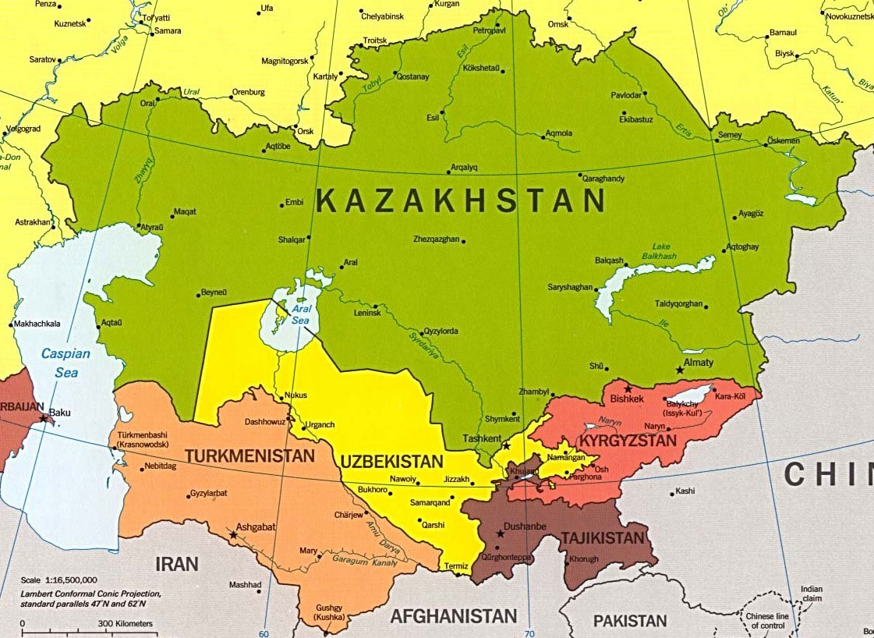
Pricing and Marketing Issues in Microfinance – Central Asia
Khartoum 2012

Slide 2
Development of Microfinance in Central Asia*
JSC «FUND for FİNANCİAL SUPPORT of AGRİCULTURE»
JSC “NATIONAL MANAGING HOLDING “KAZAGRO”
Microfinance in Central Asia started developing in mid 1990s with an active participation of the following NGOs and international organizations that introduced best practices and provided technical assistance in developing the sector:
UNDP,
the USAID/PRAGMA program on the development of entrepreneurship,
CAMFA, FINCA,
the EBRD Central Asia Business Advisory Services Program, and the TACIS program.
Several development banks have worked in the microfinance sector in Central Asia by providing financial resources, among them:
European Bank of Reconstruction and Development,
World Bank Group,
Asian Development Bank,
Islamic Development Bank,
other financial organizations.
* Central Asia in this context include Kazakhstan, Kyrgyzstan, Uzbekistan and Tajikistan. Turkmenistan is not covered in this presentation due to the absence of relevant information.

Slide 3
Three levels of microfinance system has been set up in Central Asian countries:
JSC «FUND for FİNANCİAL SUPPORT of AGRİCULTURE»
JSC “NATIONAL MANAGING HOLDING “KAZAGRO”
Macro-Level
Politics – law, regulation, control
Mezo-level
Financial infrastructure
Banks, MCOs, Insurers
Government
Micro-level
Clients
Technical assistace providers
3
3

Slide 4
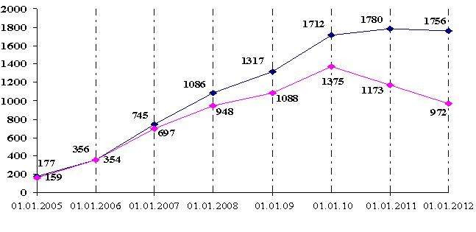
Regulation and particularities of microfinance sector in Central Asian countries
JSC «FUND for FİNANCİAL SUPPORT of AGRİCULTURE»
JSC “NATIONAL MANAGING HOLDING “KAZAGRO”
Kazakhstan
Macro-level:
Law on Microcredit Organizations (MCO) and Law on Credit Unions (CU) were adopted in 2003. According to the Laws the activity of MCOs and CUs is not licensed and MCOs are not regulated by the National Bank of Kazakhstan.
Till 2003 the activity of MCOs was licensed, but the Law on MCOs liberalized the market and the number of MCOs grew very fast. However, this growth also entailed occurrence of fraud and other illegal activities due to low level of transparency of MCOs’ activities.

Slide 5
Proposed changes in the legislation of microfinance sector in Kazakhstan:
JSC «FUND for FİNANCİAL SUPPORT of AGRİCULTURE»
JSC “NATIONAL MANAGING HOLDING “KAZAGRO”
At present, new Law on MFOs which will cancel Law on MCOs is under consideration in the Parliament of Kazakhstan. Proposed Law imply registration of MCOs and regulation by Central Bank’s the Committee for the control and supervision of the financial market and financial organizations.
These measures are directed at increasing the transparency level of MCOs’ activities and the quality of services.
According to the Laws MCOs and CUs are allowed only to disburse microcredits and are not allowed to accept deposits from the clients.
State policy in developing the microfinance sector in Kazakhstan – realization of State program on Employment-2020 that envisages among other measures microcrediting rural population, thus creating employment and alleviating poverty

Slide 6
The main stakeholders in the microfinance sector in Kazakhstan are:
JSC «FUND for FİNANCİAL SUPPORT of AGRİCULTURE»
JSC “NATIONAL MANAGING HOLDING “KAZAGRO”
• the Association of Microfinance Organizations of Kazakhstan, Center for Assistance to Microcredit organizations (CAMCO)
• the state (via JSC “Fund for Development “DAMU” and JSC “Fund for Financial Support of Agriculture” affiliate companies of national holding companies JSC “Samruk-Kazyna” and JSC “National Managing Holding “KazAgro”, respectively. During the period from 2005 to 2010 the state allocated more than 200 million USD;
• international organizations (EBRD, UNDP, etc.);
• commercial banks;
• NGOs and MCOs

Slide 7
JSC «FUND for FİNANCİAL SUPPORT of AGRİCULTURE»
JSC “NATIONAL MANAGING HOLDING “KAZAGRO”
Regulation and particularities of microfinance sector in Central Asian countries
Kyrgyzstan
Law on Credit Unions (CU) was adopted in 1999, and Law on Microfinance Organizations (MFO) and was adopted in 2002. So Kyrgyzstan was the first country in Central Asia to start developing legal framework for microfinance sector.

Slide 8
The main stakeholders in the microfinance sector in Kyrgyzstan are:
JSC «FUND for FİNANCİAL SUPPORT of AGRİCULTURE»
JSC “NATIONAL MANAGING HOLDING “KAZAGRO”
The Law on MFOs defines three types of organizations in microfinancial sector: MFO (microfinance organization), MCC (microcredit company), MCA (microcredit agency). MFOs are licensed by National Bank of Kyrgyzstan and allowed to both crediting and accepting deposits. MCC and MCA act on the basis of Certificate from the National Bank and are not allowed to accept deposits.
• the Association of Microfinance Organizations
• international organizations (EBRD, UNDP, ADB, EU-TACIS, GTZ, International Financial Corporation, Fund Soros-Kyrgyzstan, World Bank, etc.);
• commercial banks;
• NGOs, MFOs and credit partnerships.
State policy in developing the microfinance sector in Kyrgyzstan – realization of the Microfinance developing Strategy for 2011-2015 as an important measure of diminishing negative impact of 2010 events on the population’s wellbeing and continuation of the Mid-term Strategy that was complete in 2010 and showed satisfactory results.

Slide 9
JSC «FUND for FİNANCİAL SUPPORT of AGRİCULTURE»
JSC “NATIONAL MANAGING HOLDING “KAZAGRO”
Regulation and particularities of microfinance sector in Central Asian countries
Uzbekistan
Law on Microcredit Organizations (MCO) was adopted in 2006. According to the Laws on MCO the activity of MCOs licensed and is regulated by Central Bank of Uzbekistan. MCOs are allowed to accept deposits.
At present there are 32 Microcredit organizations working in Uzbekistan.
The main stake holders in the microfinance sector of Uzbekistan are:
the state - as shareholder of “Microcreditbank” JSC,
international organizations - World bank, Asian Development Bank, IDB Group, UNPD, International Development Association, Commerzbank AG, Landes Bank AG, KFW, etc.
private sector (microcredit organizations)
National Association of Microcredit Organizations and Credit Unions.
State policy in developing the microfinance sector in Uzbekistan – further expansion of the access of small business and private entrepreneurship to financial services via “Microcreditbank” JSC (that was established in 2006), attraction of investment and development of new financial products for rural and urban entrepreneurs.

Slide 10
JSC «FUND for FİNANCİAL SUPPORT of AGRİCULTURE»
JSC “NATIONAL MANAGING HOLDING “KAZAGRO”
Regulation and particularities of microfinance sector in Central Asian countries
Tajikistan
Law on Microfinance Organizations (MFO) was adopted in 2004. New Law on Microfinance Organizations was approved on 09.03.2012, but has not yet been signed by the President of Tajikistan, and, hence, has not entered into force.
According to the Laws the activity of MFOs are licensed and certified (depending on the type of organization) and regulated by the National Bank of Tajikistan.
According to the data of the National Bank of Tajikistan, at present there are:
type of organization | number of companies
Non-banking financial organization | 1
Micro-deposit organizations | 33
Microloan organizations | 44
Microloan funds | 45
Total | 123

Slide 11
The main stakeholders in the microfinance sector in Tajikistan are:
JSC «FUND for FİNANCİAL SUPPORT of AGRİCULTURE»
JSC “NATIONAL MANAGING HOLDING “KAZAGRO”
• the Association of Microfinance Organizations of Tajikistan
• international organizations (World Bank, IFC, EBRD, UNDP, ADB, USAID, DFID, Mercy Corps, etc.);
• NGOs and private MFOs
The Law on MFOs defines the following types of organizations in microfinancial sector: Micro Deposit Organization (MDO), Micro Loan Organization (MLO), Micro Loan Fund (MLF). MDOs are licensed by National Bank of Tajikistan and allowed to both crediting and accepting deposits. MLO also acts on the basis of National Bank’s license, but can only disburse microcredits. MLF is non-commercial institution that acts on the basis of National Bank’s certificate and disburses microcredits.
State policy in developing the microfinance sector in Tajikistan – realization of poverty alleviation programs via expanding access of the poor to financial resources with the support of donors and investors, i.e. “Microfinance” project to be financed by IDB.

Slide 12
Main characteristics of Microfinance sector in Central Asian countries:
JSC «FUND for FİNANCİAL SUPPORT of AGRİCULTURE»
JSC “NATIONAL MANAGING HOLDING “KAZAGRO”
 | number of MFOs (all types, excluding CUs) | loan portfolio, million USD* | number of active borrowers* | average interest rate (as yield on gross portfolio - nominal)*
Kazakhstan | 972 | 150 | 68 211 | 33,72%
Kyrgyzstan | 430 | 231 | 376 341 | 30,46%
Uzbekistan | 32 | 150 | 96 565 | 67,47%
Tajikistan | 123 | 418 | 133 619 | 73,19%
Total | 1 557 | 948 | 674 736
*source: MixMarket (as of 2010)

Slide 13
Main indicators of socio-economic development in Central Asian countries:
JSC «FUND for FİNANCİAL SUPPORT of AGRİCULTURE»
JSC “NATIONAL MANAGING HOLDING “KAZAGRO”
 | GDP per capita | Unemployment level | Level of poverty | Approx. number of people working abroad
Kazakhstan | 12 300 | 5.8% | 6.5%
Kyrgyzstan | 2 200 | 8.4% | 33.7% | up to 800 000
Uzbekistan | 3 100 | 1.1% | 26% (?) | up to 3 500 000
Tajikistan | 2 000 | 2.6% | 45% | up to 1 500 000
Sources: official statistics of the governments of respective countries and surveys of international organizations

Slide 14
Estimated level of demand for microcredits in Central Asian countries:
JSC «FUND for FİNANCİAL SUPPORT of AGRİCULTURE»
JSC “NATIONAL MANAGING HOLDING “KAZAGRO”
 | Estimated level of demand, millions of USD
Kazakhstan | 998
Kyrgyzstan | 408
Uzbekistan | 347 (7 000)
Tajikistan | 240 (2 995)
Total | 1 994 (11 401)
*estimation of demand was done on the basis of the assumption that 20% of unemployed population is willing to get microcredit to start or expand small business

Slide 15
Marketing and Pricing Issues faced by Microfinance Sector of Central Asia
JSC «FUND for FİNANCİAL SUPPORT of AGRİCULTURE»
JSC “NATIONAL MANAGING HOLDING “KAZAGRO”
Lack of available (cheap) funding for increasing the coverage of those in need of microfinance. This is seen by the large number of MFOs that are registered but do not conduct microcrediting (in Kazakhstan)
Absence of opportunities to attract investments without collateral or using their loan portfolio as collateral
Stemming from the two aforesaid issues – expensive microloans, meaning non-availability of microfinance to the poor (cost of funding is about 15-17%, expenses are at least 5%)
Low level of financial skills of population, especially rural ones, for effective use of microcredit (especially true regarding women, who are usually unaware on how finances are managed)
Lack of qualified personnel to elaborate new approaches in developing microfinance products
Absence of the tools to monitor indebtedness level of clients
As the result – Limited opportunities for MCOs to achieve both commercial and social objectives

Slide 16
Approaches to solve the issues:
JSC «FUND for FİNANCİAL SUPPORT of AGRİCULTURE»
JSC “NATIONAL MANAGING HOLDING “KAZAGRO”
- 3) Interest rate cap. This approach is applied by the governments of Kazakhstan and Uzbekistan
Collaboration with international organizations, membership in associations
Educating borrowers on effective use of financial resources
Exchange of information on clients via credit bureaus

Slide 17
Case-study “Fund for Financial Support of Agriculture” JSC, affiliate company of “National Holding “KazAgro”, JSC
JSC «FUND for FİNANCİAL SUPPORT of AGRİCULTURE»
JSC “NATIONAL MANAGING HOLDING “KAZAGRO”

Slide 18
“National Managing Holding “KazAgro” JSC:
JSC «FUND for FİNANCİAL SUPPORT of AGRİCULTURE»
JSC “NATIONAL MANAGING HOLDING “KAZAGRO”
“KazAgroFinance” JSC
“National Company “Food Contract Corporation” JSC
“Agrarian Credit Corporation” JSC
“Fund for Financial Support of Agriculture” JSC
“KazAgroGarant” JSC
“KazAgroProduct” JSC
“KazAgoMarketing” JSC

Slide 19
2 crediting companies:
JSC «FUND for FİNANCİAL SUPPORT of AGRİCULTURE»
JSC “NATIONAL MANAGING HOLDING “KAZAGRO”
“Fund for Financial Support of Agriculture” JSC
“Agrarian Credit Corporation” JSC
Microcredit
Credit
Small Farms, Poor Households, Individuals
Farms, Households, Individuals
Development and expansion of small farms, households

Slide 20
“Fund for Financial Support of Agriculture” JSC (FFSA):
JSC «FUND for FİNANCİAL SUPPORT of AGRİCULTURE»
JSC “NATIONAL MANAGING HOLDING “KAZAGRO”
Loan portfolio as of 01.01.2012 - appr. 104 million USD
Number of active borrowers as of 01.01.2012 - 16 770
Number of MCOs created in 2007-2008 - 51
Number of MCOs that bought the share of FFSA - 10
Number of credit products - 10
Partners: Microfinance Center (Poland), UNDP, IDB
Development Prospects : introduction of Islamic modes of crediting under Project “Microfinance to Rural Communities” financed by Islamic Development Bank

Slide 21
“Fund for Financial Support of Agriculture” JSC (FFSA):
JSC «FUND for FİNANCİAL SUPPORT of AGRİCULTURE»
JSC “NATIONAL MANAGING HOLDING “KAZAGRO”
Interest rate : 6-12%
Cooperation with MFC (Poland), participation in regional/international microfinance conferences. FFSA and MFC established CAMCO in order to facilitate institutional development of MCOs
Cooperation with IDB: introduction of Islamic modes of financing in rural microfinance sector.
In 2005-2008 FFSA held trainings for rural people in collaboration with “KazAgroMarketing” JSC. About 100 thousand rural people attended trainings.
Provides information on clients to Credit bureau on regular basis

Slide 22
Thank You for Your Attention! Contact details: Bakhyt Sayakova “Fund for Financial Support of Agriculture”, JSC Astana, Kazakhstan bakhyt_sayak@mail.ru
JSC «FUND for FİNANCİAL SUPPORT of AGRİCULTURE»
JSC “NATIONAL MANAGING HOLDING “KAZAGRO”

