Slide 1
Oman Development Bank
SME Sustainable Finance
At the frontier of bankability
By
Samir Saied
General Manager
Oman Development Bank

Slide 2
In a nutshell
Development Banks model at the frontier of efficient market-The ODB case.
How to reconcile the risky nature of SMEs with the required bank’s sustainability ?
No trivial, natural solution… However seizing opportunities, mitigating the identified risks, pricing/ subsidizing the quantified residual ones is part of it.

Slide 3
Brief History of ODB
ODB is the state owned development bank specialized in financing SMEs and corporate; start-ups and expansion, in almost all value added industries (excluding trading, real estate and contracting).

Slide 4
Vision of ODB
To be a leading Bank on financing development projects of Large, Medium & Small Enterprises by leveraging the professionalism of its employees and quality of its customer service.
Mission of ODB
To commit necessary long and short term financial resources that are required to support the development activities of Large, Medium & Small Enterprises in line with the Government goals to diversify the sources of national revenue.

Slide 5
ODB’s Financing
ODB is financing projects with upper limit of loan for a single project, not exceeding RO 1,000,000 (1RO=2.58 US$) in all sectors but real estate and trade.
Scheme is also available for small units with investment of RO 5,000 and below, exempted fully from interest.
  ODB has recently commenced sanctioning Working Capital (Pre-shipment & Post-shipment Finance) to SMEs
  It also started accepting Fixed Deposits to reinforce its funding base.

Slide 6
Steady growth with better quality loans (RO million)
Notes:
A quite 6 fold growth from 17 to 90

Slide 7
Impact of Recent Economic Crisis in ODB
The economic crisis affected ODB’s business as shown in the graph. The graph shows disbursement of loans. It can be seen that there is fall in disbursement in 2009 and 2011.

Slide 8
The Risky Nature of financing SMEs and Challenges of Development Banks
SMEs are generally risky, and supporting them may be costly; they are not always attractive to bankers.
As long as there is no market efficiency there is a need for the government to intervene; and that is done, among other stimulus, through development banks.
The challenge for development banks is to remain sustainable, and become self-sufficient, without burdening the government’s budget.

Slide 9
As start-ups/ new entrants, SMEs are risky; because:
    Of the effect of learning curve (lack of experience),
    Market competition; need time to capture market share
    Initial technical teething problems
    Borrowed money finance , instead of equity in the beginning

Slide 10
Risk Factors
Behavioural Factors
Some promoters may be unwilling to spend time, money and effort to undergo advisory programme
Some are not aware of their shortcomings
Over-optimism; under-estimation of risks/ obstacles which have to be faced.
External Factors
PEST (Political, Economical, Social and Technological)
e.g. SMEs are the first victims of the current economic crisis

Slide 11
SMEs are vehicles of personnel development
Transformational journey to self-accomplishment
Climbing the growth ladder from dependency to independency and then interdependency
Learning by doing and from mistakes
The experience may be painful; but the results can be astonishing: non-financial benefits may even be more considerable than financial ones

Slide 12
But, SMEs are the engines of growth
  SMEs are the main creator of jobs and wealth
  Main provider of employment (93.5%) in US
  SMEs in Oman (less than 100 employees) : 75,000 (as of 2011)
  Today’s successful SMEs will graduate and develop into the corporate of tomorrow
  SMEs will become the main provider of employment in the post-oil era, replacing the government
Notes:
Fish farming creates 2 job per hectar of ponds

Slide 13
The Risk Mitigants
Sound feasibility studies as insurance against failure and as initial guideline and planning tool
Advisory Services to accelerate the learning process (Business Mentoring, SOP,...)
Incubator programs to reduce costs (Clustering, BDC,…)
Phasing the project in several stages (Duplicate small successes)

Slide 14
Risk Vs Return
Investments with the highest probability of a big return are also the riskiest.
Expected Return = Risk-free return + Beta x Risk Premium
R_{E} =R_{F} + β x ( R_{M} – R_{F})
R_{E}= Expected Return
R_{F}= Risk-free return
R_{M}= Expected Return of market
β = Risk Factor

Slide 15

Risk – Return Duality
Lower the risk, lower the return
Higher the risk, higher the return
Risk Free Return
Risk Premium
Risk
14

Slide 16
Risk – Return Duality
Low Risk- High Return
High Risk- High Return
Risk Free Return
Risk Premium
High Risk- Low Return in the beginning
Low Risk- Low Return
Risk
15

Slide 17
Risk – Return Duality
Low Risk- High Return
(imitated)
High Risk- High Return
( Stars)
Creation of Value for investors
Risk Free Return
High Risk- Low Return
(Dilemmas)
Risk Premium
Low Risk- Low Return
Risk
16

Slide 18
Risk – Return Duality
Low Risk- High Return
High Risk- High Return
Creation of Value for investors
Key Success Factors increases return
Risk Mitigants reduces Risks
Risk Free Return
SME startups
Risk Premium
Low Risk- Low Return
High Risk- Low Return in the beginning
Role of Development Banks
Risk
17

Slide 19
After mitigating risks and creating Critical success Factors, SMEs should seek finance in the following order:
1. Own savings
2. From friends and relatives
3. Seed Capital
Venture Capital (V. C.)
(for high growth industry)
5. Short term credit
    Bill Discounting
    Factoring
    Pre-shipment Financing
    Post-shipment Financing
    Overdraft
6. Lease Financing
7. Long term credit
    Mezzanine Finance
    Senior Debt
8. Private Equity
9. Public Equity

Slide 20
Pricing the risk- Why?
It is a known fact that failure rates of start-up ventures are high compared to established ventures.
(Estimated between 40 &50% )
No Bank can survive this high rate of failure.
It is assessed that banks need RO 10-15 of good credit to
compensate for the bad credit of just RO 1
Start-ups are the natural domain of venture capital , who share the upside of the successful businesses to compensate for the losses of failures. Scalable high growth businesses fit naturally
Lifestyle start ups finance ( by far the majority) remain challenging.

Slide 21
Pricing the risk- How?
Quantification of the risk: Expected Loss
EARLIER MODEL
  Expected Loss (EL) depends on:
  Strength of Project (Borrower Risk, PD)
  Strength of Collateral (Recovery in default)
  EL = Probability of Default x Loss Given Default

Slide 22
Internal Rating Model
EARLIER MODEL
Credit Scoring is based on four categories:
  Financial
  Industry
  Management
  Business
Weights are assigned to each category to arrive at a composite Borrower Score
Borrower Score provides the Risk Rating

Slide 23
Borrower Risk Ratings (BRR) and Probability of Default (PD)
EARLIER MODEL
Borrower Risk Ratings (BRR) provide a basis for determining the PD. The impact of collateral is not considered in assigning the BRR.
ODB adopts a ten scale BRR framework, which is compliant with Basel II requirements for implementation for IRB approach, in the future.
Probability of Default (PD) measures how likely a customer is to default
PDs can be assigned for each Risk Rating based on experience and knowledge and can be fine tuned on an ongoing basis.

Slide 24
Borrower Rating & Probability of Default
EARLIER MODEL
Probability of Default (PD)
Borrower Rating

Slide 25
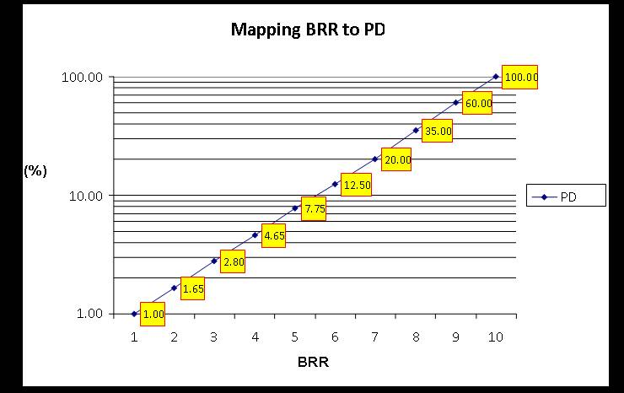
Probability of Default (PD)
Borrower Rating

Slide 26
Utility of Internal Rating Model
EARLIER MODEL
Internal Rating Model will:
provide an objective, consistent and uniform basis for determining Borrower Credit Quality
be compliant with requirements of Basel II
serve as a basis for determining Collateral and Risk Premium
Model for Determining Collateral & Risk Premium will:
help to evolve a culture of fairness and transparency in credit decisions
ensure long term sustainability of the bank

Slide 27
Pricing the risk- Who?
Size
Corporate
SME
Corporate Finance
Project Finance without recourse
PE - VC
Mezzanine
Subordinated Debt
Banks,
Guarantee Schemes & subsidies(lifestyle)
Business Angels
VC, Gov supported
DB , Grants
Low High Risk/ Return
Notes:
Where is Pilot test Hatchery or farm? Fish farm with strict BMP SOP? Cluster Hatchery-duplicated farms-Distribution? Corporate Diversification toward new species?

Slide 28
Pricing the risk borne by the state
To support SMEs the Oman government offers credit at subsidized interest rates. The interest subsidy is 6% p.a. and the customer has to pay only 3% p.a. to ODB as interest.
To support the Bank the Oman government allows to consider cost of equity free while computing the budgeted loss: No dividend required; but losses are not an option, ODB must be self sustainable.

Slide 29
Impact of Recent Economic Crisis
Financial crisis that broke out in the United States in 2007-2008, had destroyed US$34.4 trillion of wealth globally by March 2009.
Over $20 trillion of middle class tax payer’s money has been provided as government bailout/ stimulus commitments/ spending worldwide to help a few numbers of elite, rich groups…

Slide 30
....Impact of Economic Crisis
… While SMEs suffered the most from reduced lending of commercial banks and a large number of poor people paid the price of aid opportunities cost.
Stimulus packages must rather be redirected to help the crisis challenged SME entrepreneurs by subsidising the pricing of an increased risk in an efficient and systematic way, to compensate for SME finance drain and limit the job destruction disaster.

Slide 31
Thank You

