Slide 1
Green Finance in SMEs
Nataliya Mylenko
World Bank
July 6, 2012

Slide 2
Context
SME access to finance
Green finance for SME

Slide 3
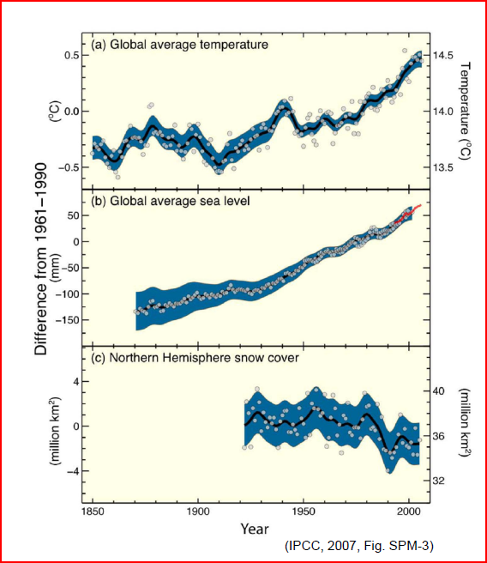
The combination of observations and paleoclimate information shows
unprecedented changes in the climate system…
…Warming in the
climate system
is unequivocal.
Intergovernmental Panel on Climate Change (IPCC), 2007

Slide 4
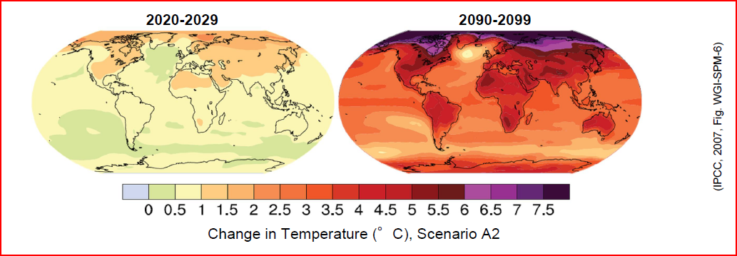
Continued GHG emissions ... would induce many changes ... that would very likely be larger than those observed
(IPCC 2007)

Slide 5
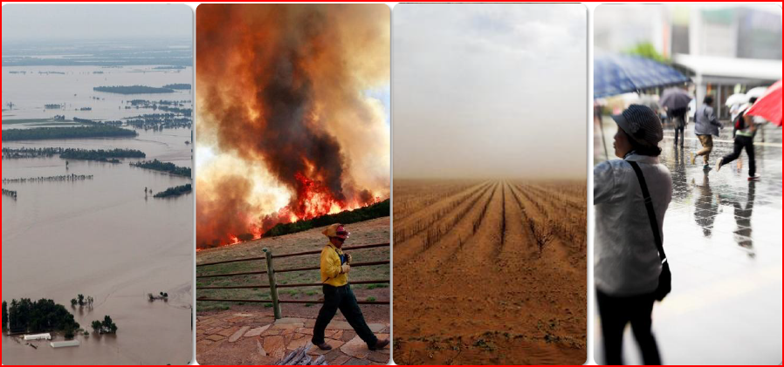
A changing climate leads to changes in extreme weather and climate events, resulting in significant economic and human costs

Slide 6
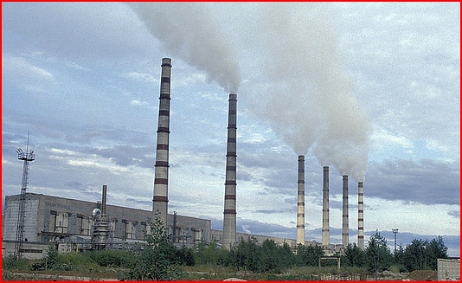
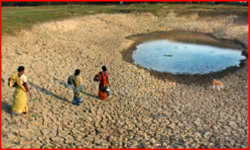
Addressing climate change challenge needs both mitigation and adaptation
Mitigation – measures to reduce greenhouse gas emissions (renewable energy, energy efficiency, reforestation, eliminating waste methane, etc)
Adaptation – measures to adjust to the changing environment (building coastal defences to prevent flooding as in the Netherlands and Maldives, water management, etc).

Slide 7
What does this mean for micro, small and medium enterprises?
More than 95% of all enterprises in the world are Micro Small and Medium Enterprises and they are key for both mitigation and adaptation to climate change
The financing is essential to enable MSMEs to contribute to addressing climate change challenge.

Slide 8
…But SMEs face a challenge to obtain financing

Slide 9
The usual constraints SMEs face when trying to obtain credit are exacerbated when they need financing for renewable energy, energy efficiency, or other new products and technologies
Lack of collateral
Small loan size but high appraisal costs
Lack of reliable accounting
New and complex products or technologies with limited performance benchmarks

Slide 10
When public financing instruments are needed?
Energy Efficiency (EE): overcome market barriers and risk perception
High upfront costs
Credit risks: Most banks rely on credit rating criteria, while many EE developers and inefficient end-users are not creditworthy
Performance risks: Lenders are not sure the expected energy savings will be realized, and measurement and verification is not an easy task
Banks lack expertise and interest in EE financing
Small deals with high transaction costs
Renewable Energy (RE): overcome cost and technology risks
Mismatch between the short-term tenure and long-term payback
Technology risks: e.g. geothermal
Credit risks for SME developers

Slide 11
Financing instruments for SMEs: tailored to market segments, barriers, and local context
Credit Lines: Effective at increasing banks’ capacity and confidence in EE/RE investments to large and medium sized clients/projects and providing longer term tenure for RE projects; BUT supporting SME EE investments is a challenge
Risk Guarantees: Effective at increasing banks’ confidence in the clients at margins of risk ratings such as ESCOs, mitigating technology risks (e.g. geothermal) and extending loan tenure; BUT only reduce banks’ perceived risks
Dedicated Funds: Effective at increasing access to EE financing for SMEs and public sector projects, and when domestic banks are not ready for RE financing; BUT leverage, sustainability, and scale-up key challenges

Slide 12
Which public financing instruments maximize financial leverage ?
Engaging domestic banks through credit lines and guarantees: high leverage of public funds and good prospects of sustainability
Technical Assistance (TA): critical with high pay-off, particularly when packaged with public financing instruments

Slide 13
Lessons Learned: Implementing Public Financing Instruments
Technical Assistance is critical to:
Financial institutions
EE/RE project developers
EE/RE policy makers and financial regulators
Generating sufficient deal flows has been a major challenge:
Need to better match banks’ financing criteria with the targeted market segments who most in need of financing
Need to expand beyond banks’ “comfort zones”: clients, sectors, technologies
Need to motivate banks’ internal organization for project origination
Governance and management of publicly funded programs is critical to success.
Careful selection of managers of financing facilities
Ensuring their independence

Slide 14
Thank you!
Nataliya Mylenko
Financial and Private Sector Development East Asia and Pacific Region,
The World Bank Group 1818 H Street, N.W., Washington, DC 20433 nmylenko@worldbank.org

