Slide 1
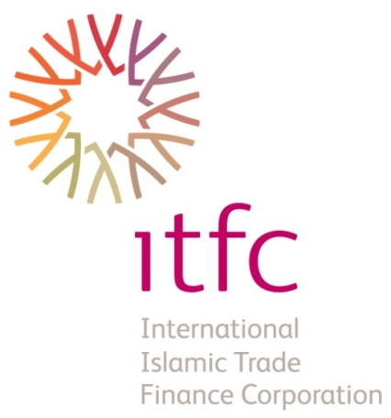

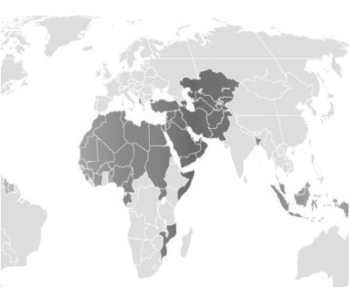

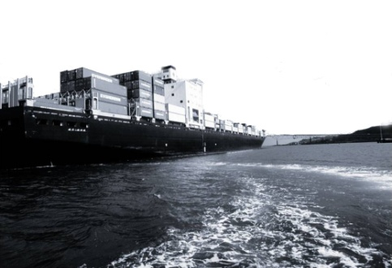

SME BANK-
ADFIMI DEVELOPMENT FORUM 2012
Kuala Lumpur
5-6 July 2012
Member of Islamic Development Bank Group

Slide 2


Content
Contents
1
IDB Group Structure
2
The Institution
3
Financing Mechanisms
4
Acceptable Collaterals
5
ITFC’s Financing Products
6
TCPP
7
ITFC Awards & Accolades

Slide 3





IDB Group Structure
Established in 1975
1981
1999
1994
2008

Slide 4

About ITFC
Became operational on 1st Muharram, 1429H (10 January, 2008G);
Authorized Capital of US$3 billion;
Subscribed Capital of US$750 million;
Paid-Up Capital of US$672 million.

Slide 5

Mission
“ We exist to be a catalyst for the development of trade among OIC member countries and with the rest of the world ”

Slide 6

Vision
“ ITFC is to be a recognized provider of trade solutions
for OIC member countries’ needs ”

Slide 7

ITFC Future Intended State
We are fostering OIC member countries’ trade
and trade integration
We are responsive to customers’ needs with
innovative Shariah compliant solutions
We are the preferred choice for trade solutions
We are delivering fair returns for our shareholders

Slide 8
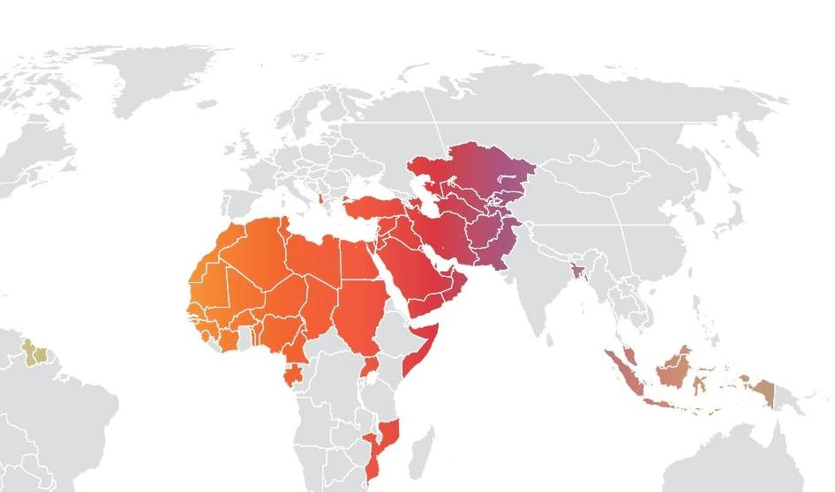
Where We Operate
38 Member Countries
18
Financial Institutions
Central Asia
MENA
Sub-Saharan Africa
Asia

Slide 9
ITFC Core Competencies

Slide 10
ITFC Intra-Trade in 1432H (2011)
ITFC Trade Approvals by Source of Supply

Slide 11
ITFC Trade Approvals
IDB/ITFC cumulative trade approvals up to 1433H (Q1): US$38.7 bn.
ITFC total approvals since inception up to 1433H (Q1): US$12.3 bn.
(US$ billion)

Slide 12
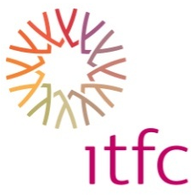
ITFC Trade Approvals by Region
(US$ million)
3,033
Half Year

Slide 13
ITFC Trade Approvals for LDMCs
In 1432H, Trade Finance Approvals for LDMCs reached US$ 1,494 million representing 49% of total approvals for the year.
(US$ million)

Slide 14
ITFC’s Support for SMEs
ASIA:
Country | Type (2SMF/Line) | No. of Operations | Amount | Year
ALBANIA | Line | 1 | Euro 3,797,372 | 2010
IRAN | 2 SMF | 4 | Euro46,000,000 | 2009
 | 2 SMF | 1 | US$ 20,000,000 | 2010
TURKEY | 2 SMF | 1 | US$ 15,000,000 | 2008
 | Line | 3 | US$ 45,000,000 | 2008
 | Line | 2 | US$ 50,000,000 | 2010
 | 2 SMF | 1 | US$ 25,000,000 | 2010
 | 2 SMF | 3 | US$ 60,000,000 | 2011
 | 2 SMF | 3 | US$ 60,000,000 | 2012

Slide 15
ITFC’s Support for SMEs
CIS:
Country | Type (2SMF/Line) | No. of Operations | Amount | Year
AZERBAIJAN | Line | 1 | US$1,000,000 | 2009
 | 2 SMF | 2 | US$31,300,000 | 2010
 | Line | 1 | US$ 1,000,000 | 2010
 | 2 SMF | 1 | US$ 1,000,000 | 2011
 | Line | 2 | US$ 2,500,000 | 2011
KAZAKHSTAN | Line | 1 | US$1,000,000 | 2009

Slide 16
ITFC’s Support for SMEs
MENA:
Country | Type (2SMF/Line) | No. of Operations | Amount | Year
BAHRAIN | 2SMF | 1 | US$20,000,000 | 2011
EGYPT | 2SMF | 1 | US$10,000,000 | 2010
JORDAN | 2SMF | 1 | US$10,000,000 | 2010
LEBANON | 2SMF | 1 | US$7,000,000 | 2008
MAURITANIA | 2SMF | 1 | US$3,850,000 | 2011
Africa:
Country | Type (2SMF/Line) | No. of Operations | Amount | Year
TOGO | 2SMF / Line | 1 | US$20,000,000 | 2012
GHANA | 2SMF / Line | 1 | US$5,000,000 | 2012

Slide 17
ITFC Source of Funding
ITFC Capital Resources
BADEA Export Financing Scheme
Other Multilateral Funds
IDB Mudaraba Fund
Commercial Banks and Financial Institutions …
…are all funding resources

Slide 18
Financing Mechanisms
Direct Financing: Financing is extended directly from ITFC’s own resources through a Murabaha Agreement between ITFC and the Beneficiary
Line of Financing: ITFC provides lines of financing to local Financial Institutions which act as Intermediary (Lines Agents) between ITFC and
the end beneficiaries for the Trade Finance Operations upon signing a Line Master Agreement.
Two-Step Murabaha: ITFC provides Two-Step Murabaha Financing to local Financial Institutions or commercial banks to be extended to SMEs.
Co-Financing & Syndication: In this mode of financing, ITFC, acting as a Mudarib (lead arranger or co-arranger), invites one or more Financial Institutions to participate in the financing.
ITFC may also participate in syndications arranged by other institutions.

Slide 19
Direct Financing
(1) A Murabaha financing agreement is signed between ITFC and the
beneficiary
- Other parties may co-sign the agreement
(2) ITFC makes payment of purchase price directly to the Supplier
(3) The beneficiary repays the sale price directly to ITFC
ITFC takes the direct credit risk of the beneficiary.

Slide 20
Line of Financing
Lines of Financing are provided to local Financial institutions acting as Intermediary (Line Agents)
A Master Agreement is signed between ITFC and the end beneficiaries
Lines Agents will finance Local SMEs

Slide 21
Two-Step Murabaha Financing
A Line of Financing agreement is signed between ITFC and the local Bank
Local Bank requests Sub-Murabaha Agreements to be signed between ITFC and the beneficiary
Local bank provides bank guarantee for the beneficiary
Payment under the financing is disbursed directly by ITFC
The beneficiary repays the sale price directly to ITFC
ITFC takes the risk of the local bank
Local Bank takes the credit risk of the beneficiary

Slide 22



Structured Trade Finance
  Asset-backed: STF as a more secure alternative to traditional lending particularly post-crisis;
  Secured Transactions: Risk-mitigated structure (Assets) + self-liquidating (Cash flow);
  Customized solutions for impact: Accessing difficult markets/LDMCs while providing tailored structures to fit clients’ needs.

Slide 23
Structured Trade Finance
  STF operations grew from US$70m. (3% of total approvals) in 1430H to US$ 501m. (16.5% of total approvals) in 1432H.
(US$ million)
715%

Slide 24
Acceptable Collaterals
  Government/Sovereign from the Government or any authorized ministries of the Government in the Beneﬁciary’s country;
  Bank Guarantee from commercial banks or Financial Institutions acceptable to ITFC;
  Export Credit Insurance to be provided by a reputable Export Credit Agency (ECA);
  Assignment of Receivables from pre-approved reputable off-takers and/or Warehouse Receipts issued by acceptable class collateral managers;
  Corporate Guarantee in the form of a Letter of Guarantee (L/G) provided by a parent entity (with acceptable creditworthiness to ITFC) for its subsidiary as the Beneﬁciary of the ﬁnancing.

Slide 25
Trade Cooperation and Promotion Program (TCPP)
To enhance Intra-trade by improving member countries’
Buyer-Seller, Business Forums, Technical support to TPOs etc.
Competitiveness to benefit from globalization.
Trade Promotion
To strengthen economic integration through removal of trade barriers, harmonization, trade infrastructure etc.
AfT Road Maps for SPECA & ESCWA, expert groups etc.
Trade Facilitation
To enhance member countries’ trade capacities for sustainable national trade development.
Training courses, establishing regional training centers etc.
Capacity Building
To develop member countries’ trade capacities and competitiveness in the sectors and products where they have comparative advantages.
Technical studies
Development of Strategic Commodities
To improve synergy and to include trade in the agenda of our main partners for better design and delivery of trade related technical assistance
NEW
Trade Mainstreaming
NEW
Trade Finance Support
Involves direct collaboration with ITFC trade finance specialists to develop needed counseling and training programs for ITFC’s national partners/financial intermediaries

Slide 26
Why ITFC Should be Your Preferred Trade Partner?
ITFC can offer an off balance sheet financing structure in the Murabaha mode of finance. This will particularly appeal to the public listed companies and the commodity players in Malaysia who want to manage their balance sheet
The Structured Trade Finance (STF) is tailored to grow with your business
Expertise in the commodity sector
Competitive pricing
Geographical presence in 56 member countries, this is significant for companies who are looking to expand beyond Malaysia

Slide 27














ITFC Awards and Accolades
2011
Africa DoY: Syndicated Murabaha Groundnut
Deal in The Gambia
Murabaha DoY:
2 Step Murabaha Finance in Favor of Mauritania to Reach SMEs
Most Innovative DoY:
A Pre-Export Financing for the Indonesian Coffee Sector
Syndicated Murabaha:
US$420m for the Import of Crude Oil and Refined Pertoleum Products for Bangladesh
Best Islamic Trade Finance Bank/Institution
2010
Syndicated Murabaha: $50m Sugar Deal in Sudan
Structured Murabaha:
$40m Wheat Deal in Kazakhstan
Syndicated Murabaha:
$50m Sugar Deal in Sudan
Syndicated
Murabaha:
$50m Sugar Deal in Sudan
Best Islamic Trade Finance Bank/Institution
Best Development Financial Institution (DFI) Middle East
2009
2008
Structured Trade Finance:
$25m Sugar Deal for the import of raw sugar in Indonesia
Structured Trade Finance:
$25m Sugar Deal for the import of raw sugar in Indonesia
Structured Trade Finance:
$25m Sugar Deal for the import of raw sugar in Indonesia
Best Islamic Trade Finance Bank/Institution
Syndicated Murabaha:
$27m Cotton Deal in Côte d’Ivoire

Slide 28
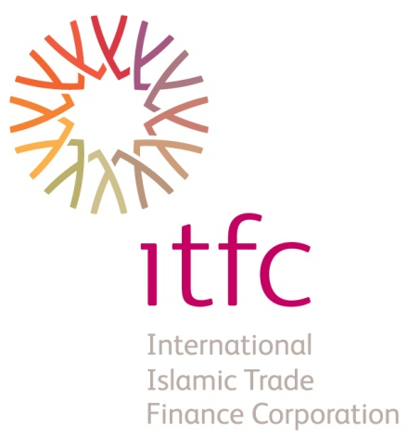

Thank You

