Slide 1

Investment & Trade Insurance for SME’s
The Islamic Corporation for the Insurance
of Investment and Export Credit
Member of Islamic Development Bank Group

Slide 2

Table of Contents
Trade & Insurance – SME’s perspective
Mission, Vision & ICIEC Mandate
ICIEC - Who we are
Business Profile
Products & few Sample Transactions

Slide 3
Trade & Insurance – an SME Perspective
Trade – Engine of Growth
Trade Credit & Political Risk Insurance
Importance of SME Sector
Malaysia’s SME sector dynamics
  SME’s 2012-2020 Strategic Plan
  SME Developmental Council
  SME’s contribution to GDP 32%, Employment share 59% and export share 19%

Slide 4





Affiliated Institution
Islamic Corporation for Insurance of Investments and Export Credits (ICIEC)
International Islamic Trade Finance Corporation (ITFC)
)
Islamic Research and Training Institute (IRTI)
Islamic Corporation for the Development of the Private Sector (ICD)

Slide 5
ICIEC Mission & Vision
Mission
Vision
To be the internationally recognized Leader in Shariah compatible Export Credit and Investment Insurance and Reinsurance in Member Countries
“To encourage Exports from Member Countries and to facilitate the flow of Foreign Direct Investment to Member Countries by providing and encouraging the use of Shariah compatible Export Credit and Investment Insurance as Credit and Country Risk mitigation instruments”

Slide 6



Who We Are
ICIEC is a multinational institution with full juridical personality and multilateral status
Established in 1994 & based in Jeddah – KSA with a representative office in DIFC - Dubai
Owned by the Islamic Development Bank Group in addition to 40 member countries from Asia, Africa and Europe
Subscribed capital is US$ 240 million
Rated Aa3 by Moody's
The only Export Credit Agency in the world that provides export credit & Investment insurance in compliance with the Islamic Shariah
Permanent Member in Berne Union, Coface Alliance, Prague club and founding member of AMAN Union
IFSR Aa3
Credit Alliance

Slide 7
ICIEC Mandate …
Investment Insurance
Import Credit Insurance
Export Credit Insurance
Domestic Credit Insurance
To encourage exports from Member Countries to the rest of the World
Covering domestic sales inside member countries
Helping MCs import of strategic and capital goods from the world
To encourage the flow of capital and investment from the World to Member Countries

Slide 8

ICIEC – Who we are.. Our mandate
Export Credit Insurance
Investment Insurance
To encourage exports from Member Countries to the rest of the World
To Encourage the Flow of
Capital and Investments
from the World
to Member Countries
Member
Countries
Member
Countries

Slide 9

ICIEC Product Mix
Banks
Trade Finance and Investment Insurance
Bank Master Policy
Documentary Credit Policy
Loss Payee Assignment for CSTP/STP
PRI for Financing Facilities
Non-Honoring of Sovereign Financial Obligations
Export & Domestic Credit Insurance:
    Comprehensive Short term Policy
    Specific Transaction Policy
    Supplement Medium term Policy
Insurance
Credit
Trade Credit
Political Risk
Suppliers
Investors
Insurance
Insurance
Inward Reinsurance :
      Quota Share Treaty
      Facultative Reinsurance
      Excess of Loss Treaty
Foreign Investment Insurance :
Equity Investments
Non Equity Investments
Reinsurance
ECAs

Slide 10
ICIEC – Who we are.. Major Shareholders

Slide 11
ICIEC Milestones …
Operating Dubai
Office
Establishment
of ITAP
Assigned rating of
Aa3 by Moody’s
Establishment
of ICIEC
Investment
Insurance
Commence
Insurance
commitments
surpass
$ 1billion
Full membership
in Bern Union
Implementation
of IIMS
1415
1416
1419
1421
1425
1426
1427
1428
1429
1430
1431
Member Countries reach 40
Commencement of
Export Credit
Insurance Operations
Reinsurance Treaty
Signed
Increase capital
to 150 m ID
Formation of
Aman Union
Articles amended to
allow cover of domestic
sales & imports from
Non member countries
ICIEC joins Coface credit Alliance
Articles amended to allow cover
of export to non member countries
Insurance Commitments Surpass $ 3 billion

Slide 12
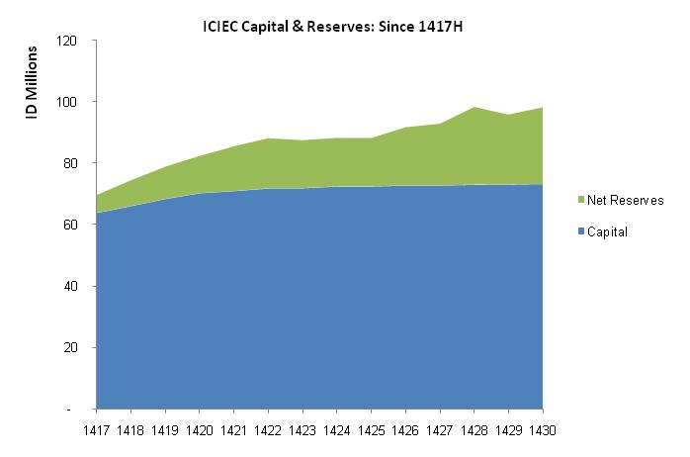
ICIEC Capital Resources
Net Reserves
24.96
73.24
Paid up Capital
One ID= 1.54 US$

Slide 13
Increasing demand for Export Credit Insurance
US$ mn
Rapid growth in new commitments

Slide 14
Business Insured…..a consistent growth
US$ mn

Slide 15
Loss Payee Assignment – Islamic alternative of Factoring
Allowing the banks to provide export related financing to its customers and utilize the export receivables as security for the repayment of the credit extended.
How does it work?
Exporter enters into a Sale Contract with an importer.
The Exporter concludes an Insurance Contract with ICIEC and pays premium.
The Exporter assigns the finance bank as a loss payee on the policy who has the right to receive the claims.
The financing Bank offers the exporter , export finance facilities against assignment of contract proceeds or Bills discounting
In case the buyer fails to pay, ICIEC compensates the bank with 90% of the contract value.
ICIEC recovers from the buyer an returns 10% share to the bank.
Importer 1
Exporter
1
Importer 2
Importer 3
3
2
4
ICIEC
5
Bank
6

Slide 16
Bank Master Policy (BMP)
  Provide insurance of banks export related financing to its customers on an Islamic basis against both commercial and political risks
Financing Bank purchase the goods from the exporter at (P)
Financing Bank makes deferred payment sale of goods to the importer at (P+Mark up)
Financing Bank applied to ICIEC to insure the Murabaha receivables (P+Mark up)
ICIEC approves, financing bank pays premium
In case of non-payment by buyer (borrower) the bank submits claim and ICIEC pays compensation (90% of loss)
ICIEC recovers arrears from issuing bank, pays back 10% to confirming bank
How does it work?
Financing Bank
Exporter
1
3
4
5
2
6
Importer

Slide 17

Thank you

