Slide 1
Customer Focused Innovation in SME Banking
Istanbul Chamber of Commerce
Assoc. Prof. Dr. Abdulkadir Tuna
SME BANK - ADFIMI INTERNATIONAL DEVELOPMENT FORUM KUALA LUMPUR, 5-6 JULY, 2012

Slide 2
OVERVIEW
A difficult environment but the outlook is improving
Today’s SMEs want many things
The challenges in pursuing SME-driven revenue growth
Customer centricity: crucial, but tough to achieve
Notes:
A difficult environment but the outlook is improving: In mid 2009, the world economy and financial system was facing a deep crisis. Not surprisingly, many banks were merely focused on short term survival. Since then, the recovery has been better than many expected, and particularly strong in emerging and developing economies. However, the sovereign debt crisis means the immediate prospects are far from clear.
Countries such as Poland and Turkey have weathered the crisis quite well and their banking sectors are strong. In contrast, the depth of the recession in some of Europe’s emerging economies was so severe that it will take more time to return to normality.
Regulators are soon to introduce new rules on capital and liquidity which will directly and indirectly impact the operating strategies of sme banks.
Today’s SMEs want many things: more appropriate and innovative financial services; sound, commercially-aware advice, not just on products and services, but also wider business issues; and more tailored and responsive multi-channel banking.
By driving a more customer centric strategy, through product, service and channel design, harnessing the power of new technology and learning from other industries, banks can deliver all of this...and more.
The challenges in pursuingSME-driven revenue growth: While the opportunity is both current and pressing, getting SME banking right presents real challenges and risks. These can largely be divided between the difficulty of achieving true customer centricity in SME banking, and the challenges posed by a number of structural barriers in the marketplace.
Customer centricity: crucial, but tough to achieve: For all banks pursuing the SME opportunity, customer-centricity is recognised as being essential, but hard to deliver.

Slide 3
The series will focus on the five key issues facing the industry in the World
The regulatory challenge
Innovating for the changing customer
Globalisation
Restructuring for growth
Rebuilding trust and reputation
Notes:
The financial services landscape is undergoing a fundamental change. Timely insight and clear focus has never been more critical. The series will focus on the five key issues facing the industry in the world:
The regulatory challenge
Innovating for the changing customer
Globalisation
Restructuring for growth
Rebuilding trust and reputation.
This point of view explores how banks can address the changing customer challenge by applying innovation to seize the SME revenue growth opportunity.

Slide 4
The tipping point in SME banking is being driven by four key factors
Needs of SMEs are changing…
Customers want more than money from
their banks, valuing innovative and tailored
products allied with sound business advice
Regulation...
Pressure from Government Regulators
Technology enables pure players to
disintermediate banks and ‘steal
their lunch’
New entrants...
Erosion of credit relationship...
Credit balances are falling, indicating that
SMEs are either using less credit, or are
finding alternative sources
Notes:
Today, a powerful combination of new regulation, evolving customer needs, and the emergence of new players and technologies is driving an unbundling of SME banking.
This has pushed the market towards a ‘tipping point’, and created a clear but short-lived window of opportunity for banks to seize the initiative and grow SME market share and revenues (See Figure 1).
However, getting SME banking right presents real challenges and risks in a period of intense economic uncertainty.
The tipping point in SME banking is being driven by four key factors:
Needs of SMEs are changing....
Regulation...
New entrants...
Erosion of credit relationship...

Slide 5
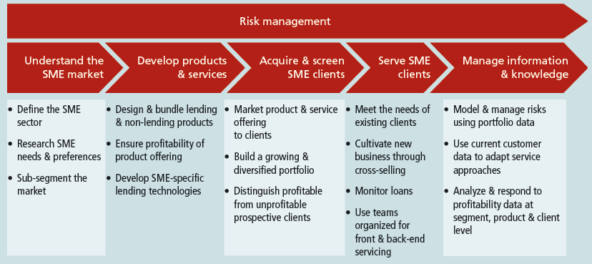
Key activities at each of the five stages of the SME banking value chain
Notes:
There are many challenging aspects to SME banking. To understand how to address each challenge, it is helpful to analyze these challenges in the context in which they occur. The banking “value chain,” or chain of activities, provides a framework for this disaggregated analysis.
Highlighted observations from the five value chain stages are
Understanding the market,
Developing products and services,
Acquiring and screening clients,
Serving clients, and
Managing information and knowledge.

Slide 6
Notes:
Risk management is always a critical bank function, but it becomes especially critical in a relatively new industry such as SME banking because there is less information on how to mitigate risks for this sector. The risks themselves are not unique: as in all banking, they include credit, market, strategic, and operational risk.
Leading banks are finding ways to manage both these risks through a comprehensive set of risk management practices undertaken at each stage of the SME banking value chain.

Slide 7
1.Understanding the SME Market
Notes:
Growing any portfolio of customers requires that banks be demand-driven, i.e., responsive to the needs and preferences of clients. SMEs differ from both large businesses and individual customers in their needs and preferences, and in what it takes to serve them.
Since a small business in one context may be a relatively large corporation in another, definitional clarity is essential to effectively understand the market. Before attempting to determine how to satisfy SME demand, the bank needed to step back and achieve consensus on how to define the market.
Even when the SME sector is clearly defined and its needs profiled, the range of businesses that make up this market may warrant further segmentation.

Slide 8
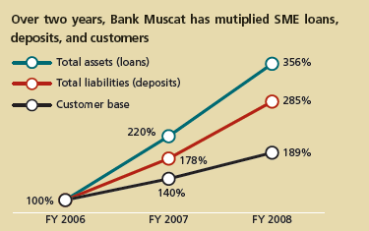
First Mover Advantage: Bank Muscat Targets Oman’s Unbanked SME Market
“ We saw that no one was trying to
lend to SMEs in Oman, so we said,
‘Why don’t we be the first?’”
Notes:
In 2006, Bank Muscat had successfully captured a 40–45 percent commercial banking market share in Oman, but noticed that no one was targeting the SME sector. Its own small portfolio of SME loans was performing poorly.
Based on these inputs, it restructured its operations, segmenting its lending into Program Lending, which offers highly structured products to smaller SMEs, and SME Finance, which provides more customized service to larger SMEs. The bank is now in the process of upgrading its Client Relationship Management (CRM) capabilities so that it can use current portfolio information to increase sales and to develop its own credit scoring models.

Slide 9
2.Developing Products and Services
Notes:
A bank’s product and service offering includes, but is not limited to, lending, deposit, and transactional products. The breadth of the offering is important because it impacts a bank’s SME market share by drawing in new clients or securing more business from existing clients.
The design of products and services also impacts the profitability of serving the SME market. Lastly, effective product development can influence the size of the addressable market itself by enabling banks to reach clients that would otherwise be uninterested or unable to meet requirements for service.

Slide 10
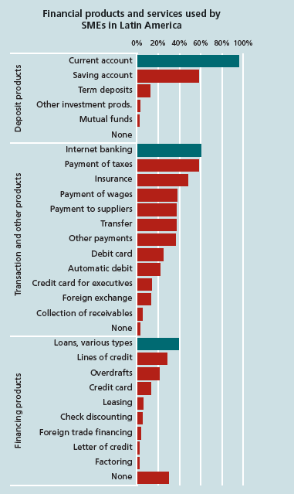
Notes:
Developing an effective product offering may begin with understanding the scope of products and services banks can offer SMEs. While lending is a central offering in SME banking, the ways in which banks can meet SME needs extend far beyond lending. Figure illustrates some of the bank products and services used by SMEs.
This list of products is consistent with what banks may offer SMEs throughout the world, though in fact it understates the potential offering by not including such product categories as advisory services, which are increasingly common, or equity financing, which is only recently emerging.

Slide 11
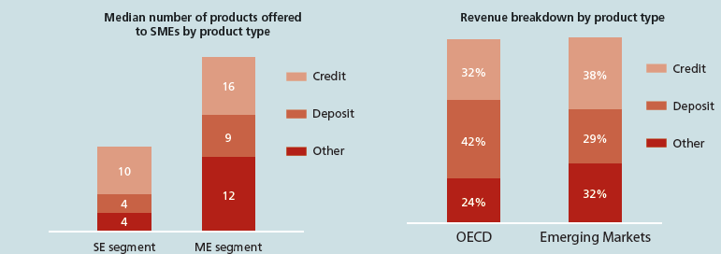
Notes:
IFC’s Benchmarking study of leading banks found that many had originally started with a limited product offering, especially to small businesses, but expanded their range as their understanding of the market grew (Figure). In addition, they reported plans to continue adding new products in response to SME needs.
Many banks are limited by the lack of data, but leading banks are working to track and analyze the information they need to assess the profitability of all the products offered to SMEs. They report, for example, that revenue from credit products represents only a fraction of total income from SME clients (Figure).

Slide 12
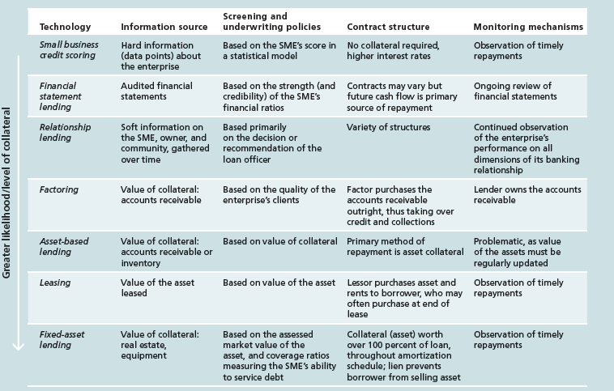
Notes:
Table details these and other bank lending technologies identified by researchers in describing a framework for SME
lending that extends beyond relationship lending methods. Even when a new lending technology can increase the size of the accessible market, banks must assess the risks and costs of employing this technology.
For example, factoring is an effective solution only if the customers of the SMEs are likely to pay their bills, and if the bank itself has the necessary competencies to efficiently conduct collections operations.
Similarly, the cost of monitoring the assets used for asset-based lending may make it unprofitable for smaller clients. Thus, for many banks, effective product design includes appropriate standardization.

Slide 13
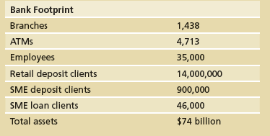
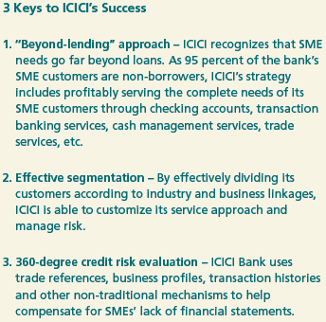
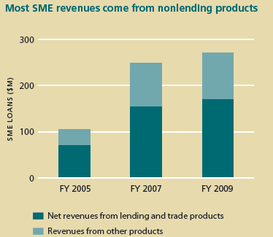
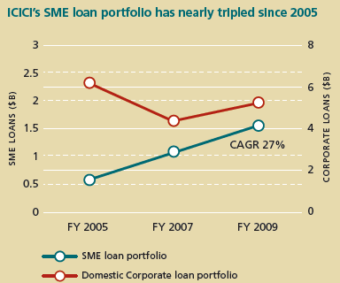
“ SME banking is not about providing a loan. It is about the complete relationship value that you can offer the SME. This spans the opportunity on the liability side and the opportunity on the transaction side.”
V. Chandok, Senior General Manager, ICICI Bank
Notes:
In the Indian market, where 70–80 banks are accessing the SME space, ICICI claims a market share of 4–9 percent depending on customer classification. While ICICI cites classic challenges in serving SMEs, such as credit risk evaluation and the cost of acquiring clients, it has witnessed explosive growth since the re-launch of its SME strategy in Three Hundred Sixty (2003). In the past four years, both its SME loan portfolio and overall SME revenues have nearly tripled.
3 Keys to ICICI’s Success
1. “Beyond-lending” approach.
2. Effective segmentation.
3. 360-degree credit risk evaluation

Slide 14
3. Acquiring and Screening SME Clients
Notes:
When building an SME client base, a bank should aim to draw from its existing individual clients where possible and to build a new client portfolio that is diverse in terms of SME size and sector representation.
Diversity enables banks to stagger loan maturity cycles and to manage the risks of economic shock to a certain industry or business segment.
Two main challenges that banks face in acquiring clients are (1) cost-effectively marketing their product offering, and (2) managing credit risk by effectively screening for profitable borrowers despite incomplete information.

Slide 15
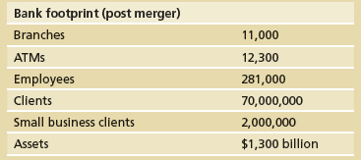
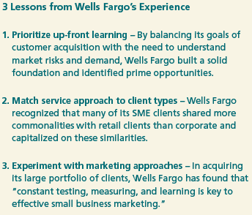
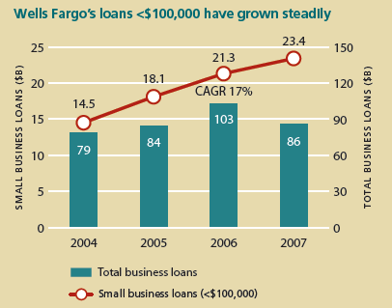
“ Many small business owners have told us that we were the first to recognize their business in a meaningful way, by giving it a line of credit.”
M. Bernstein, Head of Small Business Banking
Notes:
Wells Fargo’s plans for the future include widening its lead as the #1 lender to small businesses in the United States
and increasing its cross selling to SME clients. The recent merger with Wachovia has increased Wells Fargo’s geographical reach and customer base, and will serve as the launching point for its next phase of SME-financing growth.
3 Lessons from Wells Fargo’s Experience
1. Prioritize up-front learning.
2. Match service approach to client types
3. Experiment with marketing approaches

Slide 16
4. Serving SME Clients
Notes:
Serving SME clients includes meeting the needs of existing clients, cultivating new business through cross selling, and managing risk by addressing problem loans. The results of effective service are mutually beneficial relationships between the bank and a loyal customer base. Long-term SME clients provide stable and growing revenues and are excellent sources of information for banks.
Two key challenges in effectively serving SME clients are that (1) SMEs have unique demands and value personal and attentive service, in some cases even more than corporate clients, and (2) meeting these demands can be costly given the frequency of contact required and the potentially lower revenue earned per client.

Slide 17
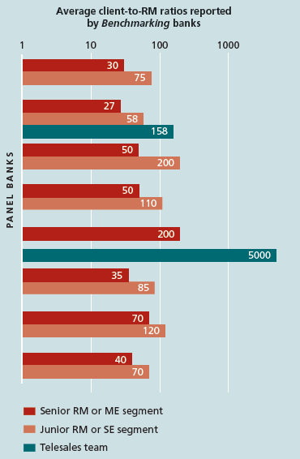
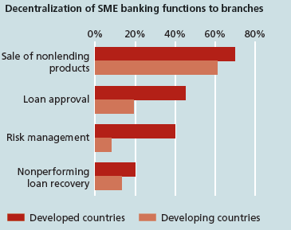
Banks that segment their approach can
provide multiple levels of personal service
Branches are the primary delivery
channel for nonlending products
Notes:
Banks serving SMEs have found ways to cost-effectively meet and even capitalize on the unique demands of SMEs. They do this by (1) using direct delivery channels, (2) segmenting and redefining relationship management, and (3) turning demands into opportunities through cross selling.
In contrast to wholesale banking, where most transactions are channeled through a relationship manager, SME banking often relies heavily on a bank’s branch network as a direct delivery channel.(Figure 1).
In addition to specialized staff, a number of banks dedicate entire branches to serve SMEs in order to improve service and efficiency. Banks also employ low-cost delivery channels such as call centers and Internet banking.

Slide 18
5. Managing Information and Knowledge
Notes:
Information and knowledge – banks must consciously learn from experience and feed this learning back into its strategic planning cycle for the SME business. This learning is especially critical because SME banking is a young and dynamic industry.
In fact, the technological capacity to analyze data on large volumes of clients has been an important catalyst in solving the problem of profitably banking SMEs. Effective management of information and knowledge involves strategic employment of these tools to improve bank operations.

Slide 19
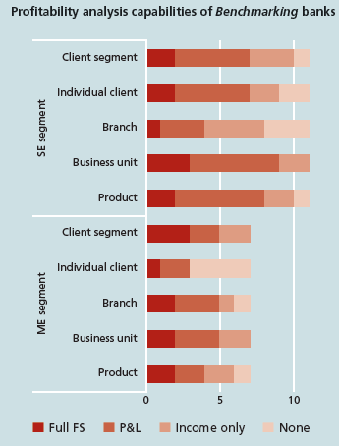
Notes:
Bank approaches to managing information and knowledge can be divided according to key functions. Some of the most important of these functions are (1) risk modeling and portfolio monitoring, (2) client relationship management, and (3) profitability analysis. important function of information management is detailed analysis of profitability.
Applications of this analysis include looking at a client’s total profitability across all products to learn about the effectiveness of a bundling strategy or the efficiency of its service approach. (Figure).

Slide 20
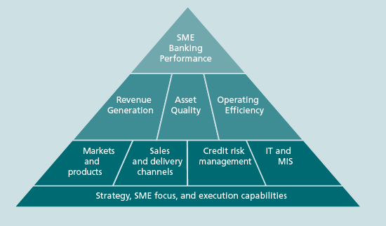
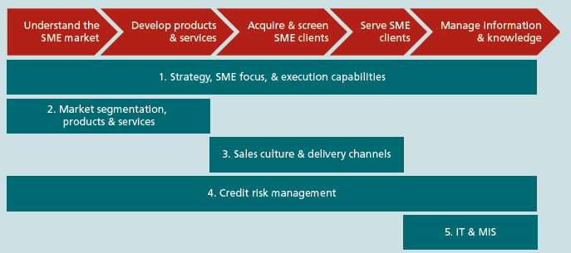
Five strategic areas form the foundation for SME banking performance
Notes:
Success at SME banking requires a bank to develop its own approach in response to its specific opportunities and capacities. However, banking performance ultimately depends on revenue generation (greater income), asset quality (lower risks), and operating efficiency (lower costs).
In the case of SME banking, five strategic areas form a foundation for strong performance along these measures(Figure):
Strategy, SME focus, and e execution capabilities
Market segmentation, products, and services
Sales culture and delivery channels
Credit risk management
IT and MIS

Slide 21
CONLUSION
Banks in general are not overly concerned...
In developing markets, there are more opportunities....
Where innovation is flourishing, ....
The challenge is very different for start-up or...
There are many examples of incremental product, channel....
Notes:
Banks in general are not overly concerned about disruptive threats from new entrants and new business models. However, in more mature markets, the available revenue and profit pool is continuing to be eroded by new entrants.
In developing markets, there are more opportunities for growth.
Where innovation is flourishing, there is evidence of an increased customer focus in the innovation process, made possible by new tools and techniques to involve customers directly.
The challenge is very different for start-up or smaller banks, and larger banks. It is not easy for the larger banks to radically change their business models and typically they are serving a diverse range of customers.
There are many examples of incremental product, channel and process innovation, but there are also examples of how banks are using a combination of product, channel and process innovation together with a new business model to create an improved customer experience.

