Slide 1
Central Banking in the Era of Blended Finance and Circular Economy
Keynote Speech delivered by Dr. Tariqullah Khan (tkhan@qfis.edu.qa)
Professor of Islamic Finance, Qatar Faculty of Islamic Studies, Hamad bin Khalifa University – Qatar Foundation
Views expressed are speaker’s own and don’t necessarily represent those of HKBU

Slide 2
Questions that come to mind!
What is blended finance?
What central banks can do?
What is Circular Economy?

Slide 3
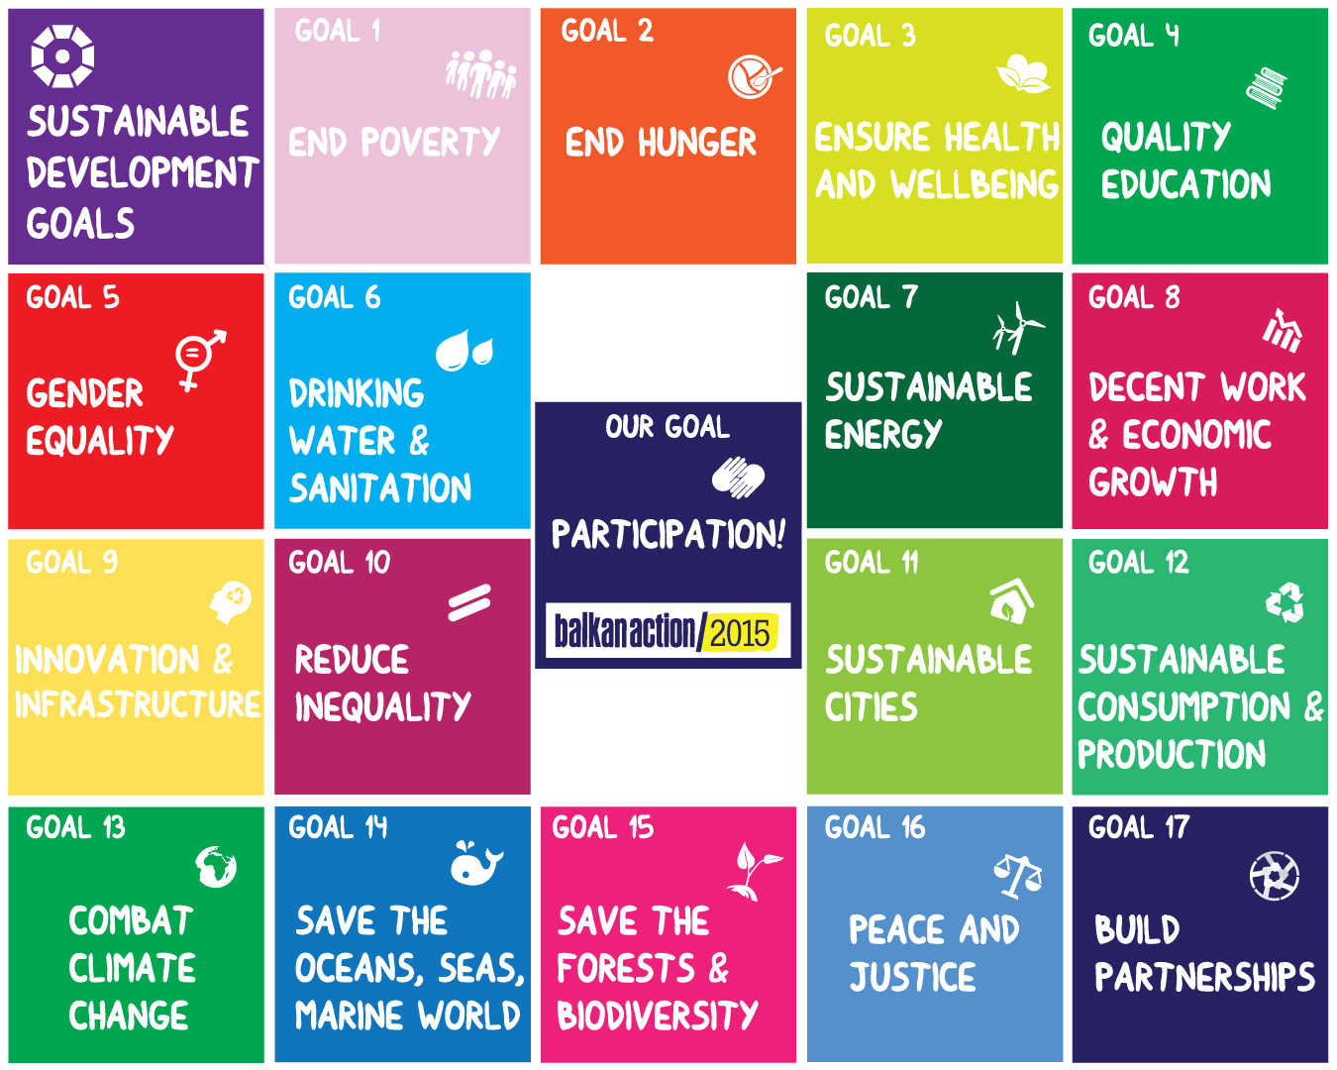
Sustainable Development Goals

Slide 4
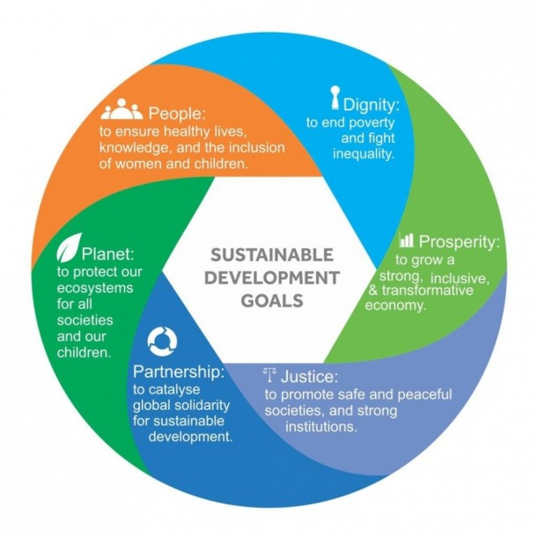
Comprehensive Human Development
Intellect
Future Generation
Self Respect
Wealth
Religion
Islamic Development Bank
The Striking Resemblance between Comprehensive Human Development and Sustainable Development Goals

Slide 5
Blended Finance
To Mobilize Private Funds for Sustainable Development
Philanthropic Funds
Development Finance
$4.5 trillion yearly needs

Slide 6
Circular Economy

Slide 7
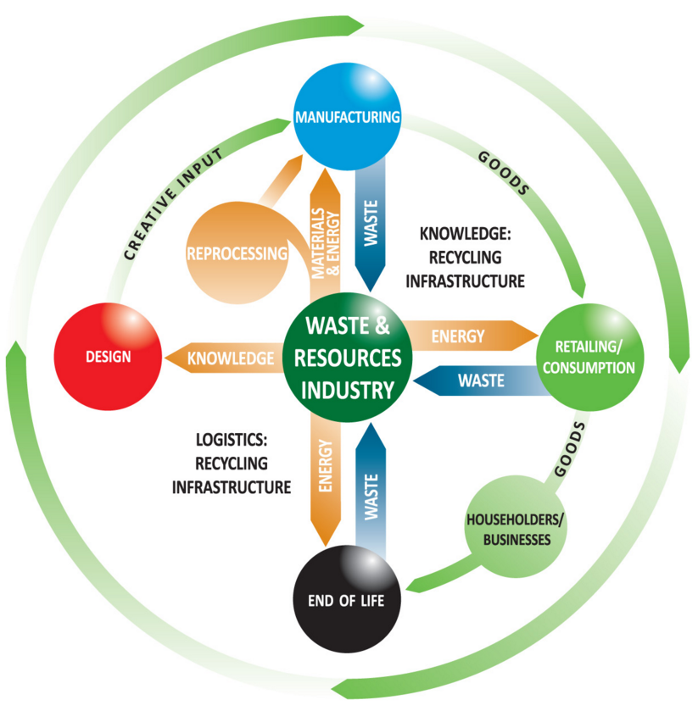
Circular Economy
Source: http://www.fccenvironment.co.uk/circular-economy.html

Slide 8
What Central Banks Can Do?
Integrate Zakah, Awqaf, Charities in Financial Sector Reforms
Subsidize financing for Micro, Small and Medium Enterprises
Disclosure requirements for ethical finance
Waste Control and Management Guidelines and Policies
Ethical Screening of Investments

