Slide 1
Central Banks and Development
Issues, challenges and risks
ADFIMI Development Forum
Darryl King
International Monetary Fund
April 25/26, 2016
Doha, Qatar

Slide 2
Outline
Recent Country Experiences
Sound principles of effective monetary policy frameworks – to support development
Financial development
Central bank contribution to financial development

Slide 3
Recent experiences
Strains are evident in many countries
Notes:
The few years have been very challenging for a number of countries. Gains thought to have been made over recent years have quickly been reversed in the face of rapid and severe changes in the external environment. Some countries facing lower export prices and a fixed exchange rate regime have had to intervene to support their pegs, while others with more flexible arrangements have also intervened to counter fears of exchange rate overshoot or disorderly market dynamics taking root.
You can see from the graphs the extent of the falls in the currencies in the face of a 50 percent fall in commodity prices. Falls in the exchange rates of commodity exporters were around 25 percent. And while to large extent their was a US dollar story at play here, illustrated by also sizeable falls of the currencies of non-commodity exporters, important is to focus on changes in international reserves during this period. The international reserves of non-commodity exporters declined only marginally while, while at one point commodity exporters had spent around 10 percent of their reserves to support their currencies.

Slide 4
Recent experiences
Some commodity exporters coped better
Notes:
However, some other countries that experienced terms-of-trade shocks weathered the storm better. Here the three examples of Australia, Canada and New Zealand are provided. Noticeable here is that movements in the currency were also large. And none of these countries intervened significantly during this period. Unemployment moved little, as did inflation.
So the point here is that policy frameworks – and by this I mean the monetary and foreign exchange frameworks – matter for development. Frameworks that are insufficiently flexible to deal with shocks will be less supportive of development in the medium term. I will have a few additional words to add about the New Zealand journey to this point a little later but I want to turn to monetary policy frameworks specifically.

Slide 5
Objectives, institutions and policies
Price Stability
Central bank
Monetary policy
Other Objectives?
Notes:
Firstly, price stability. The institution that is primarily responsible for meeting this meeting this objective is the central bank, while a number of other agencies must also help. These include statistical offices, fiscal and debt management agencies, and regulatory agencies.
An often asked question here is whether monetary policy should be aimed at objectives other than monetary policy; and if so, which ones and how?

Slide 6
Principles of Effective Monetary Policy Frameworks
The central bank should have a clear mandate, with independence and accountability
Price stability should be the overriding objective over the medium-term
There should be an explicit numerical inflation objective
Monetary policy adjustments may need to take into account macroeconomic activity and financial stability
There should be a clear and effective operational framework
There should be forward-looking with a strategy that’s maps instruments to objectives
Communication should be transparent and timely
IMF 2015: Evolving Monetary Policy Frameworks in Low-income and Other Developing Countries
Notes:
We recently undertook an exercise to clarify our thinking on monetary policy frameworks in developing economies – and here it is important to distinguish between monetary policy objectives and other objectives that the central bank may have – for example; financial stability and supplying the currency to meet the needs of the public. It was clear that monetary frameworks in many developing economies were not serving the country well. While the consensus in the developed world had moved to inflation targeting – a regime that is not always well defined or at least means different things to different people, and one which has evolved over time – many developing countries were left with regimes that placed a heavy emphasis on money aggregates and/or the exchange-rate. Rigid money targeting frameworks were clearly no longer fit for purpose – in part because financial sector development had rendered the demand for money unstable – to rigidly target money resulted in highly volatile interest rates, which made signaling the stance of policy very difficult and undermining the very channel that central banks seek to strengthen – that is the interest rate channel.
In approaching this issue, we decided to focus on principles – trying to identify a set of principles that would be relevant across a wide range of country circumstances. We also sought to identify a reform process – a sequencing of reforms – that would be more likely to help countries towards complying with the principles. I would like to spend some time going over the main principles:
A clear mandate is needed, without which the central bank would lack direction and authority. Operational independence is a key ingredient here – which basically boils down to be able to take the appropriate actions to meet mandated goals. With independence come the need for accountability – there should be a process for the central bank to explain and justify why it didn’t meet its goals and what it intends to do meet them in the future.
Modernizing the monetary policy framework may in many cases require changes to the legal framework. Such a change and in particular the granting of operational independence can be catalytic in the reform process.

Slide 7
Principles of Effective Monetary Policy Frameworks
A clear mandate in terms of goals, and operational independence to pursue the goals, within a context of public accountability.
A mandate
  Goals, clearly articulated
  Independence, to achieve states goals
  Accountability, for outcomes against the mandate
Fiscal dominance sometimes problematic
Sometimes other pressures—makes the task of monetary policy difficult
Notes:
We recently undertook an exercise to clarify our thinking on monetary policy frameworks in developing economies – and here it is important to distinguish between monetary policy objectives and other objectives that the central bank may have – for example; financial stability and supplying the currency to meet the needs of the public. It was clear that monetary frameworks in many developing economies were not serving the country well. While the consensus in the developed world had moved to inflation targeting – a regime that is not always well defined or at least means different things to different people, and one which has evolved over time – many developing countries were left with regimes that placed a heavy emphasis on money aggregates and/or the exchange-rate. Rigid money targeting frameworks were clearly no longer fit for purpose – in part because financial sector development had rendered the demand for money unstable – to rigidly target money resulted in highly volatile interest rates, which made signaling the stance of policy very difficult and undermining the very channel that central banks seek to strengthen – that is the interest rate channel.
In approaching this issue, we decided to focus on principles – trying to identify a set of principles that would be relevant across a wide range of country circumstances. We also sought to identify a reform process – a sequencing of reforms – that would be more likely to help countries towards complying with the principles. I would like to spend some time going over the main principles:
A clear mandate is needed, without which the central bank would lack direction and authority. Operational independence is a key ingredient here – which basically boils down to be able to take the appropriate actions to meet mandated goals. With independence come the need for accountability – there should be a process for the central bank to explain and justify why it didn’t meet its goals and what it intends to do meet them in the future.
Modernizing the monetary policy framework may in many cases require changes to the legal framework. Such a change and in particular the granting of operational independence can be catalytic in the reform process.

Slide 8
Principles of Effective Monetary Policy Frameworks
Price stability should be the primary objective of monetary policy
A medium term (numerical) inflation objective
Monetary policy can pursue only independent nominal variable
A numerical inflation objective operationalizes the price stability mandate
Focus on medium-term
Many countries do not have a clear inflation objective
  Confusion between forecast and objective
Notes:
Assigning price stability as the primary objective of monetary policy reflects the view that over time this is the best contribution that monetary policy can make to economic well-being. It recognizes that, in the long run, monetary policy can pursue only one, nominal, independent objective. Over the long run, the main contribution that monetary policy can make to other useful objectives (e.g., the growth of output) is to maintain an environment where the value of money is reliable. In contrast, high and variable inflation, or deflation, creates distortions in the allocation of resources and arbitrary inequities.
Some central banks have a dual mandate, for maximum employment or output, as well as price stability (e.g., the U.S Federal Reserve). Others are given the single mandate of price stability (e.g., the European Central Bank (ECB)). There appear to be no instances where the monetary policy objective includes a numerical goal for output or other real variables. This reflects that in the long run these variables depend on real factors—e.g., the mobility of labor, demographics, resource endowments and discoveries, the rate of technological progress—that monetary policy cannot affect.
Clarify the uncertainty about the target – Greenspan ‘ a rate at which changes in the general level of prices does not enter into consideration which transacting? check?’
Monetary policy can pursue only independent nominal variable
High and variable inflation creates distortions
Real output depends on real variables
Trade-offs – significant challenges
Near-term view on inflation and output may conflict
Financial stability concerns
A numerical inflation objective operationalizes the price stability mandate.
Focus on medium-term:
Short-term inflation is beyond the control of MP, e.g., due to supply shocks, long and variable transmission lags of MP.
But inflation can be expected to stabilize around objective if MP is appropriate.
Many countries do not have a clear inflation objective.
Confusion between forecast and objective.

Slide 9
Principles of Effective Monetary Policy Frameworks
Considerations of other objectives when determining magnitude and pace of adjustments
Monetary policy may involve difficult trade-offs
  Supply shocks and inflation and output stability
  Financial stability concerns and the role of monetary policy
Notes:
Supply shocks and the difficult tradeoffs between inflation and output stability:
Allow “first-round” effects but respond to “second-round” effects.
If credibility is limited, may put more weight on price stability.
Coherent framework, clear communications and strong analytical capacity can help handle tradeoffs.
Financial stability concerns and the role of monetary policy:
The costs of leaning against the wind likely to exceed benefits.
Macro-prudential policies should act as first line of defense.

Slide 10
Reflections on 25 years of Inflation Targeting
Graeme Wheeler Governor RBNZ : December 2014
Focus on price stability has played a vital role in the more stable and responsive economic climate
Resilient in the face of severe external and domestic shocks
The ability of monetary policy to help offset short-term shocks has grown as inflation expectations have stabilized
Notes:
Some persons that have looked at the principles have suggested that it looks and smells very much like inflation targeting – but that does not take account of the flexibility that countries can have in the role money aggregates and indeed the exchange rate may play when pursuing goals.
I would like to share some observations made by the Governor of the RBNZ in 2014 in light of 25 years of experience with inflation targeting. But first I would say while New Zealand was not considered a developing country back in the mid-1980s, it did have very severe problems, similar to what many developing countries face today. These problems included, chronic fiscal dominance, high and variable inflation, largely non-existent financial markets, poor financial literacy, credit policy that directed subsidized funds to priority areas – that’s why we had 3 million people and reportedly 60 million sheep – as well as highly inflexible labor and product markets. Reflecting 25 years of inflation targeting, Governor Wheeler’s noted: 1) Monetary policy’s focus on price stability has played a vital role in the more stable and responsive economic climate that emerged in New Zealand over the last 25 years. 2) In this climate, the economy has been able to take advantage of new trading opportunities….and it had been resilient in the face of severe external and domestic shocks, notably from the GFC and the Christchurch earthquake. 3) Moreover the ability of monetary policy to help offset short-term shocks to output and employment has grown as inflation expectations have stabilized at a low level and as policy credibility and transparency have increased.
It is fair to say that inflation targeting has become more flexible over time. The RBNZ target now is somewhat higher and less rigid than when first introduced; but it never was the case that the Governor received a bonus for achieving the target, or was fired immediately if he didn’t.

Slide 11
Objectives, institutions and policies
Price Stability
Central bank
Monetary policy
Financial Stability
Regulators, Micro/macro prudential
Micro-prudential and macro-prudential policies
Notes:
What of the other possible central bank objectives. Financial stability is achieved through a combination micro- and macro-prudential polices with various models here on the institutional arrangements.

Slide 12
Objectives, institutions and policies
Price Stability
Central bank
Monetary policy
Financial Stability
Regulators, Micro/macro prudential
Micro-prudential and macro-prudential policies
Economic and Financial Development
Government agencies and the central bank
Sound business environment, access to finance, financial deepening

Slide 13
Economic and Financial Development
What developmental role can/should central banks play?
  Financial development?
  Providing and directing credit?
How can development banks assist central banks to achieve their goals?

Slide 14
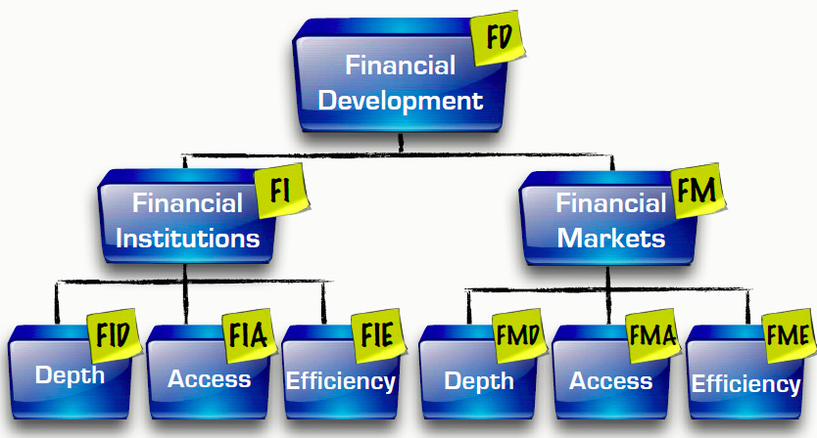
Financial Development
Sahay et al. IMF SDN: Rethinking Financial Deepening: Stability and Growth in Emerging Markets, May 2015
Notes:
Financial systems are diverse and multiple indicators are need to measure financial development. Relying solely on bank-centered measures can be mis-leading particularly as financial systems become more diverse. Both institutions and markets are important. Financial institutions include banks, insurance companies, mutual funds, pension funds and other NBFIs. Financial markets are mainly stock and bond markets. Generally relative to the banking system, domestic private bond markets and stock markets become larger as GDP per capita rises. And mutual funds and pension funds begin to grow rapidly at higher income levels.
A new Financial Development Index was constructed index by choosing a list of indictors to measure each sub-component at the bottom of the pyramid. Each indicator is normalized, outliers removed and then indicators are aggregated. Sub-indices are aggregated into higher-level indices culminating at the most aggregate level of the FD index. There are recognized limitations to this index, for example some shadow banks are excluded and financial payments, credit transfers and mobile banking are undeniably relevant aspects of depth and access in many countries, but indicators were not available. It is intended that future revisions of the index will seek to include these aspects.

Slide 15
Financial Development
There is positive relationship between financial development and growth
Figure 7. Financial Development Effect on Growth
Source: IMF staff estimates.
Sahay et al. Rethinking Financial Deepening: Stability and Growth in Emerging Markets, May 2015
Notes:
Empirical analysis indicates that there is a significant bell-shaped relationship and growth. Based on the sample of 128 countries for the period 1980-2013 suggests that financial development increases growth, but the effects weaken at higher levels of financial development and eventually become negative.
The level of financial development at which the positive effects on growth start to decline lie between 0.4 – 0.7 of the FD index. This is a wide band reflecting variations in country fundamentals and institutional settings.
It worth considering conceptually the channels through which very high levels of finance could have a negative effect on growth. One argument is that too much finance increases the frequency of booms and busts. And perhaps too much finance draws too much human capital away from truly productive sectors. Some have argued that a very large finance sector may be susceptible to moral hazard or rent seeking from other sectors, thereby undermining efficient resource allocation.

Slide 16
Financial Development
There is an avenue for development that entails few or no trade-offs to financial stability
There is evidence that too fast a pace of financial development leads to instability
Actions on regulatory reform can promote financial development and stability simultaneously
Notes:
An examination of the relationship between the pace of financial deepening and economic growth yielded inconclusive results. However, the relationship between the pace of financial deepening in institutions and the volatility of both GDP growth and inflation is significant and positive. In a similar direction, financial instability also rises with the pace of deepening. A plausible reason is that faster growth of institutions is accompanied by greater risk-taking and high leverage, particularly when the financial system is poorly regulated and supervised. Note that this relationship holds for financial institutions and not financial markets.
Paras 41 / 42

Slide 17
Central bank contribution to financial development
Appropriate regulation and supervision of financial entities
A clear and effective operational framework
Facilitating financial market development
Regulating and overseeing financial market infrastructures

Slide 18
Central bank contribution to financial development
Appropriate regulation and supervision of financial entities
Banks
Securities dealers
Other NBFIs
Insurance and pensions
Notes:
Need coordination for financial stability purposes
Banks – probably
Securities dealers - maybe
Other NBFIs – maybe
Insurance and pensions – less likely

Slide 19
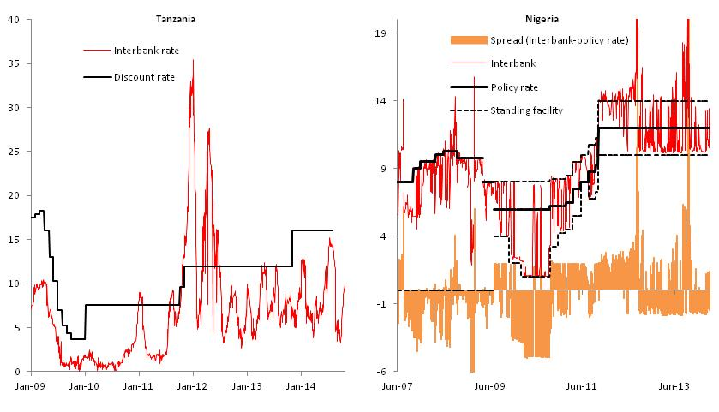
Central bank contribution to financial development
A clear and effective operational framework
– to minimize interest rate volatility and liquidity risks
Notes:
Minimize volatility for a given policy stance – the yield curve should still reflect expectations about future moves in monetary policy. of random fluctuations in money market rates was associated with sticky retail lending rates and weak policy transmission, as policy signals would be lost in the noise of random movements.

Slide 20
Central bank contribution to financial development
Facilitating financial market development
Setting standards through its own operations
Coordinating with debt managers to ensure orderly development of a risk-free yield curve
Improving market liquidity
  Providing facilities to securities dealers
Establishing/overseeing financial benchmarks
Notes:
Open market operations
Providing facilities to securities dealers – cash and securities lending

Slide 21
Central bank contribution to financial development
Financial Market Infrastructures
National Payments Council
  Establish a reform strategy
  Ensure compliance with international standards (PFMI )
Retail systems
Wholesale systems
Notes:
Financial Market Infrastructures - or payment and settlement systems as they used to be called – are a vital part of the financial architecture. Access, efficiency and governance of key systems are all important issues. From a developmental viewpoint, the central bank should be pivotal through its approach in getting all stakeholders together under a National Payments Council. The central bank should act as the secretariat to this council and the other stakeholders should include; commercial banks, government, securities dealers and regulators.
National Payments Council
Establish a reform strategy
Ensure compliance with international standards (PFMI )
Retail systems
Clearing houses
Mobile payments
Wholesale systems
Real-time-gross-settlement systems
Securities settlement systems

Slide 22
Directed Lending
  Should the central bank engage in direct lending activities?
What is the problem?
What are the risks to the central bank
  Compromised financial strength
  A loss of operational independence
  Weakened transmission mechanism
Lending is a quasi-fiscal activity
  A government responsibility
Notes:
What is the problem?
Banks are too small to carry the risks of large projects
Lack of long term funds
Costs are too high
Lack of funds flowing to government-determined priority areas
First best options
financial deepening
strengthening the business environment
strengthening legal protections for lenders
Credit risks may be large – therefore should be guaranteed by the government. Loss of financial independence, with no provision for recapitalization, may constrain the central bank’s ability to conduct the necessary operations to manage liquidity conditions consistent with the announced policy stance.

Slide 23
Directed Lending
  Development bank activities
Actions should support the transmission mechanism
Interest rates should be benchmarked off the CB policy rate (or a market rate)
Changes in credit availability should be consistent with the central bank policy stance
Activity should be scaled back as the market deepens
Notes:
Changes in credit availability should be consistent with the central bank policy stance
for example credit should not be expanded when the central bank is tightening
Activity should be scaled back as the market deepens
should not act as a constraint on development

Slide 24
Summing Up
Coherent policy frameworks and credible policy settings support development
Central banks can play a catalytic role in financial development
The operation of development banks should support central bank policy objectives

