Slide 1
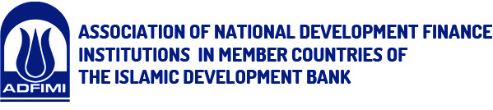


“Developments in Oil Prices and Central Banks in the Region”
ADFIMI International Development Forum
“Developmental Central Banking: Issues, Prospects and Challenges”
Ritz Carlton, Doha, Qatar, 25-26 April 2016
Presentation by: Professor Fred Joutz
تقديم البروفيسور: فريد يوتس
Department of Economics, Research Program on Forecasting
George Washington University

Slide 2
Outline
Developments in Oil Markets and Historical Experience
The Outlook for the New World Oil Regime
The Macroeconomic Outlook in the New World Oil Regime
The Fiscal Situation and Challenges from the New World Oil Regime
The Role Central Banks in the New World Oil Regime
Summary

Slide 3
Developments in Oil Markets and Historical Experience
Oil Glut
Non-OPEC
OPEC cheating
Saudi response
Source: U.S. Energy Information Administration

Slide 4
The Outlook for the New World Oil Regime – Short Run
Source: EIA Short-Term Energy Outlook, April 2016 and CME Group (http://www.cmegroup.com

Slide 5
The Outlook for the New World Oil Regime – Short Run
 | WTI Futures and Implied Probabilities
Contract | NYMEX Implied Probability of |  |  | Futures | NYMEX Implied Probability of
Month | Price < $25 | Price < $30 | Price < $35 | Price | Price > $45 | Price > $50 | Price > $55
Jun-16 | 0.3% | 6.4% | 31.7% | $ 37.96 | 11.0% | 2.6% | 0.5%
Sep-16 | 4.8% | 16.7% | 35.3% | $ 39.98 | 28.0% | 16.2% | 8.9%
Dec-16 | 9.2% | 21.8% | 37.8% | $ 40.97 | 32.7% | 22.1% | 14.5%
Mar-17 | 11.4% | 23.9% | 38.5% | $ 41.72 | 34.8% | 25.0% | 17.5%
Jun-17 | 12.9% | 25.0% | 38.7% | $ 42.44 | 36.5% | 27.1% | 19.7%
Dec-17 | 14.2% | 25.8% | 38.4% | $ 43.66 | 38.7% | 29.8% | 22.7%
Source: EIA Short-Term Energy Outlook, April 2016, and CME Group (http://www.cmegroup.com)
Notes: Probability values calculated using NYMEX market data for the five trading days ending April 7, 2016.
Notes:
The likelihood for the oil price futures path is
Futures
Price Price < $35 Price > $45
37.962 0.317 0.573 0.110
39.976 0.353 0.367 0.280
40.97 0.378 0.296 0.327
41.716 0.385 0.266 0.348
42.442 0.387 0.248 0.365
43.658 0.384 0.229 0.387

Slide 6
The Outlook for the New World Oil Regime – IMF Medium Run
 | Table 2. Medium Term Commodity Price Baseline
 | (In U.S. Dollars)
 | 2009A1 |  | 2010A1 |  | 2011A1 |  | 2012A1 | 2013A1 | 2014A1 | 2015A1 | 2016A1 | 2017A1 | 2018A1 | 2019A1 | 2020A1 | 2021A1
Energy |  |  |  |  |  |  | Actual |  |  |  |  |  | Projections
Spot Crude 1/ | 61.78 |  | 79.03 |  | 104.01 |  | 105.01 | 104.07 | 96.25 | 50.79 | 34.75 | 40.99 | 44.52 | 47.58 | 49.43 | 50.52
Natural Gas 2/
Russian in Germany | 8.86 |  | 8.22 |  | 10.60 |  | 11.98 | 11.19 | 10.46 | 7.31 | 4.83 | 4.79 | 4.79 | 4.79 | 4.79 | 4.79
Indonesian in Japan (LNG) | 7.49 |  | 9.38 |  | 15.55 |  | 18.15 | 17.34 | 17.00 | 10.86 | 10.15 | 10.15 | 10.15 | 10.15 | 10.15 | 10.15
US, domestic market | 3.94 |  | 4.39 |  | 4.00 |  | 2.75 | 3.72 | 4.37 | 2.61 | 2.07 | 2.52 | 2.58 | 2.63 | 2.73 | 2.86
Coal 3/
Australian, export markets | 76.98 |  | 106.04 |  | 130.12 |  | 103.25 | 90.60 | 75.14 | 61.62 | 48.69 | 44.08 | 43.03 | 42.51 | 42.57 | 42.57
1/ Petroleum price is average of spot prices for U.K. Brent, Dubai and West Texas Intermediate.
2/ $ / MMBTU
3/ $ / MT
Source: IMF https://www.imf.org/external/np/res/commod/index.aspx accessed April 15, 2016

Slide 7
The Macroeconomic Outlook in the New World Oil Regime
Real GDP Hydrocarbon and Non-Hydrocarbon Sectors
Growth Rate of GDP Per Capita PPP of Gulf Oil Exporting Countries
Consumer Price Inflation Rate in Gulf Oil Exporting Countries
Real GDP Growth Globally and by Groups

Slide 8
The Macroeconomic Outlook in the New World Oil Regime
Source: IIF Forecast Database, March 31, 2016

Slide 9
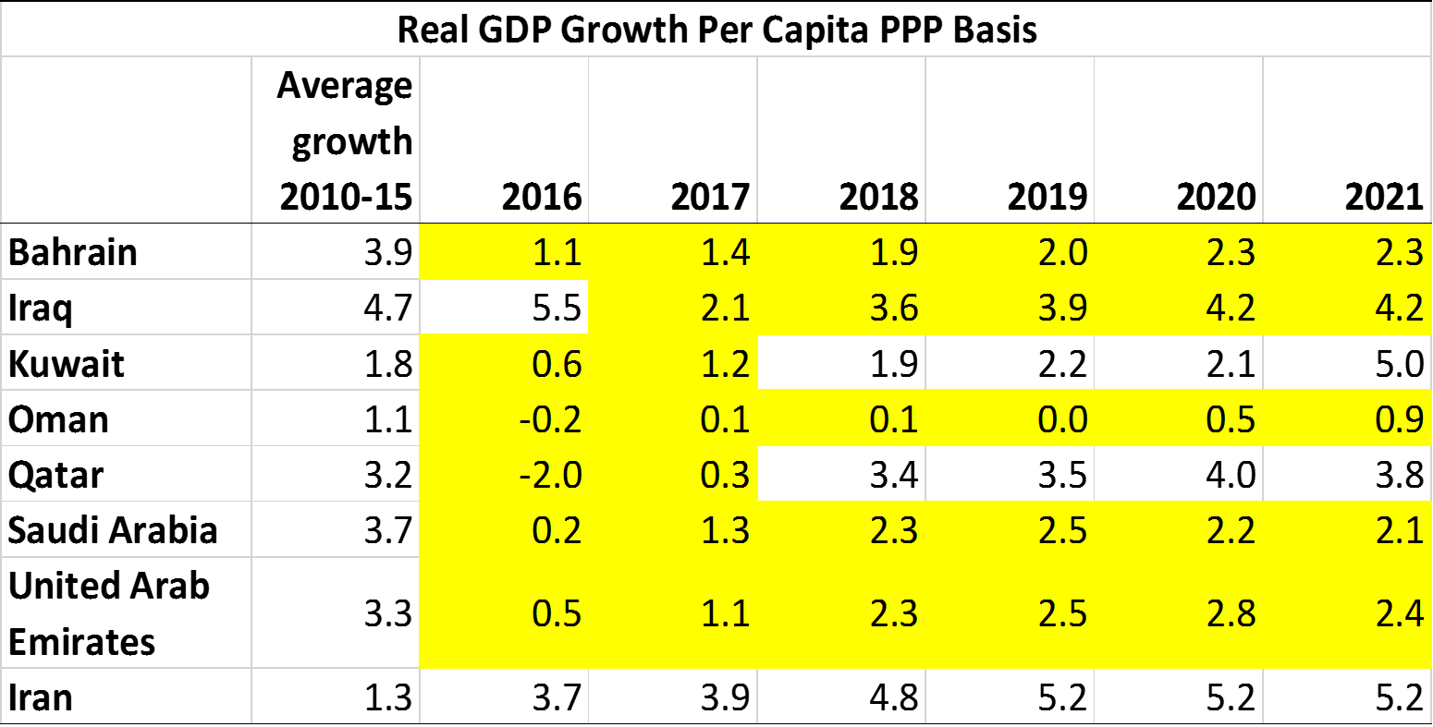
The Macroeconomic Outlook in the New World Oil Regime
Source: IMF WEO, Database, April 12, 2016

Slide 10
The Macroeconomic Outlook in the New World Oil Regime
Real Per Capita GDP Growth
Source: IMF WEO, Database, April 12, 2016

Slide 11
The Macroeconomic Outlook in the New World Oil Regime
Consumer Price Inflation Rate
Source: IMF WEO, Database, April 12, 2016

Slide 12
The Macroeconomic Outlook in the New World Oil Regime
Source: IMF WEO, Database, April 12, 2016

Slide 13
The Fiscal Situation and Challenges from the New World Oil Regime
Fiscal Revenues before and since the New World Oil Regime
Facing up to Fiscal Deficits and Tradeoffs
Changes in Sources of Revenues
Changes in Expenditures and their Path
Development Needs and Social Contracts with Population
Promote Inclusive Growth in the Private Sector ( SMEs and Consumers )
Employment and Growth in Youth Labor Population
National Stability
Security

Slide 14
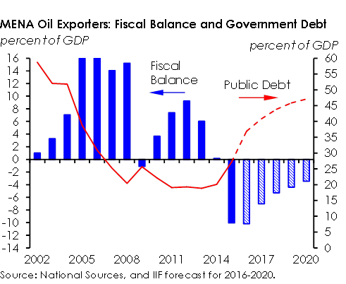
The Macroeconomic Outlook in the New World Oil Regime

Slide 15
The Fiscal Situation and Challenges from the New World Oil Regime
Government Deficit as Share of GDP
Source: IMF WEO, Database, April 12, 2016

Slide 16
The Fiscal Situation and Challenges from the New World Oil Regime
General Government Net Debt
Source: IMF WEO, Database, April 12, 2016

Slide 17
The Role Central Banks in the New World Oil Regime
Maintain the Peg? What are the Costs and Benefits?
Possible Role in SWFs and Foreign Exchange Reserves in Fiscal Balance
Monitor Foreign Exchange Assets and Liabilities
Regulatory and Supervisory Role of Private Banks
Credit to Private Sector

Slide 18
The Role Central Banks in the New World Oil Regime
Maintain the Peg? What are the Costs and Benefits from Devaluation?
 | Benefits | Costs
Policy Credibility | Anchor for Private Sector Tie to US FED Monetary Policy | Loss and Uncertainty
Macro Stability | Support Private Sector Confidence Counter-cyclical history from fiscal policy and flexible expat labor markets | Volatility with Oil Price on Fiscal Revenues and Cycles
Financial Stability | Easy to administer | Volatility due to Oil Price and REER Increase in Capital Outflows Institutions not in place Transmission mechanisms
Notes:
The J-curve for a devaluation in GCC countries for the trade balance rebound following a devaluation would most likely be an L-curve
Oil Exporting Country Import Elasticities are -0.10 and Export Elasticities are 0.14
1The estimated import and export elasticities of oil-exporting countries are statistically insignificant.
Source: IMF, Consultative Group on Exchange Rate Issues (CGER); Hakura and Billmeier, IMF WP/08/216.
Fiscal gains from higher oil prices in local currency would be partially offset by higher import bills.
The demand for capital goods and raw materials are more a function of fiscal stance than REER.
Non-Hydrocarbon exports are only about 20% and often related to the petrochemical sectors where prices have historically been subsidized.

Slide 19
The Role Central Banks in the New World Oil Regime
Maintain the Peg? What are the Costs and Benefits from Devaluation?
 | Benefits | Costs
Trade Balance | Most basic consumer goods are imported. 25% of government expenditure is on imported goods. Foreign Imbalances increase even more without peg | ML Conditions do not hold Import Elas. -0.10, Export Elas. 0.10 J-Curve would become L-Curve Non-HC exports share about 20% and much of that is PetroChemicals with historically subsidized prices.
Inflation | Some pass through from REER | Spike and increase.
Notes:
The J-curve for a devaluation in GCC countries for the trade balance rebound following a devaluation would most likely be an L-curve
Oil Exporting Country Import Elasticities are -0.10 and Export Elasticities are 0.14
1The estimated import and export elasticities of oil-exporting countries are statistically insignificant.
Source: IMF, Consultative Group on Exchange Rate Issues (CGER); Hakura and Billmeier, IMF WP/08/216.
Fiscal gains from higher oil prices in local currency would be partially offset by higher import bills.
The demand for capital goods and raw materials are more a function of fiscal stance than REER.
Non-Hydrocarbon exports are only about 20% and often related to the petrochemical sectors where prices have historically been subsidized.

Slide 20
The Role Central Banks in the New World Oil Regime
Maintain the Peg? Medium-Term Options
 | Benefits | Costs
Keep Peg | Anchor for Private Sector Tie to US FED Monetary Policy | Will depend on success of fiscal policy reforms
Managed Float | Assuming economies diversify monetary policy is freer to absorb business cycles and adverse real shocks | Will require success of fiscal policy reforms Further develop money, debt and equity markets
Flexible Exchange Rate | Assuming economies diversify monetary policy is freer to absorb business cycles and adverse real shocks “Financial Stability” | Will require success of fiscal policy reforms Build capacity for Independent CBs Further develop money, debt and equity markets Greater data transparency
Notes:
The J-curve for a devaluation in GCC countries for the trade balance rebound following a devaluation would most likely be an L-curve
Oil Exporting Country Import Elasticities are -0.10 and Export Elasticities are 0.14
1The estimated import and export elasticities of oil-exporting countries are statistically insignificant.
Source: IMF, Consultative Group on Exchange Rate Issues (CGER); Hakura and Billmeier, IMF WP/08/216.
Fiscal gains from higher oil prices in local currency would be partially offset by higher import bills.
The demand for capital goods and raw materials are more a function of fiscal stance than REER.
Non-Hydrocarbon exports are only about 20% and often related to the petrochemical sectors where prices have historically been subsidized.

Slide 21
Devaluation – Is it an Option? Does it make sense?
Russsia has devalued by 50% due to the decline
oil price, sanctions, worsening macroeconomic
situation, and currency outflows
This forced Azerbajain and Kazakhstan to devalue
as well do to importance of their trade relationship
and relatively low SWFs and Net Foreign Assets.
There have been major cutbacks in fiscal spending
particularly on infrastructure. In addition, they
suffered CPI inflation of 20% recently.
Central Banks have had to raise interest rates to
reduce inflationary expectations further reducing
growth prospects.
Declines in Standard of Living particularly among
middle and lower income cases.

Slide 22
The Role Central Banks in the New World Oil Regime
Possible Role in SWFs and Foreign Exchange Reserves in Fiscal Balance
What is their purpose?
Distinguish between Macroeconomic Buffer and Intergenerational Equity
Manage Foreign Exchange Reserves
Manage Foreign Denominated Assets
Monitor Foreign Exchange Liabilities
Manage Domestic Net Borrowing
Manage Foreign Net Borrowing

Slide 23
The Role Central Banks in the New World Oil Regime
Net Foreign Assets
Source: IIF Forecast Database, March 31, 2016

Slide 24
The Role Central Banks in the New World Oil Regime
Regulatory and Supervisory Role of Private Banks
The current and projected environment is squeezing private banks
How will they raise new capital? Is there the potential for a banking crisis?
  Macroeconomic environment
  Government Fiscal Borrowing
  Stock Prices
  Bond Market Volatility and Sokuk Pricing
  Basel III and National Capital Reserve Requirements
Stress Testing through Comprehensive Capital Analysis and Review (CCAR)
  Forward looking approach to see if banks can weather the economic and financial environment
  Bank Capital Asset Ratios
  Loan Loss Provisions
  Return on Assets
CCAR should adopt common/standardized processes and results become transparent
Bank Investors reluctant to provide funding with limited information.

Slide 25
The Role Central Banks in the New World Oil Regime
Credit to the Private Sector
How will banks and borrowers interact?
Borrowers, domestic firms and households, are subject to the same macroeconomics and financial environment
How will banks respond to borrowers having difficulty making payments as asset values and revenues decline?
Loan Workouts
Non-Performance
Private sector is critical for diversifying the economy
Credit Channel is critical to economic growth
Are the IIF forecasts realistic, financially prudent, and sustainable?

Slide 26
The Role Central Banks in the New World Oil Regime
Source: IIF Forecast Database, March 31, 2016

Slide 27
The Role Central Banks in the New World Oil Regime
Source: IIF Forecast Database, March 31, 2016

Slide 28
Summary - The Outlook for Monetary Policy in the New World Oil Regime
New World Oil Regime
Slowdown in Global and GCC Economic Growth
Fiscal Imbalances
Short-run Issues maintain peg, credibility, stability of financial system, and credit to private sector – SMEs and consumers.
Medium-run Issues Institutional and Structural Reform in Financial Sector and Macroeconomy
How can Monetary Policy and Fiscal Policy be Coordinated?
Policy Makers “Bonanza”

Slide 29
شكرًا – Thank you
I am honored to be your guest
يشرفني بأن أكون ضيفكم
All comments, suggestions, and questions are appreciated.
نقدّر جميع التعليقات والاقتراحات والأسئلة

