Slide 1
Monetary Policy in a Small, Open Economy with Pegged Exchange Rates – A Case of Oman
Moazzam Farooq
Central Bank of Oman
25th - 26th April , 2016

Slide 2
The views expressed here are those of the author and do not necessarily represent or reﬂect the views of Central Bank of Oman.
Wadi Bani Khalid – Oman Image Credits : Oman Tours

Slide 3
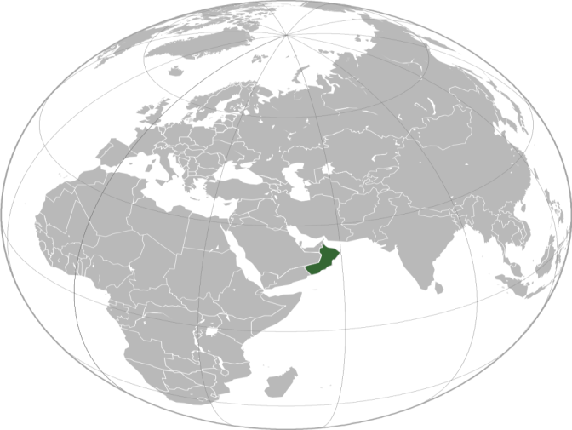
Economy of Sultanate of Oman
Small Open Economy
Population ~ 4 Million (Omanis 2.3 M)
GDP ~ RO 31 B or USD 80 B (0.1 % of World GDP)
Oil Production 950 K bpd (1% of Global Prod.)
International Trade ~ 100% of GDP
Oil & Gas Revenues 75% - 85% of Total Govt. Revenues
Major exports (crude oil) quoted in USD
Fixed Exchange Rate : 1 OMR = 2.6 USD
Flows Data Jan-Dec 2014; Stock Data as of 31-Dec-14
17

Slide 4
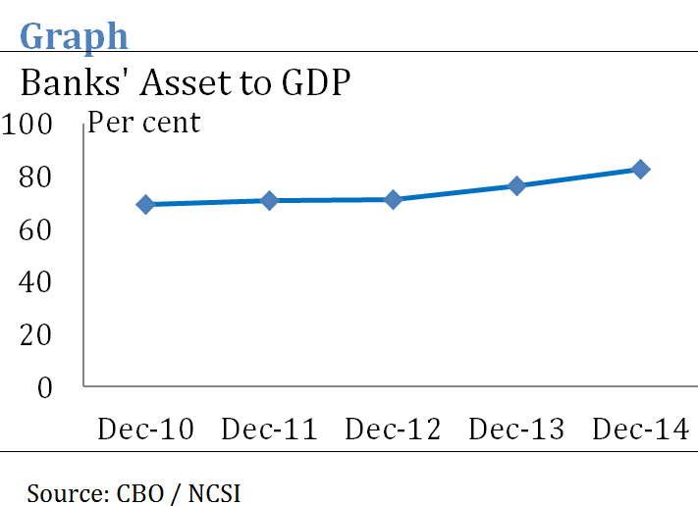
Economy of Oman
Banking Sector
Small and “Introvert”
Banking Sector Assets~ RO 26 B or 80% of GDP
Structural Liquidity
.
.
.
.
.
.
.
17

Slide 5
Economy of Oman
Banking Sector
Frictions
Directed Lending
Quantitative Ceilings
Interest Rate Ceilings
Regulations on Overseas Placements/ Lending
Forex Exposure Limits
Under Developed Financial Markets
90% deposits (by Volume; 40% by Value) are ‘zero interest’ / Prize Money
.
.
.
.
.
.
.
17

Slide 6
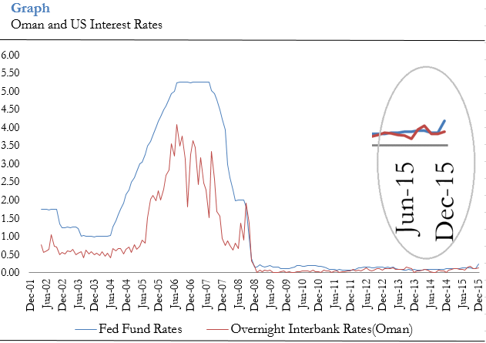
Economy of Oman
Fixed Exchange Rate
Tools : OMOs, Forex Swaps, Cash Reserves
No Independent Monetary Policy - Need to follow the US
Interest Rates may at times Deviate from Fed Fund Rate
. . . but not to pursue inflation / growth objectives
Fiscal Policy to Target Domestic Inflation and Smooth Business Cycle
.
.
.
.
.
.
.
17

Slide 7
This Study
Study “Market to Retail (Deposits and Lending) Pass-Through” of Interest Rates and its evolution over time.
Explore efficacy of various channels of transmission in influencing (non-oil) output and prices.
17

Slide 8
Model - I
Theory: Frictionless Interest Rate Pass-through
Empirical: neither instant nor complete [Hannan and Berger (1991), Berger and (Udell (1992), Neumark and sharpe (1992) etc.
Assume Relationship between money market rate and retail rate can be specified as ARDL:
$$i_{t}= β_{0}+ β_{1}i_{t−1}+β_{2}m_{t}+ . . . +β_{n+2}m_{t−n}+ u_{t}$$
where, $i_{t}$ is retail lending or deposit rate at time t
$m_{t}$ is market rate(overnight interbank rate) at time t.
Impact Multiplier = ${IM}_{i,x}= β_{2}$
Long Run Multiplier = ${LM}_{i,x}=\frac{1}{1−β_{2}}\sum_{j=0}^{n}{β_{2+j}}$
17

Slide 9
Data / Estimation
Overnight Interbank Rates and Retail Deposit and Lending Rates
Sample : 1998:01 to 2015:12
Estimation in First differences because of non-stationarity
Full Sample and Rolling Windows of 48 months
AIC used to determine lag length
Also CD rates instead of Overnight Rates/ Error Correction Model
17

Slide 10
Impact and Long-run Multipliers
Interest Rate Pass-through is weak – both in terms of initial and long-run response
Esp. so for Lending rates
Some signs of Improvement in pass-through over time
Esp. Long-run multiplier for Deposits improved, before tapering off
17
Notes:
Islamic banks gaining higher share, more than trebled during last 5 years. These questions are relevant to the policy makers as Islamic Banking is gaining more systemic importance.
Whether the stability of the financial sector will be altered when the Islamic segment of the banking sector becomes even more important.

Slide 11
Model - II
Which Channel is Effective, following Cevik and Teksoz(2012)
SVAR
$Y_{t}=α_{t}+\sum_{k=1}^{n}{{β_{t} Y}_{t−k}}+\sum_{k=1}^{n}{{λ }_{t}{ X}_{t−k}}+µ_{t}$
where, $Y_{t}$ is vector of Endogenous Variables at time t, and include Real non-Oil GDP, CPI, Private Sector Credit and Overnight interest rates (also later also NEER)
$X_{t}$ is a vector of Exogenous Variables at time t to control for changes in economic conditions (worldwide and US), and include Crude Price (Fateh and WTI, alternately), US Real GDP and Fed Fund Rate
17

Slide 12
Data / Estimation
Sample : 1998:Q1 to 2014:Q4
Seasonally Adjusted other than interest rates
AIC used to determine lag length (4)
17

Slide 13
Results
Domestic CPI does not react significantly to the Output shocks.
Bank lending is sensitive to the output shocks
Interest rate shocks affect bank credit, though the effect is not very pronounced
17

Slide 14
Conclusion
Weak Interest Rate Pass-through
Credit Channel Appears to Work
Frictions and shallow markets likely impede the transmission mechanism.
Islamic Banks hinder monetary policy transmission through credit channel (Zaheer et al (2013)). Islamic Banks are more sensitive to interest rate changes (Macit (2012). Islamic Banking new in Oman with a share of about 5 per cent. The increasing share of IB may further weaken the Credit Channel of the transmission mechanism.
Despite challenging times, reliance to be continued on fiscal measures for development and price stability
17

Slide 15
Thank you!

