Slide 1
The Role of Islamic Development Bank in addressing economic challenges in Member Countries
ADFIMI INTERNATIONAL DEVELOPMENT FORUM
“Developmental Central Banking: Issues, Prospects and Challenges
held under the auspices of
THE CENTRAL BANK OF QATAR
Ritz Carlton Hotel, Doha, 25-26 April 2016
Abdullateef Bello, PhD
Islamic Development Bank
abello@isdb.org

Slide 2
Islamic Development Bank Group at a glance
1975
1981
1994
1999
2008
Islamic Research & Training Institute (IRTI)
The Islamic Corporation for the Insurance of Investment and Export Credit (ICIEC)
International Islamic Trade Finance Corporation (ITFC)
Islamic Corporation for the Development of Private Sector (ICD)

Slide 3
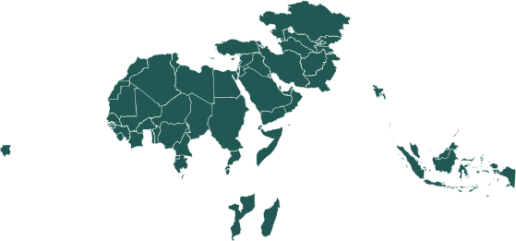
Who we are
A role model of South-South Cooperation
Foster socio-economic development of 56 member countries + Muslim communities in Non-MCs based on the principles of Shari’ah
1,128 staff distributed across entities & regional offices / Gateways
HQ in Jeddah, KSA
4
Regional Offices
+
5 Country Gateway Offices
2
EUROPE
Almaty, Kazakhstan
( 1997)
Rabat, Morocco (1993)
LATIN AMERICA
26
ASIA
1
Dakar, Senegal (2006)
Kuala Lumpur, Malaysia
( 1993)
27
AFRICA
5 new Country Gateway Offices
Indonesia, Turkey, & Nigeria established
Bangladesh & Egypt in progress

Slide 4
Our development model…
Integrated and holistic approach to development
Development Projects
Trade
Private Sector
Insurance
Research on Islamic Finance & Banking

Slide 5
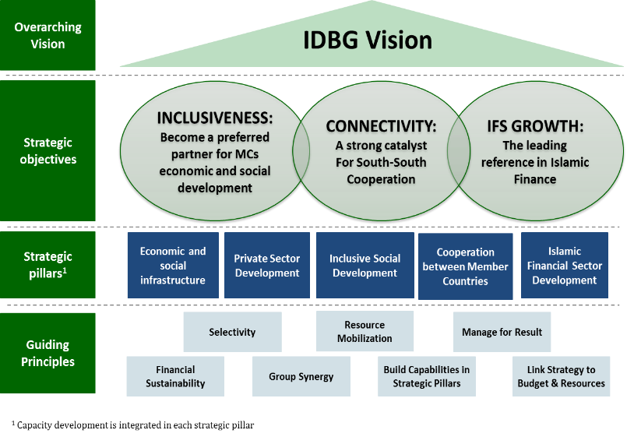
Our activities anchored on new 10 Years Strategy Framework

Slide 6
Unprecedented complex challenges in an interconnected and globalized world
Rising multidimensional poverty (esp. SSA and South Asia)
Youth unemployment (skills mismatch, demographic transition …)
Infrastructure gaps (due to rising urbanization, population, urban migration etc.)
Widening income inequality (lack of inclusive growth…)
Risk of pandemic diseases (Ebola, MERS, Zika etc.)
Climate change risks (drought, flooding, heatwaves etc.)
Undiversified economies (esp. oil exporting countries)
Dwindling remittances (esp. Central Asia countries)
Volatile commodity prices (hitting hard the oil exporting countries)
Refugee and internally displaced people crisis (war, conflicts etc.)
Rising spate of terrorism
Geopolitical risks (political instability, etc.)
Achieving SDGs ($5-7 trillion annual investments requirement!)

Slide 7
Role of IDBG in addressing the challenges in MCs
(i) Finance

Slide 8
Regional share of IDBG financing since inception
Total net approvals US$ 112 billion

Slide 9
IDB OCR sectoral interventions:
Comparing Crisis vs Pre-Crisis periods
(2008-20015 vs 2000-2007) (Ratios)

Slide 10
IDB OCR Infrastructure sub-sectors by region:
Comparing Crisis vs Pre-Crisis periods
(2008-20015 vs 2000-2007) (Ratios)

Slide 11
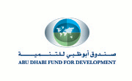
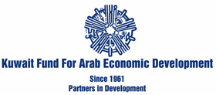
(ii) Partnership
(a) Arab Coordination Group
Arab Gulf Program for Development
(b) MDBs and International Organizations
(c) Bilateral, Philanthropic Foundations and Others

Slide 12
(d) Partnership with MCs
Through Member Country Partnership Strategy (MCPS)
Seek Common Grounds
Consultation
Country National Development Strategy/Plan
Diagnosis
Government
Development Partners
Civil Society
Private Sector
Academia
Research Institute
MCPS and Results Framework
Diagnostic and Analytical Papers
Sector and Thematic Assessments
Sector Road Maps
Self and Independent Assessments
IDB Vision 1440H and Results Framework

Slide 13
(iii) Knowledge
Promoting economic cooperation & regional integration

Slide 14
Thank You
Notes:
14

