Slide 1

The Role of Central Bank
in Promoting Sustainable Growth:
Perspectives on the Implementation of Flexible ITF
Dr. Solikin M. Juhro
Director, Economic and Monetary Policy Department
Bank Indonesia
ADFIMI INTERNATIONAL DEVELOPMENT FORUM
“Developmental Central Banking: Issues, Prospects and Challenges “
THE CENTRAL BANK OF QATAR, Doha, 25-26 April 2016

Slide 2
Issues to be discussed
2
What are the best central bank policy strategies to promote sustainable economic growth in the Post GFC?
Does the assessment on challenges facing the economy suggest a need for changes in the design of post GFC ITF-based monetary policy in the context of a small open economy?
What is the implication of a preferred central bank policy framework on stability and growth?

Slide 3
Key Messages
3
In the midst of global uncertainty, the policy configuration to maintain sustainable economic growth should be aimed to strike the internal and external balances. The role of central bank should be directed to integrate monetary and financial system stability framework. It is sufficient to balance monetary and financial stability with structural reforms …..
The post-GFC monetary policy framework enhancement in Indonesia is characterised by the ‘Flexible’ ITF. By adopting ITF-based monetary policy, Bank Indonesia has sufficient policy space to absorb a certain degree of negative impacts of a crisis, thus preserving economic growth.
The framework enhancement implies that the policy mix is ultimately part of an important strategy. Strengthening policy coordination among policy authorities in maintaining monetary and financial system stability as well as to enhance structural reforms is very essential.

Slide 4
The Challenges for Central Bank’s Role in the Post GFC
4
The GFC and the deep accompanying recession lead to a growing call for a revival of the subdued role of the central bank in promoting sustainable economic growth…… vs. the relevance of (flexible) ITF?
The rationales:
Learning from the history of economic crises, the crises had major underlying causes originating from real economic problems; the crises were not just the result of changes in financial sector behavior.
The roots of future economic problems facing central banks will be extremely complicated; the central bank should take part also in strategic roles beyond monetary boundaries.
In the evolution of central bank towards the modern era, there are always conflicts between the stabilizing and developmental roles; there is strong empirical evidence that the central bank should not fully abandon its developmental role.

Slide 5
A Sustainable Growth Model: the Role of Central Bank
5
The policy configuration need to strike the internal and external balances … by integrating monetary and financial system stability framework …
Sustainable Economic Growth
Export-led Growth
Domestic Demand-led Growth
Best practice adoption
(Comparative advantage)
Sustainable financing for development
Sustainable financing for development
Central Bank’s role:
Striking the internal and external balances
Integrating monetary and financial system stability framework
Financial market stability & countercyclical policy space
Industries/firms competition
Financial market stability & countercyclical policy space
Product development promotion
Good governance
Political economy benefits
Improved income distribution
“The strategy should not abandon exporting strategies, while building up the domestic demand side of the economy.”
Economic benefits of openness
Domestic market development
Sources: Palley (2011) and Juhro (2012)

Slide 6
Policy Framework to Promote Sustainable Growth
6
The policy configuration need to strike the internal and external balances … by integrating monetary and financial system stability framework …
Balancing monetary and financial stability with structural reforms …..
Short-term perspective:
cyclical demand management
Medium-long term perspective:
cyclical demand management
+ structural policy/reform

Slide 7
Policy Framework to Promote Sustainable Growth
7
In the medium-to-long term perspective, policy strategy should also be directed to minimize potential economic shocks that may arise and simultaneously increase the capacity of the economy to achieve sustainable economic growth.

Slide 8
From ‘Standard’ to ‘Flexible’ ITF
8
The GFC: Lessons Learned ….
Multiple challenges vs. intrument mix.
In a small open economy, the multiple challenges facing monetary policy as a result of dynamic capital flows imply that the monetary authorities should employ multiple instruments.
No macro stability without financial stability.
While price stability should remain the primary goal of central banks, the GFC demonstrated that maintaining low inflation alone, without preserving financial stability, is insufficient ....
Mishkin (2011): “none of the lessons from the financial crisis in any way undermines the nine basic principles of science of monetary policy”.
Exchange rate policy should play an important role in the ITF.
In a small open economy, exchange rate dynamics are largely influenced by investor risk perception. There is a case for managing the exchange rate in order to avoid excess volatility.

Slide 9
From ‘Standard’ to ‘Flexible’ ITF
9
Stabilization trade-off shows that ITF possesses ‘limitations’….
The model of Barro & Gordon (1983)
“The smaller weight output stabilization (b) - the more credible a policy, inflation is low and stable, but is accompanied by output volatility….”
‘Lucas’ supply:
Objective fn.
First order condition provides solution:
Unconditional moments:
“inflation bias”
“stabilization component”
Can Flexible ITF be seen as an intermediate stage between a ‘standard’ ITF and Nominal GDP Targeting ….?.
‘Standard’
ITF
‘Flexible’
ITF
Nominal
GDP

Slide 10
The implementation of F-ITF has at least three fundamental consequences on the behavior or preferences of central bank monetary policy…..
In the short-term, especially during the period of recovery after the crisis, a monetary policy preference that favors economic growth rather than price stability could be possible.
There is a major consideration on the pivotal role of financial sector developments. Within this policy perspective, the format of central bank policy should integrate the frameworks of monetary and financial system stability.
With emerging market economies characterized by undergoing general structural changes and macroeconomic fluctuations, an appropriate formula of monetary policy response should accommodate an element of flexibility; which is translated into a quality coordination between the central bank and the government.
From ‘Standard’ to ‘Flexible’ ITF
10
“……. the substance of ‘stability’ can be described in a broader perspective, not only the inflation-output growth trade-off in the short term, but also financial sector developments….”

Slide 11
The ‘Flexible’ ITF of Indonesia
11
ITF remains a reliable monetary policy strategy in Indonesia …
There is justification for the necessity to implement the ITF which is less rigid (e.g. flexible ITF) as an ideal format for the Indonesian economy (Juhro et al., 2009)
Principles of enhancement under unconventional wisdom of monetary policy:
Continuing the adherence of policy framework
to an inflation target as the overriding
objective of monetary policy
1
2
Integrating monetary and
macroprudential policy
Managing the dynamics of capital
flows and exchange rates.
3
Strengthening policy communication
strategy as part of policy instruments.
4
5
Strengthening BI and Government
policy coordination.

Slide 12
The ‘Flexible’ ITF of Indonesia
12
Policy instrument mix is ultimately part of an important strategy to optimally manage monetary policy trilemma...
Bank Indonesia’s Monetary Policy Trilemma Management

Slide 13
Empirical Transformation under The ‘Flexible’ ITF
13
Empirical transformation from ‘the impossible trinity’ into ‘a possible trinity’...
Strong empirical evidence that there is a tendency for monetary policy strategy to move away from the one that is hypothesized by the monetary policy trilemma.
Indonesia Monetary Policy Trilemma Index
Monetary Autonomy
Pre Asian Crisis
“can reach only two of three”
1 : 1 : 0
Post GFC
Vs.
2/3 : 2/3 : 2/3
“possible to manage the three”
Post Asian Crisis
Pre GFC
Financial Integration /
Capital Openness
XR Stability /
Fixed XR

Slide 14
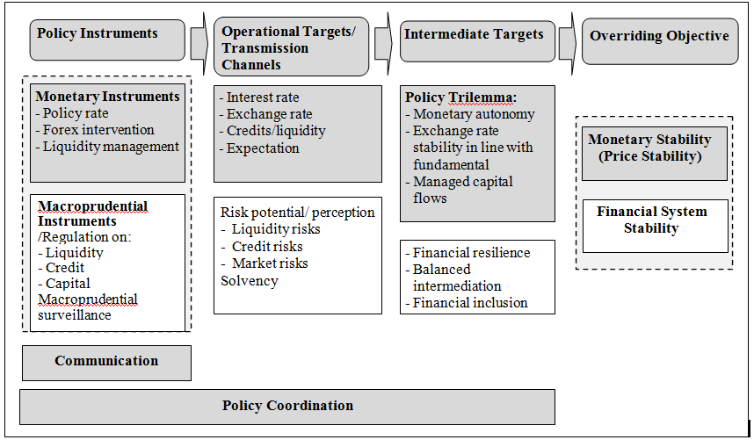
The ‘Flexible’ ITF of Indonesia
14
  Monetary policy framework under ‘Flexible’ ITF …
The central bank’s policy formulation should evaluate the strategic role of monetary policy and financial system at the same time.
Monetary Policy Framework under ‘Flexible’ ITF

Slide 15
THANK YOU

Slide 16
Stylized Facts on Stability-Growth Potential
16
Indonesian economy demonstrates considerable resilience, amid the fragile condition of the global economy in the post-GFC...
Despite the robust economic growth, Indonesia experienced a relatively low and stable inflation....
Supported by fundamental strengths attributable to a wide-ranging economic reforms including monetary, fiscal, banking, and real sectors since 1997/98.
GDP Growth and Its Determinants
Inflation: Headline vs Core

Slide 17
Stylized Facts on Stability-Growth Potential
17
Flattening Phillips Curve in the ITF period ...
There is indication of shifting in the degree of stability-growth nexus during the ITF period: the nexus appears to have weakened, especially in the post GFC period
Due to increasing role of supply response (i.e. cost push shocks related to exchange rate, commodity price, weather anomaly,) and better policy coordination between BI and the government.
Inflation and GDP Growth Nexus

