Slide 1
Monetary Policy Responses to the 2008 Financial Crisis:
Quantitative Easing Evidence from the United Kingdom
M. Kabir Hassan, Ph.D.
University of New Orleans, Louisiana, USA
Co-authors
Ali Ashraf, Ph.D. Frostburg State University, Maryland, USA
Walter Lane, Ph.D., University of New Orleans, Louisiana, USA

Slide 2
Overview on Conventional Monetary Policy Tools
FED uses three tools to achieve its monetary policy goals:
  discount rate
  reserve requirements
  open market operations
Discount Rate
discount rate is the interest rate Reserve Banks charge commercial banks for short-term loans.
Federal Reserve lending at the discount rate complements open market operations in achieving the target federal funds rate.

Slide 3
Overview on Conventional Monetary Policy Tools
Lowering the discount rate is expansionary because the discount rate influences other interest rates and would encourage lending and spending by consumers and businesses.
Otherwise, raising the discount rate is contractionary because the discount rate influences other interest rates.
Discount rate changes are made by Reserve Banks and the Board of Governors.

Slide 4
Overview on Conventional Monetary Policy Tools
Reserve requirements
Reserve requirements are the portions of deposits that banks must hold in cash, either in their vaults or on deposit with FED.
A decrease in reserve requirements is expansionary because it increases the funds available in the banking system to lend to consumers and businesses.
An increase in reserve requirements is contractionary because it reduces the funds available in the banking system to lend to consumers and businesses.

Slide 5
Overview on Conventional Monetary Policy Tools
open market operations
By far, the most frequently used tool is open market operations, the buying and selling of U.S. government securities.
This tool is directed by the FOMC and carried out by the Federal Reserve Bank of New York

Slide 6
Overview on QE
What is QE?
QE is considered as an unconventional monetary policy in which a central bank purchases government securities or other securities from the market in order to lower interest rates and increase the money supply.
Usually, when the target interest rate reaches zero-bound threshold, then a central bank would have one less monetary policy tool in their hand, as interest rate cannot be lowered down any further.

Slide 7
Overview on QE
How it works?
During the recent global financial crisis, many of the central banks from the developing countries used up all the available traditional monetary policy tools.
Target interest rates have been lowered several times and reached zero-bound threshold.
Then, the central banks had to engage in purchasing financial assets from the financial market to inject further liquidity into the system.

Slide 8
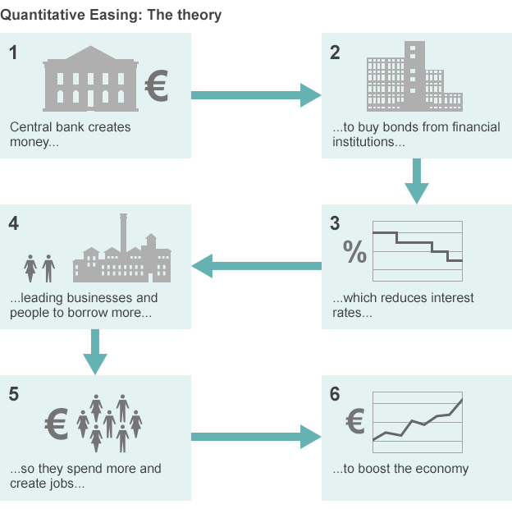
Overview on QE
http://www.bbc.com/news/business-15198789

Slide 9
Overview on QE
What are the risks?
Some economists have opposed the idea of QE in principle, because they believe in the long run, there's a danger that it could create too much inflation.
Others argue that the extra money may just bolster the price of some assets such as shares and property in some countries.

Slide 10
Overview on QE
Who else has tried QE?
Between 2008 and 2015, the US Federal Reserve in total bought bonds worth more than $3.7 trillion.
UK created £375bn ($550bn) of new money in its QE program between 2009 and 2012.
Eurozone began its program of QE in January 2015 and has so far pumped in $600bn of extra money.

Slide 11
Introduction
In a QE regime, the monetary authority actively engages in “asset purchase programs” to impart additional liquidity into the economy as the official bank rate reaches near zero threshold.
Prior to recent financial crisis, Japan was one of the developed economies to pursue QE as the effective lowest bound of zero rates in February 1999.
Following the Lehman Brothers collapse in September 2008, monetary authorities in many developed countries engaged in active monetary responses.

Slide 12
Literature Review
Earliest evidence of QE was in the US in 1932 when FED initiated a $1 billion purchase of government treasuries and maintained it until 1936. But, its monetary impact is still a debated issue.
Recent studies in QE focus on Japanese experience since February 1999.
Shirakawa (2002) finds the similarity of the Japanese experience to the experiences of Sweden and the U.S. in the early 1930s.

Slide 13
Literature Review
More recently, Shiratsuka (2010) compares Japanese QE during 2001 to 2006 to the U.S. Federal Reserve’s policy and identifies the key difference.
U.S. Federal Reserve policy reactions aim at the asset side of its balance sheet whereas the Bank of Japan focuses on a target for the current account balances on the liability side.
Using a Neo- Keynesian framework, Gauti & Woodford (2004) argue that “QE may fail to inject desired level of stimulus to an economy if central bank policy cannot change expectations about future policy.”

Slide 14
Literature Review
However, using similar framework, Auerbach and Obstfeld (2003) find that open-market operations may permanently increase the monetary base.
Bernanke (2004) identifies three alternatives during a zero-interest regime that may provide additional stimulus:
  by assuring that short-term rates will be kept lower in future, to influence investor expectations
  by changing relative supply through open market operations
  by increasing its balance sheet asset holdings.

Slide 15
Literature Review
Klyuev et al (2009) provides additional alternative:
  by purchasing government securities
  by actively intervening in specific credit markets.
Joyce et al. (2010) analyze the impact of gilt purchases by the Bank of England on long-term interest rates by using multivariate GARCH model.
Ashraf, Hassan and Hippler (2016) analyze QE in USA and its impact on the financial institutions stock and document mixed evidence supporting targeted asset purchase.

Slide 16
Motivation
This paper contributes to existing literature in three different ways.
  by providing empirical evidence on monetary policy by using the United Kingdom dataset
  by comparing monetary policy impact in pre-QE and QE period
  by analyzing whether a long-run equilibrium or steady state exists between monetary policy tools and target variable

Slide 17
Data
Source: the Bank of England’s official website.
January 31, 2007 to June 30, 2010, Daily frequency
Conventional Monetary policy tools: broad money, narrow money (M1, M2 and M4), and Official Bank rates
Target Variables: stock market index, and exchange rate index, and spot and forward rates of Overnight Index Swap (OIS), LIBOR rates, from 6 months to 25 years at six-month intervals
QE regime asset purchase data
Gilt (Govt. Treasury) purchase data: Jan. 26, 2010 to March 11, 2011
Corporate bond purchase & sales data: from March 25, 2009 & January 08, 2010 respectively

Slide 18
Bank of England action timeline
Following the global market collapse, Bank of England started reducing official bank rates on December 6, 2008.
It further reduced the official bank rates five times between January 08, 2009 and February 07, 2009 from 5.50% to 1.50%.
On March 05, 2009, the official bank rate was lowered to its threshold lowest level at 0.50.
It established an asset purchase facility on January 30, 2009 & started the first purchases of commercial papers and gilts on February 13 and March 09, 2009 respectively.
By February 2010 the Bank had approved purchase of £200 billion worth securities (an amount equivalent to 14% of nominal GDP).

Slide 19
Quantitative Easing Period
Panel 01: Official Bank Rates
Panel 02: 1 yr. Maturity spots and forwards
Panel 03: 2 yr. Maturity spots and forwards
Variables: LIBOR spot and forward, OIS spot and forward, Nominal Govt. Spot and Forward

Slide 20
Panel 04: 5 yr. Maturity spots and forwards
Panel 05: 15 yr. Maturity spots and forwards
Panel 06: 20 yr. Maturity spots and forwards
Variables: LIBOR spot and forward, OIS spot and forward, Nominal Govt. Spot and Forward

Slide 21
Results
We analyze the responses to monetary policy tools during the United Kingdom’s Quantitative Easing (QE) regime from March 06, 2009 to June 02, 2010.
We find that conventional monetary policy tools other than a zero-bound official bank rate may still be effective.
Inclusion of one unconventional tool, “the increase in government gilt holdings”, has significant impact on most of the target variables.

Slide 22
Results
Time Series Properties of the target variables are consistent with literature:
ACF (Autocorrelation Function) and PACF (Partial Autocorrelation) of the time series of target variables show the existence of significant autocorrelation.
PACF reduces drastically after one lag meaning that time series processes for the variables are in general AR(1) processes.
ADF unit root statistics suggest that for the majority of the spot and forward rates, the variables are I(1) processes; that is, the variables are non-stationary at their level but stationary at their first differences.

Slide 23
Results
Conducted Pair-wise Granger causality tests to analyze:
  a) causality between monetary tools & target variables
  b) causality within different maturities of target variables
For the overall sample, results show that:
  No causality among conventional & unconventional monetary tools
  Not enough evidence that monetary policy tools Granger cause 6 month OIS and LIBOR spots and forwards.
  But, for year 1 and above maturity, both conventional tools (M1 and M4) and unconventional tool (log of gilt holdings) Granger cause the target variables.

Slide 24
Results
Existence of long-run equilibrium:
Target variables are AR(1) process of I(1), which suggest that there may exist a long-run equilibrium
Smaller time span of sample is a constraint to regular co-integration process.
Pedroni (2004) panel procedure is robust to inconsistency due to smaller time span, as it allows to draw information from cross-sections of variables.
We analyze if monetary policy tools, both conventional and unconventional, are co-integrated with the target variables

Slide 25
Results
Existence of long-run equilibrium:
Responses to the monetary policy tools are not robust.
For Market index, exchange index, investment-grade and non-investment bond yields, as a group, are co-integrated with monetary policy tools, during both QE and pre-QE sample; but not during the overall sample
Similar results hold for LIBOR spot and forward rates.
However, OIS spots and forwards and inflation spots and forwards are not co-integrated during QE.

