Slide 1
MONETARY POLICY AND BANK LENDING IN
A DUAL BANKING SYSTEM
Mansor H Ibrahim (INCEIF)

Slide 2
Content
Introduction
Bank Lending Channel: Overview
Why is the Bank Lending Channel important for Islamic Banks?
Empirical Assessment
Conclusion

Slide 3
INTRODUCTION
The recurrence of financial crises over past decades has called for closed scrutiny of financial sectors, particularly the banking sector.
- The banking sector is the originator/propagator/amplifier of
aggregate disturbances.
Among the various aspects of bank operations/performance under the present scrutiny, the bank lending decision especially during episodes of adverse shocks has been much emphasized.
The Islamic banking sector, being the fastest growing segment of the global financial sector, is no exception to this scrutiny, but more towards finding as to whether the Islamic banking system is a viable alternative system.

Slide 4
INTRODUCTION
As for the present analysis, our questions are:
How do Islamic banks fit into the present monetary framework?
Do they have contributive roles in Monetary Transmission Mechanisms?
Objective: Assessments of the Bank Lending Channel of Monetary Transmission Mechanisms

Slide 5
BANK LENDING CHANNEL
Financial frictions and market imperfections
- Imperfect substitutability of financial assets
- External finance premium
Contractionary Monetary Policy forces to cut loan supply. The inability for banks to have access to alternative sources of funds or the costs are prohibitive.
Implications:
- Complementing other channels of MTM
- Amplifying aggregate fluctuations
- Distributional Consequences

Slide 6
ISLAMIC BANKS AND THE BANK-LENDING CHANNEL
HOW WOULD ISLAMIC BANKS RESPOND TO MONETARY POLICY SHOCKS? MILDER OR STRONGER?

Slide 7
RELATED LITERATURE
Bhaumik et al. (2011), Olivero et al. (2011), Yang and Shao (2016), Altunbas et al. (2009, 2010), Perera et al. (2014).
Aggregate Data
Identification of Loan Supply and Loan Demand
Bank-level Data
Loan Supply Depends on Bank’s Balance Sheet Strength
Other Bank-Specific Factors
Ownership
Size, Capitalization, Liquidity
Competition
Securitization
Risk
Others
Kishan & Opiela (2000, 2006), Kakes and Sturm (2002), Jimborean (2009), Matousek & Sarantis (2009), Peek & Rosengren (1995), Altunbas et al. (2002), Gambacorta (2005) and others

Slide 8
RELATED LITERATURE: ISLAMIC
Aggregate Data
Kassim et al. (2009), Sukmana and Kassim (2010), Ibrahim and Sukmana (2011), Ergec and Arslan (2013)
Islamic bank financing exhibits excess sensitivity to interest rate changes.
Bank-level Data
Few studies
Macit (2012): stronger reaction of financing by participation banks to monetary policy shocks for Turkey
Asbeig and Kassim (2015): absence of the bank lending channel for both Islamic and conventional banks for Malaysia
Zulkhibri (2013): bank lending channel is operative for Malaysia but no distinction is made between Islamic and Conventional Banks

Slide 9
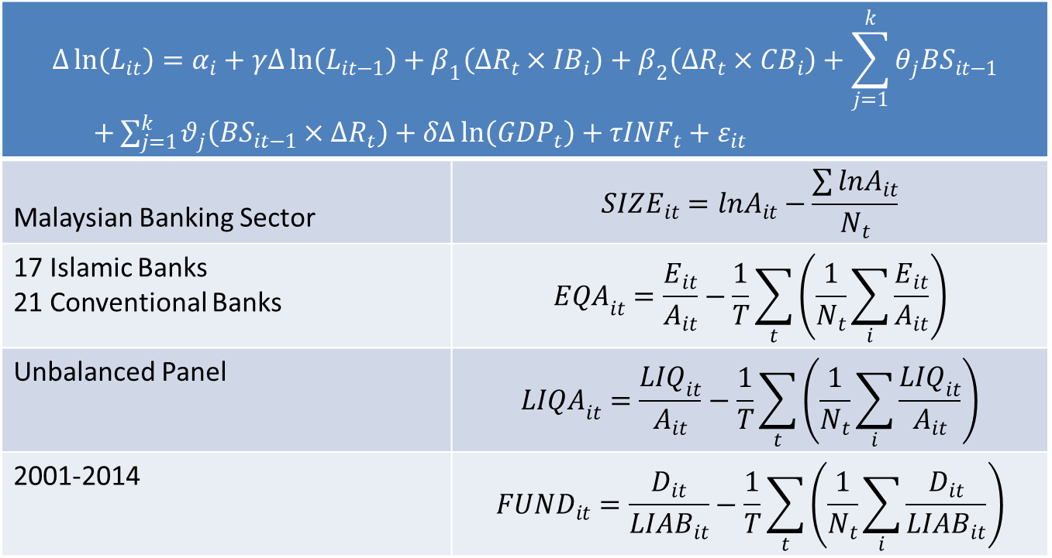
MODEL AND DATA
$$∆\ln\left(L_{it}\right)=α_{i}+γ∆\ln\left(L_{it−1}\right)+β_{1}\left(∆R_{t}×{IB}_{i}\right)+β_{2}\left(∆R_{t}×{CB}_{i}\right)+\sum_{j=1}^{k}{θ_{j}{BS}_{it−1}}$$ $+\sum_{j=1}^{k}{θ_{j}\left({BS}_{it−1}×∆R_{t}\right)}+δ∆\ln\left({GDP}_{t}\right)+τ{INF}_{t}+ε_{it}$
Malaysian Banking Sector | $${SIZE}_{it}=lnA_{it}−\frac{\sum{lnA_{it}}}{N_{t}}$$
17 Islamic Banks 21 Conventional Banks | $${EQA}_{it}=\frac{E_{it}}{A_{it}}−\frac{1}{T}\sum_{t}{\left(\frac{1}{N_{t}}\sum_{i}{\frac{E_{it}}{A_{it}}}\right)}$$
Unbalanced Panel | $${LIQA}_{it}=\frac{{LIQ}_{it}}{A_{it}}−\frac{1}{T}\sum_{t}{\left(\frac{1}{N_{t}}\sum_{i}{\frac{{LIQ}_{it}}{A_{it}}}\right)}$$
2001-2014 | $${FUND}_{it}=\frac{D_{it}}{{LIAB}_{it}}−\frac{1}{T}\sum_{t}{\left(\frac{1}{N_{t}}\sum_{i}{\frac{D_{it}}{{LIAB}_{it}}}\right)}$$

Slide 10
DESCRIPTIVE STATISTICS
Variables | All Banks |  | Conventional Banks |  | Islamic Banks
 | Mean | SD | Mean | SD | Mean | SD
Loan Growth | 0.1298 | 0.2402 | 0.0939 | 0.2455 | 0.2075 | 0.2089
Total Assets (ln) | 15.4141 | 1.4420 | 15.5337 | 1.6290 | 15.1807 | 0.9412
Equity:Assets | 10.8354 | 6.9248 | 11.7883 | 7.6499 | 8.9748 | 4.7233
Liquid Assets | 30.7133 | 19.6186 | 32.7031 | 20.8811 | 26.8284 | 16.2601
Funding Ratio | 72.5221 | 18.4766 | 68.8297 | 19.0942 | 79.7311 | 14.8037

Slide 11
BASIC ESTIMATION RESULTS
Independent Variables | First-Difference GMM |  | System GMM
 | Coefficients | S.E. | Coefficients | S.E.
∆ln(L_{it-1}) | 0.0482 | 0.0806 | 0.0808 | 0.0927
∆R_{t} | -0.1123 | 0.0374*** | -0.0916 | 0.0501*
SIZE_{t-1} | -0.4549 | 0.0956*** | 0.0192 | 0.0673
EQA_{t-1} | -0.0018 | 0.0087 | 0.0005 | 0.0067
LIQA_{t-1} | 0.0117 | 0.0021*** | 0.0097 | 0.0015***
FUND_{t-1} | 0.0037 | 0.0021* | 0.0075 | 0.0021***
∆ln(GDP_{t}) | 0.0270 | 0.0074*** | 0.0253 | 0.0101**
INF_{t} | 0.0029 | 0.0134 | 0.0060 | 0.0165
Constant | 0.0380 | 0.1243 | -0.0268 | 0.0606
No. of Banks Observations | 38 341 |  | 38 379
P-value AR(1) AR(2) Sargan | 0.0587 0.2974 0.4871 |  | 0.0478 0.2212 0.5098

Slide 12
FURTHER RESULTS
Independent Variables | Regression
 | (1) | (2) | (3) | (4) | (5) | (6)
∆ln(L_{it-1}) | 0.0396 (0.079) | 0.0438 (0.075) | 0.0406 (0.078) | 0.0407 (0.082) | 0.0515 (0.080) | 0.0457 (0.086)
∆R_{t}×IB | -0.1746 (0.048)*** | -0.1909 (0.051)*** | -0.1766 (0.053)*** | -0.1759 (0.048)*** | -0.1741 (0.051)*** | -0.1851 (0.052)***
∆R_{t}×CB | -0.0866 (0.043)** | -0.0839 (0.042)** | -0.0894 (0.044)** | -0.0848 (0.040)** | -0.0848 (0.0408)** | -0.0836 (0.038)**
SIZE_{t-1} | -0.4066 (0.095)*** | -0.4129 (0.098)*** | -0.4228 (0.105)*** | -0.4080 (0.095)*** | -0.3999 (0.091)*** | -0.4183 (0.093)***
EQA_{t-1} | -0.0004 (0.008) | -0.0009 (0.009) | -0.0015 (0.010) | -0.0005 (0.008) | -0.0001 (0.008) | -0.0008 (0.009)
LIQA_{t-1} | 0.0111 (0.002)*** | 0.0109 (0.002)*** | 0.0111 (0.002)*** | 0.0112 (0.002)*** | 0.0110 (0.002)*** | 0.0109 (0.002)***
FUND_{t-1} | 0.0034 (0.002) | 0.0031 (0.002) | 0.0031 (0.002) | 0.0033 (0.002) | 0.0033 (0.002) | 0.0031 (0.002)
SIZE_{t-1}×∆R_{t} |  | -0.0145 (0.014) |  |  |  | -0.0118 (0.020)
EQA_{t-1}×∆R_{t} |  |  | 0.0028 (0.003) |  |  | 0.0003 (0.004)
LIQA_{t-1}×∆R_{t} |  |  |  | 0.0006 (0.001) |  | 0.0003 (0.002)
FUND_{t-1}×∆R_{t} |  |  |  |  | -0.0008 (0.001) | -0.0000 (0.001)
∆ln(GDP_{t}) | 0.0274 (0.008)*** | 0.0282 (0.008)*** | 0.0280 (0.008)*** | 0.0274 (0.008)*** | 0.0275 (0.008)*** | 0.0284 (0.008)***
INF_{t} | 0.0027 (0.012) | 0.0033 (0.012) | 0.0031 (0.013) | 0.0026 (0.013) | 0.0019 (0.013) | 0.0029 (0.013)
Constant | 0.0390 (0.118) | 0.0418 (0.120) | 0.0462 (0.123) | 0.0457 (0.117) | 0.0423 (0.119) | 0.0457 (0.121)
No. of Banks Observations | 38 341 | 38 341 | 38 341 | 38 341 | 38 341 | 38 341
P-values AR(1) AR(2) Sargan | 0.0597 0.3081 0.4839 | 0.0622 0.3383 0.4555 | 0.0627 0.3166 0.4434 | 0.0663 0.3226 0.4752 | 0.0625 0.3816 0.4539 | 0.0694 0.3785 0.4710

Slide 13
CONCLUSION
Our results have important implications.
They emphasize the need to factor in the presence of the bank lending channel for the proper conduct of monetary policy.
The strength of the lending channel via Islamic banks means that
- (i) financial frictions and information asymmetry is more acute for the Islamic banking sector,
- (ii) alternative sources of funds are more limited for the Islamic banks,
- (iii) the Islamic banks have a role in the amplification of aggregate fluctuations, and
- (iv) the Islamic banks and their clients would be more adversely affected by monetary policy
contraction jeopardizing its roles in society especially pertaining to financial inclusion.
As the Islamic banking sector will be systemically more important in the future, these implications of our findings should not be ignored.

Slide 14
THANK YOU

