Slide 1
“Managing Short-Term Capital Flows in New Central
Banking: Unconventional Monetary Policy Framework and New Central Banking”
Ahmet Faruk Aysan*
Monetary Policy Committee Member and Member of the Board
Central Bank of the Republic of Turkey
ADFIMI Development Forum organized under the auspices of QATAR CENTRAL BANK
Developmental Central Banking: Issues, Prospects and Challenges
Ritz Carlton, Doha, Qatar, 25-26 April 2016
Disclaimer: The views expressed here are those of the authors and should not be interpreted as reflecting the official views of the Central Bank of the Republic of Turkey.

Slide 2
Contents
Challenges after the Global Financial Crisis
New Central Banking
Turkish Monetary Policy: The New Framework
Effectiveness of Macroprudential Policies in Turkey:
Two Empirical Assessments

Slide 3
Challenges after the global fInancIal CrISIS

Slide 4
While ACs’ central banks pumping liquidity…
Policy Rates in Advanced Economies
(%)
Liabilities of Major Central Banks
(% of GDP)
Source: Bloomberg
Source: Bloomberg
Notes:
After Lehman Brothers’ collapse, central banks started to aggressively reduce interest rates in advanced countries driving them closer to the zero bound.
These rate reductions were coupled with unconventional monetary policies geared towards improving balance sheets of banks and other financial intermediaries through large-scale purchases of government and private sector assets.

Slide 5
… global stress increases the capital flow volatility.
Capital Inflows to Emerging Markets
(Billion USD)
Risk Appetite
(VIX Index)
Source: EPFR, Bloomberg.
Source: Bloomberg.
Notes:
Quantitative easing policies in advanced countries had significant implications for Emerging Markets through ample and low-cost short-term foreign financing.
However, there have been downside risks for the global risk appetite as a result of Eurozone problems, energy prices and growth rates of US and China.
Therefore, risk appetite and capital inflows to emerging markets have been very volatile.

Slide 6
Need for Rebalancing
Current Account Balance
(Seasonally Adjusted, Monthly Average, Million USD )
Capital Flows and Credit Growth
(percent)
Source: TURKSTAT, CBRT.
Source:TurkStat, CBRT .
Notes:
The excessive liquidity flowing in Turkey have fueled a credit boom leading to a significant rise in imports leading to higher current account deficit.

Slide 7
Need for Rebalancing
Monthly Imports and Exports
(Seasonally Adjusted, Million USD)
Main Sources of Current Account Deficit Finance
(12-months Cumulative, Billion USD)
Source: TurkStat, CBRT.
Source: CBRT.
*Short-term capital movements are sum of banking and real sectors' short term net credits and deposits in banks.
Notes:
The domestic spending spree has skyrocketed imports, while appreciation in the Turkish Lira restricted exports to a great extent.
Besides, these inflows were mostly short term in nature and created huge risks on financial stability in case of a sudden reversal in risk appetite.

Slide 8
NEW Central bankING

Slide 9
Central Bank’s Role
Price Stability (Safeguard)
Financial Stability (Contribute to)
Notes:
Before the global financial crisis, it was generally agreed that monetary policy should take care of price stability.
However, after the crisis, the idea that is gaining ground is that central banks should contribute to financial stability while maintaining the price stability.

Slide 10
Two Approaches
Approach 1: Use capital flow measures to restrict inflows while tightening via interest rates (Brazil, South Korea)
Approach 2: Use macro-prudential measures to restrict domestic credit and domestic demand (Turkey)
Notes:
The capital flow measures against short term inflows employed by Brazil and Korea have created quite a controversy in the global arena.
On the other hand, Turkey has opted to go for a policy mix, using macroprudential measures to restrict domestic credit and domestic demand.

Slide 11
Macroprudential Toolkit
Countercyclical capital buffers
Systemic levy for leveraged financial institutions
Limits to the LTV ratios on bank lending
Better resolution regimes for SIFIs
Surcharges on capital requirements for SIFIs
Notes:
Financial stability is best ensured through the newly established macroprudential toolkit.
These tools (mentioned above) are engineered to overcome the problems faced by the financial sector through volatile risk appetite and capital flows.

Slide 12
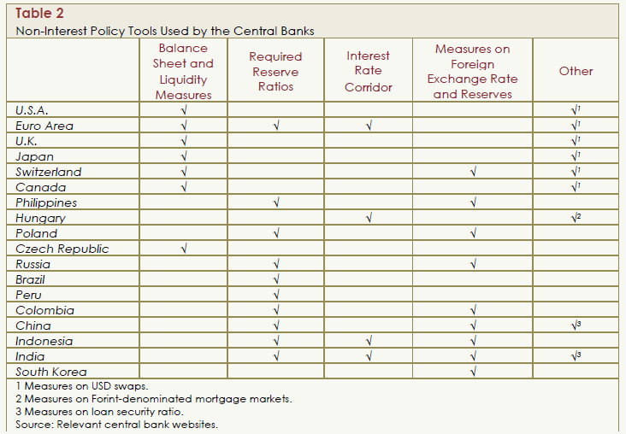
Non-Interest Policy Tools
Notes:
Both developed and developing countries have used non-interest policy tools.

Slide 13
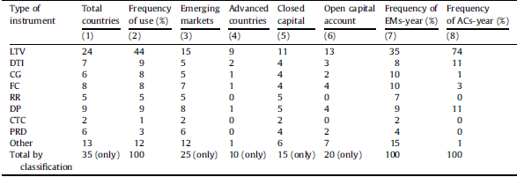
MaP instruments are widely used across the globe…
Notes: There are in total 35 countries using a macro-prudential policy at any point during the period 2000–2010. Countries are classified into emerging versus advanced economy countries (source: IMF), and open versus closed capital account countries (source: Chinn–Ito Index 2008). A country is defined as an open capital account country if its Chinn–Ito Index is larger than the global mean in 2005, and a closed capital account country if its Chinn–Ito Index is smaller than the global mean in 2005. The frequency of use is the ratio of country-pairs using a particular instrument to the total number of country-year pairs using a macro-prudential policy (e.g., 44% of the time during 2000–2010, countries were using LTV ratios compared to only 9% of the time using DTI ceilings).
Claessens et al. (2013) «Macro-prudential policies to mitigate financial system vulnerabilities», Journal of International Money and Finance, Volume 39, December 2013, Pages 153-185
Claessens et al. (2014), «Macro-Prudential Policies to Mitigate Financial System Vulnerabilities», IMF wp, 14/155 .
Notes:
Loan-to-value limits (LTV)
Debt-to-income limits (DTI)
Credit growth limits (CG)
Limits on foreign currency lending (FC)
Reserve requirements (RR)
Dynamic provisioning (DP)
Countercyclical capital requirements (CTC)
Regulations on profit redistribution (PRD)

Slide 14
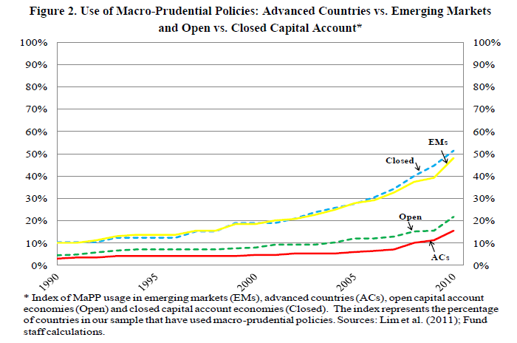
… where these instruments are used more frequently by EMEs.
Claessens et al. (2014), «Macro-Prudential Policies to Mitigate Financial System Vulnerabilities», IMF wp, 14/155
Notes:
Why EMs use more MaPs?
Claessens et al. (2014): While the greater recognition has come from the recent crises in advanced countries, emerging markets have had much greater experiences with macro-prudential policies, in part as they have had more pronounced business and financial cycles. This greater cyclicality is due to their larger exposures to volatile international capital flows, commodity price shocks, and other risks, and external and internal transmission channels that operate more adversely. In this context, there is much to learn for advanced countries from emerging markets, and there are lessons for emerging markets themselves, on the effectiveness of macro-prudential policies. (page 3)
For financial openness, Chin&Ito index is used.
We also differentiate between open and closed capital account countries on the basis of the country having a Chinn-Ito (2008) index of financial openness in 2005 above (33 countries) or below (15 countries) the median global index. The capital account dimension is an analytically useful distinction as it indicates what risks are (more) important and affects the consequences that may need to be managed. On this measure, as expected, all advanced countries have open capital accounts, while in the case of emerging markets, some have relatively open capital accounts, but others like China and India, are relatively closed. In turns out that macro-prudential policies have been used somewhat more in closed capital account countries, reflecting perhaps these countries’ generally less liberalized financial systems.

Slide 15
TURKISH MONETARY POLICY:
THE NEW FRAMEWORK

Slide 16
Multiple Instruments, Multiple Objectives
Credit Policy
Reserve Requirements
Macro- prudential Tools
Weekly Repo
Interest Rate Policy
Liquidity Policy
Interest Rate Corridor
Funding Strategy
KEY INDICATORS
INSTRUMENTS
OBJECTIVES
Financial Stability
Price Stability
Expectations
Credit Growth
Exchange Rate
Notes:
The new policy approach preserves the main objective of achieving and maintaining price stability while safeguarding financial stability as a supporting objective.
In this context, there is credit policy, interest rate policy, liquidity policy.
Expectations, credit growth and exchange rate are monitored as key indicators when utilizing these policies.

Slide 17
Liquidity Management
Interest Rate Corridor and Average Funding Rate
(Percent)
Euro Area Debt Crisis
Tapering Signal
QE3
Source: BIST, CBRT.
Last Observation: May 15, 2015

Slide 18
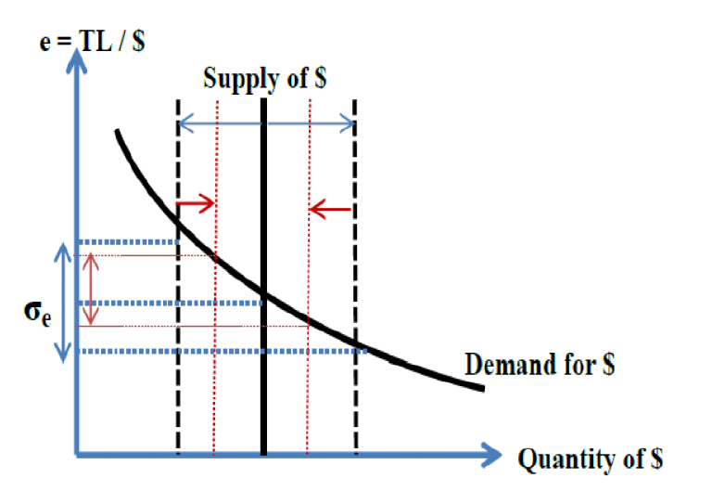
Smoothing Role of the Interest Rate Corridor
The corridor policy can be used to discourage short-term capital flows
by creating a managed uncertainty
about short-term yields.

Slide 19
Reserve Requirements
Maturity-Based Reserve Requirements
Currency-Based Reserve Requirements
Leverage-Based Reserve Requirements
Reserve Options Mechanism
Core vs Noncore Reserve Requirements
Notes:
Central Bank of Turkey is actively using reserve regquirements. In addition to the traditional uses of reserve requirements; maturity based,
currency based, leverage based reserve requirements as well as Reserve Options Mechanism has been implemented by CBRT.

Slide 20
Maturity Based / Core- Non-core
Reserve Requirements
Reserve Requirement Ratios (%)
TL |  | FX
Core Liabilities |  | Core Liabilities
Demand deposits, notice deposits and current accounts, deposits/participation accounts with maturities up to 3 months | 11.5 | Demand deposits, notice deposits and FX current accounts up to 1-year maturity | 13
≤ 6-month maturity | 8.5 | ≥ 1-year maturity | 9
< 1-year maturity | 6.5 | Non-Core Liabilities
≥ 1-year maturity | 5 | ≤1-year maturity | 20
Non-Core Liabilities |  | ≤ 2-year maturity | 14
≤1-year maturity | 11.5 | ≤ 3-year maturity | 8
≤ 3-year maturity | 8 | ≤ 5-year maturity | 7
> 3-year maturity | 5 | > 5-year maturity | 6
Lower RR for higher maturities → encourage longer term funding
Higher RR for Non-Core Liabilities → discourage non-core funding
Notes:
In order to enhance financial stability by extending maturity of the banking sector liabilities, reserve requirements were differentiated by maturities, with higher reserve requirements for short-term liabilities.

Slide 21
Currency Based Reserve Requirements
TL Reserve Requirements
FX Reserve Requirements
weighted average
of TL RRs
weighted average
of FX RRs
Source: CBRT.
Source: CBRT.
Actively used during episodes of capital inflow surges or high domestic credit growth.
Notes:
Similar to interest rate corridor, reserve requirements are adjusted according to the course of economic and financial developments.

Slide 22
Leverage Based Reserve Requirements
Leverage-based RRR
(additional %)
Leverage Ratios
Higher RR for highly leveraged banks.
Leverage Ratio: Bank’s Capital / (Liabilities + OBS items)
Notes:
Extremely high debt level in the financial system is one of the main reasons of the global financial crisis. Economic literature shows that leverage is cyclical, triggers financial cycles, increases during financial expansion periods, and drops during contractions. As for the Turkish banking sector, higher asset growth is associated with higher leverage.
The use of leverage ratio will curb the accumulation of risks that emanate from extreme leverage in the banking sector as well as the whole financial system.
In this context, a countercyclical and macroprudential policy based on leverage ratios will be put into effect in a gradual way.
The leverage ratio subject to the CBRT’s policy will be calculated by dividing the sum of tier-1 capital to total liabilities and off-balance sheet items with certain consideration ratios.
According to the leverage-based reserve requirements policy, firstly, an additional reserve requirement of 1 to 2 percent in three stages will be imposed on the banks having an average 3 to 3.5 percent leverage ratio in the last quarter of 2013. In the following years, the upper limit of the leverage ratio, will be raised to 5 percent gradually, and will be kept at that level.

Slide 23
Reserve Options Mechanism
Introduced by the CBRT in September, 2011.
Mechanism:
    banks can voluntarily hold a certain fraction of their domestic-currency required reserves in foreign currency or gold.
    amount of FX to meet 1 TL required reserve = Reserve Option Coefficient (ROC).

Slide 24
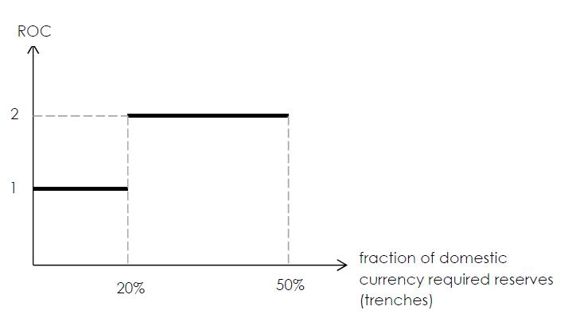
Reserve Options Mechanism
  Example: Suppose banks are obliged to hold 100TL as required reserves, and allowed to hold up to 50% of their domestic currency reserve requirement in FX.
  Let ROC=1 for 0-20% and = 2 for 20% - 50%. Then, if a bank is willing to utilize the mechanism fully, then
      instead of 100TL
      can hold [ (20TL * 1 + 30TL * 2) worth of FX ] + 50 TL

Slide 25
Reserve Options Mechanism
  Motivation:
  E.g. During capital inflow surges:
    cost of FX funding is lower than TL funding : utilize the mechanism more. → smoothing the business cycle.
    smooth excessive exchange rate fluctuations in a market-friendly manner, in turn cushioning the economy from excessive fluctuations in capital flows.
  support the FX reserve management of the banking system.

Slide 26
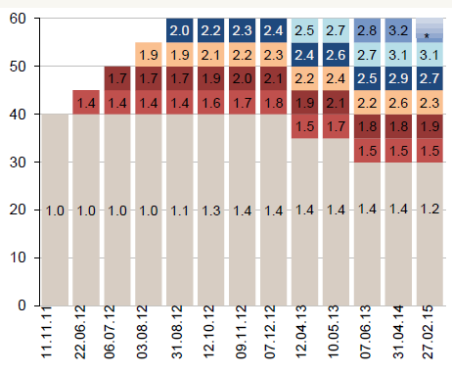
Reserve Options Mechanism (FX)
Reserve Option Coefficients (ROC)
Notes:
In the Reserve Options Mechanism, banks have the option to hold FX or gold reserves in increasing tranches in place of Turkish Lira reserve requirements and Reserve Option Coefficients shows multiplier coefficients of these tranches.
This facility not only provides the Turkish lira liquidity to the banks in a more permanent way and lowers their cost, but also supports the CBRT’s foreign exchange and gold reserves.
The main objectives of ROM are:
to reduce the adverse impact of volatile capital flows on the macroeconomic and financial stability
to increase the resilience of the economy against external financial shocks
to smooth the imbalances between foreign exchange supply and demand
to operate as an automatic stabilizer

Slide 27
Reserve Options Mechanism (FX)
Reserve Option Coefficients (ROC)
ROC
4.7
3.1
1.2
Percent of
Required Reserves in FX
30
35
40
45
50
55
60
Notes:
In the Reserve Options Mechanism, banks have the option to hold FX or gold reserves in increasing tranches in place of Turkish Lira reserve requirements and Reserve Option Coefficients shows multiplier coefficients of these tranches.
This facility not only provides the Turkish lira liquidity to the banks in a more permanent way and lowers their cost, but also supports the CBRT’s foreign exchange and gold reserves.
The main objectives of ROM are:
to reduce the adverse impact of volatile capital flows on the macroeconomic and financial stability
to increase the resilience of the economy against external financial shocks
to smooth the imbalances between foreign exchange supply and demand
to operate as an automatic stabilizer

Slide 28
Reserve Options Mechanism (Gold)
Reserve Option Coefficients (ROC)
ROC
2,5
1,4
Percent of
Required Reserves in Gold
15
20
25
30
Notes:
The proportions that can be kept in FX and in gold are determined separately.

Slide 29
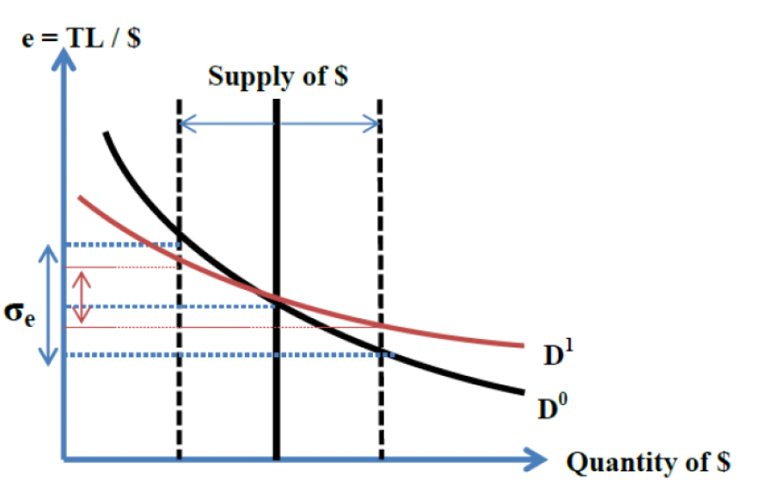
Smoothing Role of the ROM
smooths fluctuations in the exchange rate via changing the effective market demand for foreign exchange.

Slide 30
… and where monetary policy is conducted in harmony with other policy institutions responsible for economic management.

Slide 31
Institutions in charge and supervision of financial system
Undersecretariat of Treasury
Public debt management
Central Bank of the Republic of Turkey (CBRT)
Lender of last resort function
Banking Regulation and Supervision Agency (BRSA)
Regulation and supervision of banks and financial holding companies, leasing, factoring and consumer finance companies.
Oversight of payment systems.
Tools: Interest Rates, Reserve Requirements, Liquidity Tools
Tools: Capital Adequacy Ratio, Provisioning Rules, Loan-to-value ratio, Regulation on Bank cards and Credit cards
Regulation and supervision of insurance companies.
Capital Markets Board (CMB)
Regulation and supervision of capital markets and intermediary institutions.
Savings Deposit Insurance Fund (SDIF)
Protecting the rights of depositors,
Ministry of Finance
Tax related policies
Tools: Resource Utilization Fund Rates, Withholding tax.
Resolution of banks.
Memorandums of Understanding (MoUs) exists, which enhance cooperation, coordination and information sharing among these institutions.
Notes:
There are five authorities that are directly in charge of regulation and supervision of the various part of the financial system.
Though it is not directly in charge of regulation and supervision of part of financial system, We also included ministry of finance. That is due to the fact that MoF is authorized to implement taxing policies including for the financial servises and institutions. We can say that it assumes important macroprudential tools.

Slide 32
… where the «Financial Stability Committee» (FSC) enhances coordination and communication among member institutions.
UNDERSECRETARIAT OF TREASURY
BANKING REGULATION AND SUPERVISION AGENCY
SAVINGS DEPOSIT INSURANCE FUND
CAPITAL MARKETS BOARD
CENTRAL BANK OF THE REPUBLIC OF TURKEY
In order to monitor macro financial risks closely and more effectively, the FSC was established on June 8, 2011 by the Decree Law.
Members: Deputy Prime Minister for Economic and Financial Affairs responsible for the Treasury (Chair), Heads of the Under secretariat of Treasury, CBRT, BRSA, CMB and SDIF.
  Depending on the topics, other Ministers and government executives might be invited by the Deputy Prime Minister.
  The results of the meetings and the decisions of the Committee are presented to the Council of Ministers by the Deputy Prime Minister.
  Secretariat is carried out by the Under secretariat of Treasury.
FINANCIAL STABILITY COMMITTEE
CHAIR: DEPUTY PRIME MINISTER

Slide 33
… where the «Financial Stability Committee» (FSC) enhances coordination and communication among member institutions.
  Additionally;
  A Systemic Risk Assessment Group was established under the FSC on October 30, 2012 (Each institution is represented by the Deputies) and governed under an MoU amongst related authorities.
Established sub-groups work on more specific and technical issues which the FSC request.
Importance of the Committee:
An important step in the institutional design of financial stability and macroprudential policy framework in Turkey.
Enhances information sharing, coordination and cooperation among member institutions.
However, each institution has its own mandate and responsibility.
Main responsibilities of the FSC
1. Monitor and prevent systemic risks
2. Crisis management
Duties of the Committee
To determine and monitor systemic risks that might spread to whole financial system and to identify necessary measures and policy proposals in order to mitigate them.
To warn related institutions about systemic risks and to follow the relevant practices regarding policy proposals.
To evaluate systemic risk management plans prepared by the related institutions.
To coordinate the systemic risk management.
To collect all the data and information within the context of its duties, and to coordinate policies and implementations among the institutions.
To make decisions related to other subjects within the framework of this law.

Slide 34
Many policy measures were assessed by the FSC since its inception.
Macroprudential policy measures on credit growth
Systemically Important Financial Institutions (SIFIs)
Payment systems
Deposit insurance scheme
Non-bank financial sector
Leverage ratio
Increasing domestic savings
Bringing gold savings into the economy
Improvement of the investment environment
Extending the maturity of deposits
Financial inclusion
Financial education
Financial consumer protection
Microfinance
Over the Counter (OTC) Derivatives
Credit Rating Agencies
Legal Entity Identifier (LEI)
Notes:
To give an idea on the kind of issues that are handled by FSC, here I have a list of topics discussed at FSC meetings.
Issues range from macroprudential measures to curb credit growth to Financial education and inclusion.

Slide 35
Macroprudential Measures (Timeline)
Measure | Description | Adoption Date
Dividend Policy | Requires banks to seek approval from the BRSA before distributing dividends. The maximum dividend payout for CAR>18 percent is 20 percent, for 18 percent<CAR<16 percent is 15 percent and for 13 percent<CAR<16 percent is 10 percent. | October 2008; extended in 2010 and 2011
Restrictions on FX lending | Allows non FX-earnings companies to borrow in FX from local banks (previously, only FX-earning companies could borrow FX), provided FX loan amount is greater than US$5 million and maturity date is longer than a year; bans consumers from taking out FX-linked loans. | June 2009
Loan-to-value (LTV) ceilings | Implements loan-to-value ceilings on housing loans to consumer (at 75 percent) and on purchases of commercial real estate (at 50 percent). | December 2010
Guidance to Cap Credit Growth | The authorities provided guidance to banks that credit growth (adjusted for FX movements) in 2011 should not exceed 25 percent. | Spring 2011
Higher risk weights for consumer loans | Higher risk weights introduced for fast growing consumer loans. For new general purpose loans with maturities below two years, the capital adequacy risk-weight is increased to 150 percent (from 100 percent). For new general purpose loans with a maturity greater than two years, the risk-weight is increased to 200 percent (from 100 percent). | June 2011
Increased provisions for consumer loans | For new (performing) general purpose standard loans (Group 1), general provisions were increased from 1 percent to 4 percent. Specific provisions for closely followed up loans (Group 2) increased from 2 percent to 8 percent. The higher provisioning requirements are for banks having a consumer loan portfolio exceeding 20 percent of total loans or having a general purpose loan NPL greater than 8 percent. If there is a restructuring of the loan allowing maturty extension a minimum of 10 percent provisioning is required. | June 2011
Limits to credit card payments | If three or more monthly payments within a calendar year are less than half of the outstanding balance for the period, the individual credit card limits cannot be increased and cash advances for such credit cards cannot be permitted, unless the outstanding balance for the period is fully covered. | June 2011
Notes:
after established, The committee implemented various tools. The red coloured measures are the ones that are undertaken by FSC.

Slide 36
Macroprudential Measures (Timeline)
Measure | Description | Adoption Date
Changes to minimum Capital Adequacy Requirements | Amended by the BRSA in September 2011 to apply to banks with foreign strategic shareholders as of January 2012. The minimum ratio would depend on various factors such as the CDS spread of the parent and its sovereign, EBA stress test results and the public debt ratio in the country of origin. | September 2011
Some sectoral measures for provisions | Determining higher provisions by the BRSA taking into account the riskiness of the particular sectors . | September 2012
Differentiation of Tax Rate for Interest Income of Deposits | Amended by cabinet decision (01.01.2013) to differentiate 15 % tax rate taken from interest income of deposits according to maturity of the deposit. New tax rates are as follows: In TL deposits rates are 15% for 6 months, 12% for 6 - 12 months and 10% for more than one year. In FX deposits rates are 18% for 6 months, 15% for 6 - 12 months and 13% for more than one year. | January 2013
Differentiation of Resource Utilization Fund Rates | Amended by cabinet decision (01.01.2013) to differentiate resource utilization fund rate taken from credit users. New rates are as follows: 3% for loans given for less than one year, 1% for loans given for 1 - 2 years (before it was 0%), 0,5% for loans given for 2 - 3 years (before it was 0%) and 0% for loans given for more than 3 years. | January 2013
Withdrawal from a time deposit account before maturity | Depositors can withdraw half of their time deposits at most two times without losing interest income if maturity of their account is one year and longer. For cumulative deposit account, the same process is valid if half of the amount is withdrawn at most three times. | January 2013
Leverage, capital buffers, capital adequecy | BRSA has issued the several regulations within the framework of the harmonization process for Basel III on leverage, capital Conservation and countercyclical capital buffers | January 2014
Measures on creadit card usage and consumer loans | The scope of the incremental provision ratios increased for consumer loans. Risk weights of receivables from credit cards and long-term automobile loans that were used in calculating capital adequacy ratios were increased. The minimum payment ratio for credit cards increased, card limits reduced for the first time users and lower income group. | January 2014
Notes:
As you would see, very rich set of measures has been evaluated and implemented by the committee. Ranging from measures to alter the composition of loans, to measures strenghtenin capital adequecy of banks or like th emeasures aimin at lenghtening the maturities of bank liabilities.

Slide 37
EffectIveness of macroprudentIal polIcIes In Turkey:
An empIrIcal assessment

Slide 38
Global capital flows have been excessively large and volatile…
Portfolio Flows to Emerging Markets (1/2005-5/2014)
(13-week moving average, billion USD)
Source: EPFR.

Slide 39
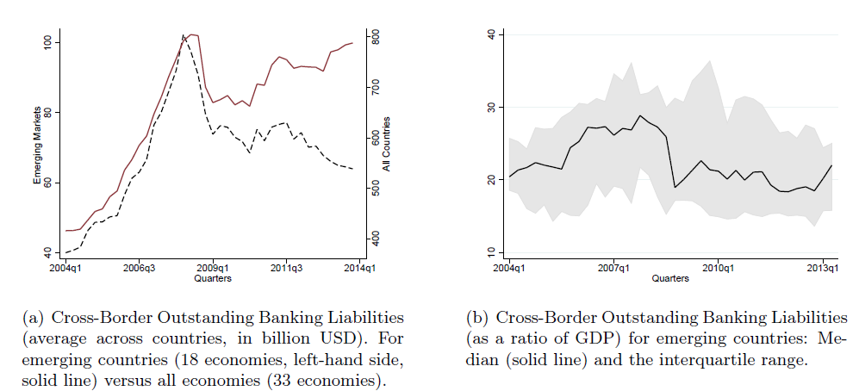
… similarly for bank-based flows as well…
Bank-based cross-border capital flows
Source: BIS, Authors’ calculations.

Slide 40
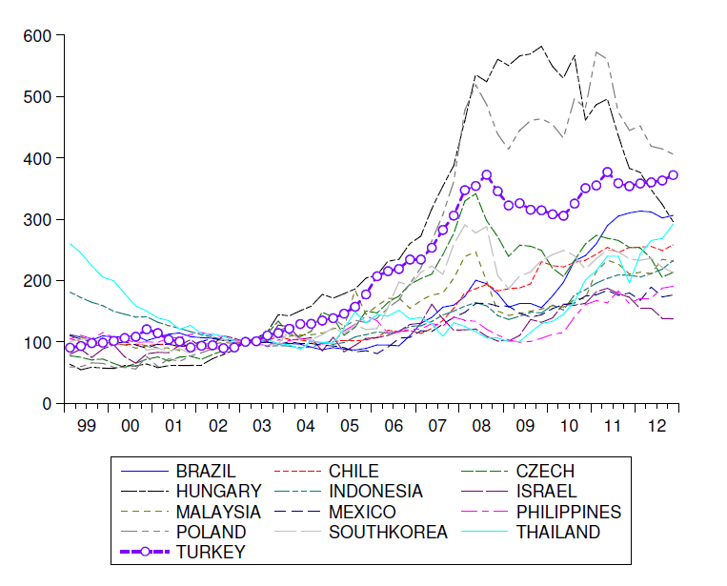
… and similar pattern for many EMEs: a harmonized increase in the flows
Bank-based gross cross-border capital flows
(2003=100, selected countries)
Source: BIS, Authors’ calculations.

Slide 41
Large and volatile capital flows → financial stability risks
Capital-flows-driven financial instability cycle
Currency Appreciation
Improved balance sheet
of non-financial firms +
Increased collateral values
Domestic Credit Expansion
Non-tradable price inflation
further appreciation
A surge in capital inflows
favorable global financial conditions

Slide 42
Large and volatile capital flows → financial stability risks
Capital-flows-driven financial instability cycle
Currency Appreciation
Improved balance sheet
of non-financial firms +
Increased collateral values
Domestic Credit Expansion
Non-tradable price inflation
further appreciation
A surge in capital inflows
favorable global financial conditions
Need for capital flow management and macroprudential policies, e.g. to
  reduce the sensitivity of capital inflows to global financial conditions,
  reduce the sensitivity of domestic credit growth to capital inflows.

Slide 43
Turkey has augmented its policy framework with financial stability tools…
Implicit
Inflation Targeting
Full fledged
Inflation Targeting
Inflation Targeting +
Financial Stability Framework
2002 2006 2010
Financial Stability Framework
Structural Tools:
  Reserve Requirements (Maturity-/Currency-/Leverage-based)
  Reserve Option Mechanism
Cyclical Tools:
  Policy Rate
  Asymmetric Interest Rate Corridor
  TL and FX Liquidity Management
Micro-prudential policies by the BRSA
 | Old Approach | New Approach
Objectives | Price Stability | Price Stability Financial Stability
Policy Tools | Policy Rate | Structural Tools Cyclical Tools

Slide 44
Turkey has augmented its policy framework with financial stability tools…
Implicit
Inflation Targeting
Full fledged
Inflation Targeting
Inflation Targeting +
Financial Stability Framework
2002 2006 2010
Financial Stability Framework
Structural Tools:
  Reserve Requirements (Maturity-/Currency-/Leverage-based)
  Reserve Option Mechanism
Cyclical Tools:
  Policy Rate
  Asymmetric Interest Rate Corridor
  TL and FX Liquidity Management
Micro-prudential policies by the BRSA
 | Old Approach | New Approach
Objectives | Price Stability | Price Stability Financial Stability
Policy Tools | Policy Rate | Structural Tools Cyclical Tools
novel tools

Slide 45
Turkey has augmented its policy framework with financial stability tools…
Implicit
Inflation Targeting
Full fledged
Inflation Targeting
Inflation Targeting +
Financial Stability Framework
2002 2006 2010
Financial Stability Framework
Structural Tools:
  Reserve Requirements (Maturity-/Currency-/Leverage-based)
  Reserve Option Mechanism
Cyclical Tools:
  Policy Rate
  Asymmetric Interest Rate Corridor
  TL and FX Liquidity Management
Micro-prudential policies by the BRSA
 | Old Approach | New Approach
Objectives | Price Stability | Price Stability Financial Stability
Policy Tools | Policy Rate | Structural Tools Cyclical Tools
higher maturity → lower RR

Slide 46
Turkey has augmented its policy framework with financial stability tools…
Implicit
Inflation Targeting
Full fledged
Inflation Targeting
Inflation Targeting +
Financial Stability Framework
2002 2006 2010
Financial Stability Framework
Structural Tools:
  Reserve Requirements (Maturity-/Currency-/Leverage-based)
  Reserve Option Mechanism
Cyclical Tools:
  Policy Rate
  Asymmetric Interest Rate Corridor
  TL and FX Liquidity Management
Micro-prudential policies by the BRSA
 | Old Approach | New Approach
Objectives | Price Stability | Price Stability Financial Stability
Policy Tools | Policy Rate | Structural Tools Cyclical Tools
FX versus TL

Slide 47
Turkey has augmented its policy framework with financial stability tools…
Implicit
Inflation Targeting
Full fledged
Inflation Targeting
Inflation Targeting +
Financial Stability Framework
2002 2006 2010
Financial Stability Framework
Structural Tools:
  Reserve Requirements (Maturity-/Currency-/Leverage-based)
  Reserve Option Mechanism
Cyclical Tools:
  Policy Rate
  Asymmetric Interest Rate Corridor
  TL and FX Liquidity Management
Micro-prudential policies by the BRSA
 | Old Approach | New Approach
Objectives | Price Stability | Price Stability Financial Stability
Policy Tools | Policy Rate | Structural Tools Cyclical Tools
higher leverage → higher RR

Slide 48
Turkey has augmented its policy framework with financial stability tools…
Implicit
Inflation Targeting
Full fledged
Inflation Targeting
Inflation Targeting +
Financial Stability Framework
2002 2006 2010
Financial Stability Framework
Structural Tools:
  Reserve Requirements (Maturity-/Currency-/Leverage-based)
  Reserve Option Mechanism
Cyclical Tools:
  Policy Rate
  Asymmetric Interest Rate Corridor
  TL and FX Liquidity Management
Micro-prudential policies by the BRSA
 | Old Approach | New Approach
Objectives | Price Stability | Price Stability Financial Stability
Policy Tools | Policy Rate | Structural Tools Cyclical Tools
an option for banks to fulfill domestic currency RR with FX (USD/Euro)

Slide 49
Turkey has augmented its policy framework with financial stability tools…
Implicit
Inflation Targeting
Full fledged
Inflation Targeting
Inflation Targeting +
Financial Stability Framework
2002 2006 2010
Financial Stability Framework
Structural Tools:
  Reserve Requirements (Maturity-/Currency-/Leverage-based)
  Reserve Option Mechanism
Cyclical Tools:
  Policy Rate
  Asymmetric Interest Rate Corridor
  TL and FX Liquidity Management
Micro-prudential policies by the BRSA
 | Old Approach | New Approach
Objectives | Price Stability | Price Stability Financial Stability
Policy Tools | Policy Rate | Structural Tools Cyclical Tools
lower and wider corridor during large inflows, and vice versa

Slide 50
Two main questions we would like to address:
Capital-flows-driven financial instability cycle
Currency Appreciation
Improved balance sheet
of non-financial firms +
Increased collateral values
Domestic Credit Expansion
Non-tradable price inflation
further appreciation
A surge in capital inflows
favorable global financial conditions
Need for capital flow management and macroprudential policies, e.g. to
  ① reduce the sensitivity of capital inflows to global financial conditions,
  ② reduce the sensitivity of domestic credit growth to capital inflows.

Slide 51
Two main questions we would like to address:
Turkey has implemented a battery of macroprudential policies to support financial stability.
A comparative framework to study the effectiveness of capital- flows-related financial stability measures.
Two Main Questions:
  ① Do portfolio inflows become less sensitive to fluctuations in global risk perceptions after the new policy framework (compared to other economies)?
  ② Does credit growth become less immune to swings in portfolio flows after the new policy framework (compared to other economies)?
What is the picture for other emerging countries?

Slide 52
Some pre-thoughts…
Need to decide the ‘specific’ objective of the policy tool/framework:
  inflation, credit growth, lending rates, lending/deposit rate spread, term premium, asset prices,…
  currency risk, maturity risk, leverage growth, systemic liquidity risk, capital buffers,…
May need to decide to study whether a specific tool or the framework in general:
  many tools introduced at similar times, used as complements with each other.
Need to take into account possible transmission lags:
  might become effective noticeably after its initial announcement,
  effects might appear after certain lags (e.g. inflation, credit growth,etc.).
Need to choose set of control variables carefully:
  otherwise spuriority.
and the estimation framework itself !

Slide 53
① Global financial conditions ↛ Capital Flows
Methodology:
  A large data set of developed and EMs. (Developed: 24; Emerging: 22).
  Data Source: BIS, IMF-BOP, Fed, WB.
  Fixed effects panel estimation.
  First Question: Do gross portfolio inflows to Turkey become less sensitive to fluctuations in global risk perceptions after the new policy framework?
  ∆ Gross Capital Inflows / GDP _{it} = α _{i} + φ ( Control Variables _{it-1} )
  + β₁ (Global Factor _{t-1} )
  + β₂ (Global Factor _{t-1} ) * D_MPrud_Framework
  + β₃ (Global Factor _{t-1} ) * D_Country
  + β₄ (Global Factor _{t-1} ) * D_Country * D_MPrud_Framework
  + ε _{it}

Slide 54
① Global financial conditions ↛ Capital Flows
Methodology:
  A large data set of developed and EMs. (Developed: 24; Emerging: 22).
  Data Source: BIS, IMF-BOP, Fed, WB.
  Fixed effects panel estimation.
  First Question: Do gross portfolio inflows to Turkey become less sensitive to fluctuations in global risk perceptions after the new policy framework?
  ∆ Gross Capital Inflows / GDP _{it} = α _{i} + φ ( Control Variables _{it-1} )
  + β₁ (Global Factor _{t-1} )
  + β₂ (Global Factor _{t-1} ) * D_MPrud_Framework
  + β₃ (Global Factor _{t-1} ) * D_Country
  + β₄ (Global Factor _{t-1} ) * D_Country * D_MPrud_Framework
  + ε _{it}
∆ RER, ∆ Global Money, ∆ GDP,
∆ Debt to GDP
∆ VIX _{t-1}, VIX _{t} (ala Bruno and Shin, SJE 2014)

Slide 55
① Global financial conditions ↛ Capital Flows
Methodology:
  A large data set of developed and EMs. (Developed: 24; Emerging: 22).
  Data Source: BIS, IMF-BOP, Fed, WB.
  Fixed effects panel estimation.
  First Question: Do gross portfolio inflows to Turkey become less sensitive to fluctuations in global risk perceptions after the new policy framework?
  ∆ Gross Capital Inflows / GDP _{it} = α _{i} + φ ( Control Variables _{it-1} )
  + β₁ (Global Factor _{t-1} )
  + β₂ (Global Factor _{t-1} ) * D_MPrud_Framework
  + β₃ (Global Factor _{t-1} ) * D_Country
  + β₄ (Global Factor _{t-1} ) * D_Country * D_MPrud_Framework
  + ε _{it}
= 1 after 2010Q4;
= 0 else.
= 1 for Turkey;
= 0 else.

Slide 56
① Global financial conditions ↛ Capital Flows
Methodology:
  A large data set of developed and EMs. (Developed: 24; Emerging: 22).
  Data Source: BIS, IMF-BOP, Fed, WB.
  Fixed effects panel estimation.
  First Question: Do gross portfolio inflows to Turkey become less sensitive to fluctuations in global risk perceptions after the new policy framework?
  ∆ Gross Capital Inflows / GDP _{it} = α _{i} + φ ( Control Variables _{it-1} )
  + β₁ (Global Factor _{t-1} )
  + β₂ (Global Factor _{t-1} ) * D_MPrud_Framework
  + β₃ (Global Factor _{t-1} ) * D_Country
  + β₄ (Global Factor _{t-1} ) * D_Country * D_MPrud_Framework
  + ε _{it}
sensitivity of inflows to global factor…
for all countries (before 2010Q4)

Slide 57
① Global financial conditions ↛ Capital Flows
Methodology:
  A large data set of developed and EMs. (Developed: 24; Emerging: 22).
  Data Source: BIS, IMF-BOP, Fed, WB.
  Fixed effects panel estimation.
  First Question: Do gross portfolio inflows to Turkey become less sensitive to fluctuations in global risk perceptions after the new policy framework?
  ∆ Gross Capital Inflows / GDP _{it} = α _{i} + φ ( Control Variables _{it-1} )
  + β₁ (Global Factor _{t-1} )
  + β₂ (Global Factor _{t-1} ) * D_MPrud_Framework
  + β₃ (Global Factor _{t-1} ) * D_Country
  + β₄ (Global Factor _{t-1} ) * D_Country * D_MPrud_Framework
  + ε _{it}
sensitivity of inflows to global factor…
for all countries (what has changed after 2010Q4)

Slide 58
① Global financial conditions ↛ Capital Flows
Methodology:
  A large data set of developed and EMs. (Developed: 24; Emerging: 22).
  Data Source: BIS, IMF-BOP, Fed, WB.
  Fixed effects panel estimation.
  First Question: Do gross portfolio inflows to Turkey become less sensitive to fluctuations in global risk perceptions after the new policy framework?
  ∆ Gross Capital Inflows / GDP _{it} = α _{i} + φ ( Control Variables _{it-1} )
  + β₁ (Global Factor _{t-1} )
  + β₂ (Global Factor _{t-1} ) * D_MPrud_Framework
  + β₃ (Global Factor _{t-1} ) * D_Country
  + β₄ (Global Factor _{t-1} ) * D_Country * D_MPrud_Framework
  + ε _{it}
sensitivity of inflows to global factor…
for Turkey
(what differs compared to average, before 2010Q4)

Slide 59
① Global financial conditions ↛ Capital Flows
Methodology:
  A large data set of developed and EMs. (Developed: 24; Emerging: 22).
  Data Source: BIS, IMF-BOP, Fed, WB.
  Fixed effects panel estimation.
  First Question: Do gross portfolio inflows to Turkey become less sensitive to fluctuations in global risk perceptions after the new policy framework?
  ∆ Gross Capital Inflows / GDP _{it} = α _{i} + φ ( Control Variables _{it-1} )
  + β₁ (Global Factor _{t-1} )
  + β₂ (Global Factor _{t-1} ) * D_MPrud_Framework
  + β₃ (Global Factor _{t-1} ) * D_Country
  + β₄ (Global Factor _{t-1} ) * D_Country * D_MPrud_Framework
  + ε _{it}
sensitivity of inflows to global factor…
for Turkey
(what differs after 2010Q4)

Slide 60
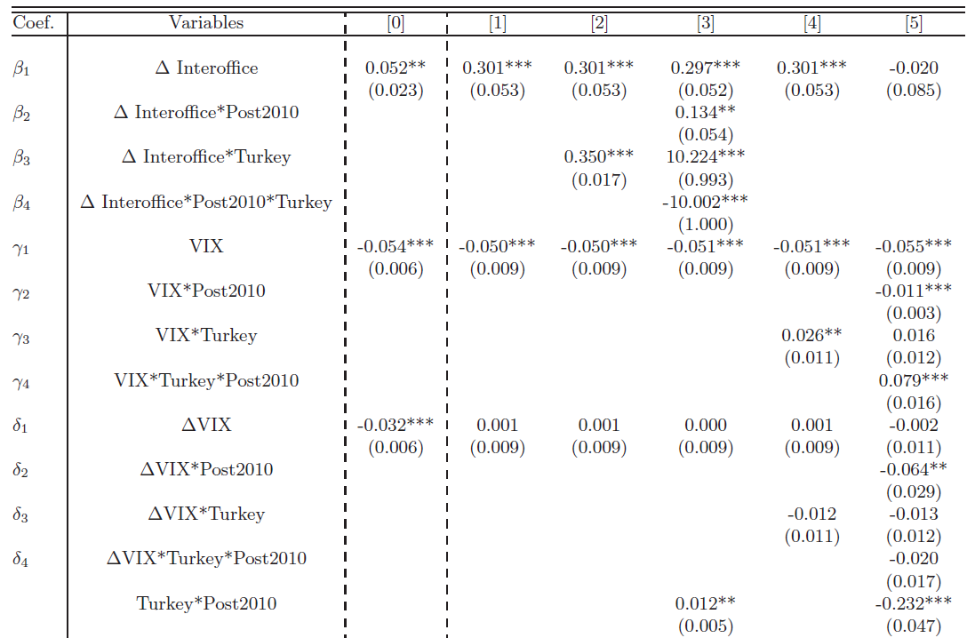
① Global financial conditions ↛ Capital Flows
Global wholesale funding → higher inflows
Higher VIX → lower inflows
and control v. as expected:
∆ RER (+)
∆ Global Money (+)**
∆ GDP (+)**
∆ Debt to GDP (-)***

Slide 61
① Global financial conditions ↛ Capital Flows
Turkey is more sensitive to wholesale funding.

Slide 62
① Global financial conditions ↛ Capital Flows
lower sensitivity
after 2010Q4 !

Slide 63
① Global financial conditions ↛ Capital Flows
  Results:
  Turkey has become less sensitive to global wholesale funding after 2010Q4 (compared to before 2010Q4), and has become close to average sensitivity of other economies.
  Turkey has become less sensitive to the VIX after 2010Q4 (compared to before 2010Q4), is now less sensitive compared to average of other economies.

Slide 64
Two main questions we would like to address:
Capital-flows-driven financial instability cycle
Currency Appreciation
Improved balance sheet
of non-financial firms +
Increased collateral values
Domestic Credit Expansion
Non-tradable price inflation
further appreciation
A surge in capital inflows
favorable global financial conditions
Need for capital flow management and macroprudential policies, e.g. to
  ① reduce the sensitivity of capital inflows to global financial conditions,
  ② reduce the sensitivity of domestic credit growth to capital inflows.

Slide 65
② Capital Flows ↛ Domestic Credit Growth
  ② Does credit growth become less immune to swings in portfolio flows after the new policy framework (compared to other economies)?

Slide 66
② Capital Flows ↛ Domestic Credit Growth
Methodology:
  A large data set of developed and EMs. (Developed: 15; Emerging: 18).
  Data Source: BIS, IMF-BOP, Fed, WB.
  Dynamic panel estimation.
  Second Question: Does credit growth become less immune to swings in portfolio flows after the new policy framework?
  Real Credit Growth _{it} = α _{i} + φ ( Control Variables _{it-1} )
  + β₁ (∆ P. Flows / GDP _{t,t-1} )
  + β₂ (∆ P. Flows / GDP _{t,t-1} ) * D_MPrud_Framework
  + β₃ (∆ P. Flows / GDP _{t,t-1} ) * D_Country
  + β₄ (∆ P. Flows / GDP _{t,t-1} ) * D_Country * D_MPrud_Framework
  + dynamic terms + ε _{it}
∆ Fiscal Balance, Interest Rate,
Inflation, RER (robust to other spesifications).
= 1 after 2010Q4*;
= 0 else.
= 1 for D[C];
= 0 else.

Slide 67
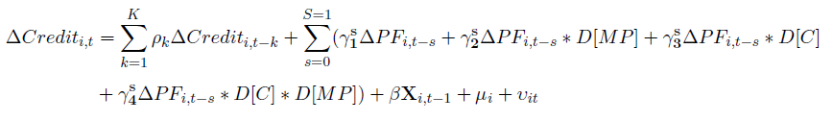

② Capital Flows ↛ Domestic Credit Growth
Methodology:
  A large data set of developed and EMs. (Developed: 15; Emerging: 18).
  Data Source: BIS, IMF-BOP, Fed, WB.
  Dynamic panel estimation.
  Second Question: Does credit growth become less immune to swings in portfolio flows after the new policy framework?

Slide 68
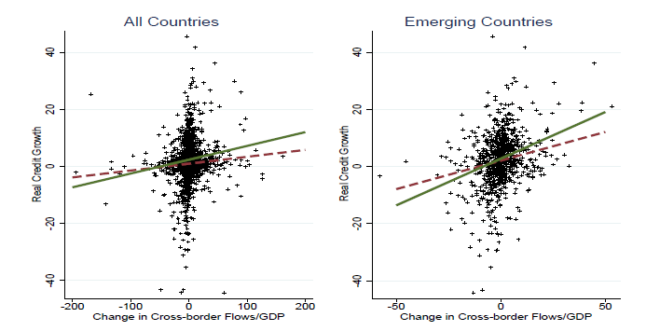
② Capital Flows ↛ Domestic Credit Growth
  Unconditionally, real credit growth appears positively correlated with p. inflows, and the relation seems weakened after 2010 (dashed line).

Slide 69
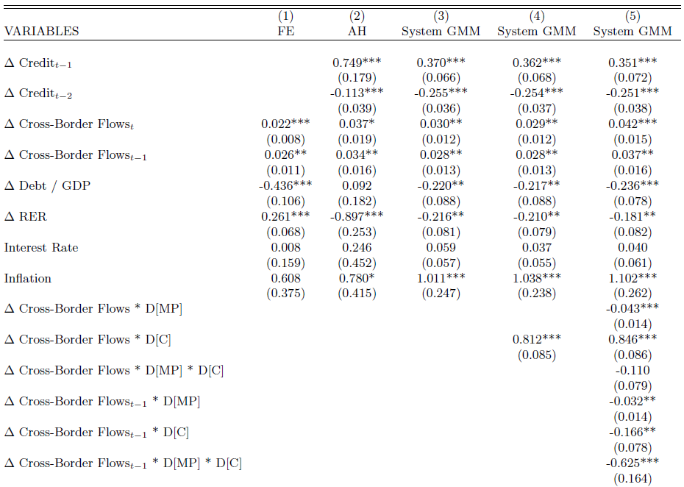
② Capital Flows ↛ Domestic Credit Growth
Different methodologies considered:
FE, AH (Anderson-Hsiao), System GMM.
D[MP] = 1 for 2010Q4 onwards and 0 before.
(2010Q3 and 2011Q1 are also studied for robustness).
D[C] = 1 for Turkey, 0 otherwise.
(other country cases are also studied).
How does Turkey differ compared to others? (before 2010Q4)
How does Turkey differ compared to others? (after 2010Q4)
… and similarly for the lagged term …

Slide 70
② Capital Flows ↛ Domestic Credit Growth
a significant dynamic structure
Control v. (as expected) :
∆ RER (+)***
∆ Inflation (+)***
∆ Debt to GDP (-)***

Slide 71
② Capital Flows ↛ Domestic Credit Growth
Positive and st.sgnft. relation between p. inflows and credit growth
where the relation has been weakened during recent years

Slide 72
② Capital Flows ↛ Domestic Credit Growth
Credit growth in Turkey had been more sensitive to p. inflows before 2010Q4

Slide 73
② Capital Flows ↛ Domestic Credit Growth
Credit growth in Turkey has become less sensitive to p. inflows after 2010Q4.
Notes:
Credit growth in Turkey has become less sensitive to p. inflows after 2010Q4 (compared to previous periods). -0.110 (contemporaneous) or -0.625*** (lagged)
(a) After 2010Q4, credit growth in Turkey has become less sensitive to p. inflows, yet the sensitivity is still high compared to other countries (when we look at the contemporaneous relation). 0.846*** - 0.110 >0.
(b) After 2010Q4, credit growth in Turkey has become less sensitive to p. inflows, and the sensitivity is even lower compared to other countries (when we look at the lagged relation). -0.166** - 0.625*** < 0

Slide 74
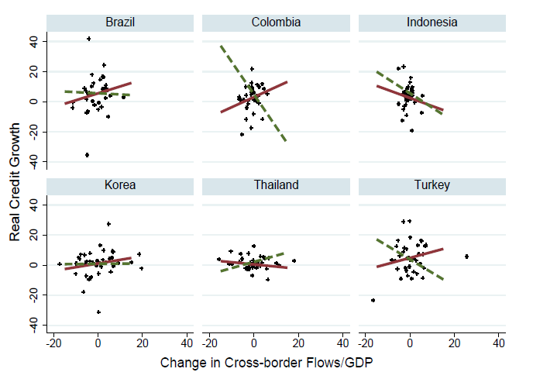
② Capital Flows ↛ Domestic Credit Growth similar question for some major EMEs?
  Unconditionally, real credit growth is less positively associated with cross-border flows for most of these selected emerging countries.

Slide 75
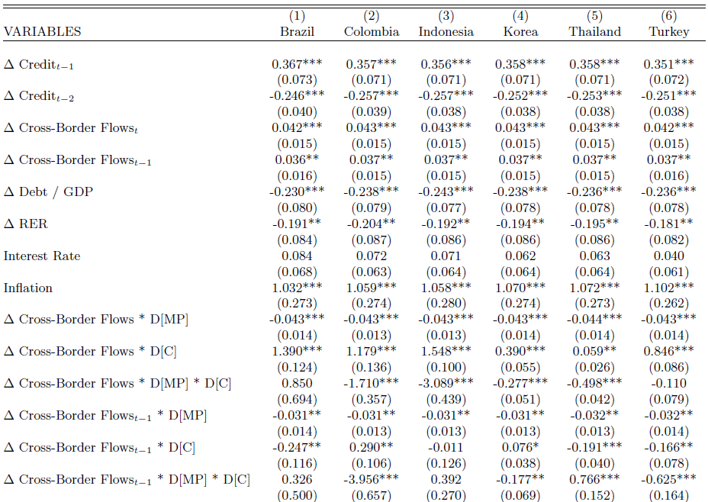
② Capital Flows ↛ Domestic Credit Growth

Slide 76
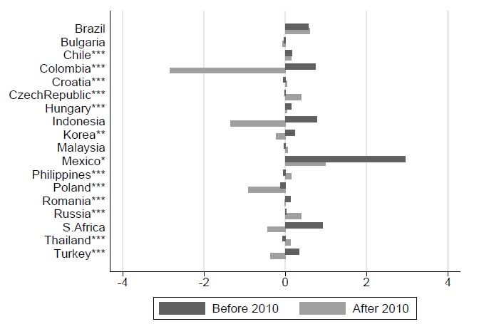
② Capital Flows ↛ Domestic Credit Growth
Note: «Before 2010»: average γ₃ ; «After 2010»: average γ_{4.}

Slide 77
Summary and Robustness
Sensitivity of… | to… | Sample | Result (statistically significant) (after controlling for domestic factors) | Robustness
Bank-based cross-border portfolio flows | VIX | All | lower (for TR) | . Using EM sample; . Using BOP data for gross/net inflows.
Real Domestic Credit Growth | Bank-based cross-border portfolio flows | All | lower (for TR and many other EM) | . Using EM sample; . Using 2010Q3 or 2011Q1 as the start of prudential framework; . Constructing a MaPP index for each country (in progress).

Slide 78
Final Remarks
  The new framework appears effective in managing capital inflows and mitigating financial stability risks compared to average of the rest of the economies.
  For most emerging countries, the macroprudential frameworks seem helpful in reducing the sensitivity of domestic credit growth to cross-border portfolio flows.

Slide 79
“Managing Short-Term Capital Flows in New Central
Banking: Unconventional Monetary Policy Framework and New Central Banking”
Ahmet Faruk Aysan*
Monetary Policy Committee Member and Member of the Board
Central Bank of the Republic of Turkey
ADFIMI Development Forum organized under the auspices of QATAR CENTRAL BANK
Developmental Central Banking: Issues, Prospects and Challenges
Ritz Carlton, Doha, Qatar, 25-26 April 2016
Disclaimer: The views expressed here are those of the authors and should not be interpreted as reflecting the official views of the Central Bank of the Republic of Turkey.

