Slide 1
The Development and Financing of SMEs in I.R. Iran:
The Role of the Bank of Industry and Mine (BIM)
ADFIMI – ODB JOINT REGIONAL SEMINAR on SME DEVELOPMENT, Muscat, Oman, 13-15 February 2017
Morteza Naderi, Ph. D
Economist & Director of Training and Research Division
Bank of Industry and Mine, I.R. Iran
E-mail: naderi@bim.ir

Slide 2
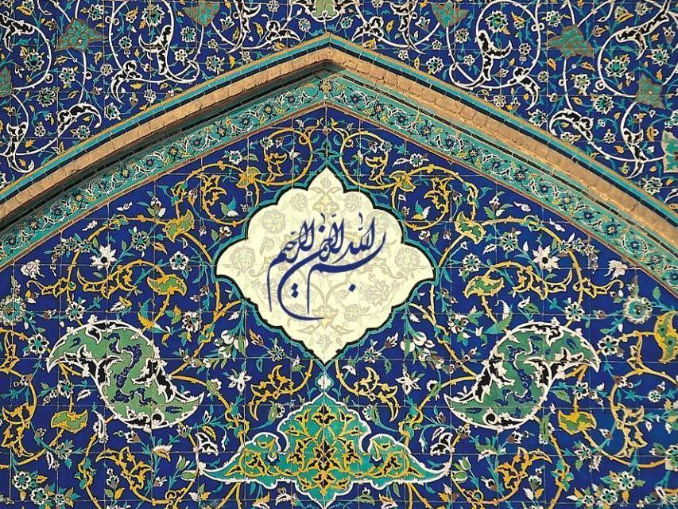
In the name of Allah, the Most Gracious, the Most Merciful

Slide 3
Presentation Contents
Country review and macro indicators affecting SMEs
SME Support Model in I.R. Iran
The Bank of Industry & Mine, its experiences and role in supporting SMEs in I.R. Iran
Suggestions: Toward Professional Collaboration Between ADFIMI Members to Support SMEs

Slide 4
Country Review
I.R. Iran

Slide 5
Country review: I.R. Iran
The second largest economy in the MENA region.
Estimated GDP in 2016 more than US$400bn.
Has the second largest population in the region (more than 80 million).
Ranks second in the world in natural gas reserves and fourth in proven crude oil reserves.
Although the country is one of the world’s major oil producers, the oil sector accounts for only 23% of GDP.
Has a fairly diversified economy: the largest contributor to GDP is services (around 50% of total output). Manufacturing and mining constitute 20% of GDP, and agriculture 10%.

Slide 6
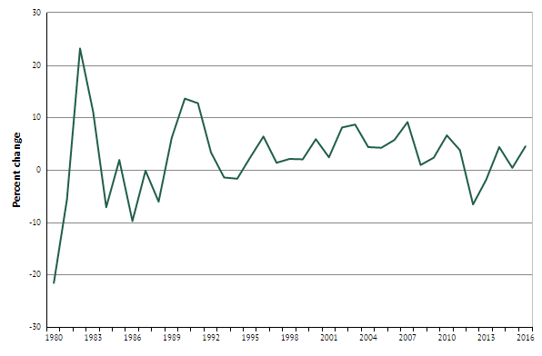
I.R. Iran Macroeconomic Indicators
GDP Growth Rate
On average, 4.5% is a reasonable estimation for Iran’s long-term GDP growth rate over the coming years.
Real GDP and SMEs show similar growth rates in I.R. Iran.

Slide 7
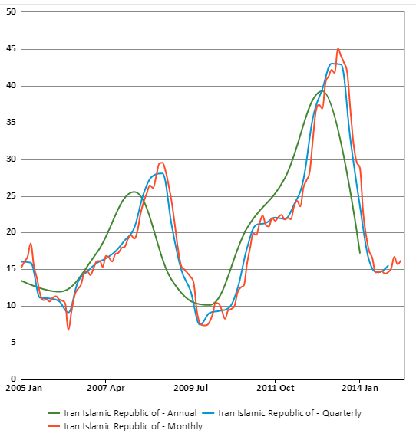
I.R. Iran Macroeconomic Indicators
Inflation Rate
The target inflation rate
is around 10% in coming years.
A stable inflation rate at around 10% creates a positive atmosphere for SME development and performance in a stable environment.

Slide 8
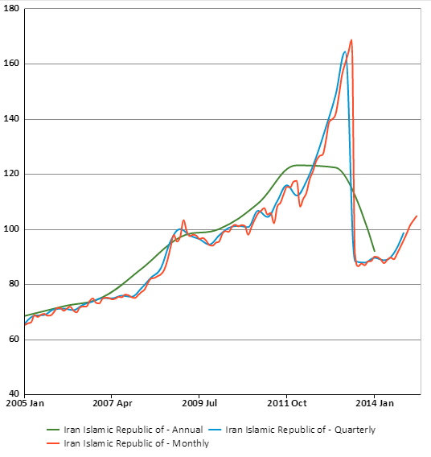
I.R. Iran Macroeconomic Indicators
Real Effective Exchange Rate (REER)
Decreasing REER has negative effects on SMEs who are dependent on imports.

Slide 9
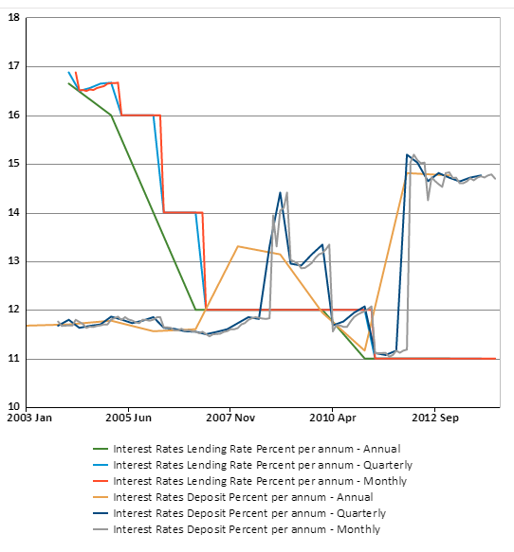
I.R. Iran Macroeconomic Indicators
Lending and Deposit Rates Gap
So long as this gap exists, and remains more than the marginal cost of financial intermediaries in the economy, the money market fails to support the real sectors of the economy and therefore also fails SMEs.

Slide 10
I.R. Iran Potentials for SME Development
Population: More than 80 million (demand for SMEs)
Literacy rate (aged 15+): Almost 83% (labor force of SMEs)
GINI index: Almost 0.42% (SMEs as a moderator)
Sharp Students: Almost 1 million new students take up a course of study each year (a baseline for SME-startups)
Manufacturing and mining share of GDP (20%): this should increase much more: SMEs as an accelerator

Slide 11
SME
Support Model in Iran

Slide 12
Conceptual Model: SME Access to Financial Resources and Supporting Policies

Slide 13
SME Support Model in I.R. Iran
Return

Slide 14
SME Definition in I.R. Iran
1 - As defined by the CBI and the Iran Small Industries & Industrial Parks Organization (ISIPO - affiliated to the Ministry of Industry and Mines), SMEs are industrial and service enterprises with less than 50 employees.
2 - The Iranian Statistical Center (ISC) only considers businesses with less than 10 employees to be SMEs; all others are regarded as “Large Manufacturing Establishments”.

Slide 15
SMEs in Iran: Changes between 1996/97-2013/14
 | 1996/97 | 2013/14 | Average annual growth rate (%)
Number of SMEs | 51489 | 82810 | 3.57
Total industrial enterprises (SMEs + LSEs) | 55095 | 90503 | 3.78
SMEs as percentage of total enterprises | 93.4% | 91.5% | -0.12%
Note:
Data are based on the 1st definition of SMEs (industrial and service enterprises with fewer than 50 employees).
Long run real GDP and SMEs have similar growth rates in I. R. Iran.

Slide 16
Characteristics of SMEs in Comparison with LSEs
 | 1996/97 |  | 2013/14 |  | Average growth rate%
 | SMEs | LSEs | SMEs | LSEs | SMEs | LSEs
Capital % | N/A | N/A | 24.4 | 75.6 | - | -
Labor % | 61.1 | 38.9 | 41.2 | 58.8 | -1.91 | 3
Value-added (percentage of total industrial sector) | 34% | 66% | 36% | 64% | 0.35 | -0.18
Note:
SMEs are more labor intensive, decreasing the growth rate
SMEs performance (% of value-added to the industrial sector) was weaker than LSEs, increasing growth rate (potential for GDP growth through SME-TFP in Iran)

Slide 17
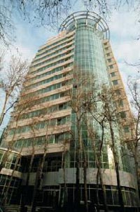
Bank of Industry & Mine
(BIM)

Slide 18
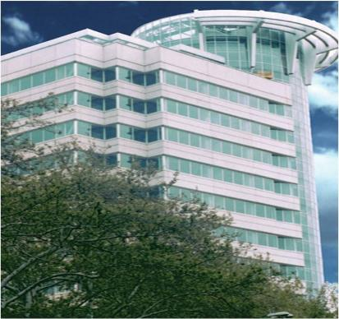
At a Glance
BIM Founded: 1979
By merging of the following:
Industrial Credit Bank (1956)
Industrial and Mining Development Bank of Iran (1959)
Development and Investment Bank of Iran (1973)
Iranian Banks Investment Company (1975)
Industrial Guarantee Fund (1960)
Paid Capital: $ 1.237 Billion
Employees: 1200
Rating, Outlook: (BB-) , Stable

Slide 19
At a Glance
Branches: 60
I & M Market Share: less than % 10
Total Assets (almost) $ 10 Billion
No. of Completed Projects (2014 & 2015) 480

Slide 20
The Bank of Industry & Mine
is a
Development Bank
Focusing on Providing
Banking Services for
The Private Sector

Slide 21
Activities
Project Finance (SMEs and LSEs)
Corporate Banking
Investment Banking
Islamic Banking
Derivatives & New Tools

Slide 22
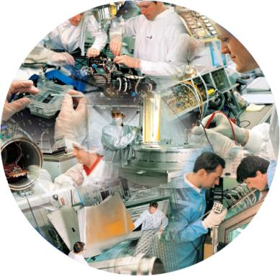
SMEs
BIM has recently established a Strategic Business Unit (SBU) to finance & serve entrepreneurs’ SME projects more efficiently through a customized Empowering Package.
BIM has its own definition of SMEs: Based on BIM’s definition, all industrial and services enterprises with less than 100 employees, and property valued at less than 300bn IRR (almost 9.3 million USD), are categorized as SMEs.

Slide 23
Tendency towards SMEs According to Loans Granted

Slide 24
Tendency towards SMEs According to the Volume of Loans Granted
Decreasing Trend from 2013;
10-year Average is 24.6%

Slide 25
Tendency towards SMEs: Combined Index
Maximum 23.7%, Minimum 9%;
10-year Average is 18.4%, Decreasing from 2010

Slide 26
BIM’s Key Indicators on SME Finance
Low share: BIM had only a 3.5% share of the total SME financing in Iran in 2015, and if all its facilities had been granted to SMEs, its share of SME financing in 2015 would have been 14%.
Main specialized financial supporter: BIM is a major specialized financing agency for SMEs in Iran.
High NPLSME compared with its NPLLSE: at the end of 2016, the NPLs ratio for BIM was calculated as being around 13%. The composition of BIM’s NPLs for loans granted to LSEs and SMEs was 8% and 32% respectively, while the ratio of SME NPLs to total bank loans was 7%.
Low performance-tendency towards SMEs: There has been an implicit tendency in the BIM to switch from SMEs to LSEs, based on its performance over the last decade.

Slide 27
Advantages in BIM Supporting SMEs
The most experienced SME financial supporter in Iran.
Organizational knowledge to provide supplementary support as well as financial support to SMEs.
Has a Strategic Business Unit (SBU) to finance and serve SME entrepreneurs more efficiently in the coming years.

Slide 28
Barriers in BIM Supporting SMEs
BIM’s lending capacity cannot serve all the financial and development demands to support SMEs across the whole of Iran: Its share is 3.5%, with a potential of up to 14% achievable.
Low Capital Adequacy (CA) ratio.
High NPLSME index and Basel considerations.
Concerns about continuing its tendency to switch from SMEs to LSEs, based on its loan profile in the last decade (Needs to follow government reps, and policymakers: see SME Supporting Model).

Slide 29
Towards Professional Collaboration Between ADFIMI Members to Support SMEs

Slide 30
BIM Suggestions
Sharing experience and know-how through annual SME development seminars between members, perhaps with the need for an active secretary in arranging the seminar in coming years.
A yearly ADFIMI-Regional SME Monitor for sharing the most common information regarding SMEs within the ADFIMI members region.
Introducing well-performing SME financial supporters, based on a professional jury assessment process in the ADFIMI members region.
Development Islamic financial instruments to promote SMEs between ADFIMI members through sharing experiences and best practices.

Slide 31
Many Thanks

